Slide 1




Slide 2

Before we start...
ML who?

Slide 3
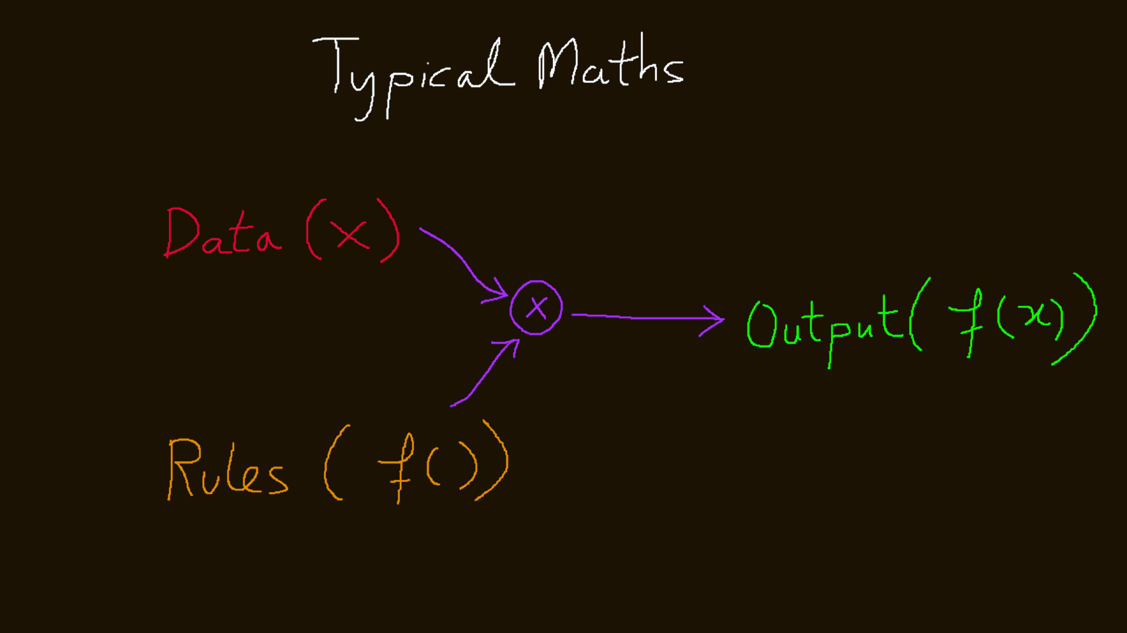

Slide 4
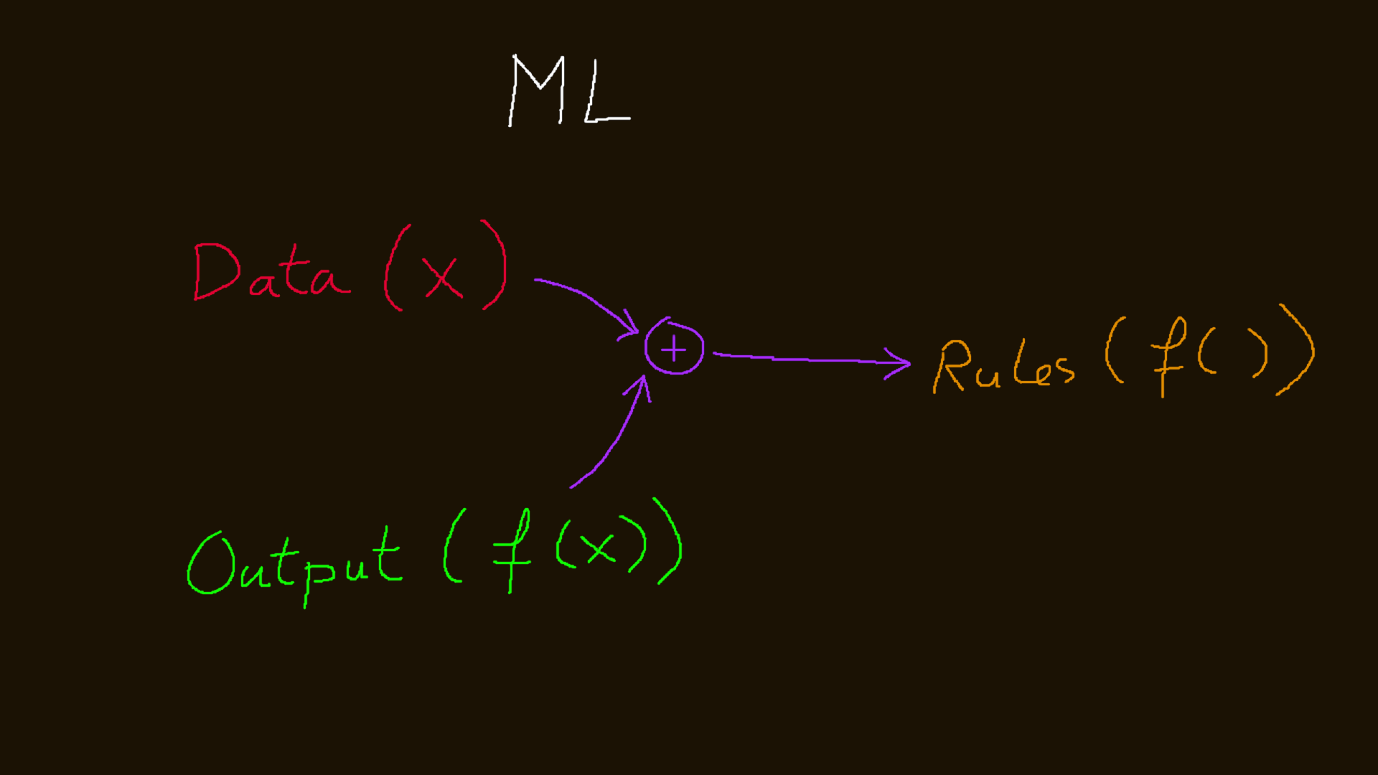

Slide 5
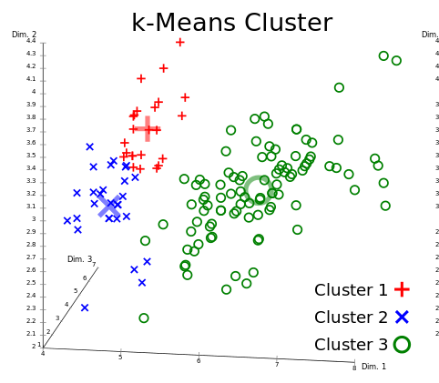
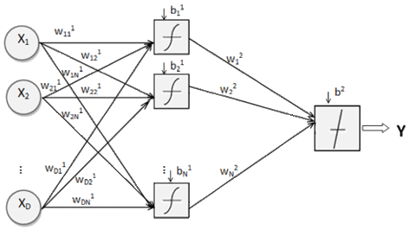
Supervised learning
Unsupervised learning
Types...
Will need labeled data
Can work with unlabeled data

Slide 6
Probably the easiest of all...
K-Means Clustering

Slide 7
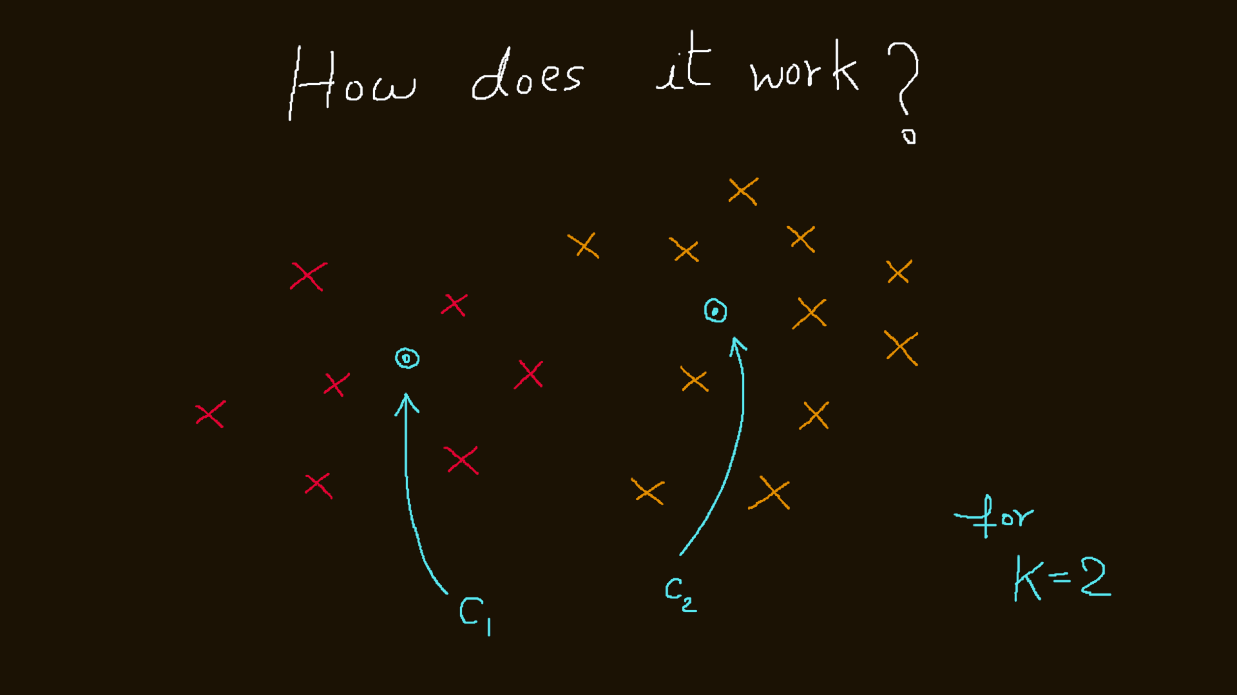

Slide 8
A simplified perspective

Slide 9
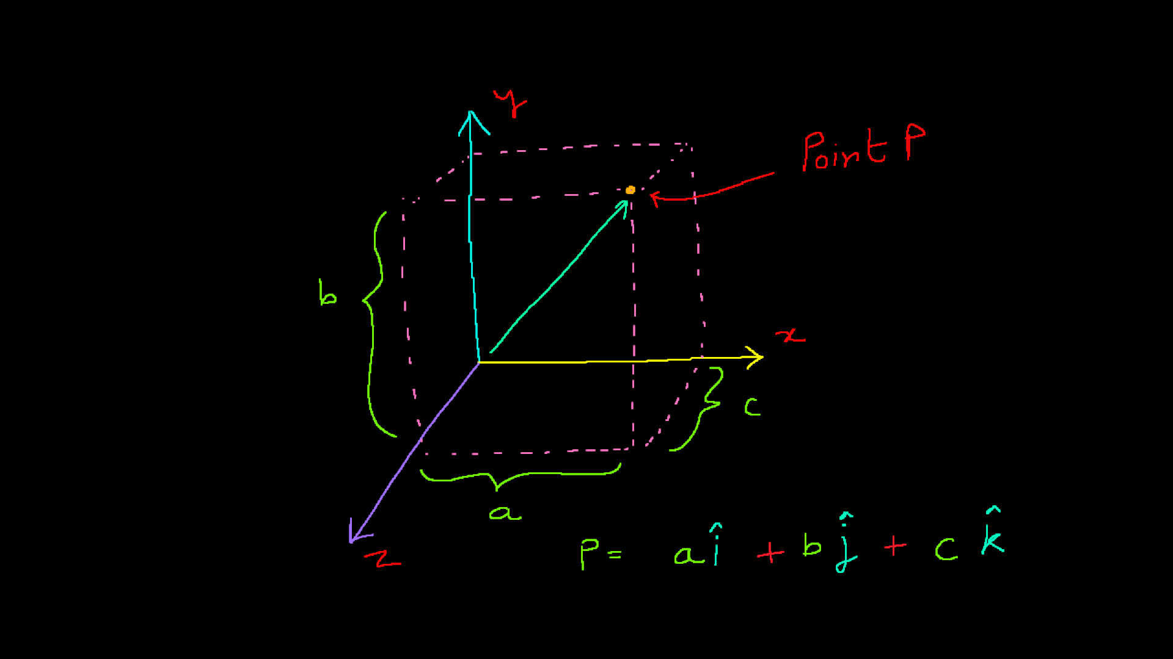

Slide 10
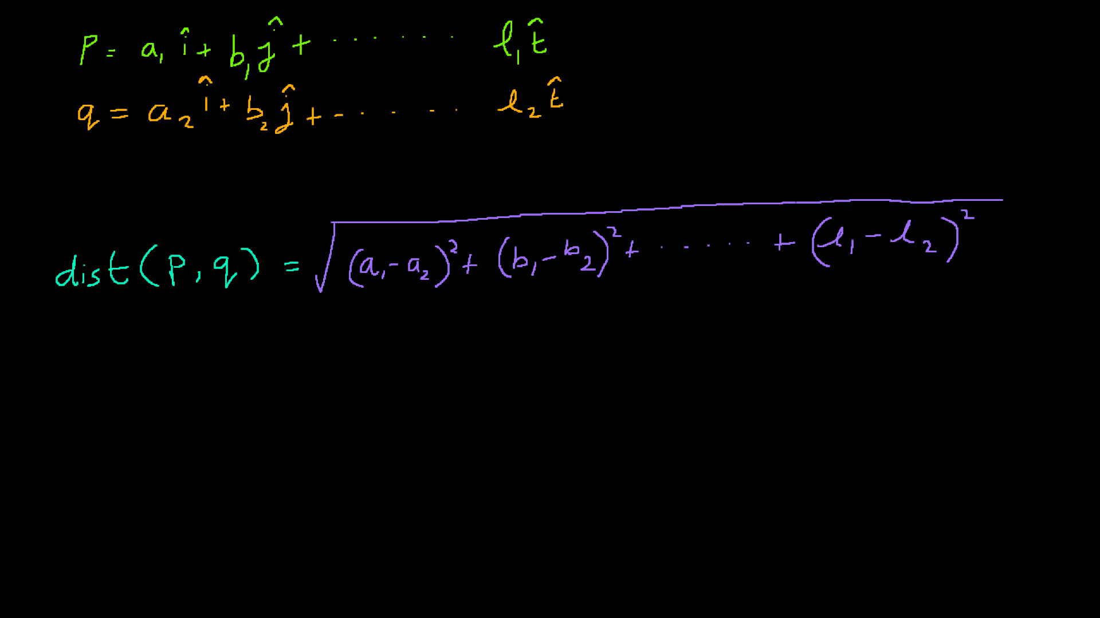

Slide 11

Data Points

Slide 12
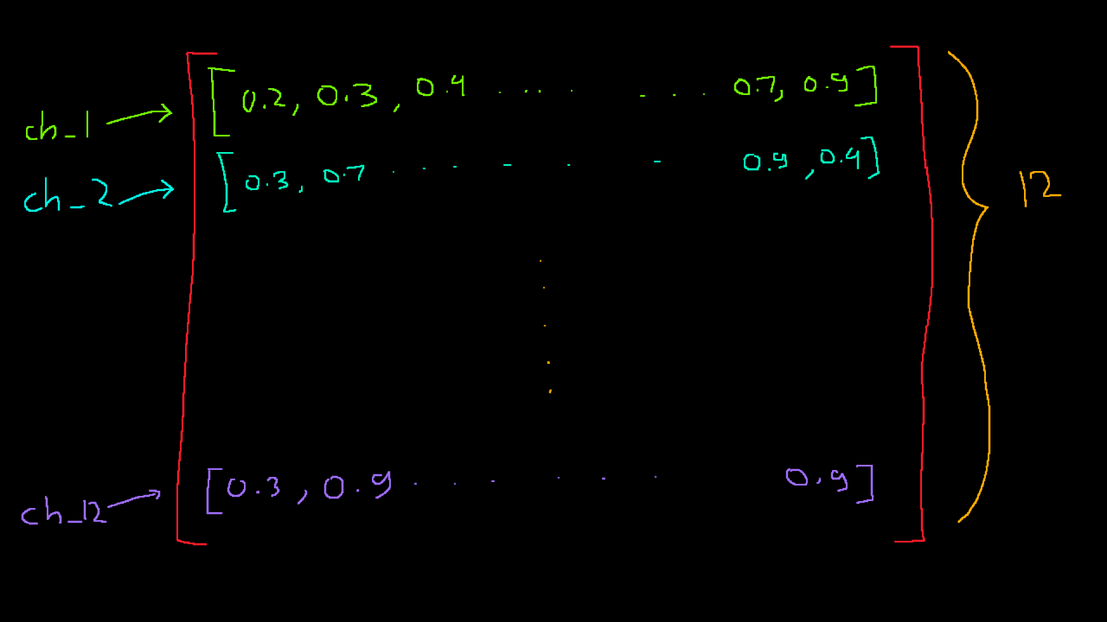

Slide 13
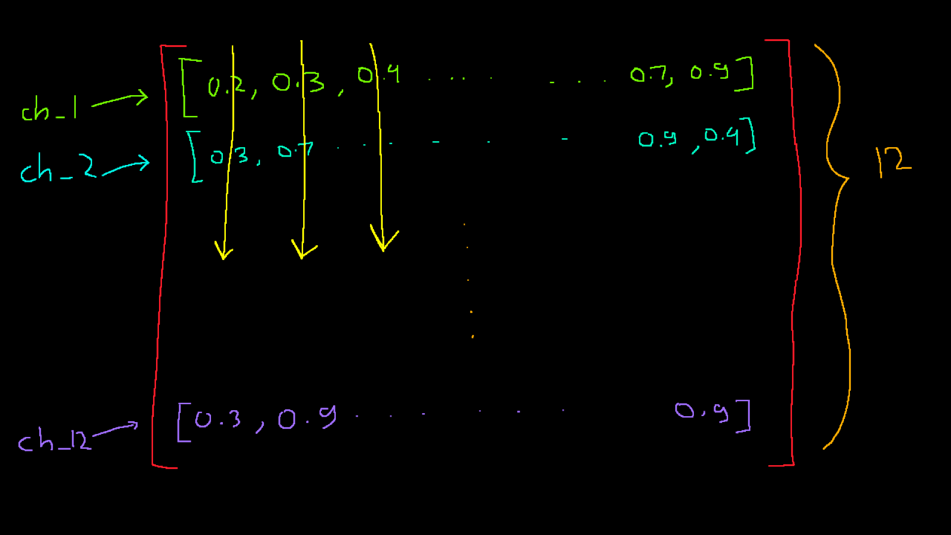

Slide 14
Visualizing the TF graph

Slide 15
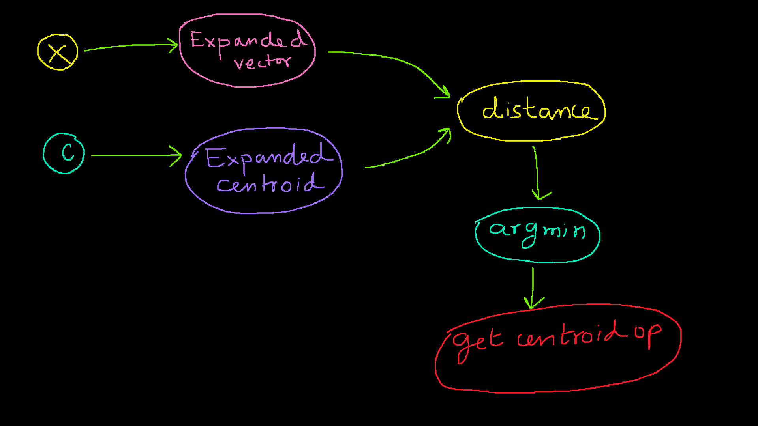

Slide 16
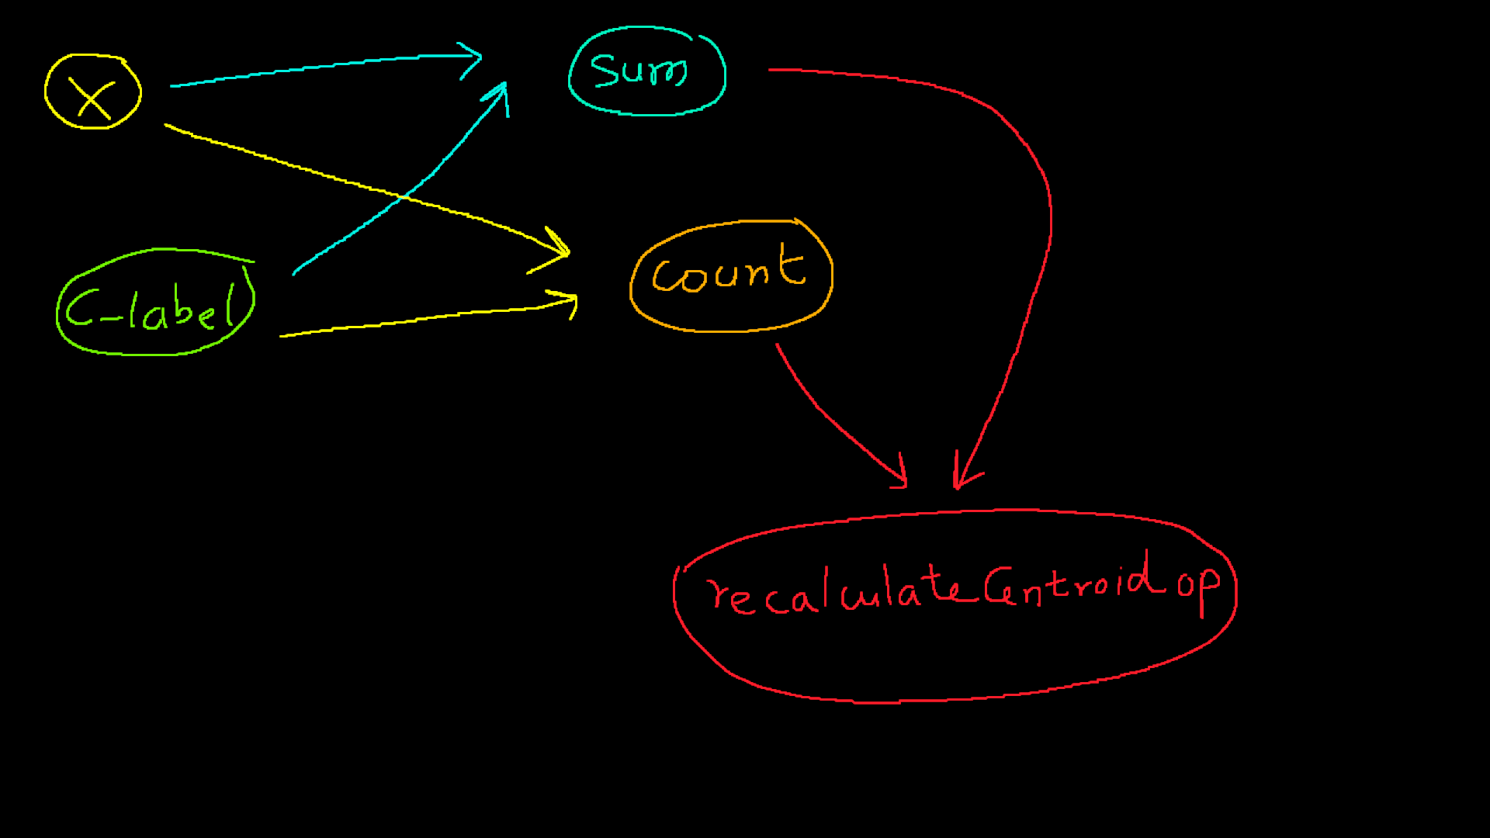

Slide 17
Broadcasting

Slide 18
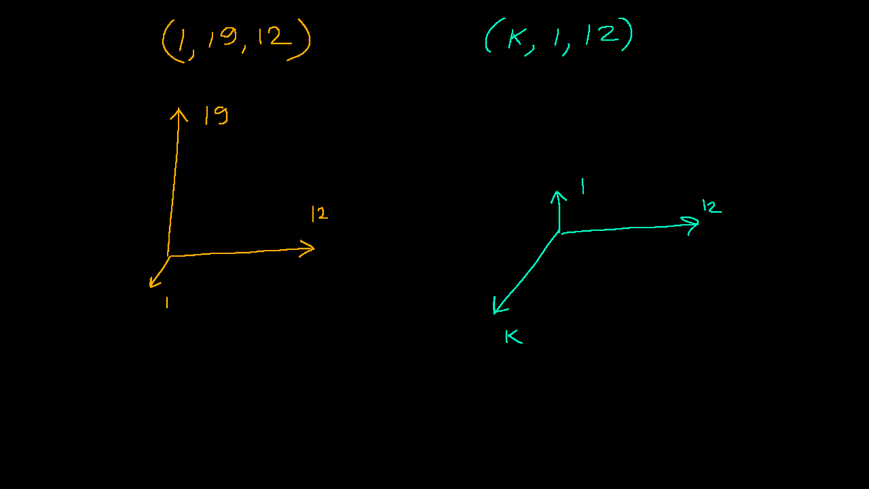

Slide 19
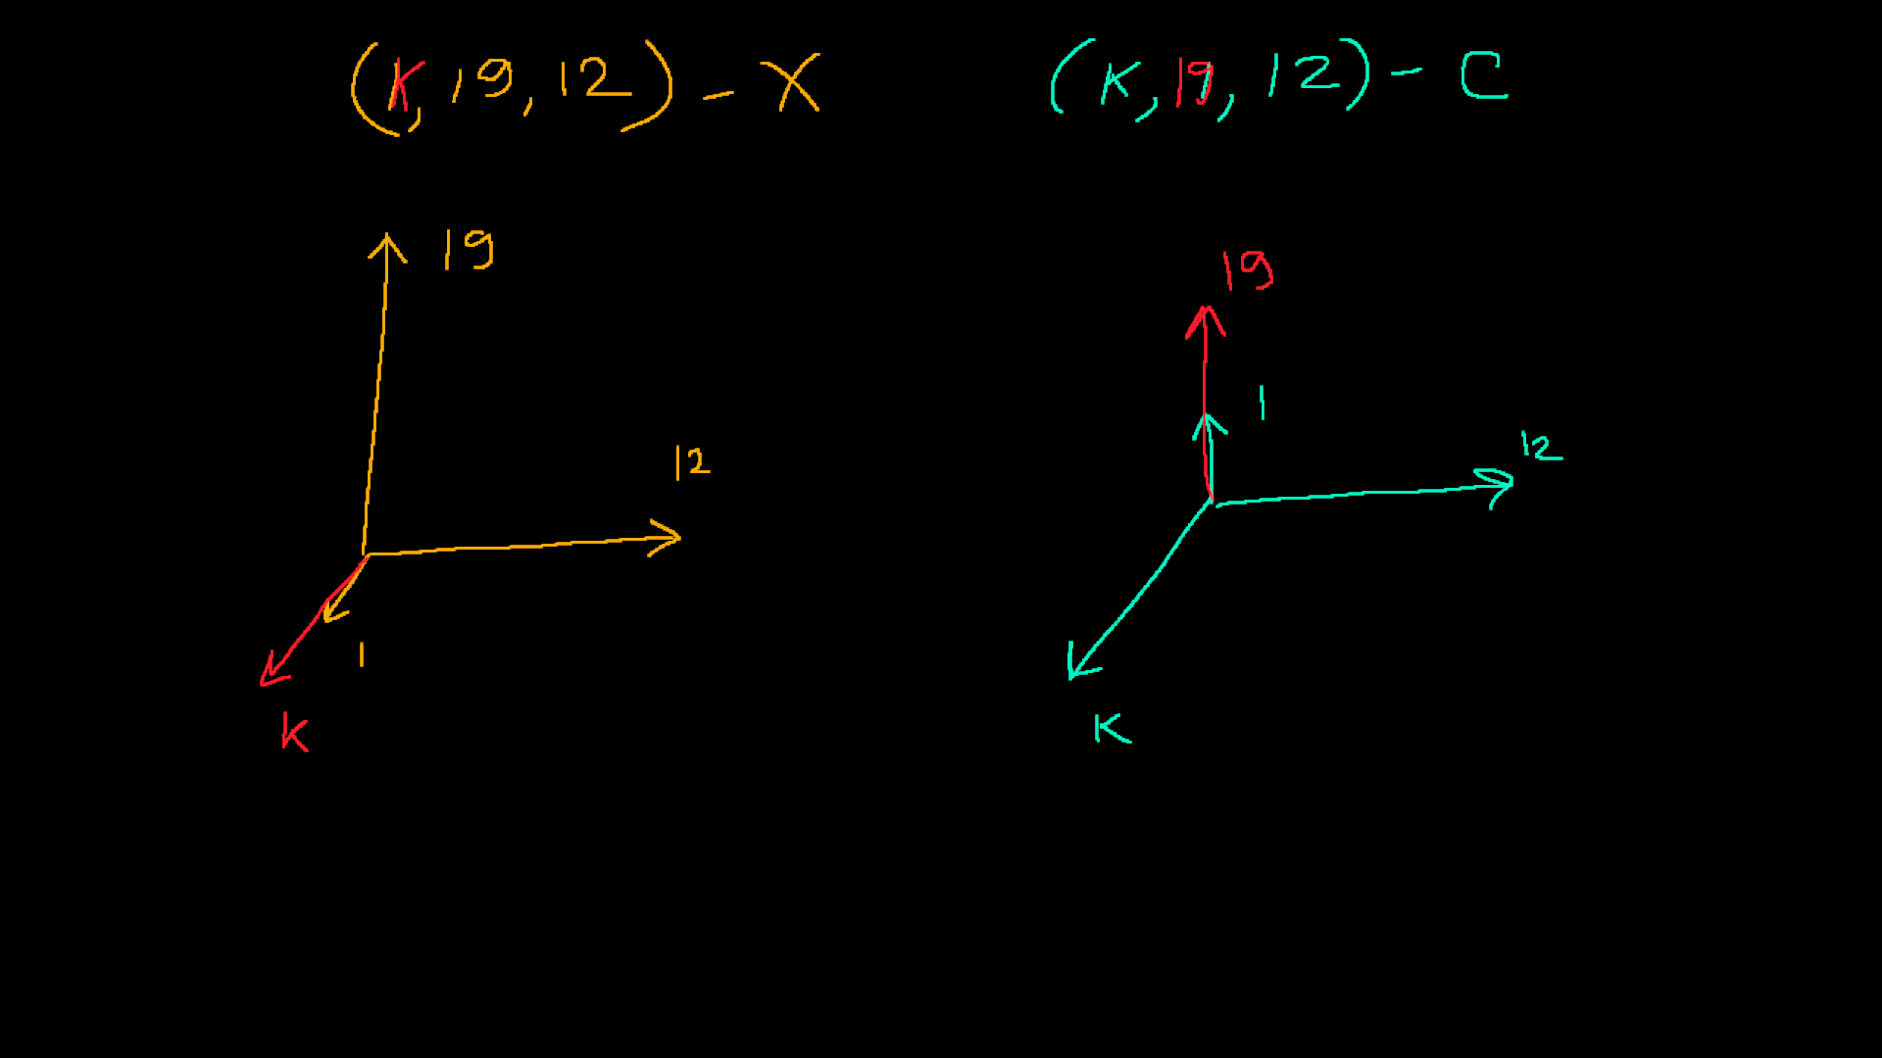

Slide 20
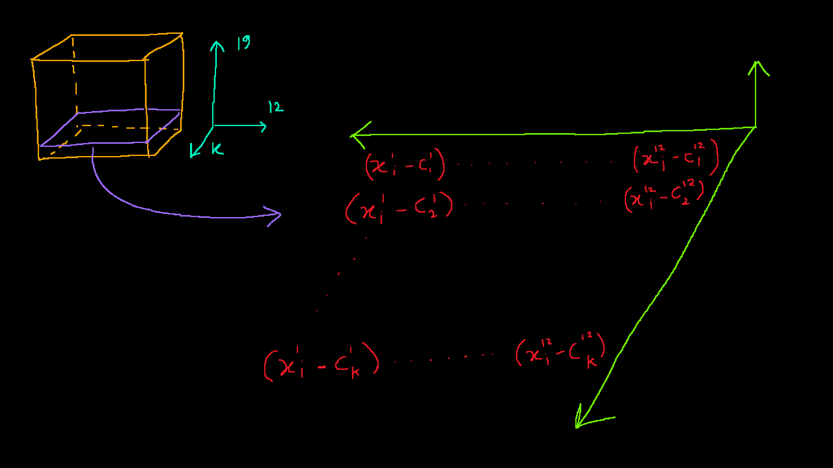

Slide 21


