Slide 1

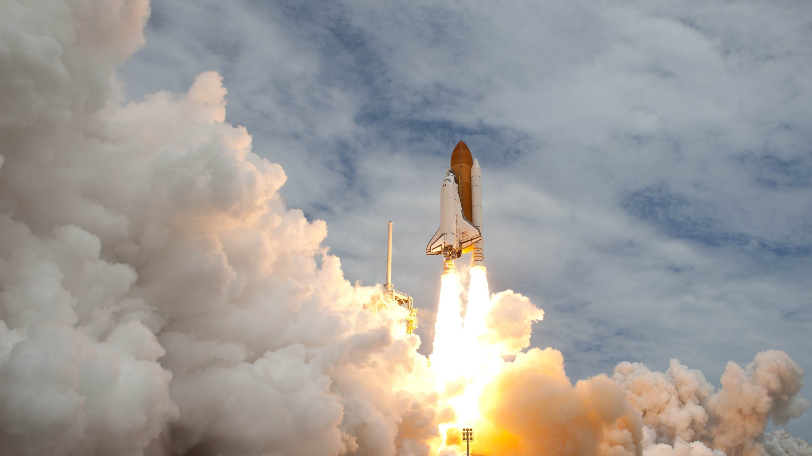
MBSE
Pipeline for Turbopump Design and Optimization
Aakash Nandy
Engineering Science – Aerospace (University of Toronto)

Slide 2
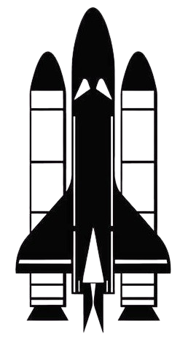
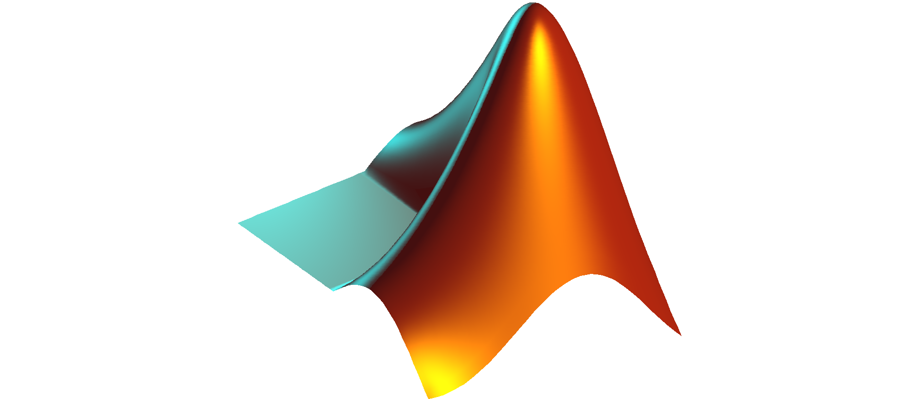

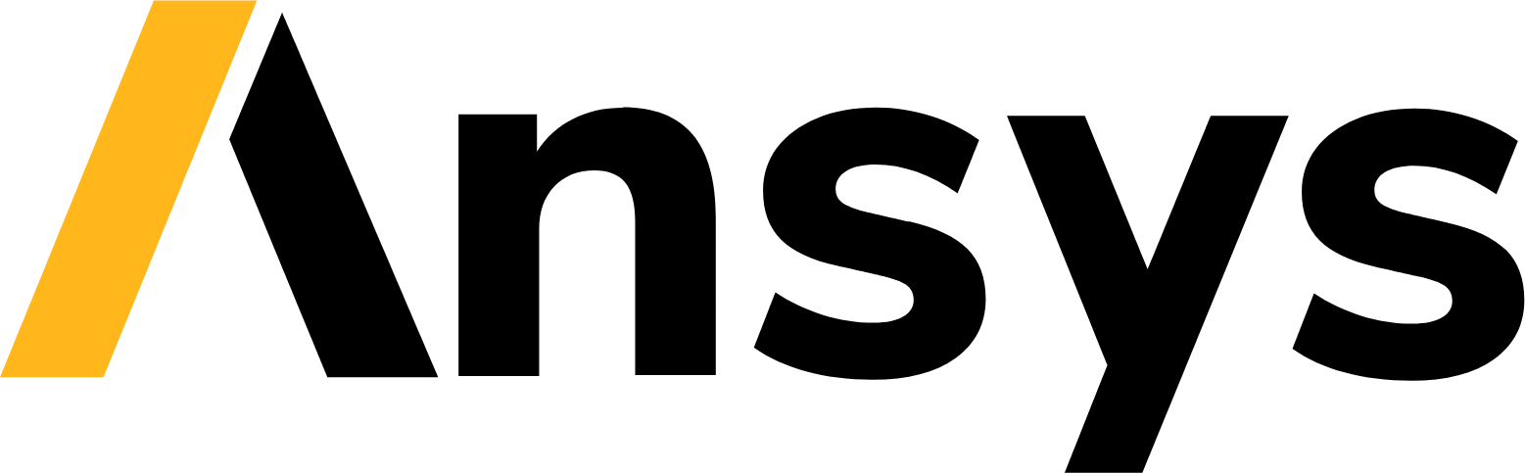

MBSE Pipeline: Overview
1D hydraulic simulation
Blade angle calculation with slip factor
CoolProp integration for variable thermal properties
NASA SP-8109 check to ensure viability
Genetic algorithm optimizer for preliminary design choices
Cavitation check
Pump Generation
1D Sim and Optimization
Generate pump geometry
Integrate with ANSYS Workbench for CFD
Export to CAD for detailed design
Use Cfturbo Workbench module then mesh each part
  TurboGrid for moving
  SpaceClaim for stationary
Run CFX simulation
Use OptiSlang for detailed optimization
Export fluid forces and other useful information to mechanical and NVH simulations
3D Sim and Optimization
Pump Casing
Develop pump casing and additional solid geometry
Required for structural and NVH simulations
Aakash Nandy ▪ Engineering Science - Aerospace

Slide 3
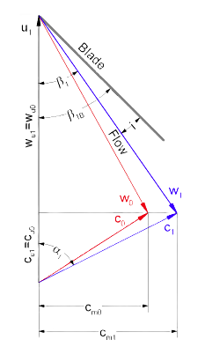
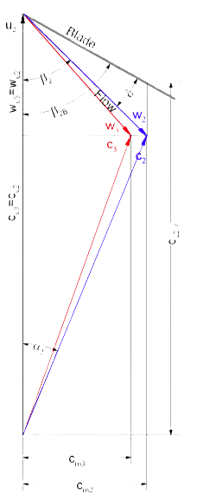
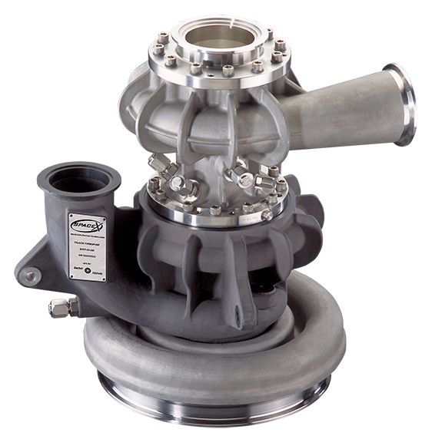

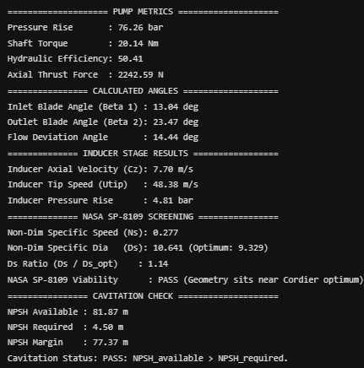
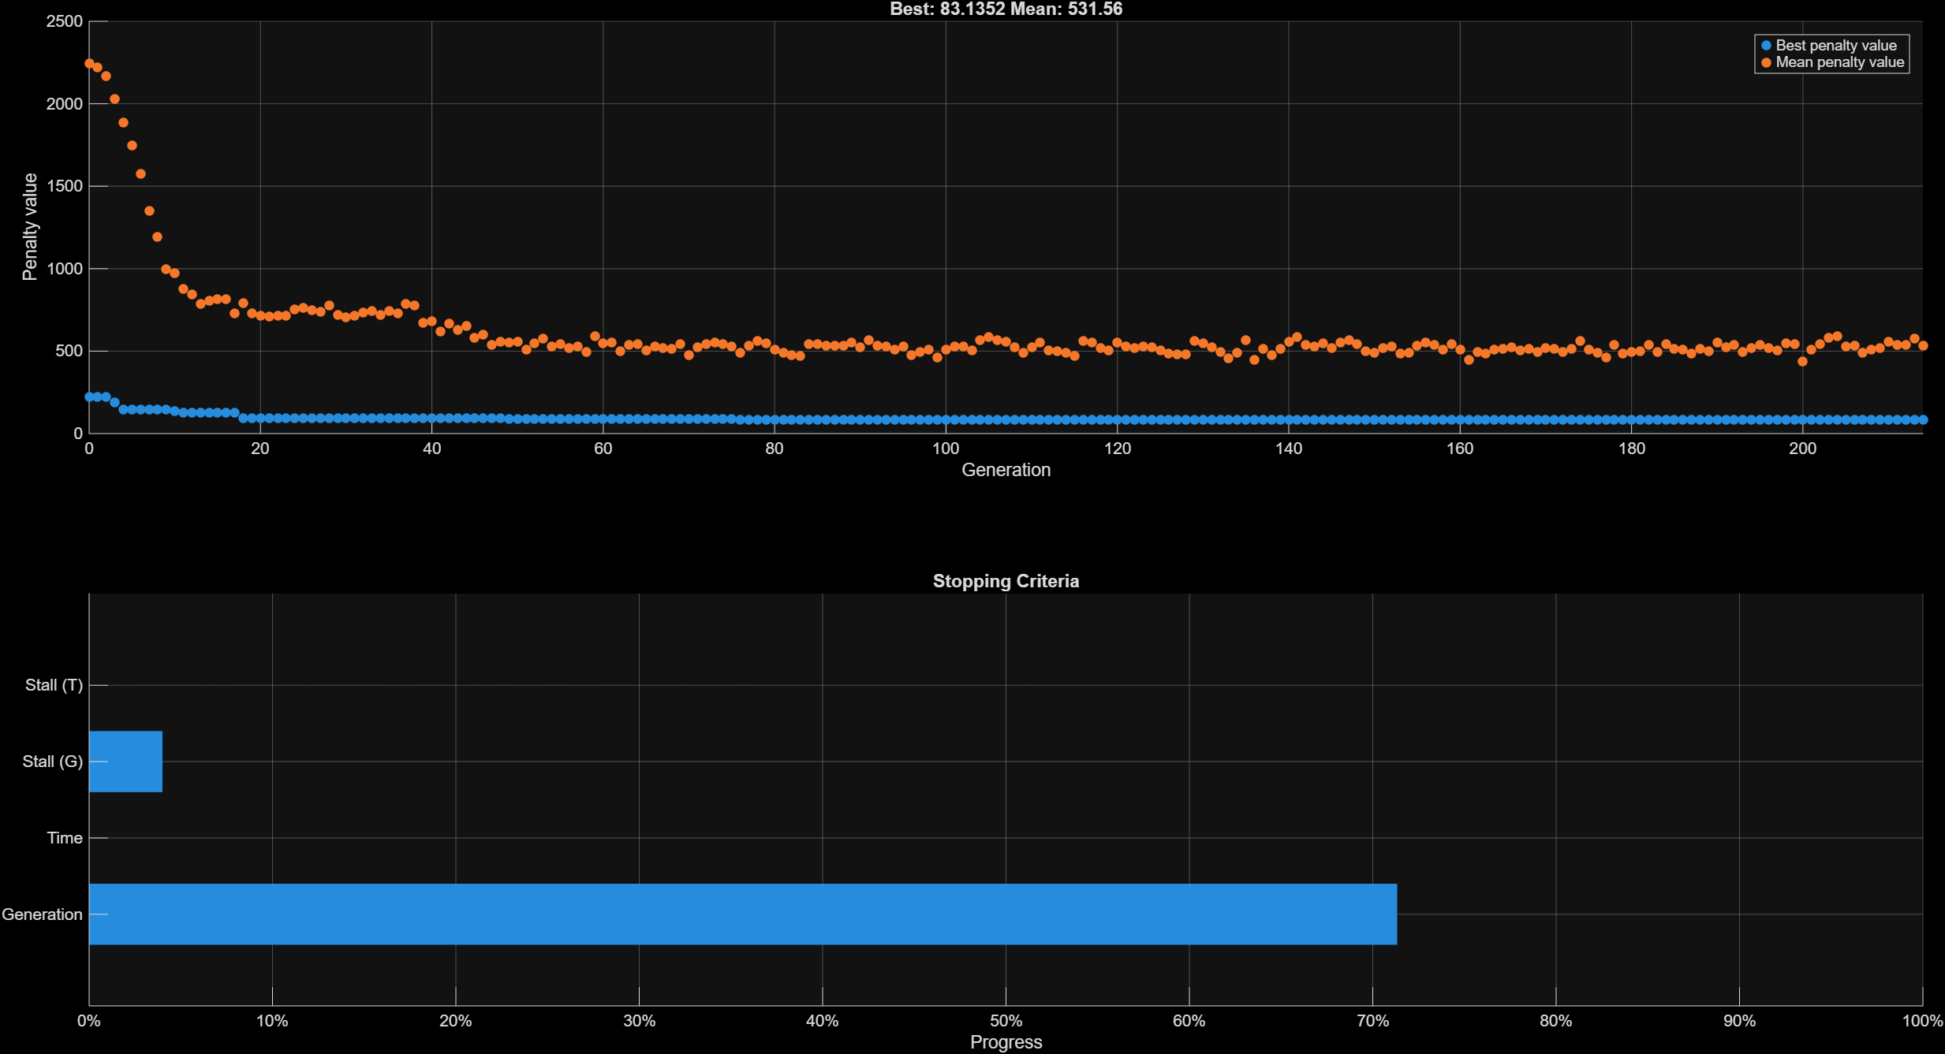
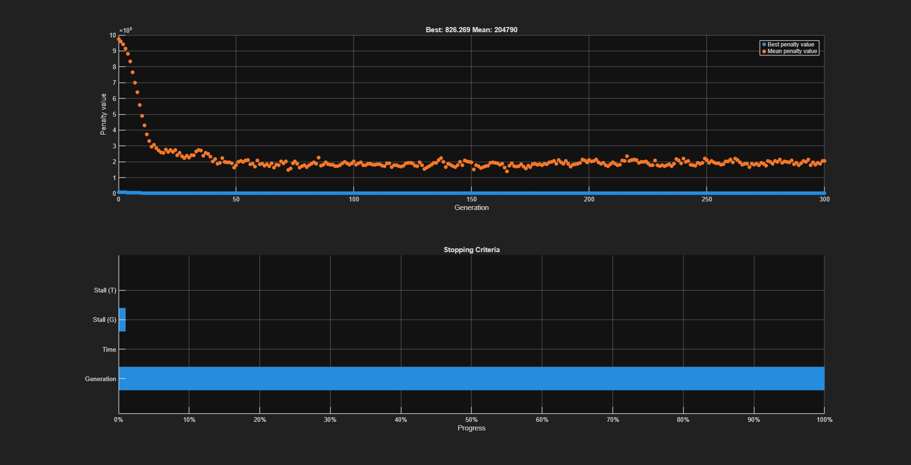
MBSE Pipeline: 1D Simulation and Optimization
1D Simulation
1D Pump simulation based on Dr. El-Naggar’s 1D flow analysis
Includes blade angle calculation through velocity triangle analysis
  Assume zero incidence (inlet)
  Stodola slip factor implemented for slip prediction along blade (used for outlet blade angle)
NASA SP-8109 consolidates empirical flight data into design guidelines, loss trends, and geometric scaling laws using Cordier-Balje optimal line
Cavitation prediction is done through NPSH screening
Read full report here
Optimizer
The chosen optimization algorithm is the genetic algorithm
  Inspired by the process of natural selection and genetics
  Population of candidate solutions (chromosomes) is evolved toward better solutions (natural selection)
Limitations are placed based on established pump design parameters (most pulled from the Cfturbo handbook), NPSH screening, and NASA SP-8109
Example output
Aakash Nandy ▪ Engineering Science - Aerospace

Slide 4
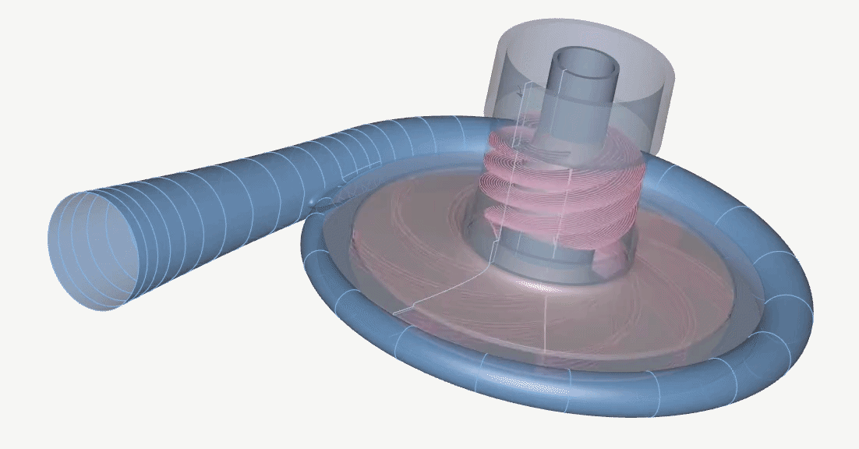
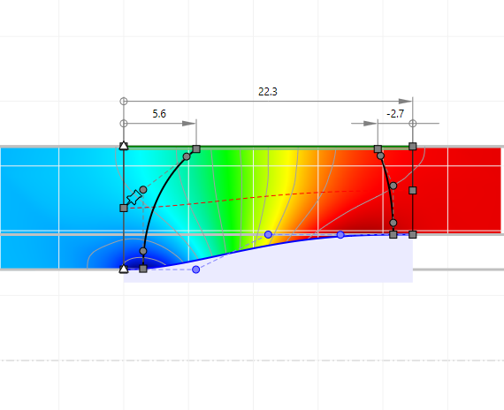

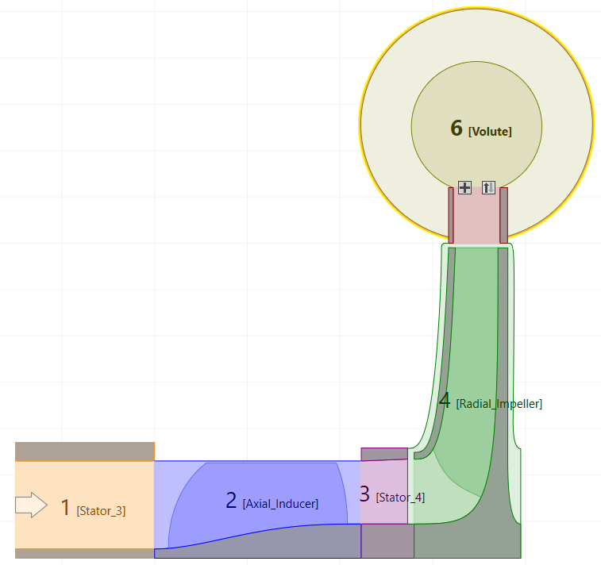
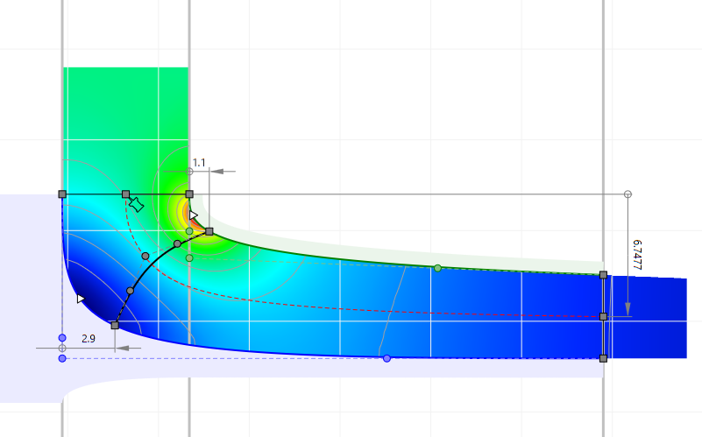
MBSE Pipeline: Pump Geometry Design and CAD
3D Solid Domain
Inducer Meridional Contour
See CAD here
This geometry is preliminary and should be developed more after the optimization process. A simpler geometry is easier for an optimizer to deal with.
  Secondary flow paths should be routed for cooling.
  Volute should be more
.
Casing design should be done after a fluid/solid domain has been finalized and then used in structural/NVH simulations. A mix of CFturbo and CAD can be used.
Full Pump Meridional Contour with Secondary Flow and Relevant Solids
Impeller Meridional Contour
Aakash Nandy ▪ Engineering Science - Aerospace

Slide 5







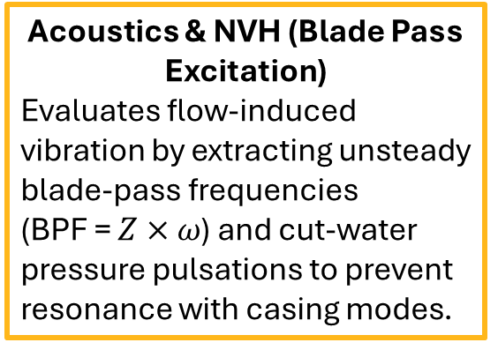
MBSE Pipeline: Simulation and Detailed Optimization
Fluid-Structure Interaction (FSI)
Maps 3D CFX static pressure fields and steady fluid forces onto solid impeller blades and volute casing in ANSYS Mechanical to verify von Mises stresses and centrifugal yield margins.
Casing Geometry
Optimal Fluid Boundaries
Mesh
Structural
TurboGrid
Pump Geometry
CFD
SpaceClaim
NVH
Acoustics & NVH (Blade Pass Excitation)
Evaluates flow-induced vibration by extracting unsteady blade-pass frequencies (BPF = $Z×ω$) and cut-water pressure pulsations to prevent resonance with casing modes.
Optimizer
Aakash Nandy ▪ Engineering Science - Aerospace

Slide 6
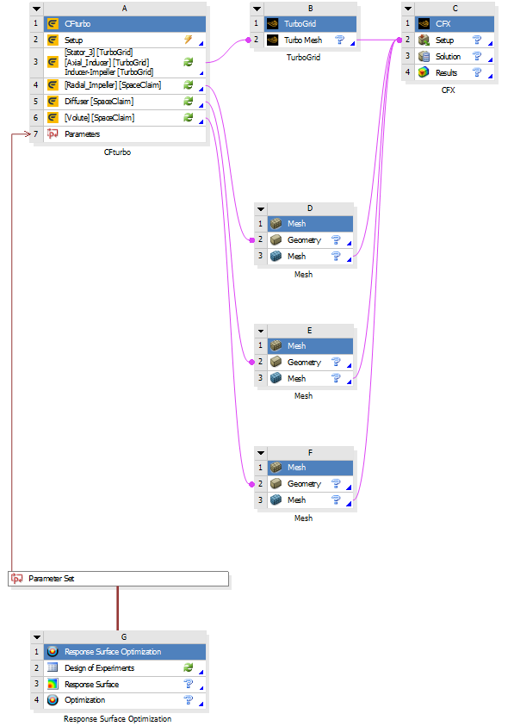
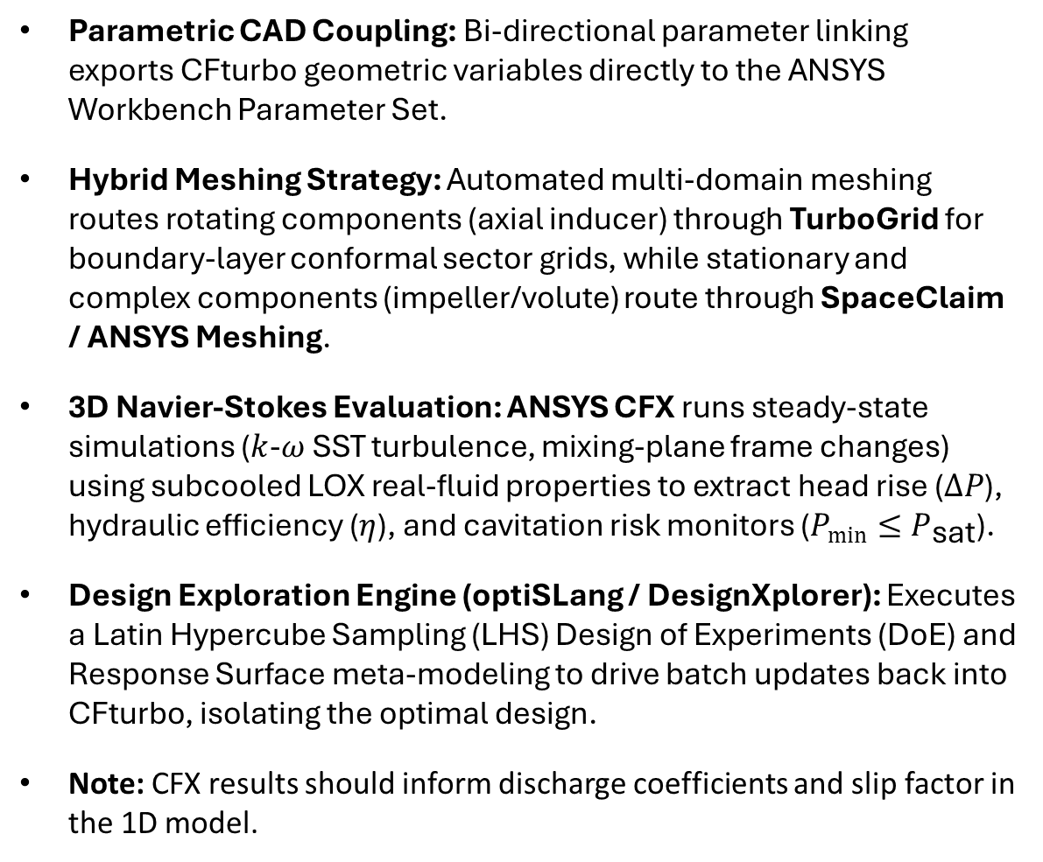
MBSE Pipeline: Workbench Project
Parametric CAD Coupling: Bi-directional parameter linking exports CFturbo geometric variables directly to the ANSYS Workbench Parameter Set.
Hybrid Meshing Strategy: Automated multi-domain meshing routes rotating components (axial inducer) through TurboGrid for boundary-layer conformal sector grids, while stationary and complex components (impeller/volute) route through SpaceClaim / ANSYS Meshing.
3D Navier-Stokes Evaluation: ANSYS CFX runs steady-state simulations ($k$-$ω$ SST turbulence, mixing-plane frame changes) using subcooled LOX real-fluid properties to extract head rise ($ΔP$), hydraulic efficiency ($η$), and cavitation risk monitors ($P_{min}≤P_{\text{sat}}$).
Design Exploration Engine (optiSLang / DesignXplorer): Executes a Latin Hypercube Sampling (LHS) Design of Experiments (DoE) and Response Surface meta-modeling to drive batch updates back into CFturbo, isolating the optimal design.
Note: CFX results should inform discharge coefficients and slip factor in the 1D model.
Aakash Nandy ▪ Engineering Science - Aerospace

Slide 7
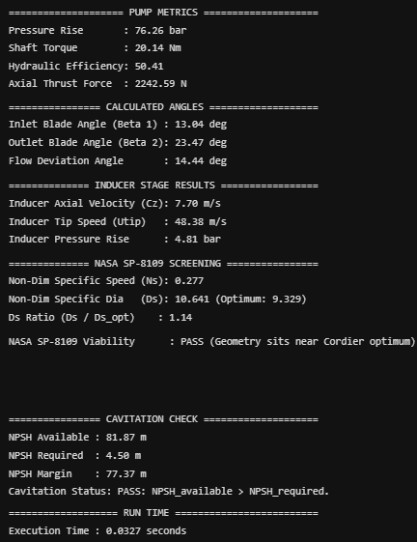
Example Pipeline Run: Preliminary Design
Design Point: Fit for a Rutherford Class (25 kN) engine.
Load desired design point into 1D optimization script.
Property | Value
Propellant | Subcooled LOX (90 K)
Shaft Speed | 28,000 RPM
Pressure Rise | 75 bar
Flow Rate | 250 L/min (~5 kg/s LOX)
MATLAB
CFturbo
Aakash Nandy ▪ Engineering Science - Aerospace

Slide 8
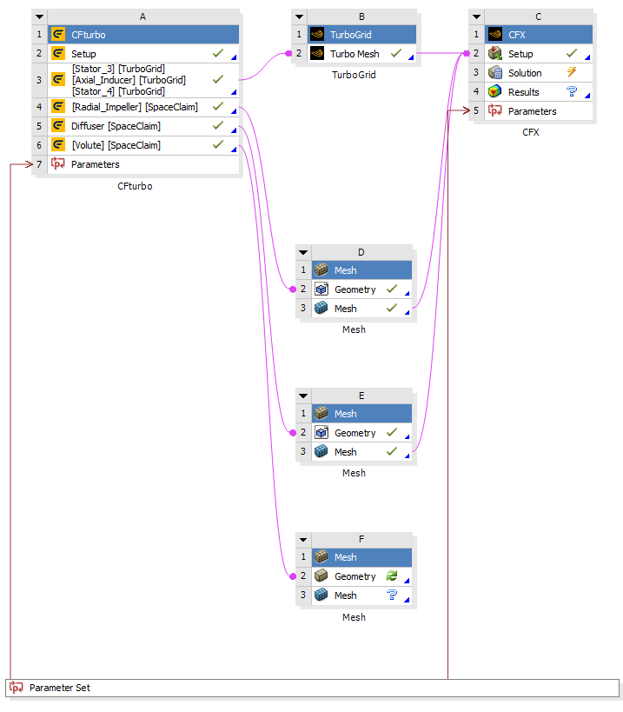
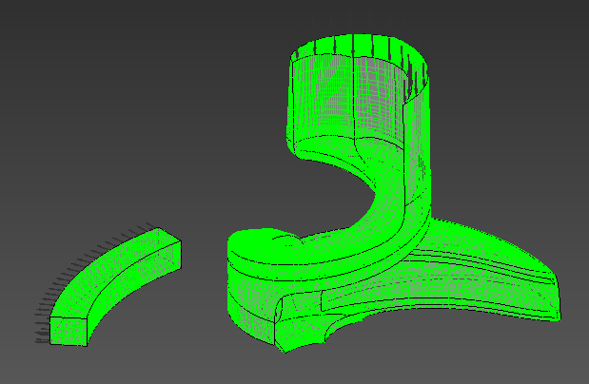
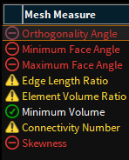
Example Pipeline Run: “High-fidelity” Simulation Setup
Issue: ANSYS student license only allows 512,000 elements which is not nearly enough for a good simulation.
Temporary Solution: Run simulation without volute (only rotationally non-periodic part) for proof of concept. Then, take advantage of the periodicity of the other parts of the pump to reduce element count.
Elements: 502,426
4 inducer blades → 1
8 impeller blade → 1
Orthogonality and skewness issues but they’re unavoidable with 512k limit
TurboGrid Mesh Stats
Aakash Nandy ▪ Engineering Science - Aerospace

Slide 9
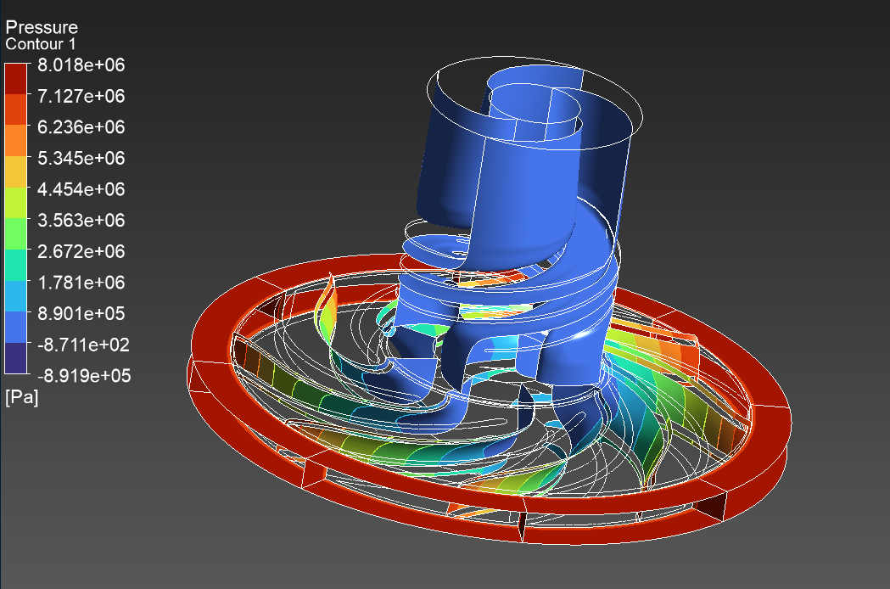
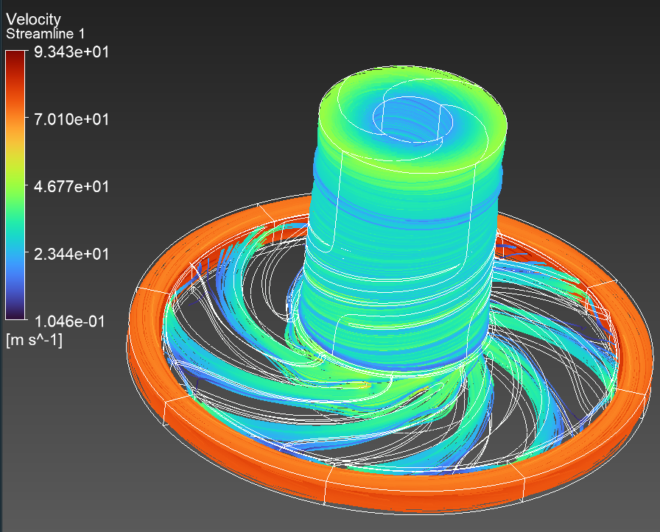
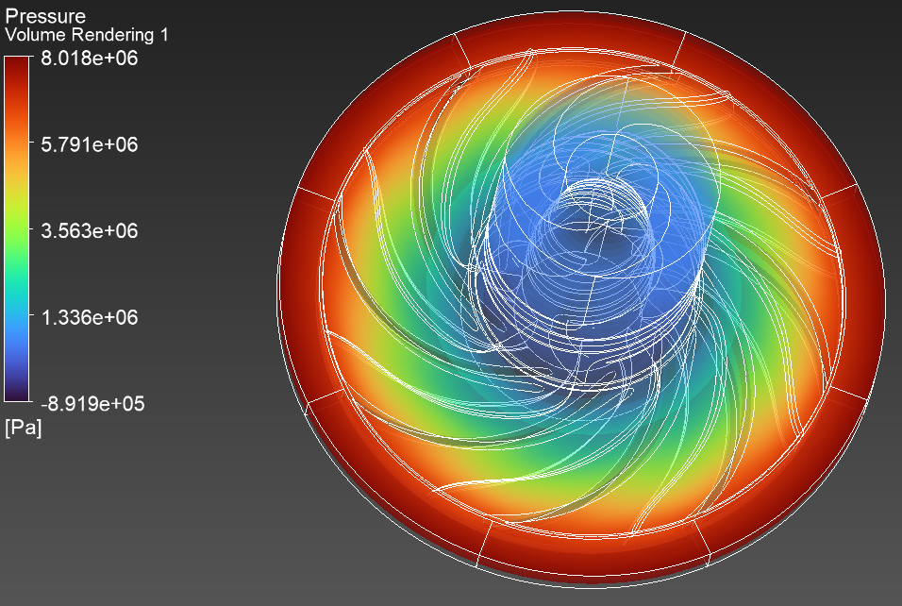
Example Pipeline Run: “High-fidelity” Simulation Results
Expression | Value
Pressure Rise | 106.219 bar
Shaft Torque | 2.39668 Nm
Hydraulic Efficiency | 25.5263 %
Results are very off from 1D simulation but that makes sense due to the missing volute
  Higher pressure rise because of no expansion through volute
  Low outlet flow rate because of no volute which leads to low hydraulic power which leads to low hydraulic efficiency
Pressure and velocity change through inducer and impeller look good
Chosen expression values were properly exported to the Workbench Parameter Set for optimization with optiSlang
Aakash Nandy ▪ Engineering Science - Aerospace

Slide 10
Next Steps
Obtain more capable ANSYS license for full high-fidelity fluid simulation and optimization loop
Structural and Centrifugal FEA (ANSYS Mechanical):
  Map 3D fluid pressure fields and thermal boundary conditions directly from CFX onto the solid blade/hub mesh for one-way Fluid-Structure Interaction (FSI)
  Evaluate von Mises stresses under a 20% overspeed case (33,600 RPM) using a chosen material (like Inconel 718 or Ti-6Al-4V) to verify a minimum yield safety factor
Rotordynamics and Critical Speed Assessment:
  Model shaft deflection, bearing stiffness, and hydrodynamic cross-coupling in Dyrobes/ANSYS to produce a Campbell diagram
  Verify the first bending critical speed remains at least 25–50% above nominal operational speed to ensure subcritical operation
Acoustic and Blade-Pass Vibration (NVH):
  Extract unsteady blade-passing frequencies and cut-water pressure pulses to ensure no lock-in occurs with the casing structural modes (resonance)
Design for Additive Manufacturing (DfAM):
  Transition the idealized circular volute cross-section to an internally self-supporting teardrop profile tailored for Laser Powder Bed Fusion (LPBF) printing without internal support structures
  Run a trade study to quantify the marginal hydraulic efficiency penalty of the printable geometry versus the hydrodynamic baseline
Aakash Nandy ▪ Engineering Science - Aerospace

Slide 11
Works Cited (1)
[1] G. P. Sutton and O. Biblarz, Rocket Propulsion Elements, 9th ed. Hoboken, NJ, USA: John Wiley & Sons, 2017.
[2] N. Makovnik et al., "Development of a 5,000 lbf open-cycle kerosene-oxygen turbopump," Purdue University, West Lafayette, IN, USA, Tech. Rep., 2025.
[3] CFturbo GmbH, "CFturbo BLADERUNNER: Gas turbine design for a turbopump," 2025 Series – Study #4, Dresden, Germany, 2025.
[4] E. M. Bennett, "CFD analysis of unsteady cavitation instabilities in a turbopump inducer," presented at the ISimT-16 Symp. Innovative Simulations in Turbomachinery, Mechanical Solutions, Inc., Whippany, NJ, USA, Nov. 29, 2016.
[5] L. Cope, "What is a Campbell diagram and how do you read one?," Engineer Fix, Nov. 7, 2025. [Online]. Available: https://engineerfix.com/what-is-a-campbell-diagram-and-how-do-you-read-one/.
[6] CFturbo, "CFturbo in ANSYS Workbench Webinar: Cryogenic Rocket Turbopump," YouTube video, 2024. [Online]. Available: https://www.youtube.com/watch?v=SVK4hdKiRsE.
Aakash Nandy ▪ Engineering Science - Aerospace

Slide 12
Works Cited (2)
[7] CFturbo, "Conceptual Design of a Cryogenic Rocket Turbopump with CFturbo," YouTube video, 2023. [Online]. Available: https://www.youtube.com/watch?v=m_stugtpWgk.
[8] CFturbo, "CFturbo Design of an Axial, Single-Stage Turbine for a Rocket Turbopump," YouTube video, 2023. [Online]. Available: https://www.youtube.com/watch?v=vmnQ42eIgLE.
[9] "Velocity Triangle Considering Slip Factor in Centrifugal Compressor," YouTube video, 2024. [Online]. Available: https://www.youtube.com/watch?v=9Eazw6cygrA.
[10] Liquid Rocket Engine Centrifugal Flow Turbopumps, NASA Space Vehicle Design Criteria (Chemical Propulsion), NASA SP-8109, Aug. 1973.
[11] "A Method of Calculating the Weight and Dimensions of a Turbo Pump for Rocket Propellants," Rocket Propulsion Department, Westcott, Tech. Note, 2026.
[12] "Pump Cavitation Risk Assessment: Calculation, Prevention, and Free Online Calculator," Engineering Technical Notes and Reference Formulas, 2026.
Aakash Nandy ▪ Engineering Science - Aerospace

