Slide 1




Green Chef
Packaging Analysis
Customer Experience, Competitive Landscape and the Case for Change Faculty Advisor: Prof. Sean Raines | Sponsor Advisor: Kayla Baber
May 6, 2026

Slide 2
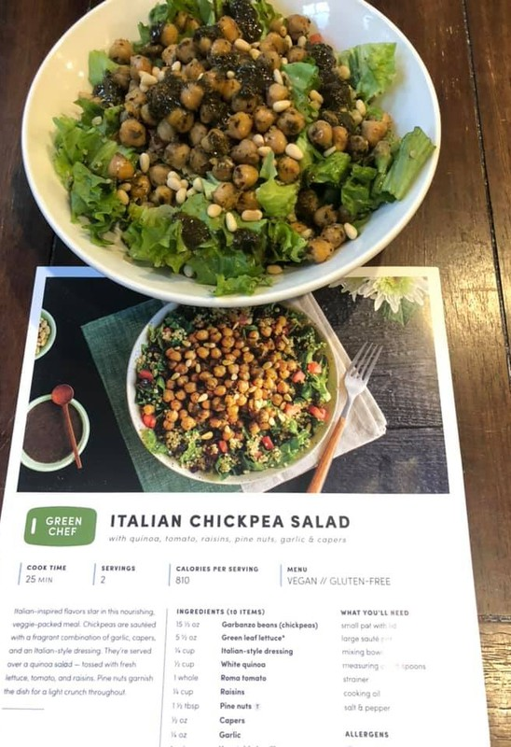

Content
Our Team Overview
Problem Statement Project Objectives Data Analysis
Economic Analysis
Recommendations Next Steps
01
02
03
04
05
06
07
08

Slide 3






Our Team
Aakash Nihalaney
Avi Gupta
Harsh Sahu
Om Kapdoskar

Slide 4





Overview
Green Chef is the premium organic meal kit. 75 % of customers are
sustainability conscious. But most
ingredient packaging is still plastic.
01
4 , 211 packaging- related cancellations in 8 weeks. 77 - 86 % of plastic ingredient packaging ends up in the garbage.
02
How does Green Chef close the gap between i ts sustainability
identity and i ts packaging reality?
03

Slide 5
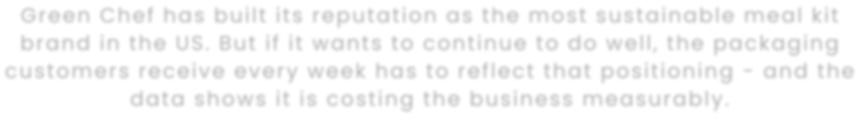
THE PROBLEM
Green Chef has built i ts reputation as the most sustainable meal kit brand in the US. But i f i t wants to continue to do well, the packaging
customers receive every week has to reflect that positioning - and the data shows i t is costing the business measurably.

Slide 6








Objectives
Identify packaging pain points
Pinpoint which components drive the most dissatisfaction and churn.
Evaluate sustainable alternatives
Assess viable replacements against
environmental, food safety, cold chain and cost criteria.
Build the economic case
Quantify the f inancial impact through NPV, payback and ROI modeling.
Deliver actionable recommendations
Prioritized roadmap Green Chef can
implement as part of i ts 2026 roadmap.

Slide 7
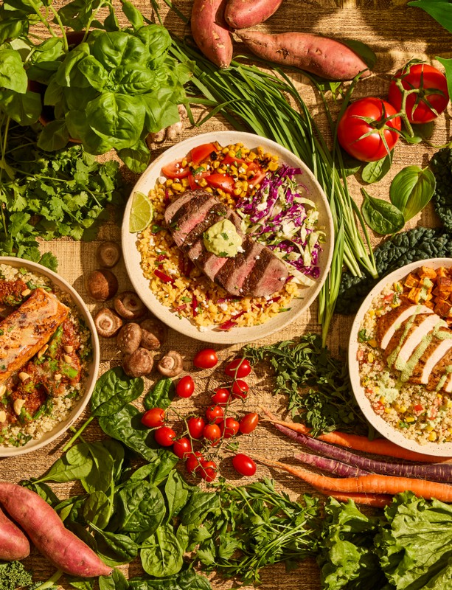


Data Analysis - I
What the customers are telling us
Across 4 data sources — one story emerges consistently.
48% cite plastic reduction as their top packaging concern 71 % say a switch to paper
packaging would improve brand perception
67 % say i t would improve overall satisfaction

Slide 8
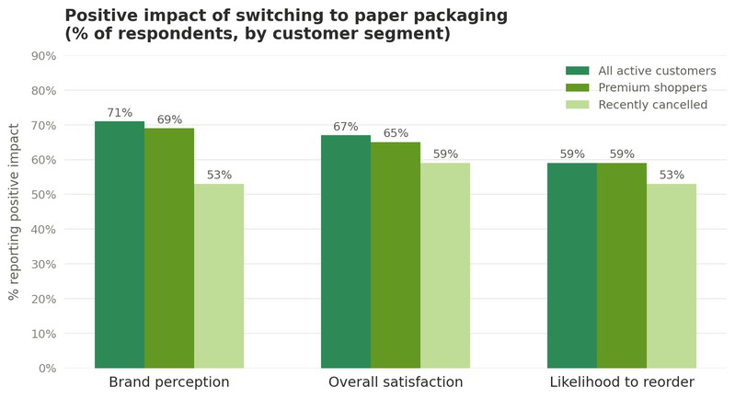
Data Analysis - I
What the customers are telling us

Slide 9
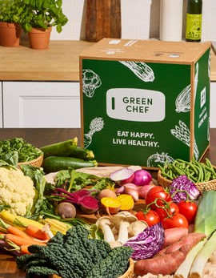
Data Analysis - II
Where the Friction Is
Plastic ingredient packaging is the clearest opportunity area. Customers want to recycle and they do — when the materials make i t
easy.
84% recycle the cardboard box
77 -86 % throw out plastic ingredient packaging
4, 211 of 21 , 967 Q 1
cancellations cite
packaging or freshness
Hungryroot, our largest competitive threat, has already turned packaging into an
acquisition tool.

Slide 10
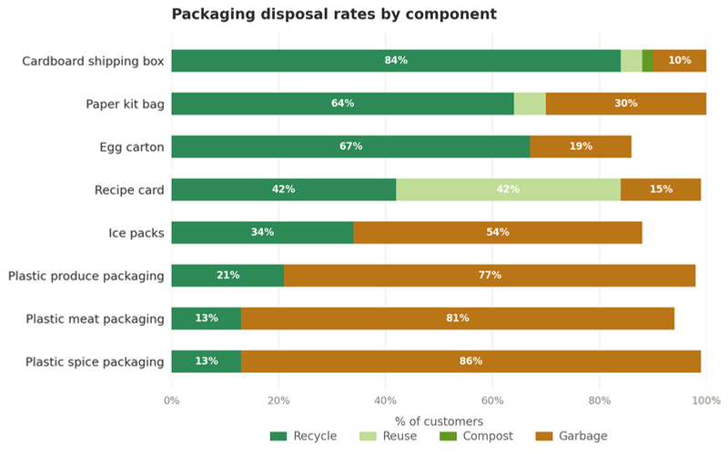
Data Analysis - II
Where the Friction Is

Slide 11


ECONOMIC ANALYSIS
A phased two- t ier approach.
Tier 1 generates returns in under a year.
Tier 2 builds long- term competitive advantage.
 | Nutri-Ice | Sustainable Materials
Annual Cost | $ 811 K | $ 330 K + $ 200 K one- t ime
Annual Benefit | $ 854 k | $ 424 K
ROI | 5 . 3 % | 28 . 4 % ongoing
Payback | 11 . 4 months | 25 . 6 months
3 - yr NPV | $ 106 k | $ 52 K

Slide 12
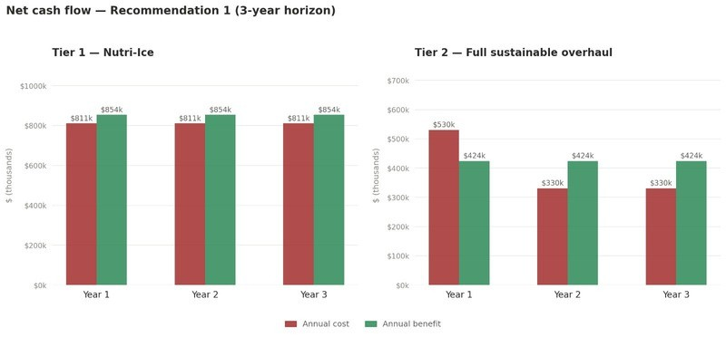
ECONOMIC ANALYSIS
A phased two- t ier approach.
Tier 1 generates returns in under a year.
Tier 2 builds long- term competitive advantage.

Slide 13




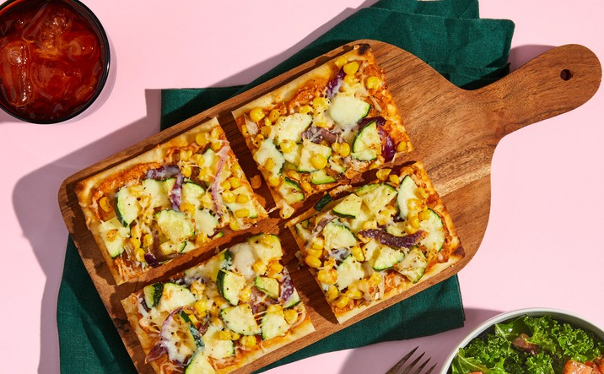
Recommendations
01 Phased Packaging Overhaul
Tiered Marketing Strategy
Smart Disposal Guide via QR Code

Slide 14

PHASED PACKAGING OVERHAUL
Tier 1 generates returns in under a year.
Tier 2 builds long- term competitive advantage.
TIER 1
TIER 2
SMART PACKING ASSISTANT
Nutri- Ice
Sustainable Materials
Weather- smart, sits
on Katana + Pick- to- Light
Costs: +$ 0 . 20 / box
Plastic - > paper/
compostable
5 . 3 % ROI
11 . 4 months
payback period
Adjusts each box for i ts
destination based on the weather
28 . 4 % ROI
25 . 6 months
payback period
No infrastructural changes

Slide 15
RECOMMENDATIONS
02 - Tiered Marketing Strategy
A packaging upgrade only matters i f customers know i t happened.
Four pillars make i t visible: Freshness Promise,
Sustainability Story,
win- back to lapsed customers, in- box storytelling cards.
03 - Smart Disposal Guide via QR Code
A QR code on each component l inks to a webapp with disposal
instructions for that material, keyed to the customer' s zip code.
No packaging changes required.

Slide 16
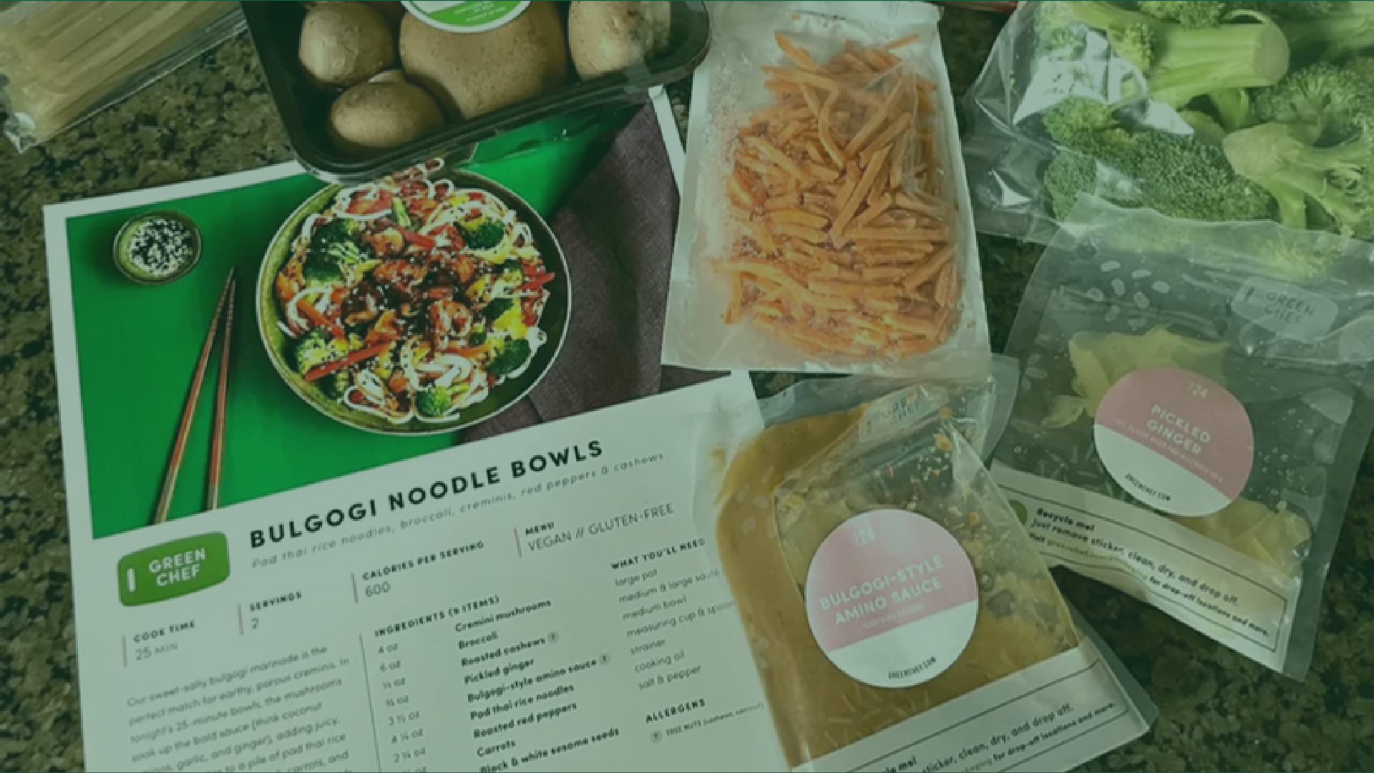

QUESTIONS?

Slide 17



THANK YOU!

