Slide 1

AMERICAN INTERNATIONAL UNIVERSITY-BANGLADESH (AIUB)
Department : COMPUTER SCIENCE ENGINEERING

Slide 2
INTRODUCTION TO DATABASE ON Dhaka Metro Rail
AHMED ISIAQ 15-29546-2
JISEN MOHAMMAD 15-29499-2
RAHMAN MD. ARAFAT 15-29580-2
RAHMAN S.M SHAMIUR 15-29564-2
ISLAM TAOFIQUE 15-29547-2

Slide 3
Tools We have Use
1.Xampp

Slide 4
System summary
Total 6 Metro Rail Stations
3 Rail Engine
Length 15.6 K.M.
From BANANI to MIRPUR-10

Slide 5
Project Objectives
To make the system easier to keep traveler records
Passengers will be able to know upcoming trains schedule in website
Passengers will not have to queue in long line for tickets

Slide 6
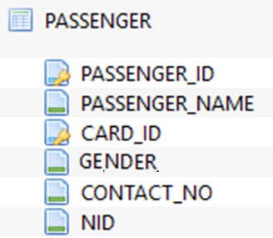
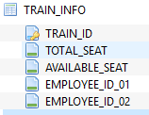
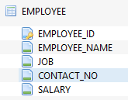
Database Relationship Diagram
TABLE 1
TABLE 2
TABLE 3

Slide 7


Database Relationship Diagram
TABLE 4
TABLE 5

Slide 8
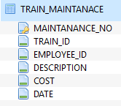
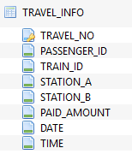
Database Relationship Diagram
TABLE 6
TABLE 7

Slide 9
Entity-Relationship Database Model
STATION_LIST
EMPLOYEE_INFO
TRAIN_MAINTANANCE
TRAVEL_INFO
CARD_INFO
PASSENGER_INFO
TRAIN_INFO
MECHANICS
STATION MASTERS
TRAIN EMPLOYEE
TRAINS
TRAVELERS
TRAVELS
CARDS

Slide 10
Normalization
First Normal Form :
No multivalued attributes
Every attribute value is atomic

Slide 11
Normalization
Second Normal Form :
every non-key attribute is fully functionally dependent on the ENTIRE primary key

Slide 12
Normalization
Third Normal Form :
Any field which is dependent not only on the primary key but also on another field is moved out to a separate table.

Slide 13

Sample Query
Question : INCOME ON 22 NOVEMBER 2016
Query : SELECT SUM (PAID_AMOUNT) FROM TRAVEL_INFO WHERE DATE='2016-11-22';

Slide 14
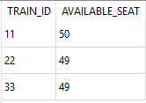
Sample Query
Question : AVAILABLE SEAT ON 2016-11-22 AT 5:06
Query : SELECT TRAIN_ID, TOTAL_SEAT-(SELECT COUNT (TRAVEL_NO) FROM TRAVEL_INFO WHERE TRAVEL_INFO.TRAIN_ID=TRAIN_INFO.TRAIN_ID AND DATE="2016-11-22" AND TIME="5:06") AS AVAILABLE_SEAT FROM TRAIN_INFO;

Slide 15
Sample Query
Question 01:
Query :

