Slide 1

CINEPOLIS
Online Ticket Booking System

Slide 2
Index
Company Profile
PHP
Working of PHP
Existing things.
Project Description
Objective
Existing Vs. Our System
Technology
WAMPP
Snapshots
Future Prospects

Slide 3
About Company
Company Name
D-Link Institute
CEO
Mr Sahil Mahajan
Certificate
ISO 9001:2000 Certified
Services
Asp.Net, VB.Net, Java, PHP, Oracle, Embedded Systems, Networking, Auto-Cad, Pro-E,CATIA & STADD-Pro.

Slide 4


Slide 5
Advantages of PHP
Only Web development
Open Source
There are good tools available
Codes and solutions are easily available
Fast installation and setup for development
Lots and lots of knowledge and documentation
Widely available
Speed of development

Slide 6
Server Side language demand distribution graph

Slide 7


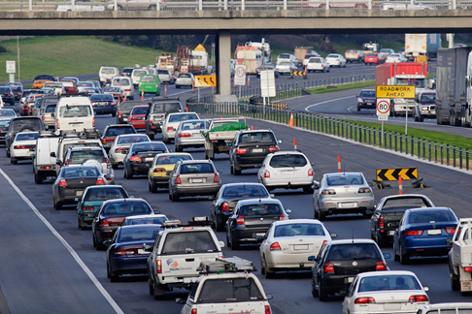
BUYING TICKET FROM THEATER
Wastage Of Fuel. Wastage Of Time. Leads to Traffic.

Slide 8
Title and Content Layout with Chart

Slide 9
About Project
Web-related application that permits us to book movie tickets online .
System stores the records of Various movies that are showing.
Separate selection of seats available.
Users also have a facility of changing their passwords.
Users can also find location of various Theaters of Cinepolis in country.

Slide 10
OBJECTIVE
The main purpose of our online ticket booking system is to provide another way for the customer to buy cinema ticket. It is an automatic system.
Less Time Consuming.
To provide a anytime anyplace service for the customer
To minimize the number of staff at the ticket box
Several controls help the application to be friendly to the users.
To increase the profit.
To obtain statistic information from the booking record.
Internet access is possible.
To promote the film on the internet

Slide 11
EXISTING SYSTEM VS OUR SYSTEM
EXISTING SYSTEM | OUR SYSTEM
In existing System it is very time consuming, and tough job | Our system Consumes less Time, and it is very simple.
In existing system if user has to buy a ticket then he had to travel through the cinema. | In our System user can book Ticket from anywhere.
Our system is very user friendly and interactive which any one can use and understand.

Slide 12
TECHONOLOGY BUILD THE PROJECT
BACK END
MySQL(database)
PHP
HTML & CSS
Java Script
FRONT END

Slide 13
TECHONOLOGY BUILD THE PROJECT
Sublime text
Google chrome
Wamp Server

Slide 14
WAMP Server
WAMP Server is a free and open source cross platform web application.
WAMP Server is used for web development on our local machine.
WAMP Server is an acronym for
W
A
M
P
Apache Http Server
MySQL
PHP
Windows

Slide 15
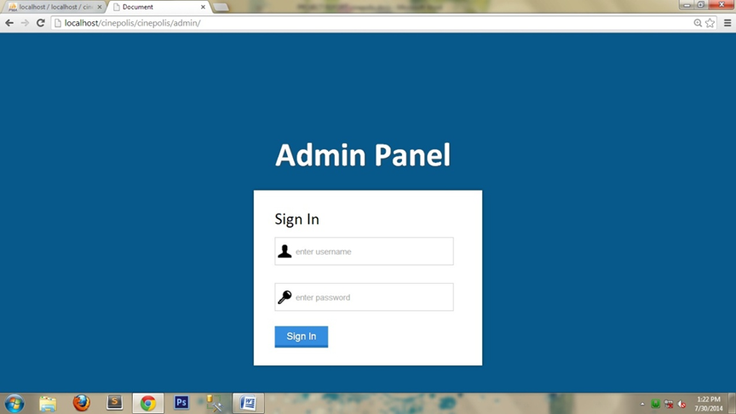
Snapshots
Admin Panel

Slide 16
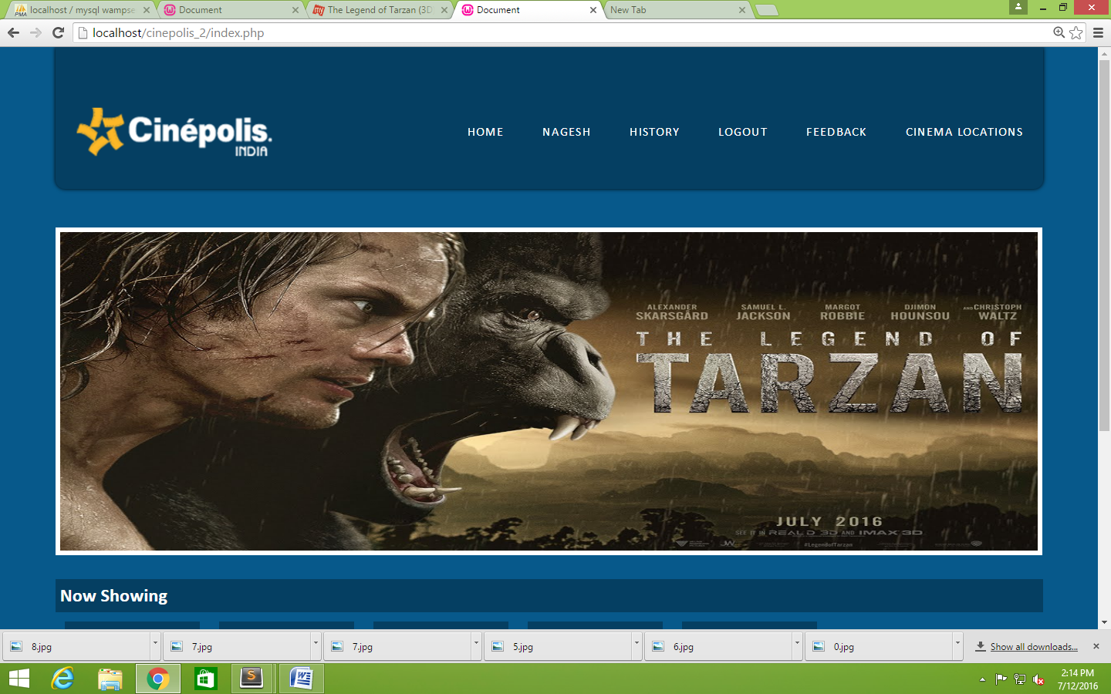
Snapshots
Home Page

Slide 17
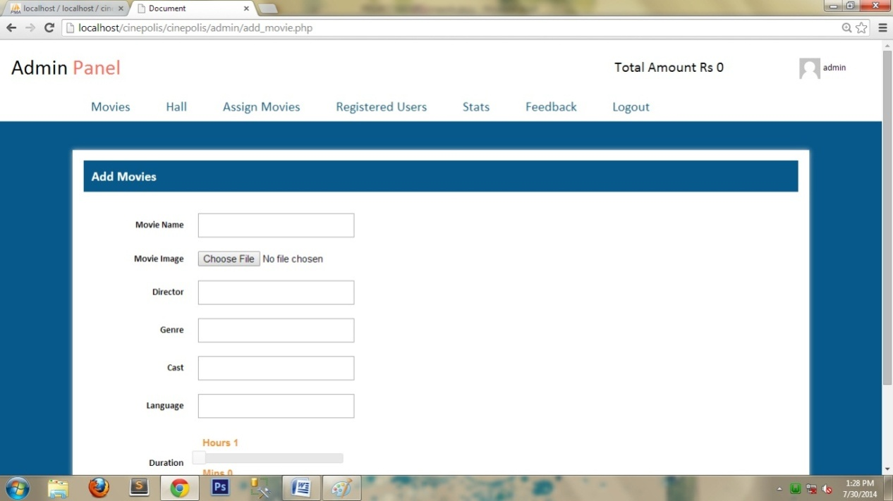
Snapshots
Add Movies

Slide 18
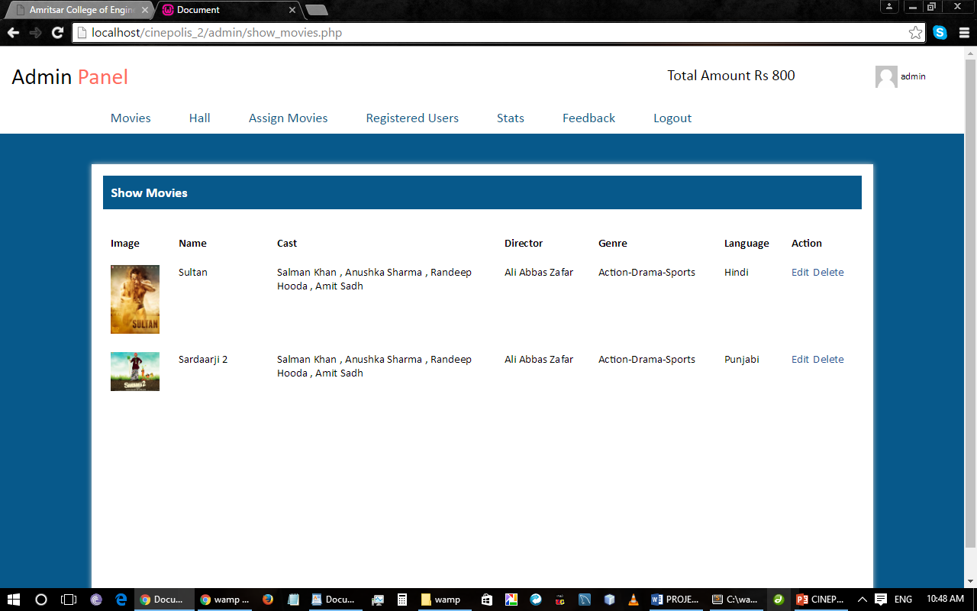
Snapshots
Show Movies

Slide 19
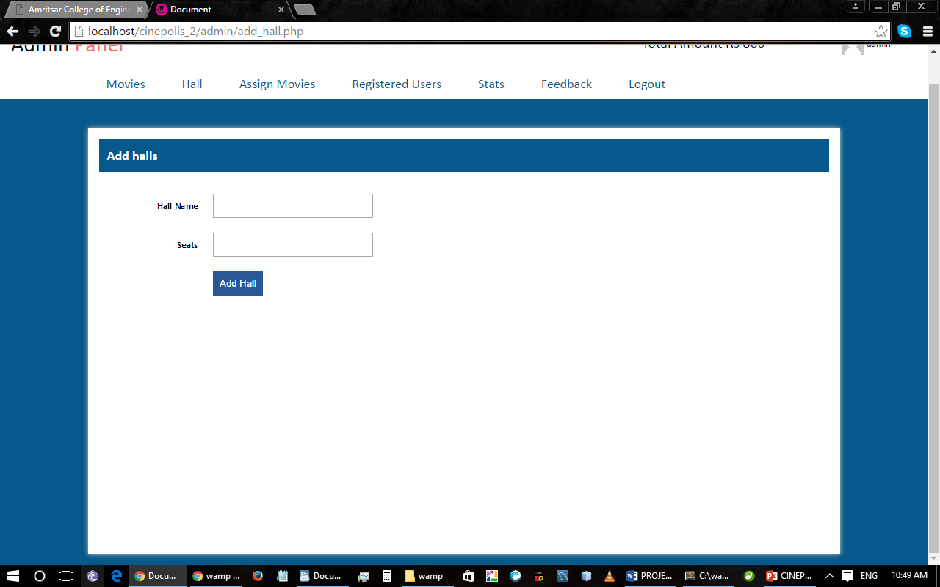
Snapshots
Add Hall

Slide 20
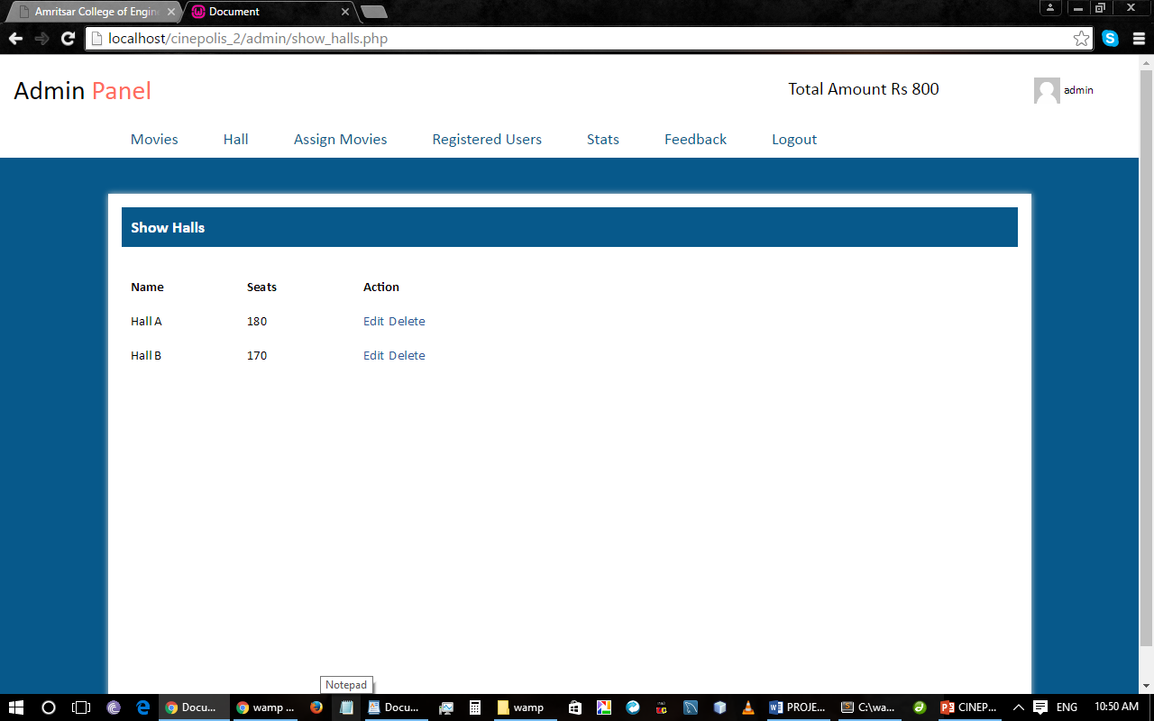
Snapshots
Show Hall

Slide 21
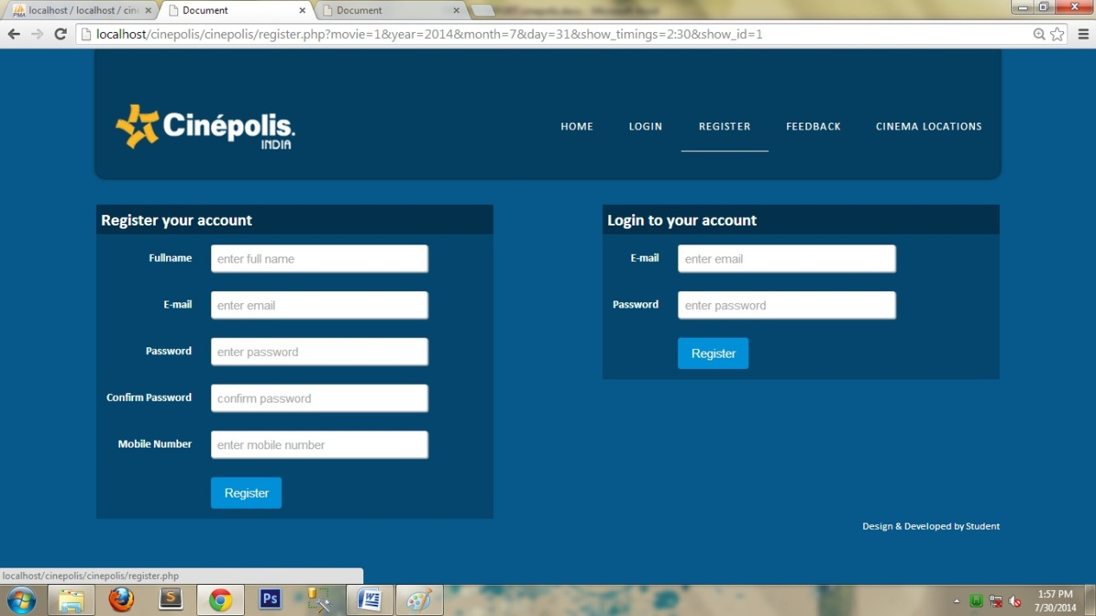
Snapshots
Login or Sign Up

Slide 22
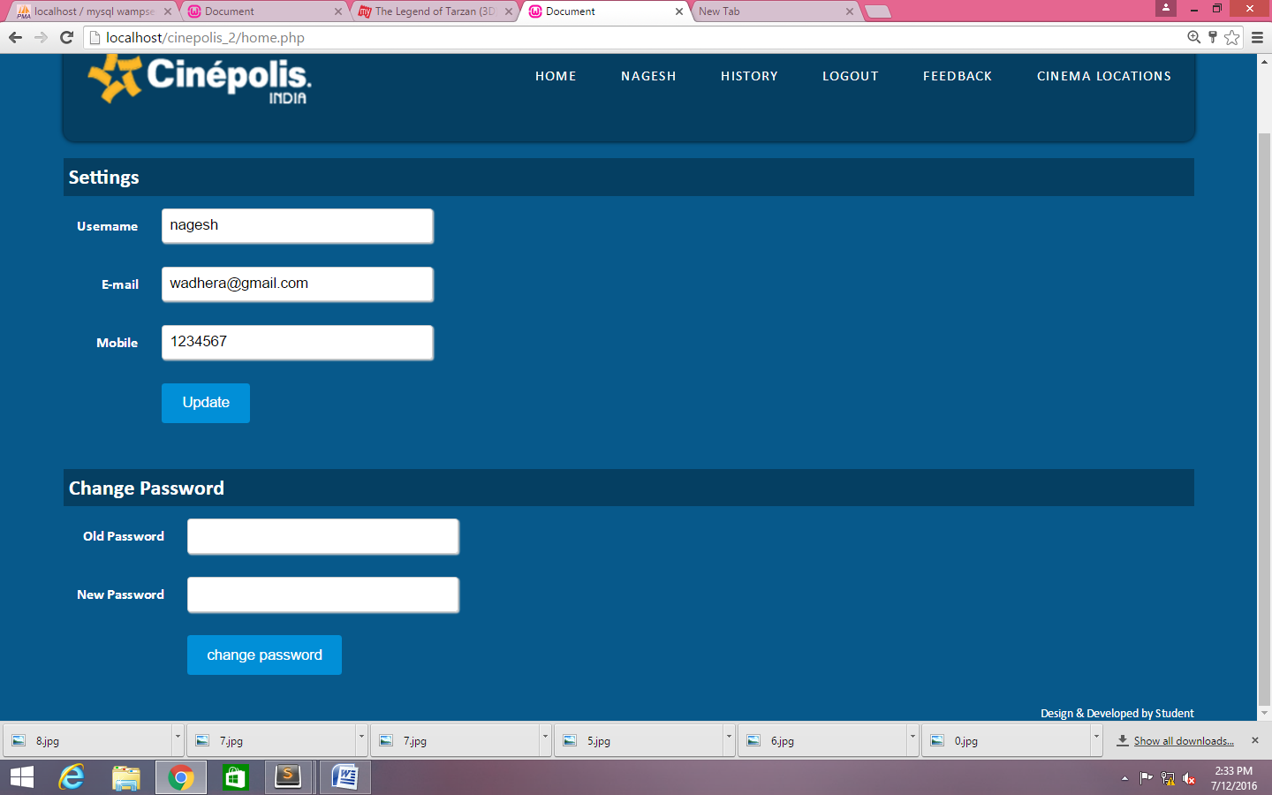
Snapshots
User Settings

Slide 23
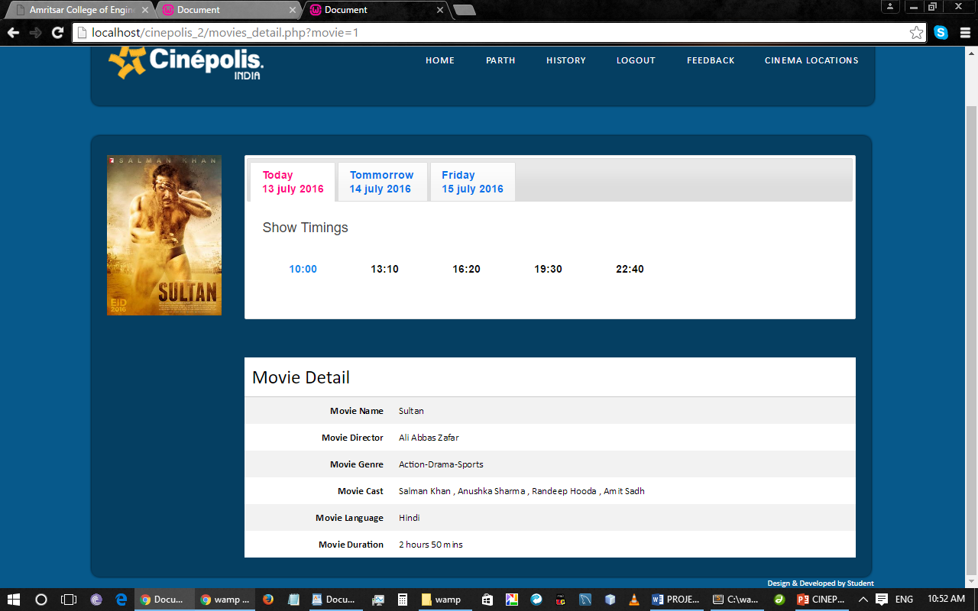
Snapshots
Show Timings

Slide 24
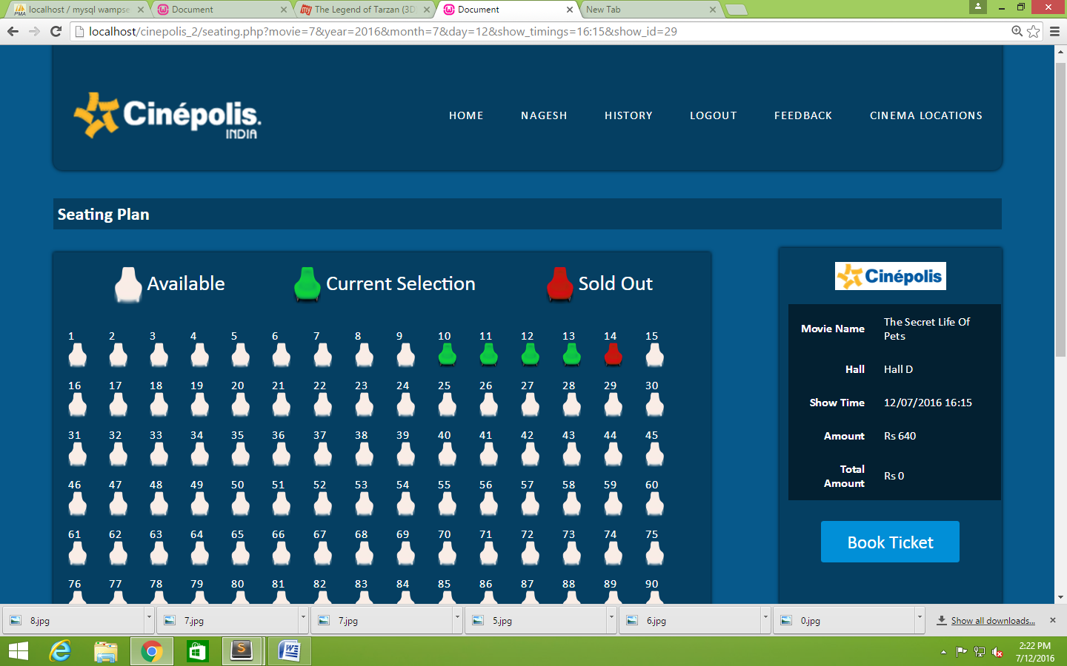
Snapshots
Seeting Plan

Slide 25
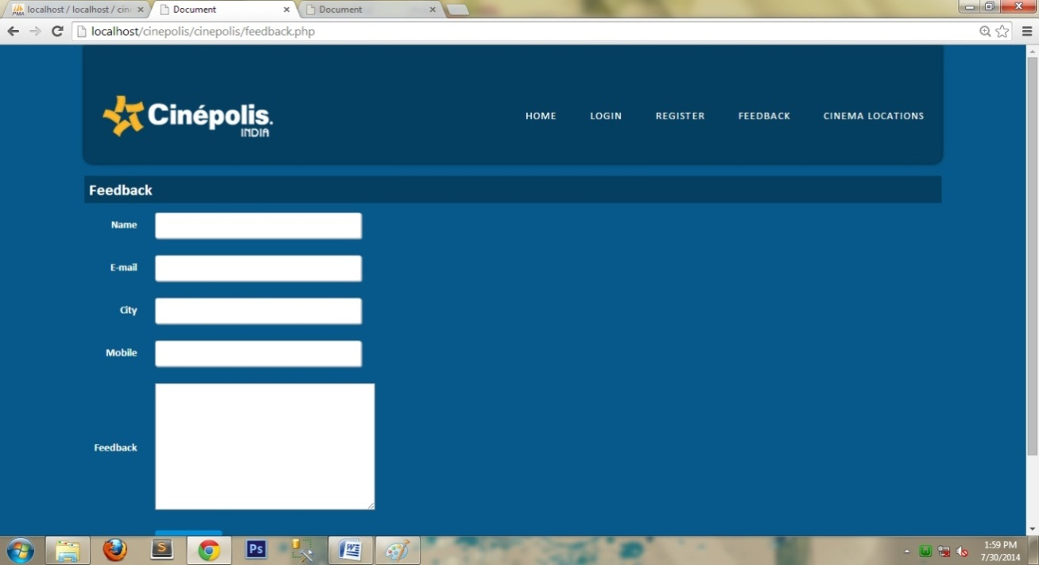
Snapshots
Seeting Plan

Slide 26
Future Prospects
The future prospects of our management system is to shift it to the live server so that it should be easy for the people to access it.
The next part would be that to add other tickets also like online booking etc.
We would also like to connect with other theaters also.

