Slide 1

Slopsquatting Shield
Stopping AI-invented software packages before they reach your computer
Logic League Ideathon | Cybersecurity: Software Supply Chain
Notes:
Introduce the project: a tool that checks AI-suggested packages before you install them.

Slide 2

Problem: AI invents packages
Developers ask AI for code, then copy the install command.
AI can hallucinate: it suggests names that sound real but do not exist.
Beginners rarely double-check before pressing Enter.
How do I read a PDF in Python?
Sure! Install this package:
pip install pdf-reader-pro
Slopsquatting = slop + squatting. Slop is made-up AI output; squatting is grabbing a name before its owner.
This package does not exist
Notes:
The AI sounds confident, but the name does not exist. Slopsquatting is the attack built on this mistake.

Slide 3
Problem: how the attack works
1
2
3
4
AI invents a name
Hacker registers it
Malware is hidden inside
Victim installs it
It suggests a package that sounds real but does not exist.
AI repeats the same fake names, so hackers can predict them.
The fake package is uploaded to PyPI or npm with bad code.
Copying the AI's command runs the malware automatically.
What it can cause: stolen passwords and API keys, malware and ransomware, compromised company pipelines.
Notes:
Key point: the AI repeats the same invented names, which is what makes the attack practical. No typo is involved.

Slide 4
Existing solutions and the gap
Existing tool | What it does | Why it falls short here
npm audit, pip-audit, Dependabot | Flag known vulnerabilities | A newly registered fake package has no known vulnerability yet
Software-composition scanners | Analyse package risk | Often run at pull-request or CI time, after the dependency is added
Typosquatting detectors | Compare names with popular packages | AI-invented names are usually not a typo of any real name
Manual checking | Developer reads the package page | Slow, inconsistent, and rarely done by beginners
The gap: nothing checks a package name between the AI's suggestion and the install command.
Notes:
Existing tools are good at what they do, but none treats 'an AI may have invented this name' as a risk signal before installation.

Slide 5
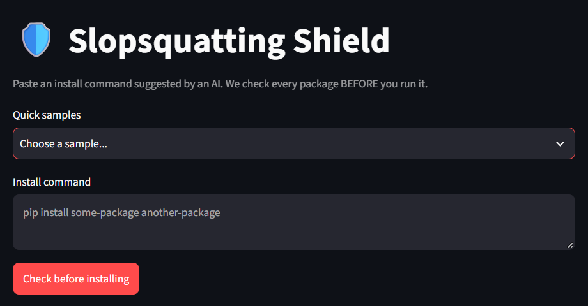



Proposed solution: a guard
BLOCK
Does not exist or is highly risky: do not install.
WARN
Exists but looks suspicious: new, no source code, little history.
ALLOW
Old, trusted and linked to a public source repository.
Working prototype: paste a command, get a verdict with reasons and a 'Did you mean' fix
Notes:
The tool sits between the AI's suggestion and the install command. Every verdict comes with plain-English reasons.

Slide 6
Technical approach
1
Read the command
Warning sign | Points
Package does not exist | BLOCK
Name on AI-invented list | +40
Under 30 days old | +25
No source repository | +15
Install-time script (npm) | +10
1+ year old, 10+ releases | -30
Extracts names from pip or npm text
2
Ask the real registry
PyPI or npm: exists? age? source repo?
3
Check the AI-invented list
Flags names AIs commonly make up
4
Score the risk
Adds points for each warning sign
5
Explain the verdict
Score 60+ = BLOCK | 25+ = WARN | below 25 = ALLOW
Green, yellow or red, with reasons
Notes:
The scoring is transparent: every point comes from a visible reason shown to the user, so it is easy to explain and tune.

Slide 7
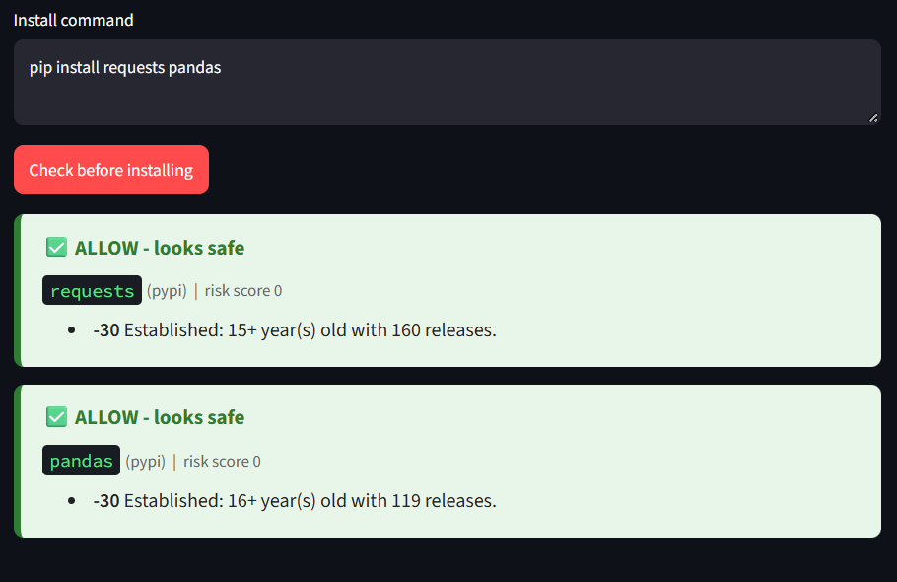
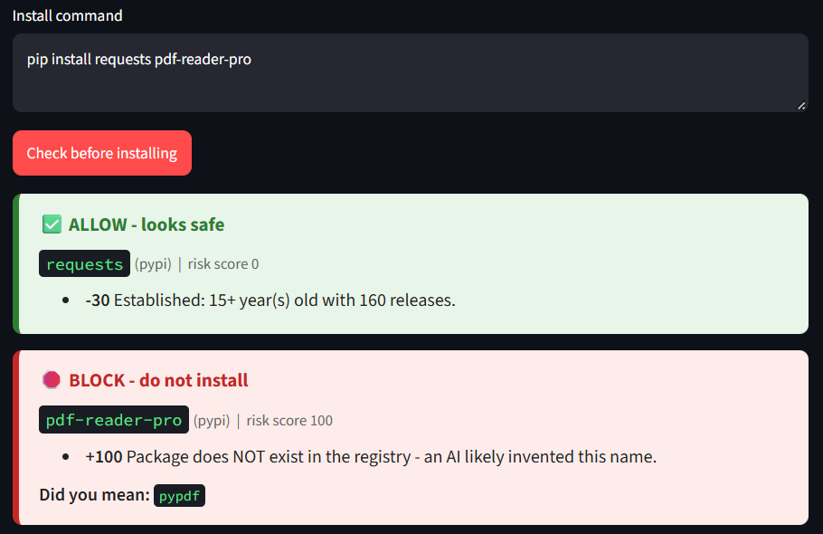
Prototype results: PyPI
Trusted packages: both ALLOW, risk score 0
Fake package: BLOCK, risk score 100, with a 'Did you mean: pypdf' fix
Notes:
Left: real, long-established packages pass. Right: the invented name was checked live against PyPI and does not exist. Present it as an example of an invented name; only name a specific chatbot if you verified it.

Slide 8
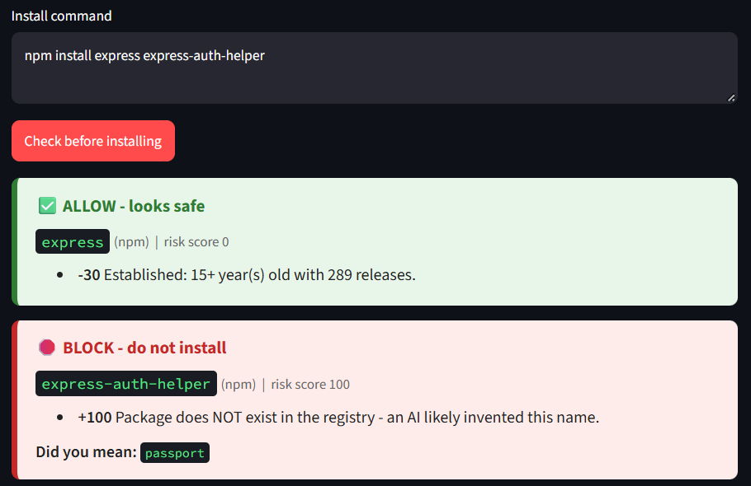
Prototype results: npm
COMMAND TESTED
npm install express express-auth-helper
express: ALLOW, 15+ years old, 289 releases
express-auth-helper: BLOCK, risk score 100
Not found in the npm registry
Suggests the real package: passport
Notes:
Same logic works for JavaScript. The registry lookup is live, so results reflect the real state of npm.

Slide 9






Technology stack
BUILT AND WORKING IN THE PROTOTYPE
PLANNED
VS Code extension (TypeScript)
FastAPI backend
PostgreSQL and cache
GitHub Action for CI
Python 3
Streamlit
Requests
Core logic and command-line tool
Web interface for the demo
Calls the registry APIs
PyPI and npm APIs
JSON list
Regex, shlex, difflib
Live package age, releases, repo
Names AI models commonly invent
Parsing and 'Did you mean'
Notes:
Everything on the left is already running in the demo. The right panel is the roadmap.

Slide 10


Feasibility, limits and impact
Feasibility
Limitations
Impact
Working prototype already built
Uses free public registry APIs
Small codebase a student team can maintain
Transparent scoring, easy to tune
Only PyPI and npm today
New but legitimate packages may get warnings
Checks metadata, not the package code
Needs internet and a maintained names list
Stops the attack before any code runs
Protects beginners who copy-paste AI commands
Teaches safe habits with plain reasons
Names list can be shared with the community
Notes:
Be upfront about limits: it checks registry metadata, not code, and a legitimate new package may trigger a warning, which is why the tool explains its reasons.

