Slide 1
LLMs and Their Pros and Cons
An Overview of Language Models

Slide 2
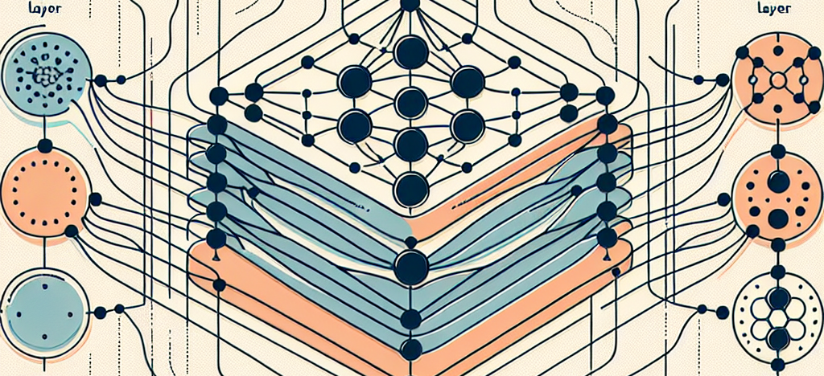
What are Language Models?

Slide 3
Pros of Using LLMs
1. High accuracy in language understanding.
2. Ability to generate human-like text.
3. Versatile applications in various industries.

Slide 4
Cons of Using LLMs
1. Can produce biased or inaccurate content.
2. Require large amounts of data and computing power.
3. Lack of true understanding and reasoning.

Slide 5
Common Applications of LLMs
1. Customer service chatbots.
2. Content creation and summarization.
3. Language translation services.

Slide 6

Evaluating the Impact of LLMs

Slide 7
The Future of LLMs
1. Improved conversational abilities.
2. Enhanced ethical considerations in design.
3. Greater accessibility across languages.

Slide 8
Final Thoughts
1. Continuous research and development are essential.
2. Balancing benefits and risks is key to responsible use.
3. Collaboration across fields will optimize LLM potential.

Slide 9
Key Takeaways
Understanding the landscape of LLMs helps in leveraging their strengths while mitigating risks. They hold immense potential but require careful management.

Slide 10
Resources for Further Learning
1. Academic papers on AI advancements.
2. Online courses on machine learning.
3. Community forums and blogs on LLM developments.
Explore more at: AI research publications, Coursera, and AI community platforms.

