Slide 1

POC
UXReach
Proof of Concept: UXReach Invite Agent

Slide 2
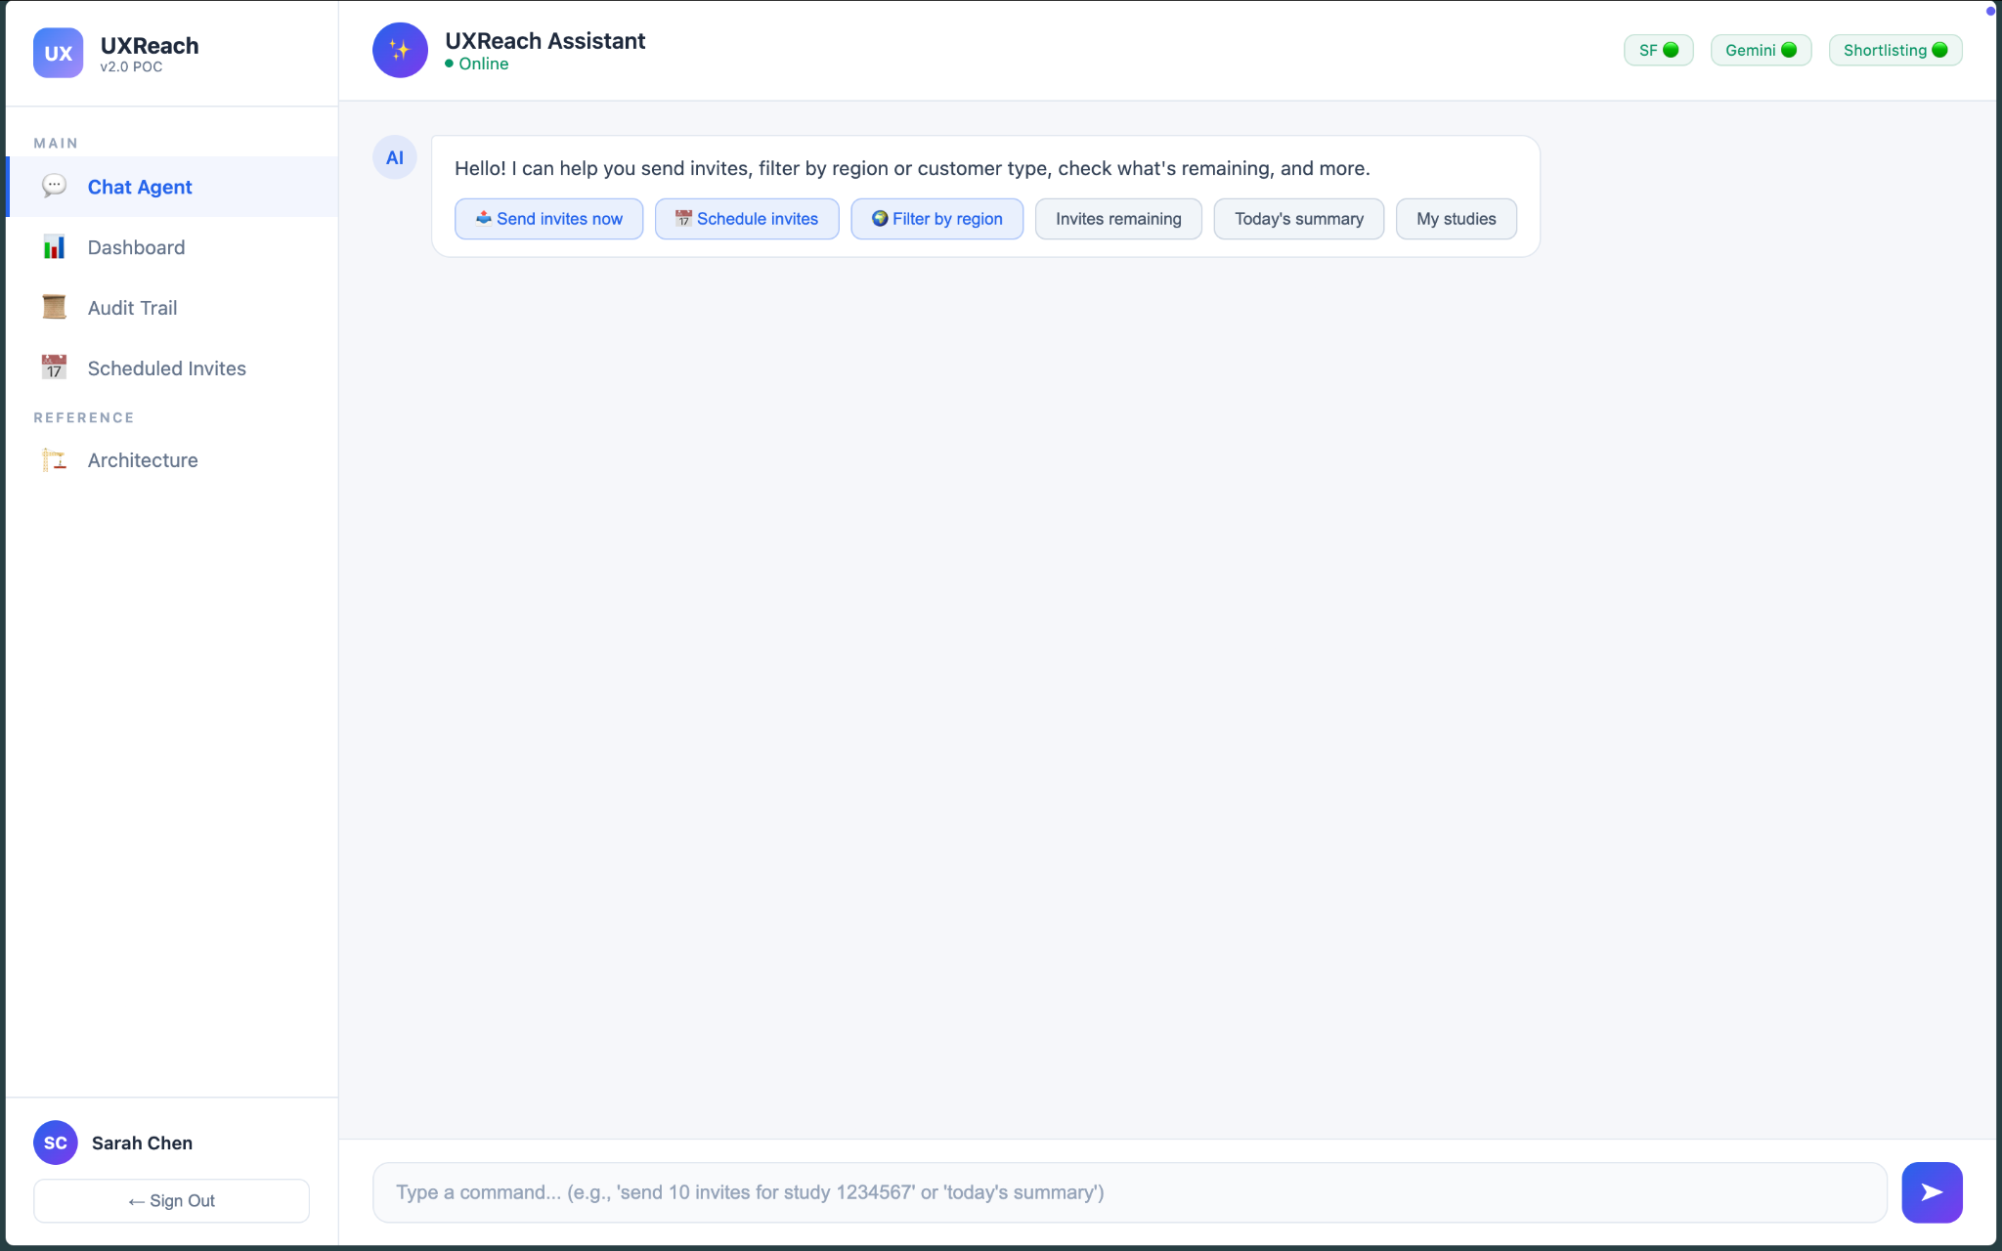
Quick Actions
1. Click here

Slide 3
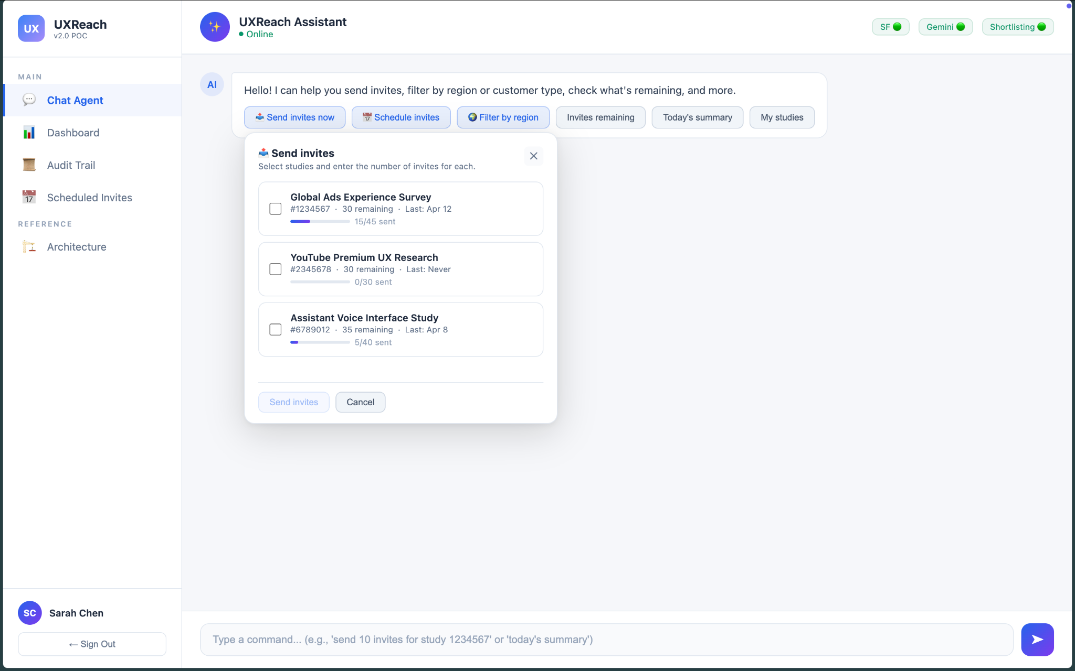
Active Studies

Slide 4
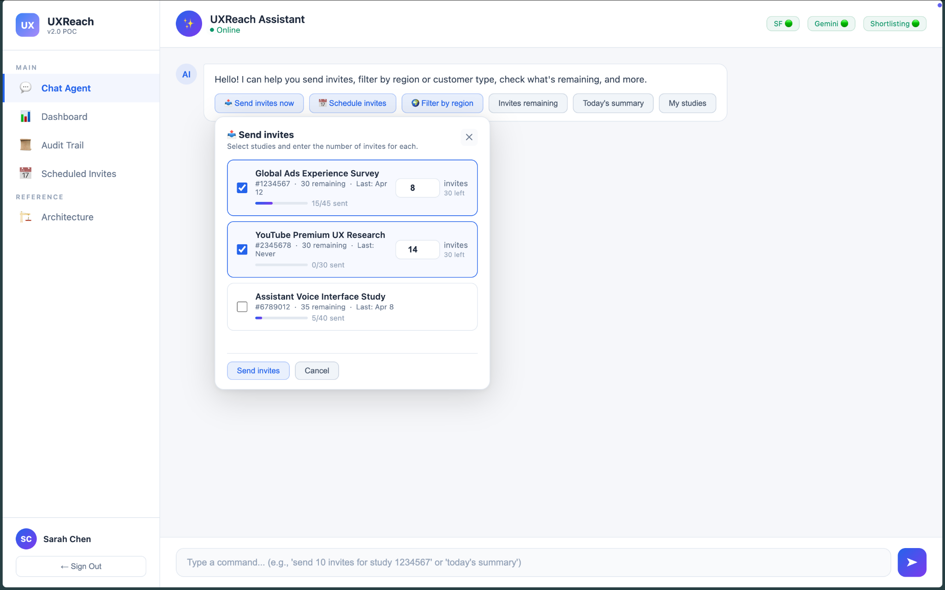
2. Select the studies and number of invites to send
3. Click

Slide 5
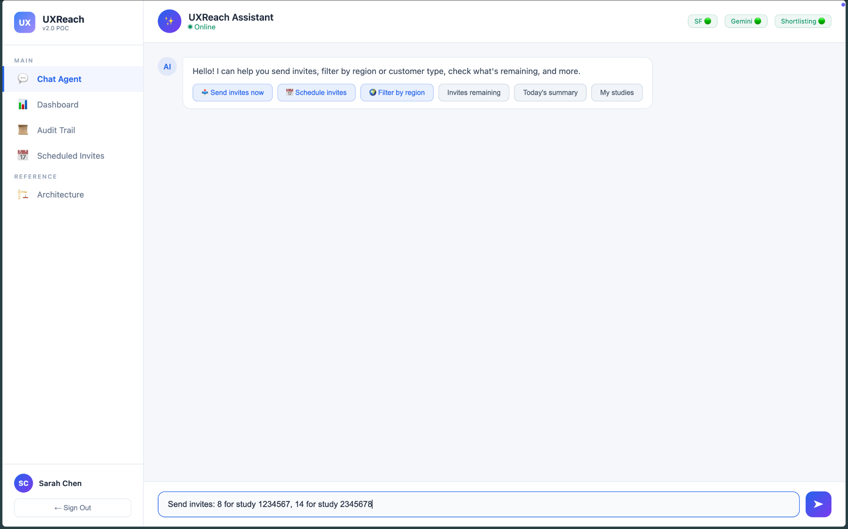
4. Agent generates the prompt. Review/Edit
5. Send

Slide 6
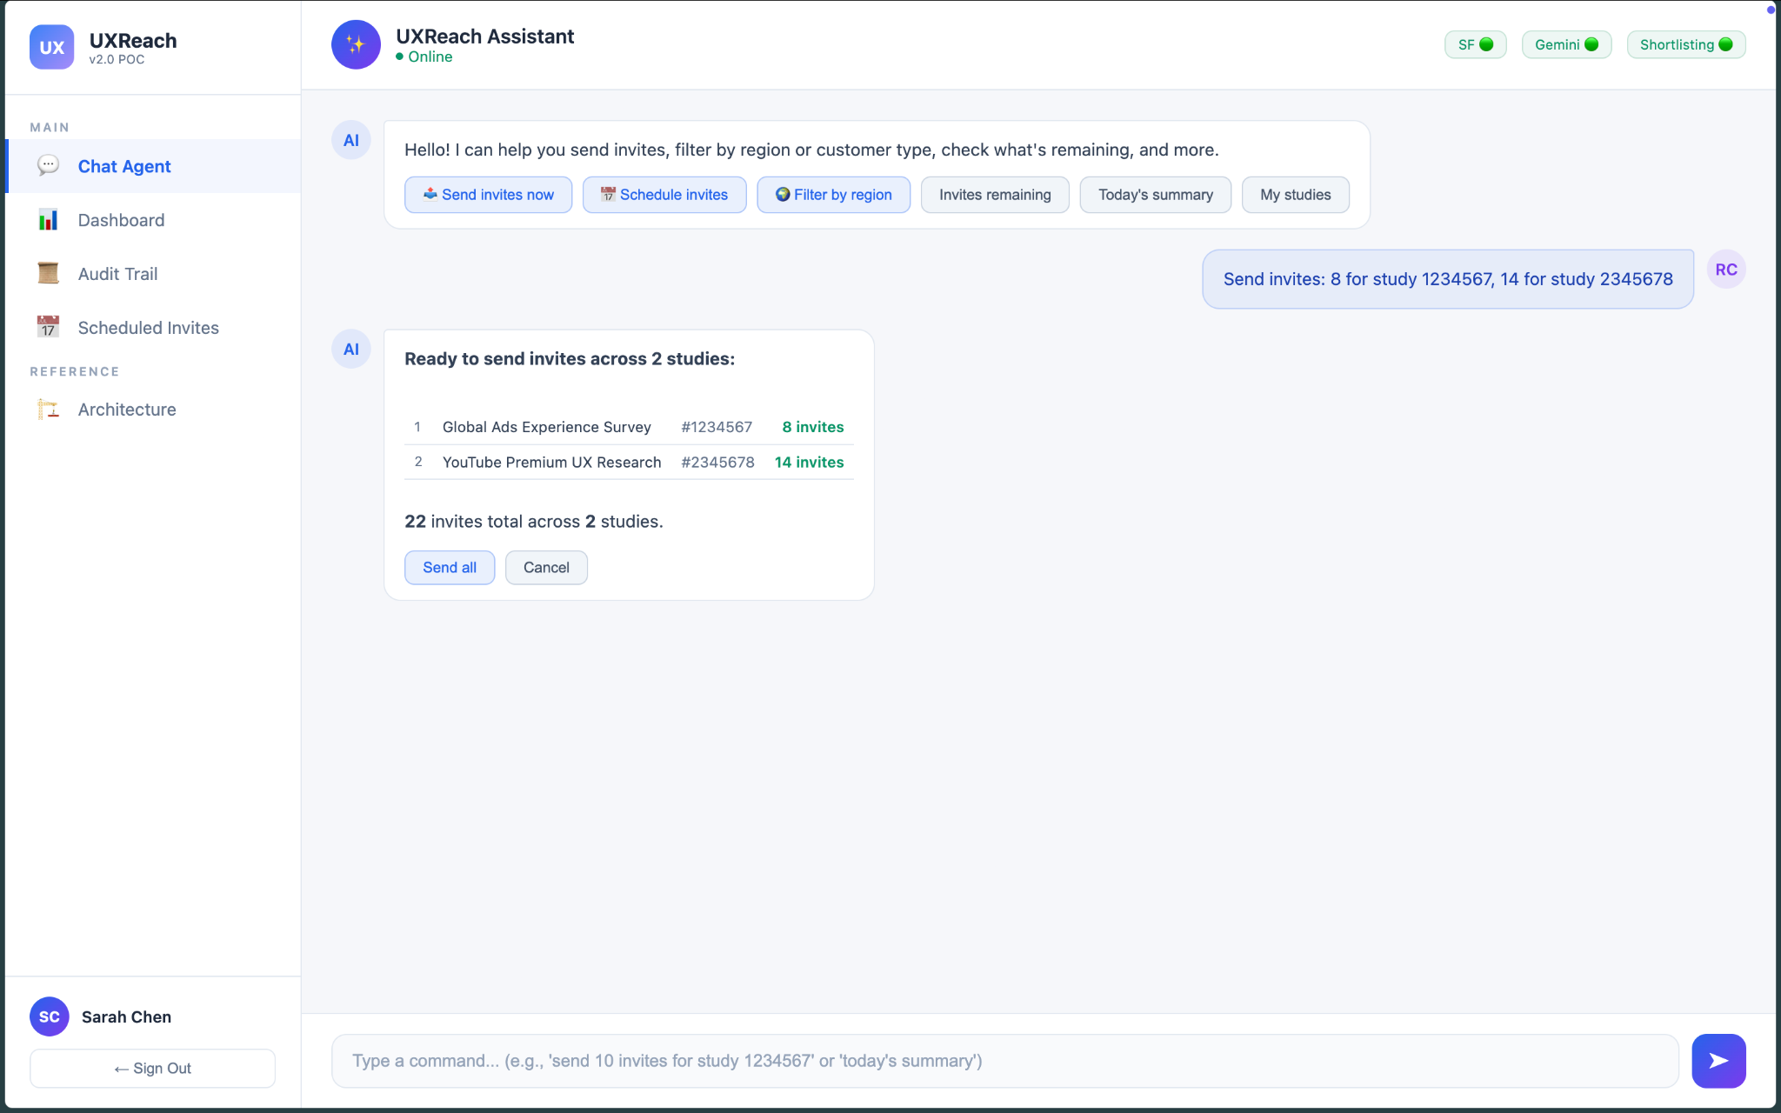
6. Click

Slide 7
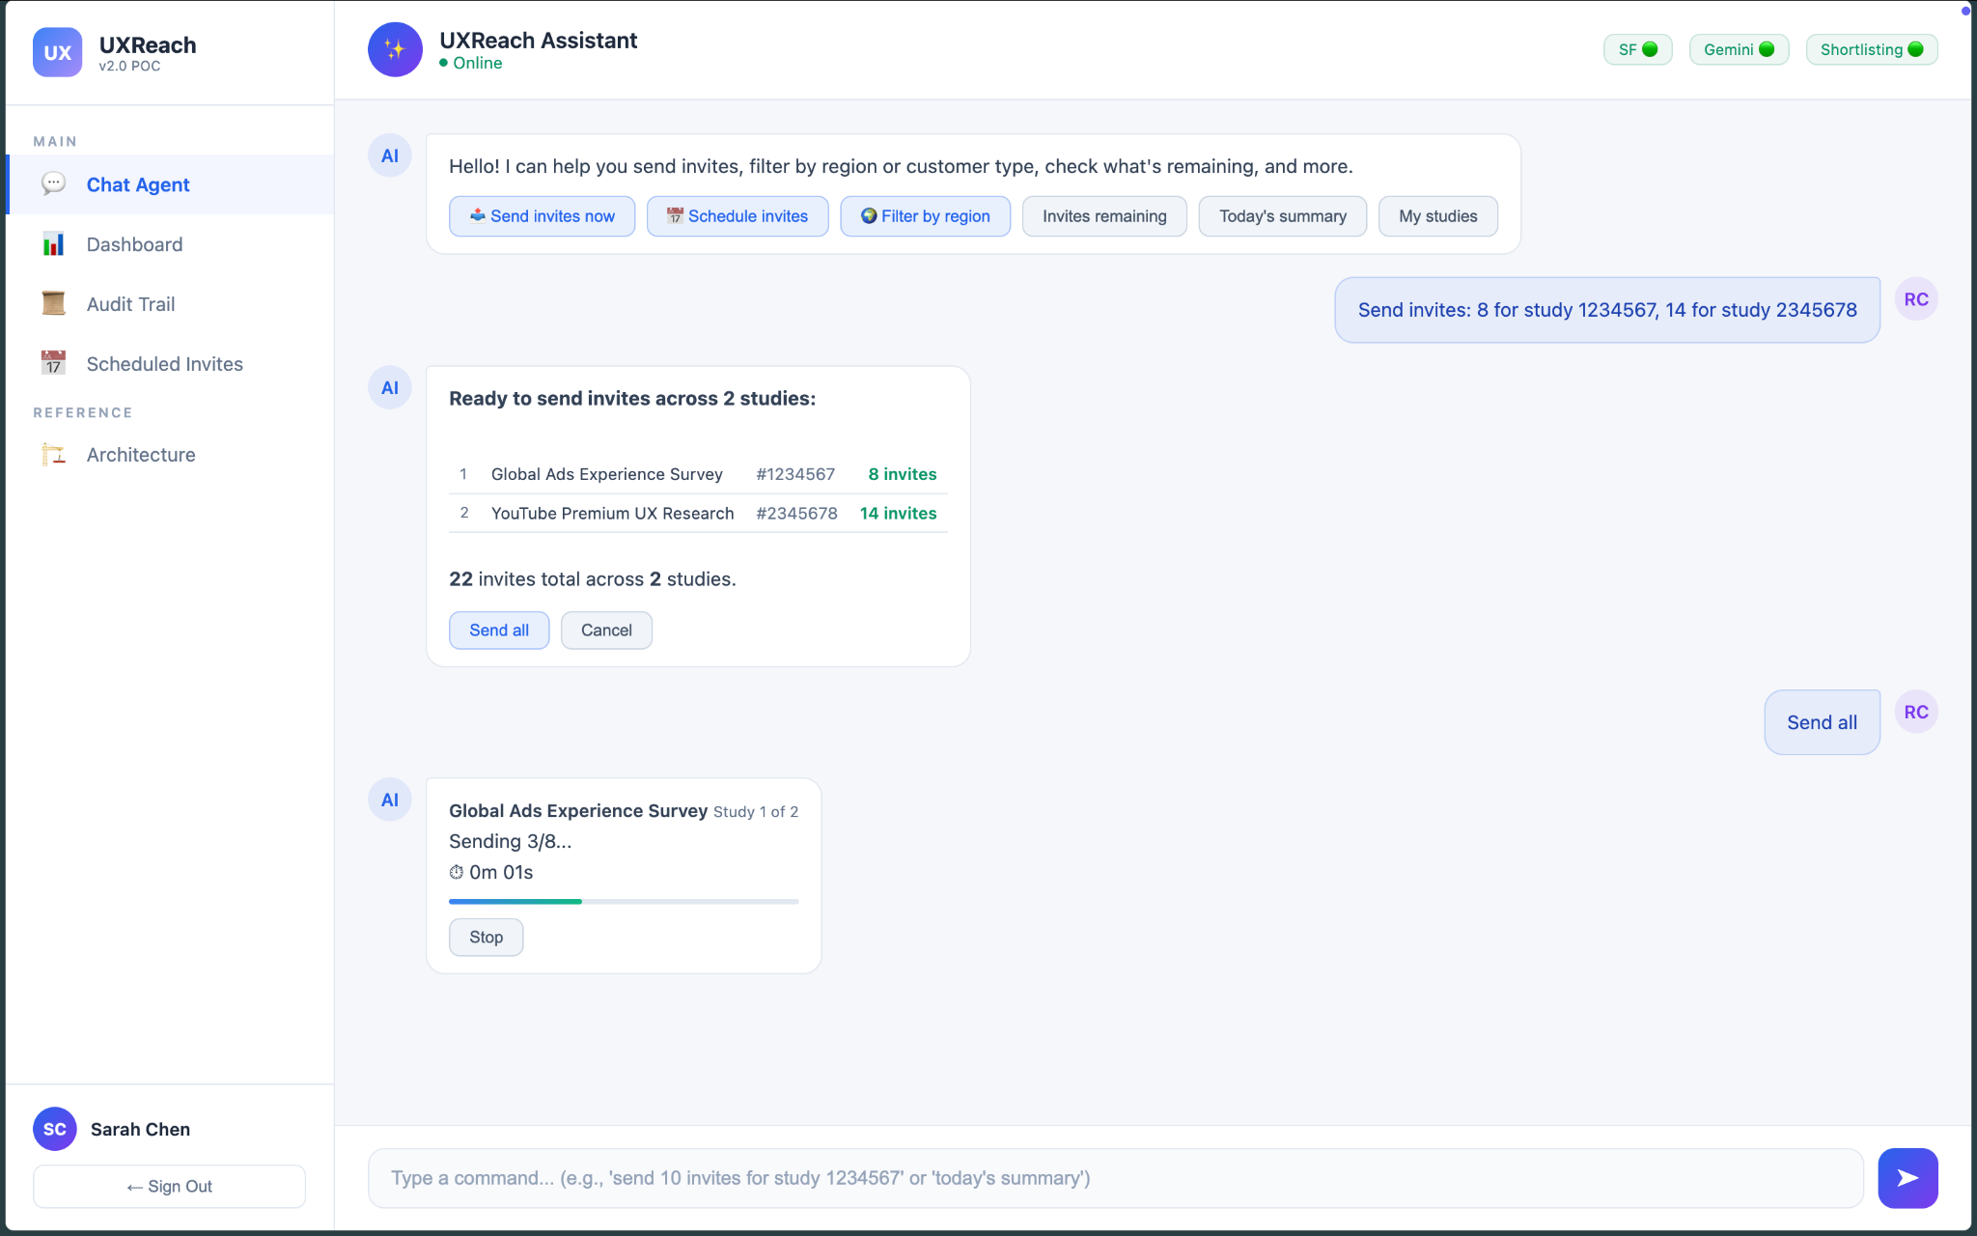
Sending Invites for each study

Slide 8
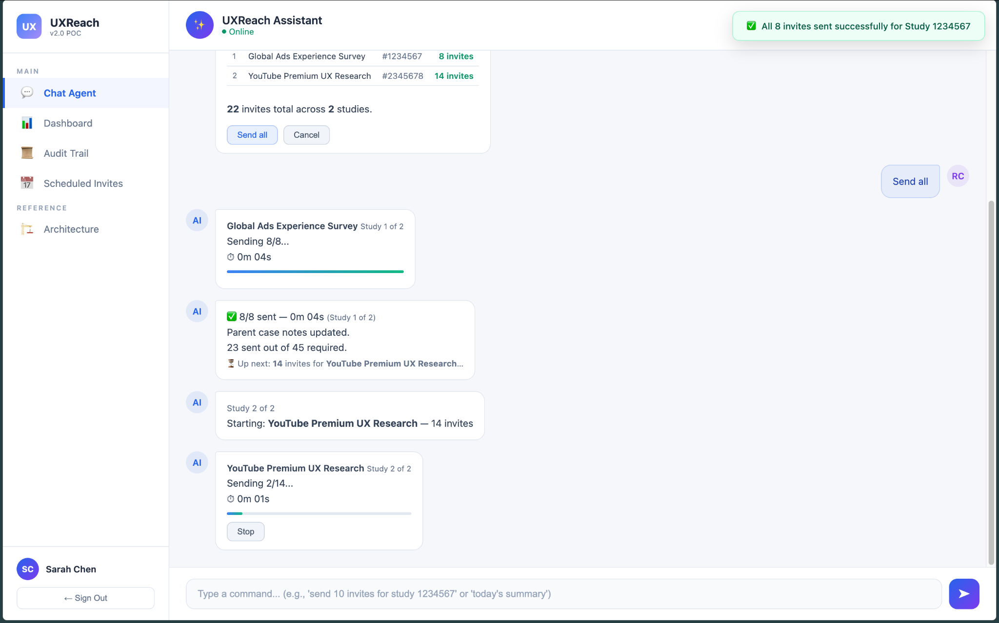
Sending Invites for each study

Slide 9
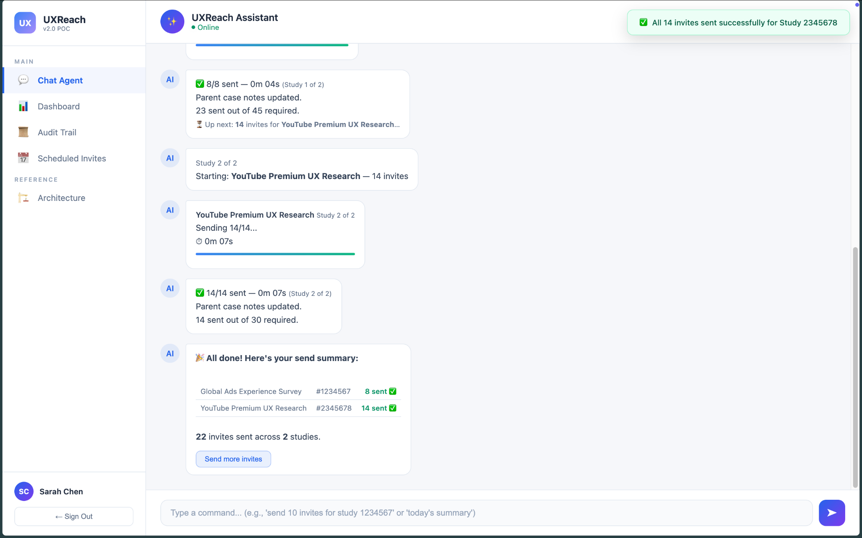
Final summary

Slide 10
Quick Actions
For Scheduling Invites: 1. Click here

Slide 11
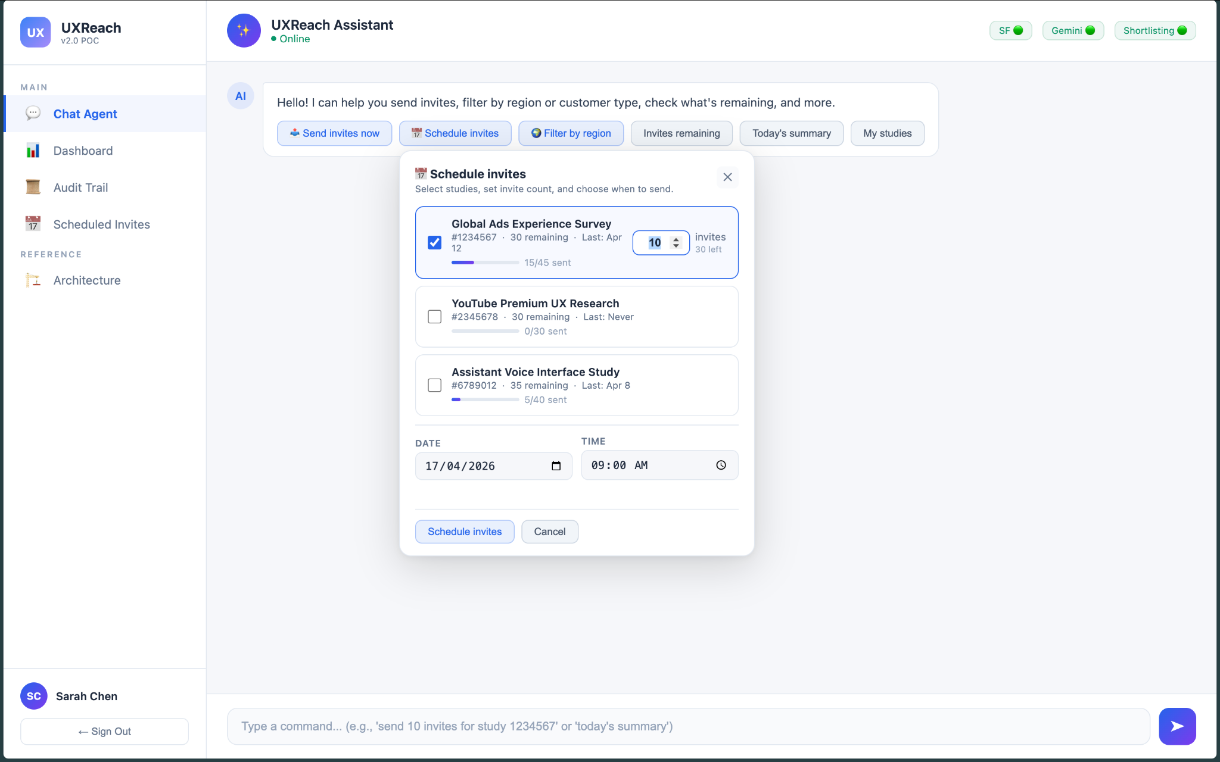
2. Select the studies and number of invites to send
3. Select date & time
4. Click

Slide 12
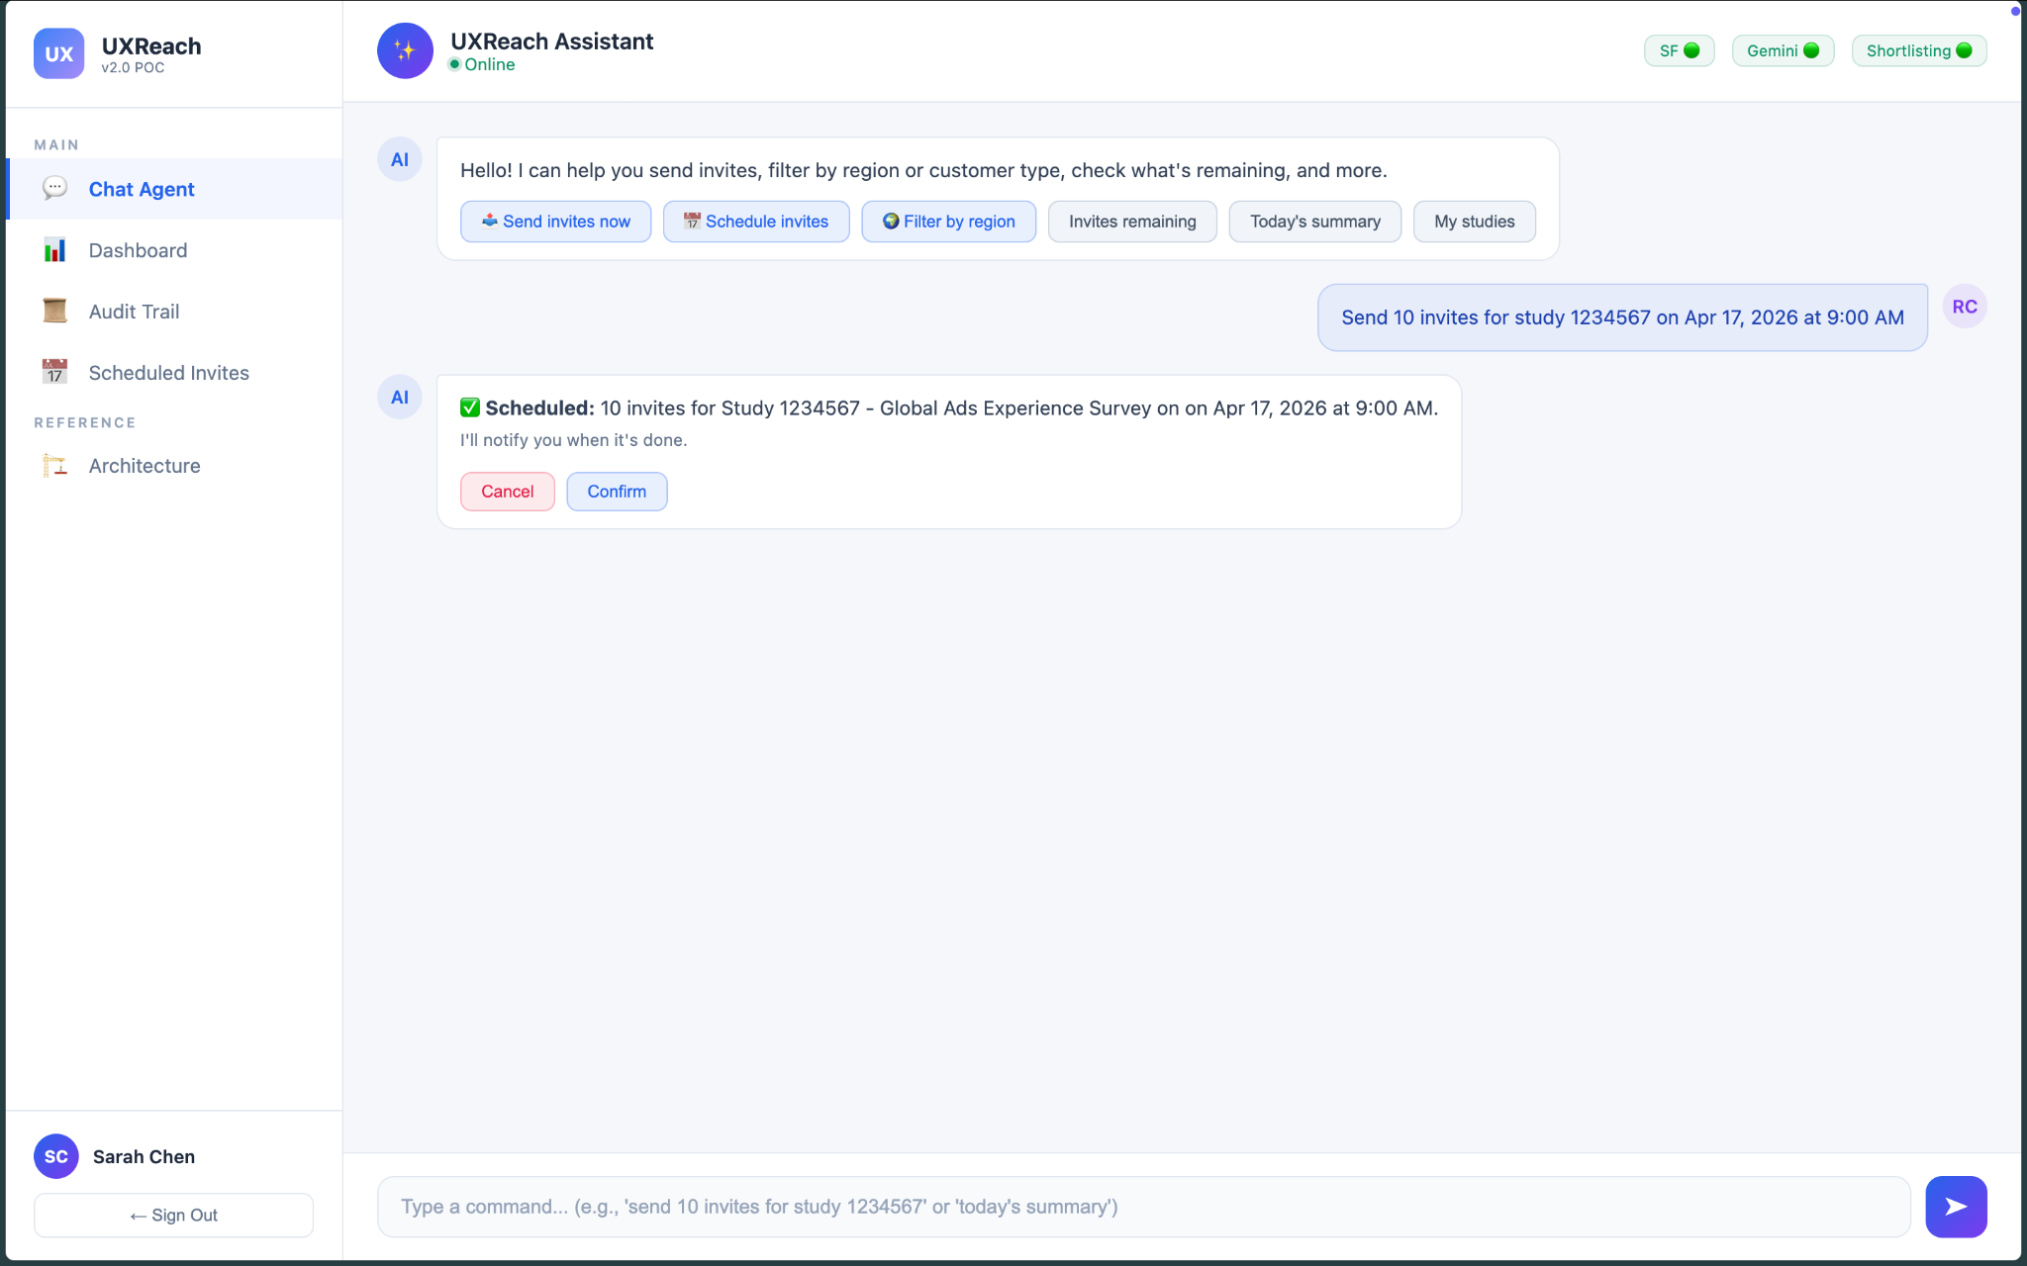
5. Click

Slide 13
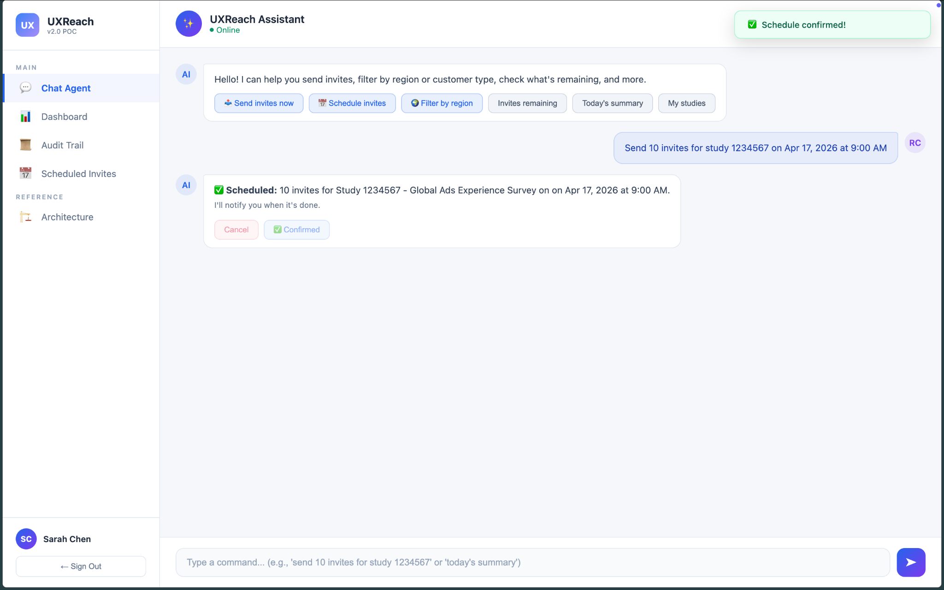
Schedule confirmed

Slide 14
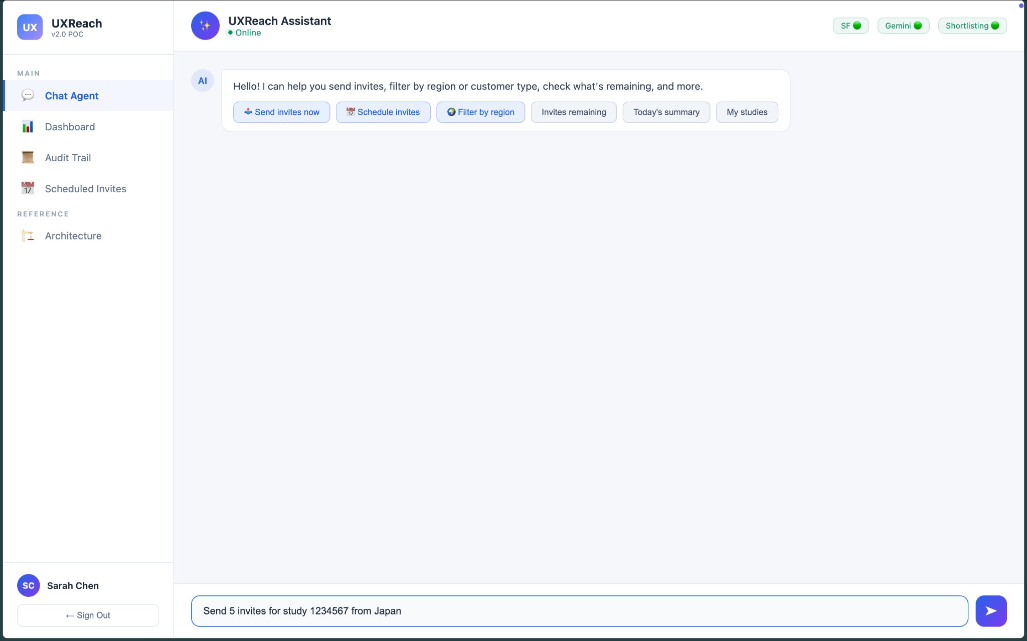
Filter participants: 1. Click
2. Define filters (region, company type, etc.) using a conversational prompt.
3. Send
(Example 1)

Slide 15
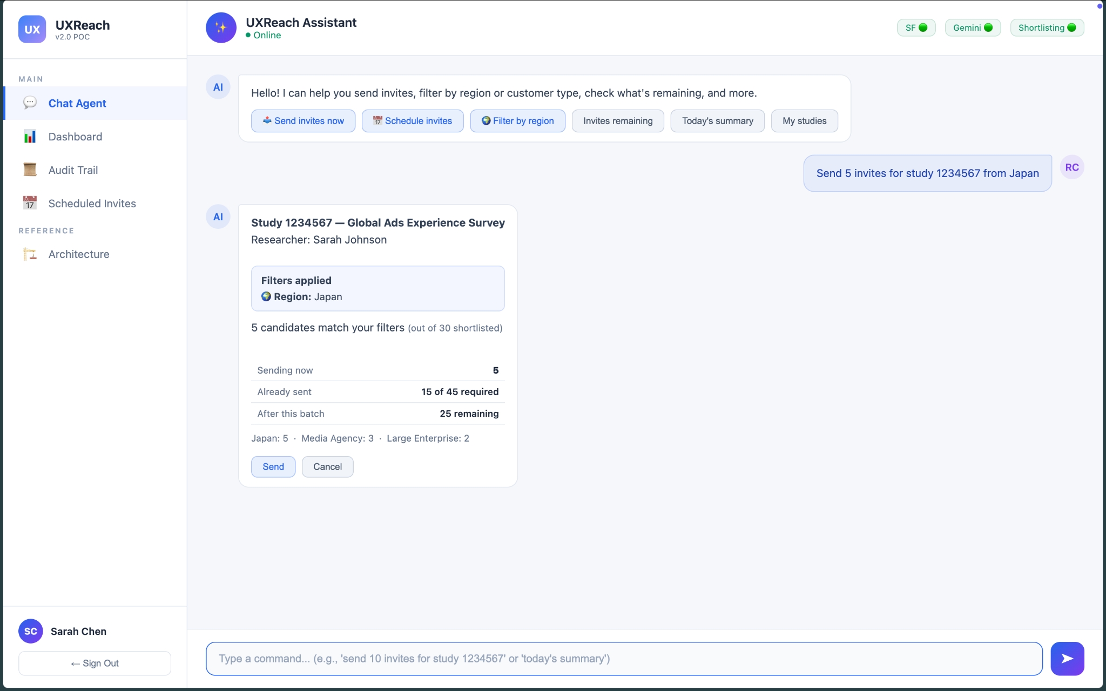
Filters applied
4. Click

Slide 16
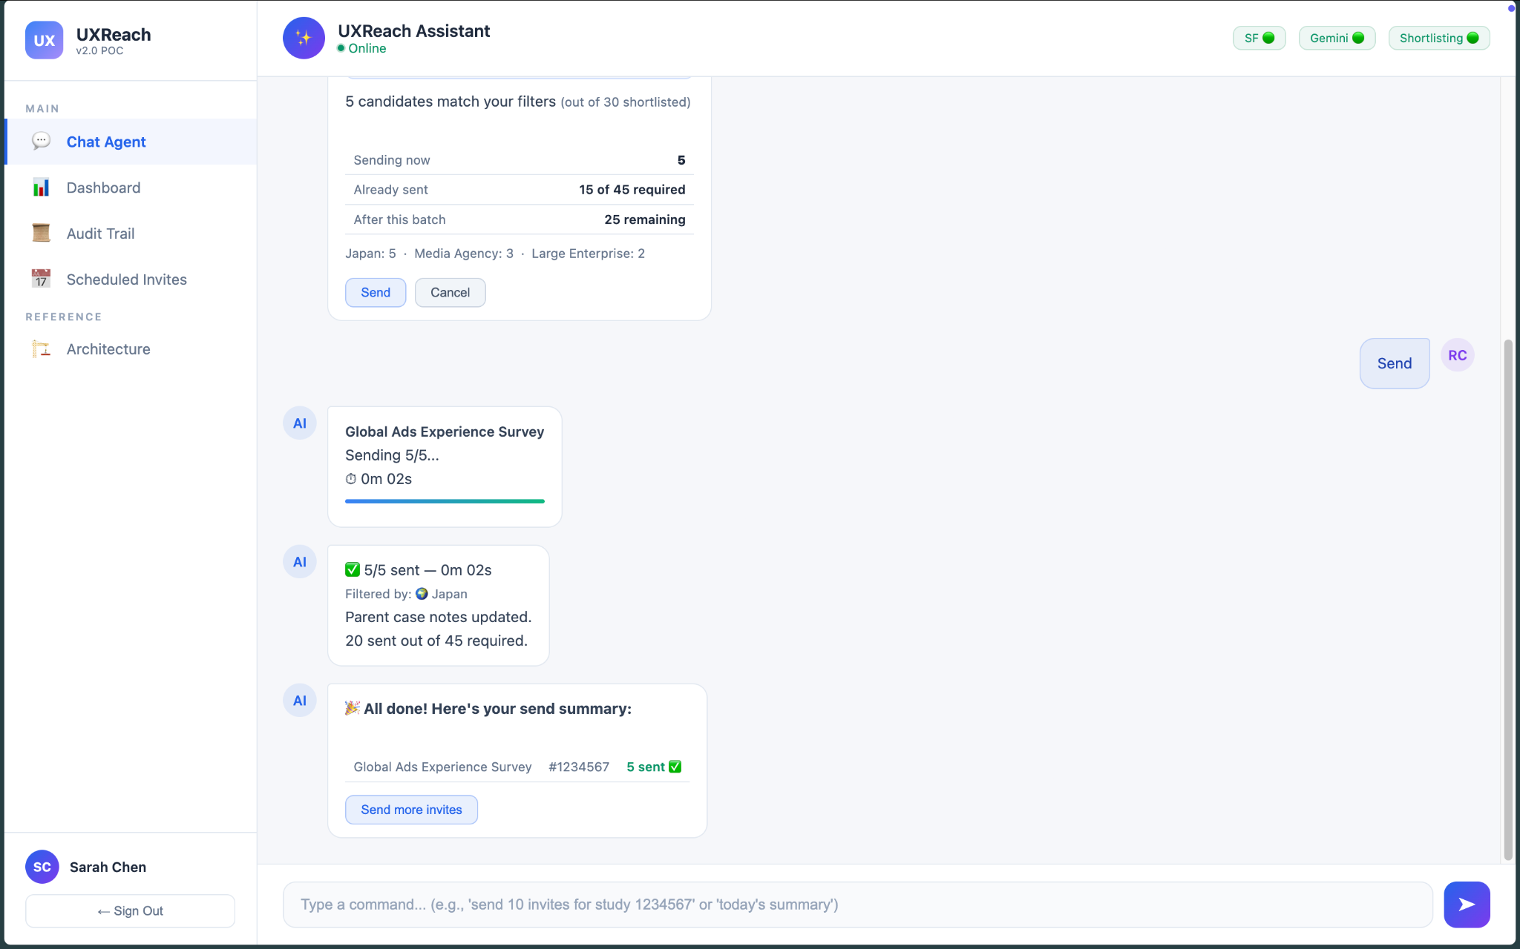
Invites sent

Slide 17
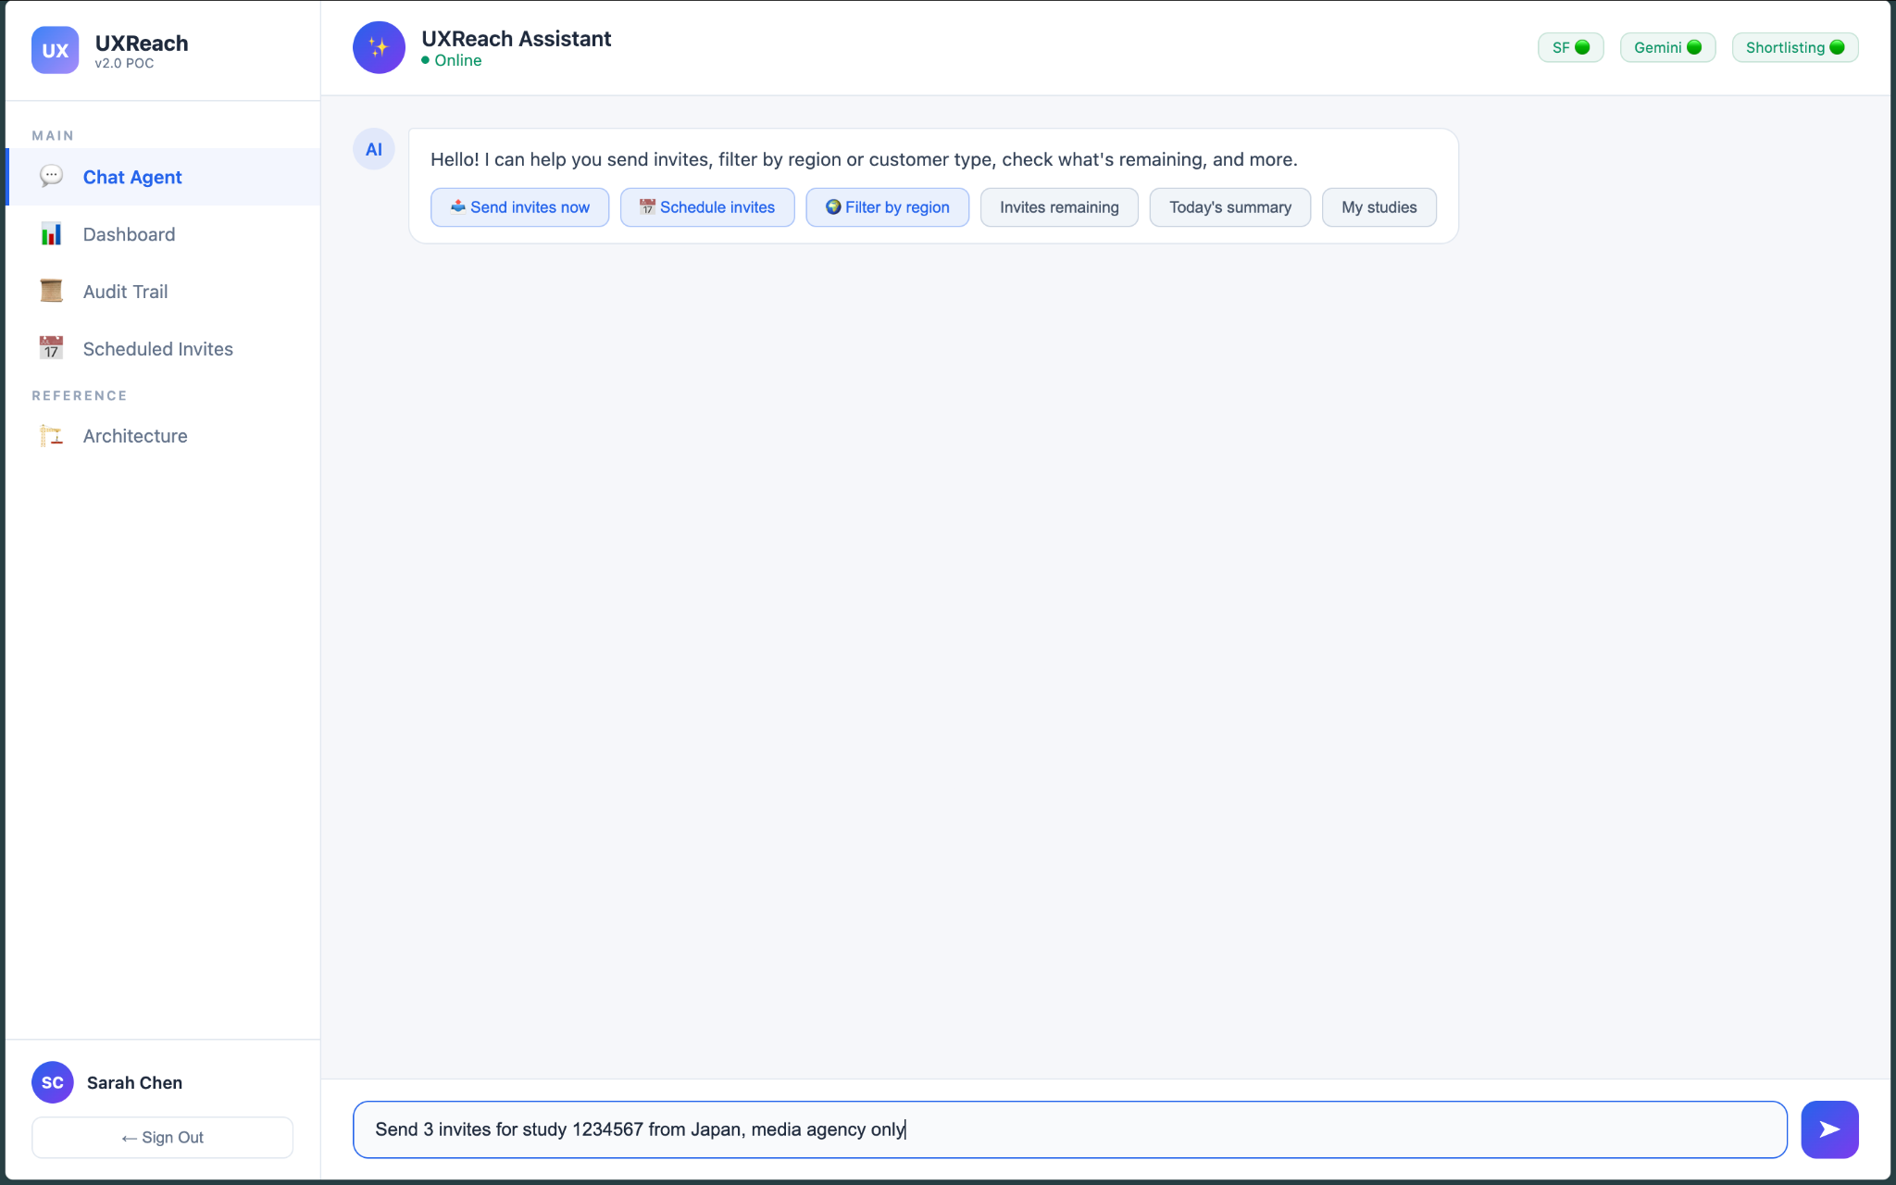
Filter participants: 1. Click
2. Define filters (region, company type, etc.) using a conversational prompt.
3. Send
(Example 2)

Slide 18
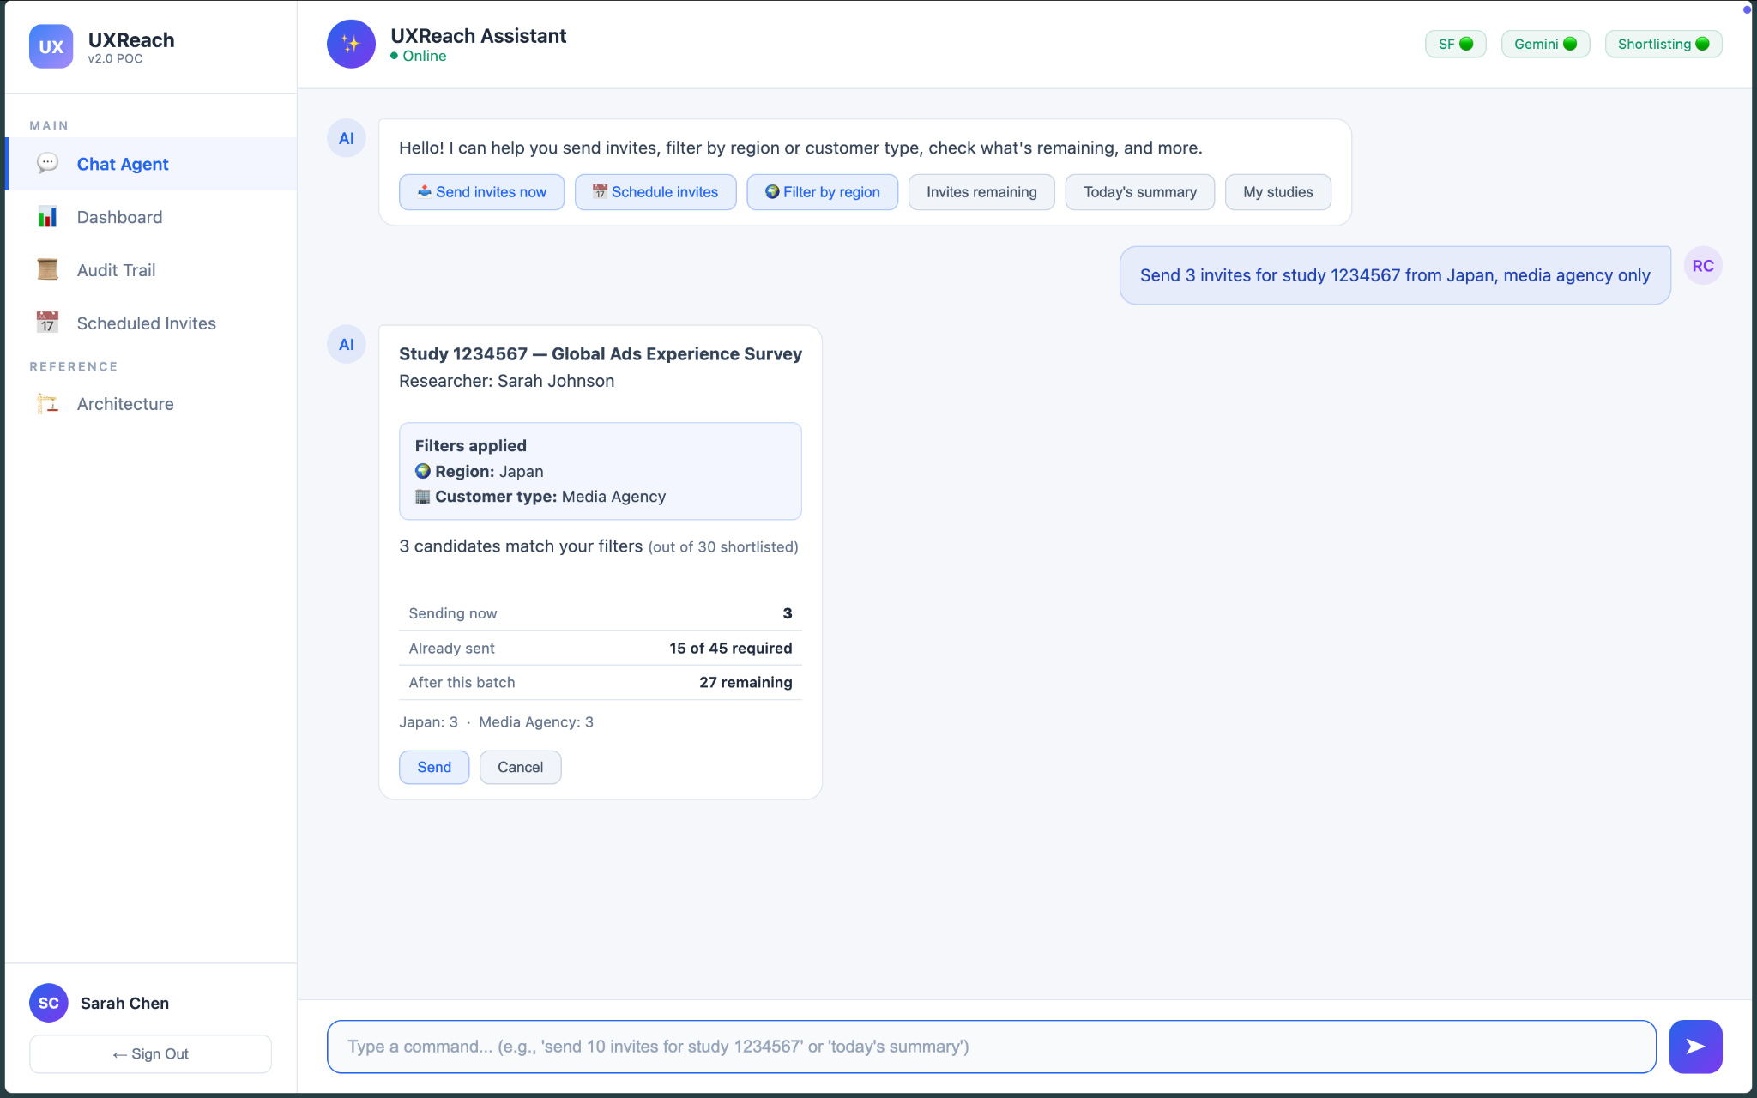
Filters applied
4. Click

Slide 19
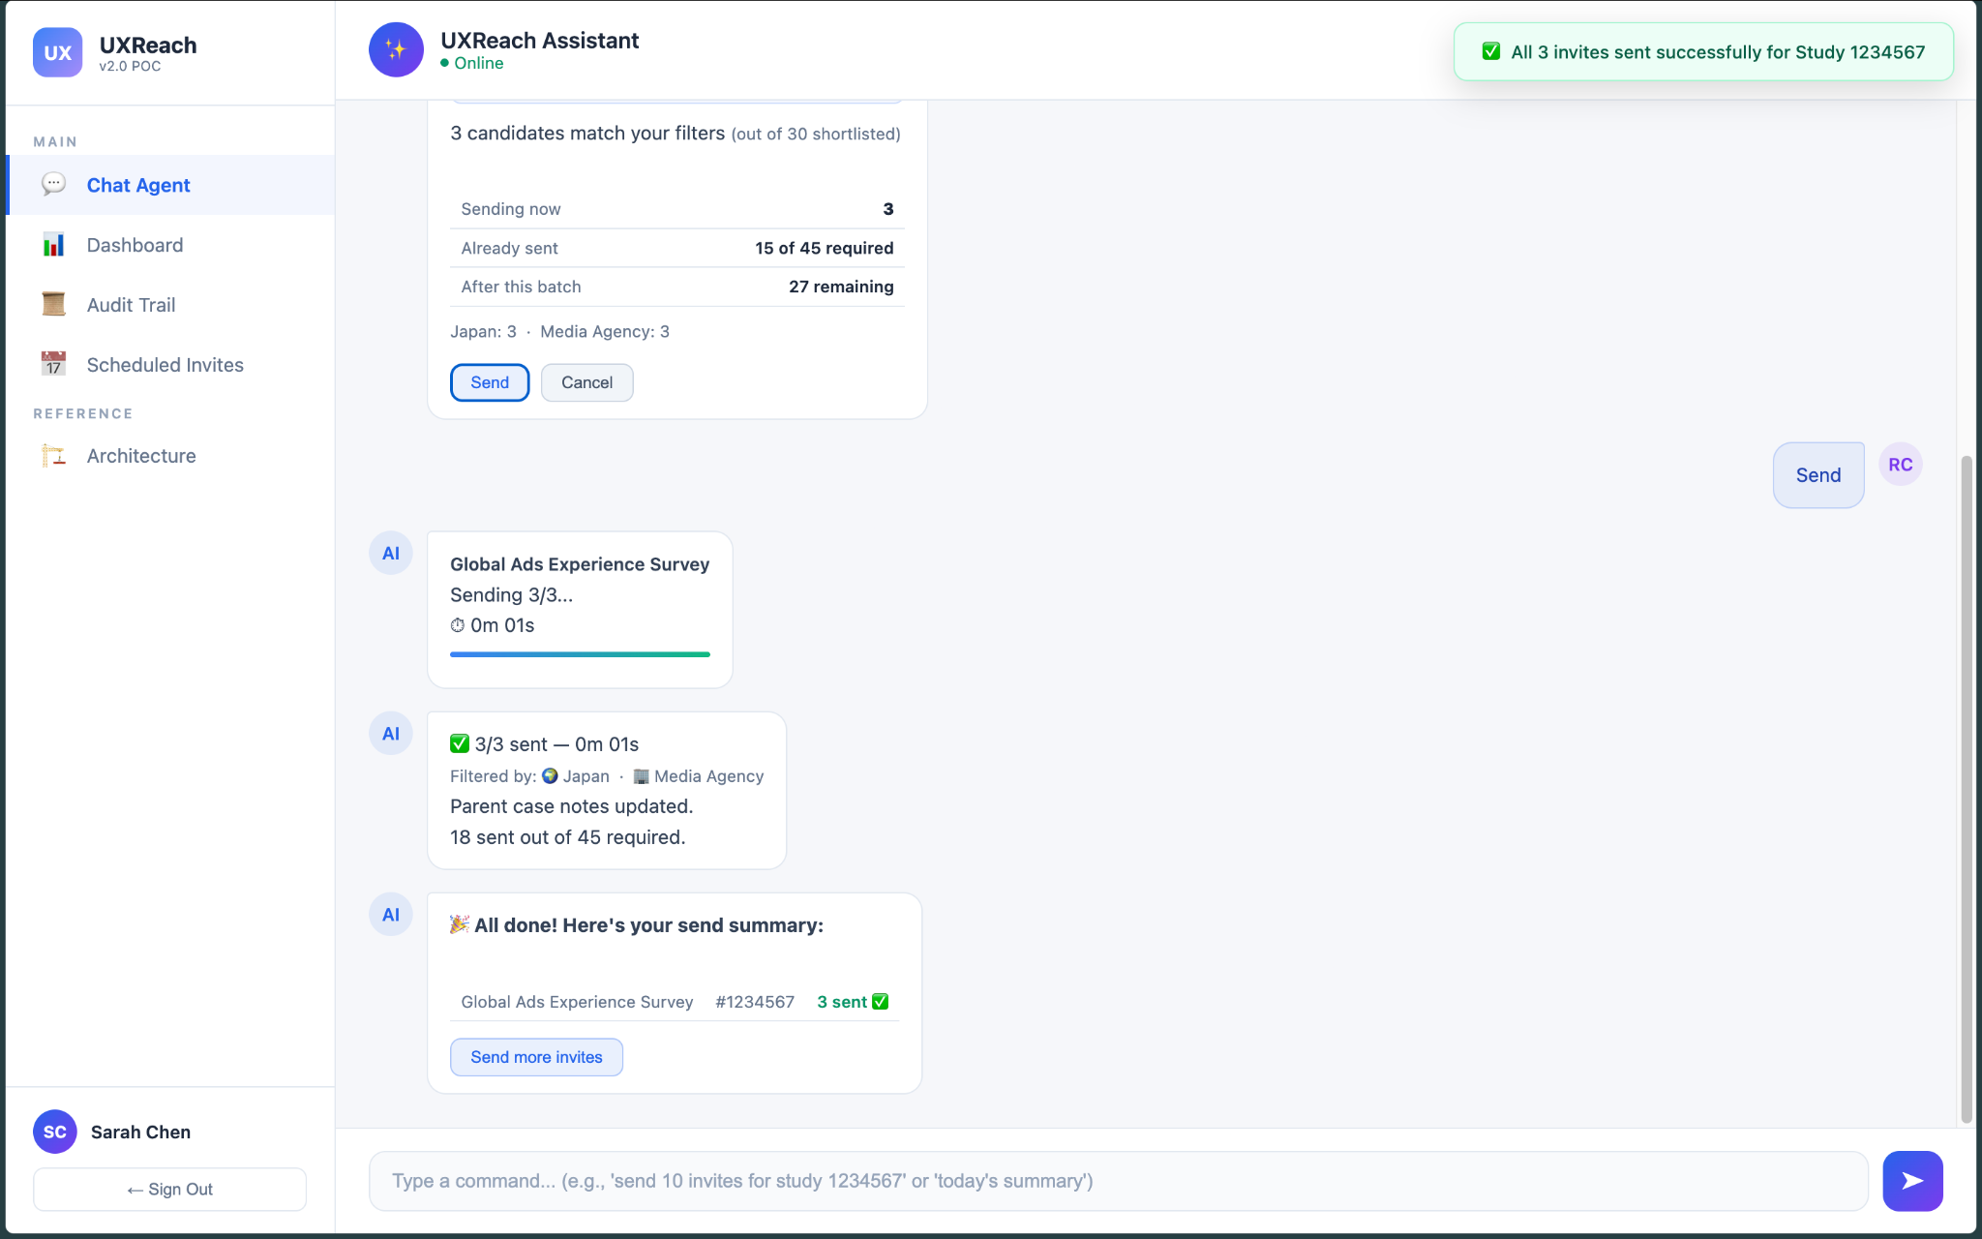
Invites sent

Slide 20
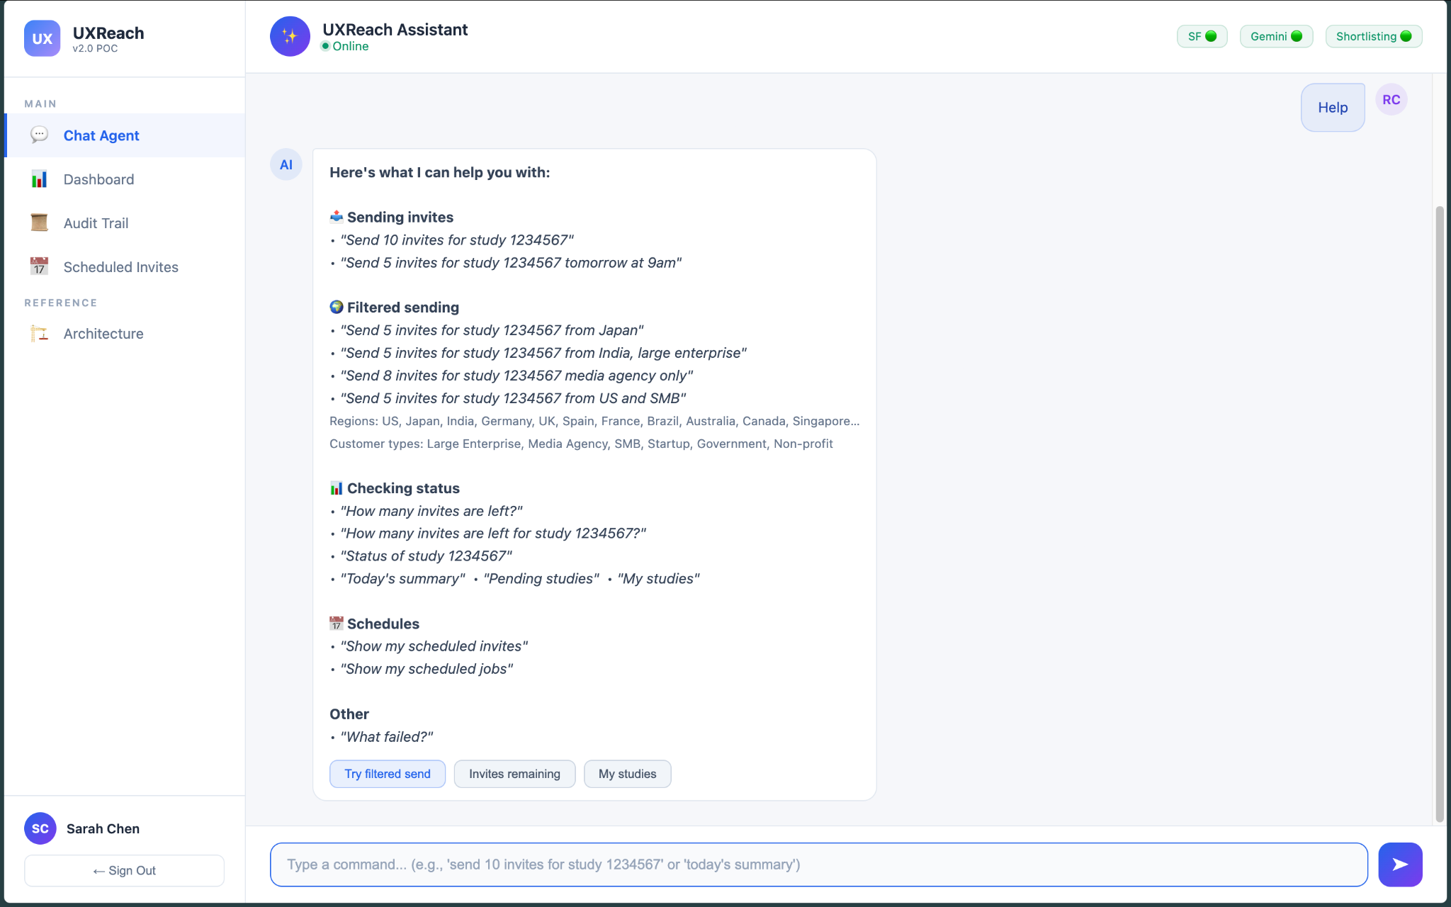
Help command
Capabilities Overview

Slide 21
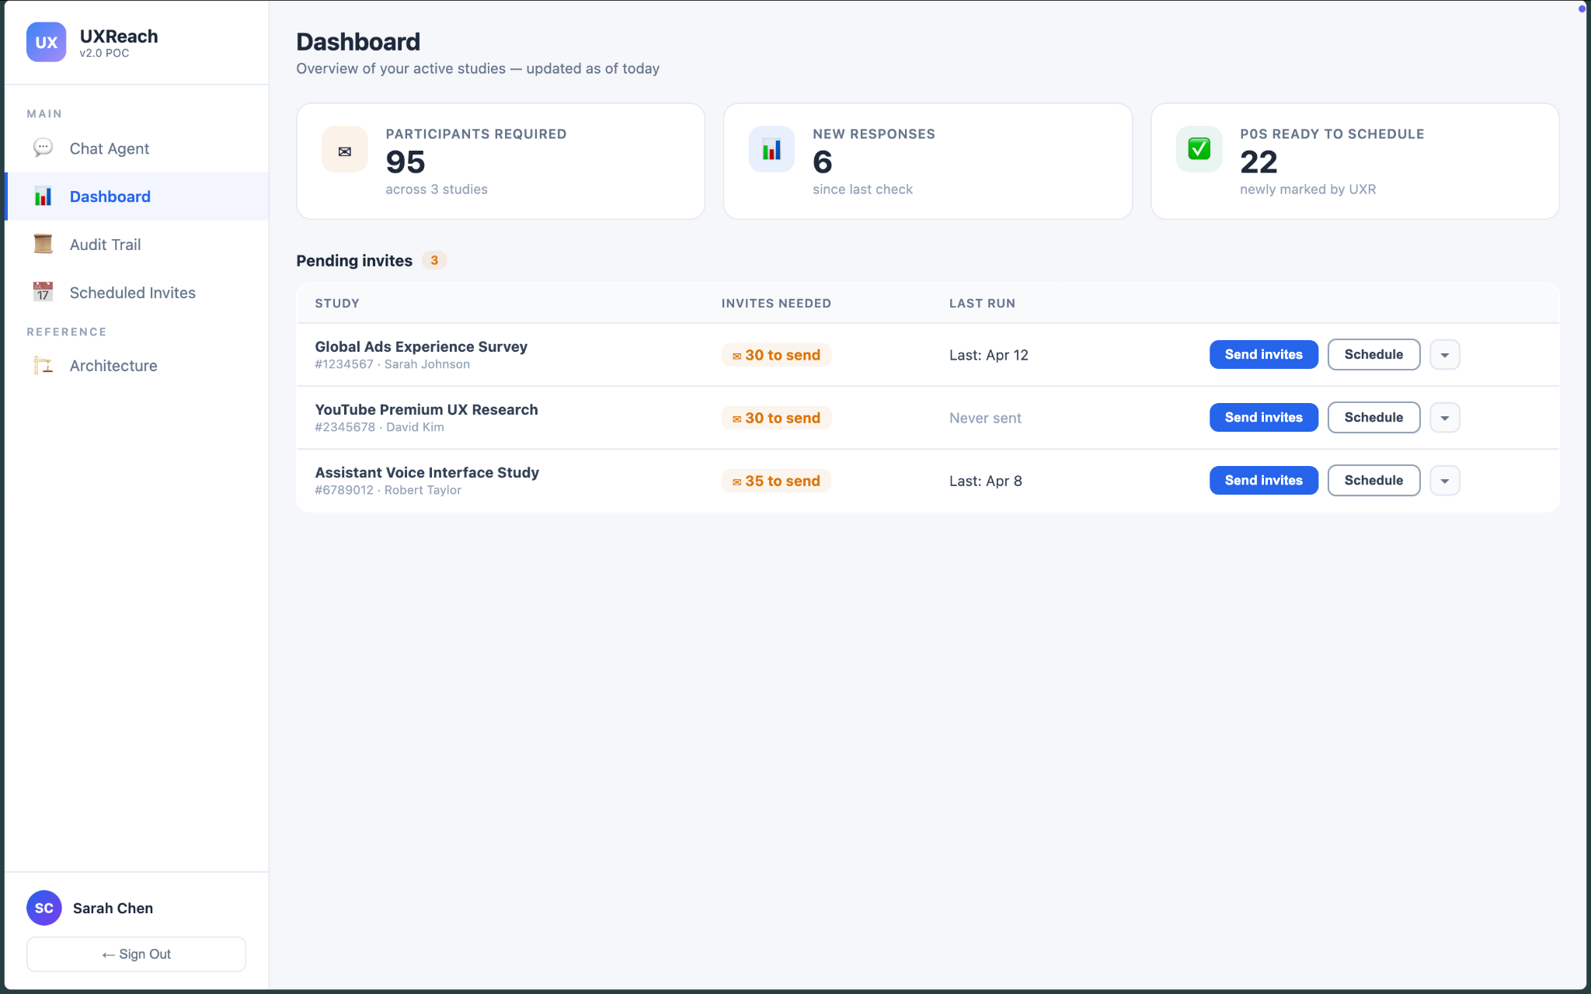

Slide 22
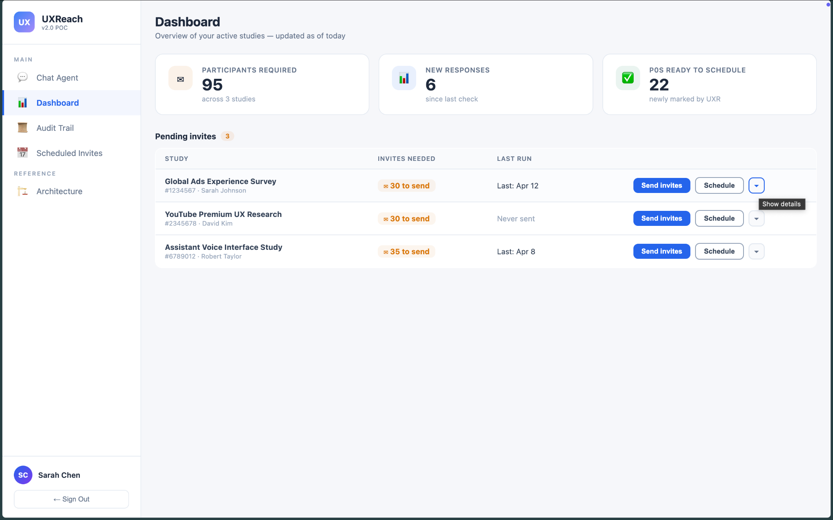
Click

Slide 23
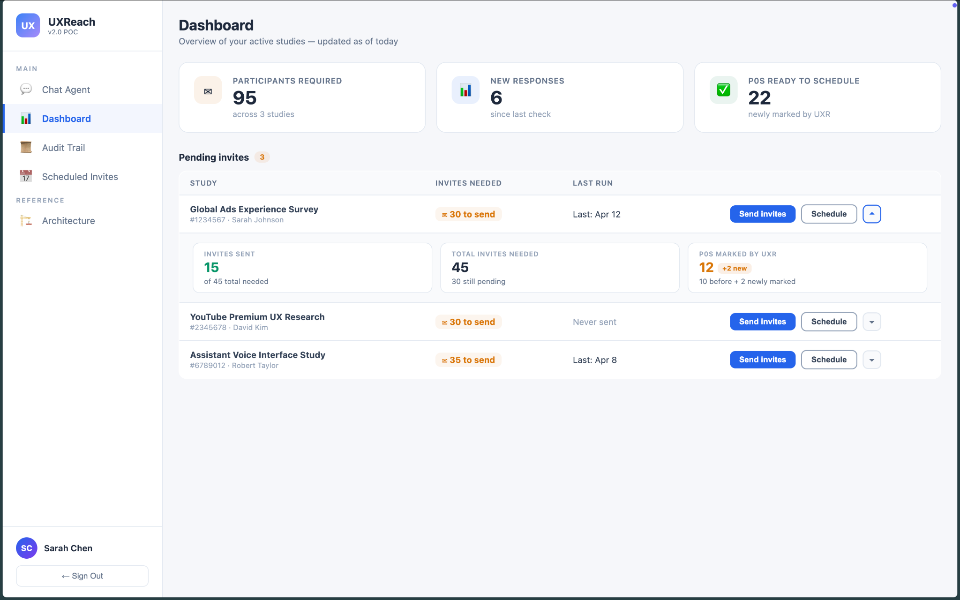

Slide 24
These actions trigger the conversational interface, automatically staging the necessary commands.

Slide 25
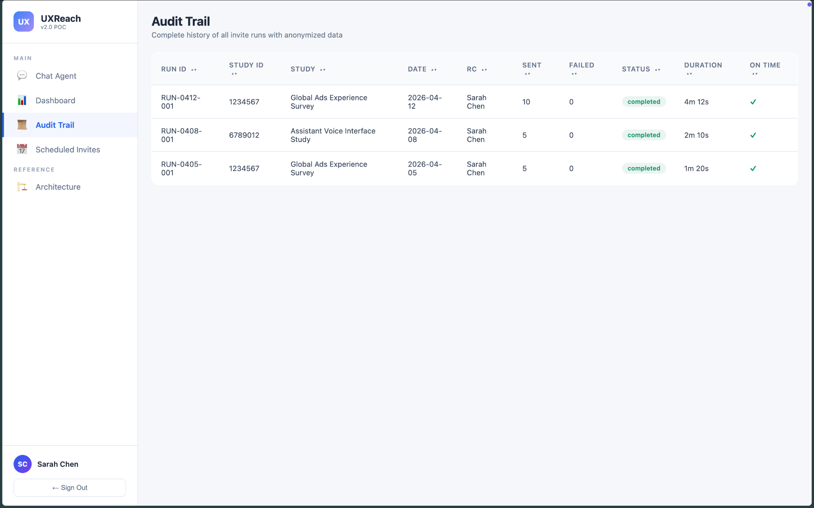

Slide 26
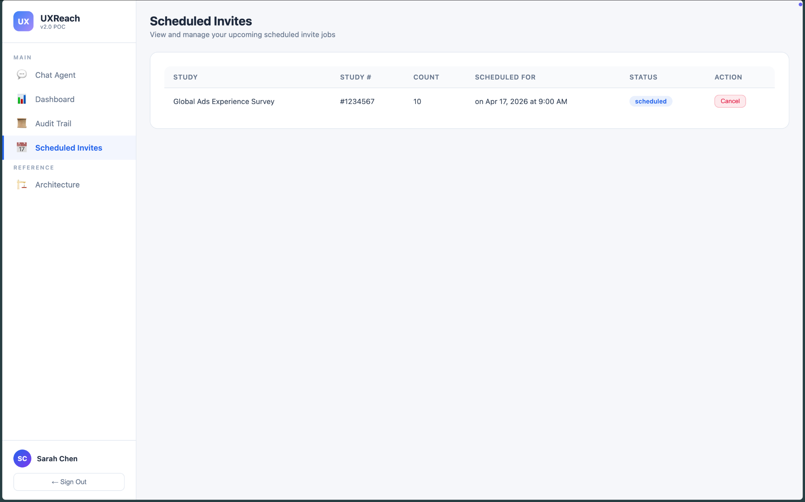

Slide 27

Thank You
UXReach Invite Agent POC Presentation

