Slide 1

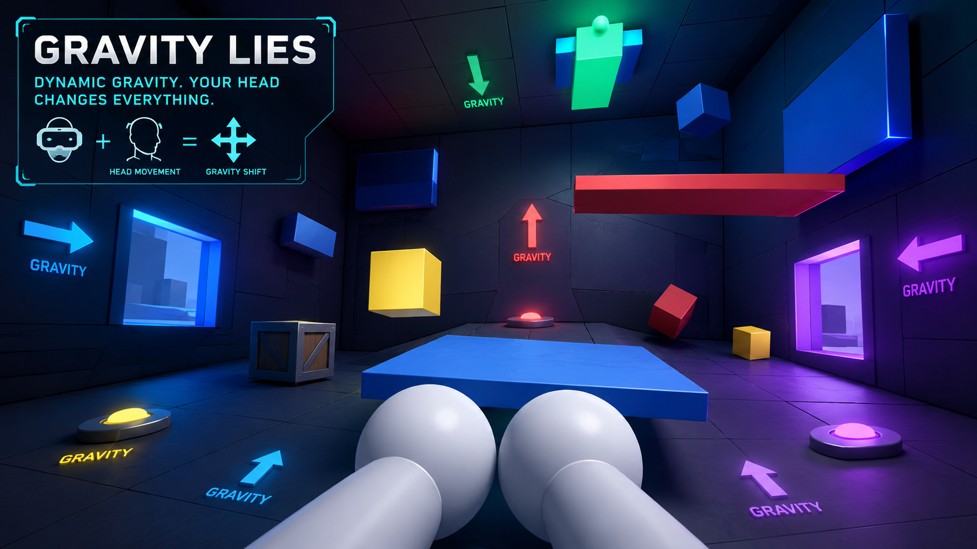
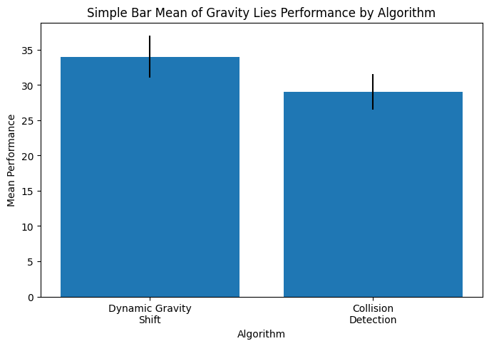
.
Student Name: Shaik Asif
Project Guide: Dr. Rama A Reg. No: 192324144
Gravity Lies: An Innovative Virtual Reality Game with Dynamic Gravity Shifts Based on Player Head Movement
INTRODUCTION
Traditional VR games operate with fixed gravity systems, limiting environmental interaction and gameplay variation.
Gravity Lies introduces an innovative VR gaming experience where gravity dynamically changes whenever the player looks away from their current viewing direction.
The game challenges players to navigate platforms, solve puzzles, and overcome obstacles while constantly adapting to changing gravity orientations. This enhances spatial awareness, immersion, and movement strategy.
The system combines natural VR head tracking with dynamic environmental physics to create a unique and highly immersive gameplay experience.
FIG 1 :- Virtual Reality Environment Demonstrating Dynamic Gravity Shifts in Gravity Lies
MATERIALS AND METHODS
Unity 3D Engine – Used for designing and developing the Virtual Reality game environment.
VR Headset and XR Toolkit – Used for immersive gameplay, player tracking, and interaction.
C# Programming Language – Used to implement gravity control, player movement, and game logic.
3D Assets and Models – Platforms, cubes, obstacles, puzzle objects, and environment elements for gameplay.
A VR game environment was created in Unity 3D with interactive platforms and puzzle elements.
The system was tested to evaluate gameplay immersion, spatial awareness, and puzzle-solving performance.
Dynamic gravity shifting was implemented based on the player’s viewing orientation.
Physics-based mechanics were applied to move platforms, objects, and obstacles according to gravity changes.
Audio integration techniques were used to add background music and gameplay sound effects for actions like jumping, gravity shifting, and level completion.
RESULTS
The Dynamic Gravity Shift algorithm demonstrated better gameplay performance with a mean value of 34.00 compared to 29.00 for the Collision Detection system, enabling smoother gravity transitions and improved player navigation across floors, walls, and ceilings.
The Collision Detection system successfully enabled accurate interaction between the player, hazards, platforms, and goal gate, improving player safety, level reset functionality, and gameplay responsiveness within the Gravity Lies environment.
Overall, the integration of Dynamic Gravity Shift and Collision Detection techniques enhanced gameplay stability, player immersion, puzzle-solving capability, and level progression, resulting in a smoother and more engaging gravity-based gaming experience.
FIG 2 :- Mean Performance of Dynamic Gravity Shift and Collision Detection in Gravity Lies
DISCUSSION AND CONCLUSION
Gravity Lies introduces a new VR gameplay approach using adaptive gravity systems connected to player awareness and movement.
The project successfully improves immersion and interaction through dynamic environmental physics, headset tracking, and real-time world orientation changes.
The experience creates tension, fear of falling, confusion, wonder, isolation, curiosity, and psychological immersion while maintaining comfortable VR transitions.
Future improvements may include multiplayer gameplay, advanced puzzles, AI-based adaptation, and improved environmental realism.
The developed system provides a strong foundation for future enhancements such as full VR controller support, improved UI, advanced puzzle mechanics, checkpoints, and enhanced visual effects.
BIBLIOGRAPHY
Mikropoulos, T.A., & Natsis, A. (2024). Educational virtual environments: A ten-year review of empirical research. Computers & Education, 56(3), 769-780.
Chapman, S.J. (2023). Electric Machinery Fundamentals. McGraw-Hill Education. (Two Wattmeter Method, Ch. 6).
Unity Technologies. (2024). Unity XR Interaction Toolkit Documentation. https://docs.unity3d.com/Packages/com.unity.xr.interaction.toolkit@2.0/manual/index.html
Khronos Group. (2025). OpenXR Specification and Developer Documentation. https://www.khronos.org/openxr/
Freina, L., & Ott, M. (2024). A literature review on immersive virtual reality in education: State of the art and perspectives. eLearning & Software for Education Conference.
Unity Technologies. 2026. “Unity Audio System Documentation.” Unity Technologies. AudioSource and AudioListener Manual.
Unity XR Interaction Toolkit, XR Interaction Toolkit Documentation, Unity Technologies, Available:XR Interaction Toolkit Documentation

