Slide 1
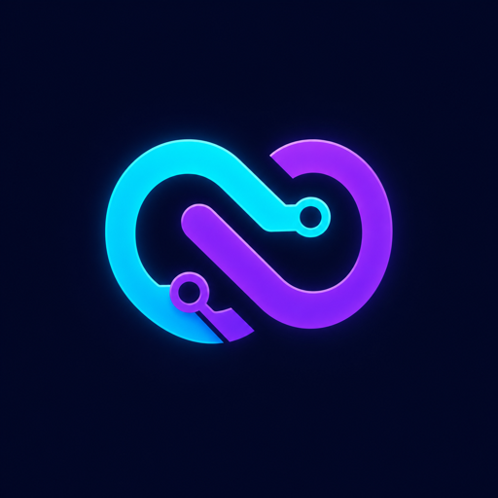
NAMASTEDEV · OPENAI CODEX HACKATHON
DevLoop AI
The first answer is
just the beginning.
A visible engineering loop that plans, generates, reviews, scores, and improves AI-created code.
Built by Aakash Shah

Slide 2
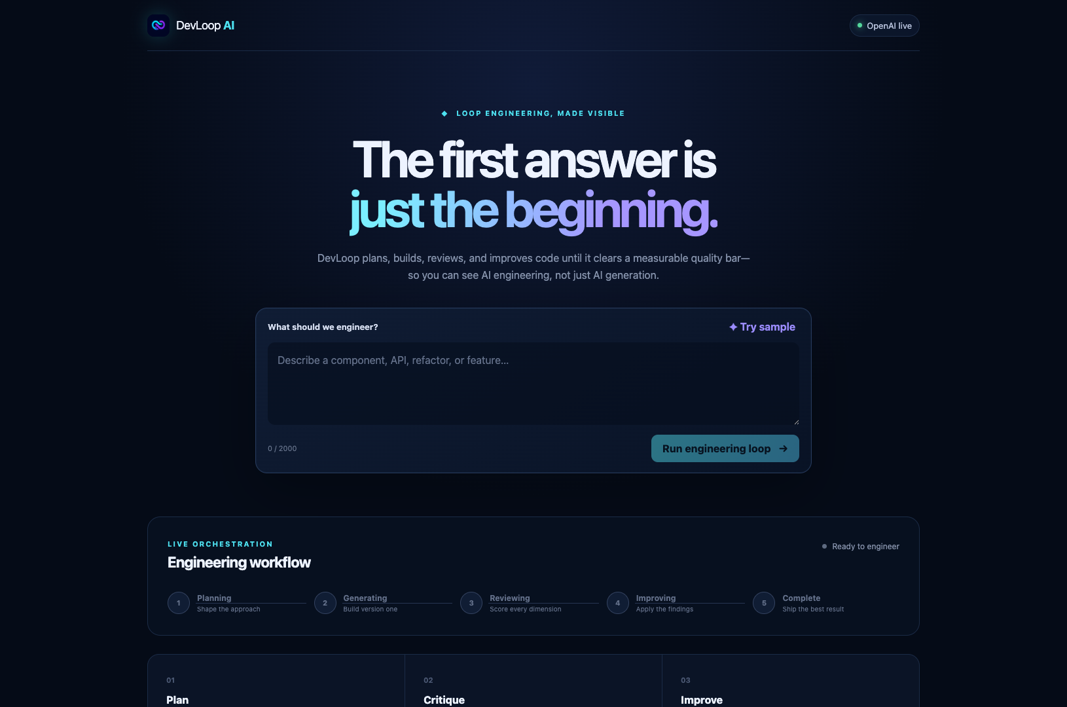
THE PROBLEM
AI code can look finished before it is engineered.
01
Missed requirements
A polished answer can quietly omit the behavior that matters.
02
Fragile error paths
Happy-path code hides loading, retry, and failure-state gaps.
03
Weak accessibility
Labels, focus states, and keyboard flows are easy to miss.
04
Hidden maintenance cost
One response rarely explains what changed or why.
The risk is not generation. It is stopping too early.
02

Slide 3
THE SOLUTION
DevLoop makes improvement visible.
01
02
03
04
PLAN
GENERATE
REVIEW
IMPROVE
Shape the approach
Build version one
Score six dimensions
Apply the findings
CONTROLLED STOP CONDITION
Quality score ≥ 85 or 3 reviewed iterations
03

Slide 4
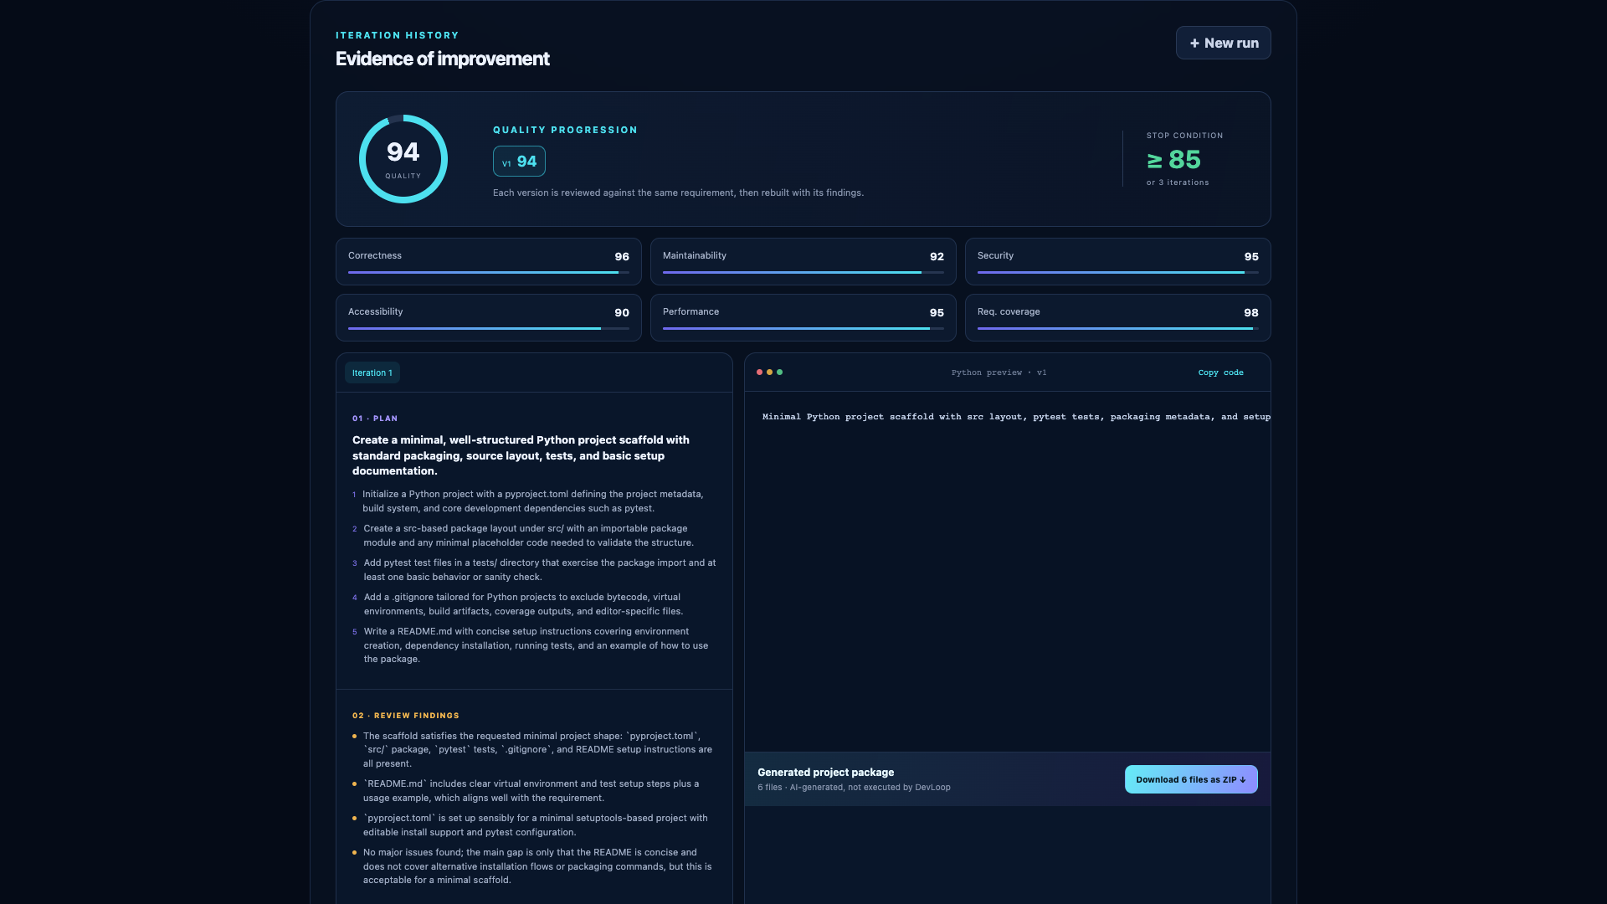
WORKING EVIDENCE
A working product leaves an evidence trail.
94
reviewed quality score
6
structured dimensions
6
downloadable project files
This live run cleared the threshold on iteration one—so the loop stopped early by design.
04

Slide 5
ARCHITECTURE AND TRUST
The application owns the loop—and its limits.
ANGULAR
EXPRESS + TYPESCRIPT
OPENAI
Visible workflow
and evidence
Bounded orchestration
and SSE updates
Strict structured
responses
SERVER-SIDE KEYS
ZOD VALIDATION
NO CODE EXECUTION
Secrets never enter Angular
Every model response is checked
Archives are generated, not run
05

Slide 6
DEVLOOP AI
Better first drafts come
from visible engineering.
The first answer is just the beginning.
LIVE PROTOTYPE
PUBLIC REPOSITORY
devloop-ai.onrender.com
github.com/AakashShah14/devloop-ai

