Slide 1
Facial Emotion Classification using CNN
Submitted by :
Aakash (242IS001)
Aditya Negi (242IS002)
Ankit Gwal (242IS005)

Slide 2
Introduction
Facial emotion detection is a branch of computer vision that identifies human emotions based on their facial expressions.
The process involves analyzing key facial features like the eyes, eyebrows, mouth, and nose to detect expressions associated with emotions.
The task is to perform classification on image data and predict which class does it falls in.

Slide 3
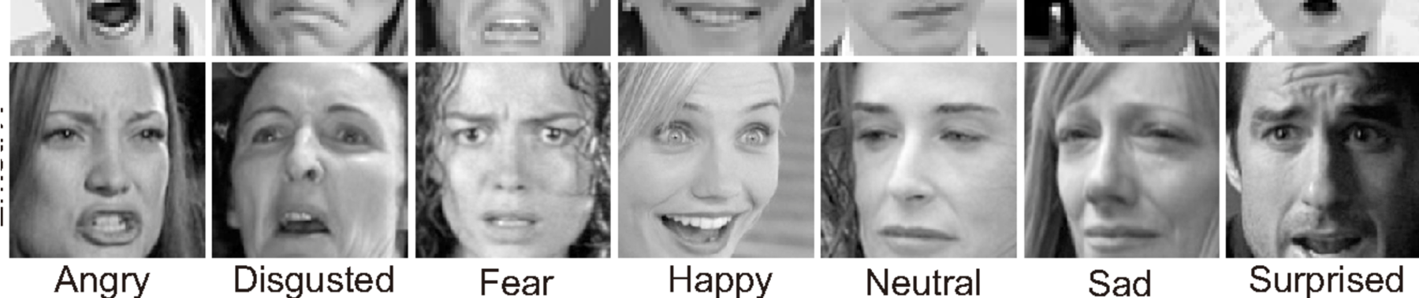
Dataset:
The dataset chosen for performing the classification task is FER – 2013
Source: Kaggle
Contains: The data consists of 48x48 pixel grayscale images of faces.
Splits: Total(35,887images), Training (28,709 images), Test (7178 images).
Labels: Seven emotions — Angry, Disgust, Fear, Happy, Sad, Surprise, Neutral.

Slide 4
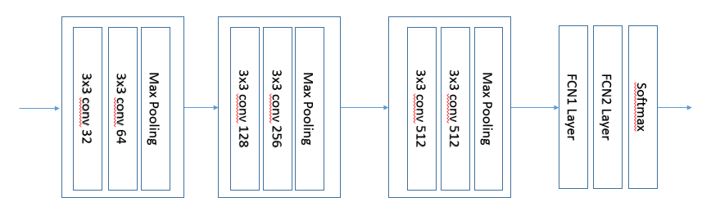
Architecture:
We have performed the classification task using three different models.
Model 1: It is a custom CNN model
3 convolutional blocks : each having 2 convolution layers
relu activation function
Batch Normalization performed after 2nd conv layer in each block
Max Pool layer for dimensionality reduction.

Slide 5
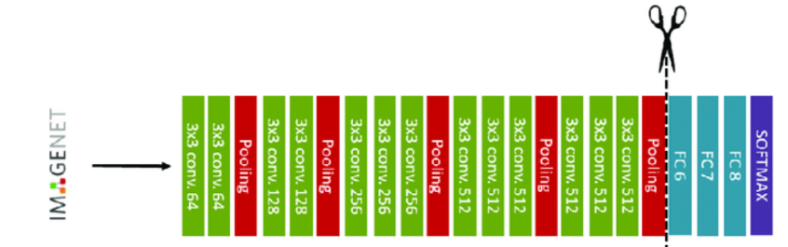
Model 2 : (VGG 16)
This model is based on VGG 16 architecture.
Takes input as 224 x 224 image.
We have freezed all the convolution layers except the last 3 fully connected layers.

Slide 6
Model 3 (ResNet 50V2) :
This model is based on Resnet 50v2 architecture.
This architecture consists of 49 convolution layers and 1 fully connected layers. Apart from these there are several batch normalization , Relu and pooling layers.
In this architecture we are freezing all the layers except top 50.
The layers frozen include all layers up to 126. These layers correspond to:
The Initial Convolutional Layer
Residual blocks from the conv1, conv2_x, conv3_x, and most of conv4_x stages.
Batch Normalization, Activation (ReLU) , and Pooling layers included in these stages.
The last 50 layers, starting from layer 127, include:
The remaining part of the conv4_x block.
All layers of the conv5_x block.
The fully connected layers.

Slide 7
Parameters
Number of parameters in our models can be shown as follows:
Model 1(Custom CNN) :
Trainable parameters : 17,044,871
Non Trainable parameters : 1,664
Total parameters : 17,046,535
Model 2 (VGG 16) :
Trainable parameters : 30,939,143
Non Trainable parameters : 9,995,072
Total parameters : 40,934,215
Model 3 (ResNet50V2) :
Trainable parameters : 22,779,527
Non Trainable parameters : 7,216,768
Total parameters : 29,996,295

Slide 8
Experimental Results:
After performing experiment all three models following were the results obtained.
Model 1(Custom CNN) :
Model 2 (VGG 16) :
Model 3 (ResNet50V2) :

Slide 9
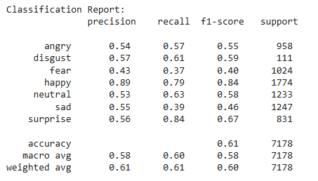
Classification report for the ResNet50V2 model :

Slide 10
References:
https://www.kaggle.com/datasets/msambare/fer2013/data
https://www.python.org/doc/

