Slide 1

Distributed Version Control System April 15, 2021
Commercial Technologies Team
Aakash Sidana – Salesforce Technical Lead

Slide 2
What is Version Control?
Version control (also known as source control) is the management of file changes within a version control system. These systems automatically maintain character level changes for all files stored within allowing for a complete retrace of all versions of each file, the author of those versions and a complete rollback of all changes from the beginning of version control
Without a VCS in place
Without a VCS in place, we're probably working together in a shared folder on the same set of classes(code). Shouting through the office that you are currently working on class "xyz" and that, meanwhile, your teammates should keep their fingers off is not an acceptable workflow. It's extremely error-prone as you're essentially doing open-heart surgery all the time: sooner or later, someone will overwrite someone else's changes.

Slide 3
Benefits of Decentralized Version Control System
GitHub
Git stores revisions of projects/code
Only changes to the code gets pushed to the distributed central repository(GitHub)
Single Source of Truth
Team Collaboration
Code Visibility
Code Sharing and Reuse
Flexibility to Handle Change
Compatible with Click Deploy(deployment tool)
Free if there are 3 collaborators and 4 USD per month if more than 3

Slide 4
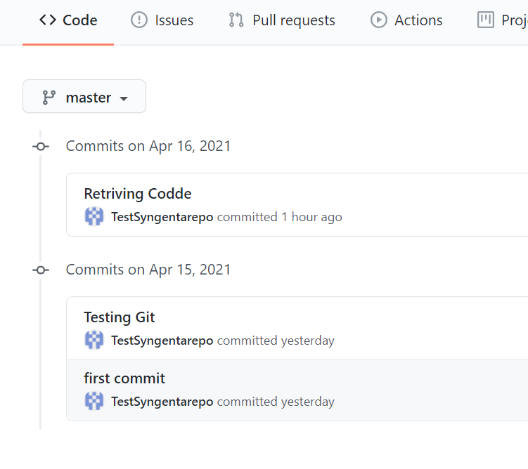
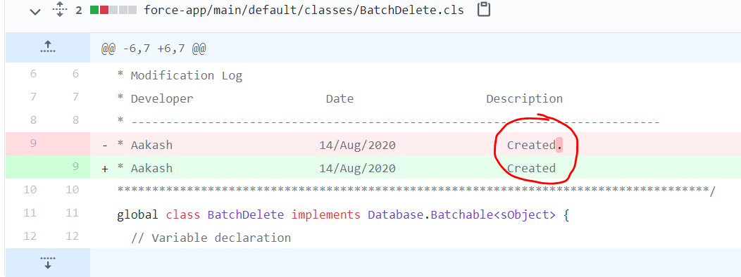
How does it look like

Slide 5
Next Steps
Download and install a compatible editor like VSCode(Free for Developers) and follow the steps
https://www.sfdcstop.com/2019/06/how-to-setup-visual-studio-code-for.html
Create an account on GitHub and connect VSCode with GitHub(will share a tutorial to follow)
Start pushing everything to gitbub and you are good to go
Once GitHib is setup, I will add the member to our team account on GitHub

Slide 6

The trademarks displayed or otherwise used herein are registered and unregistered trademarks of a Syngenta Group Company or other third parties.”

