Slide 1
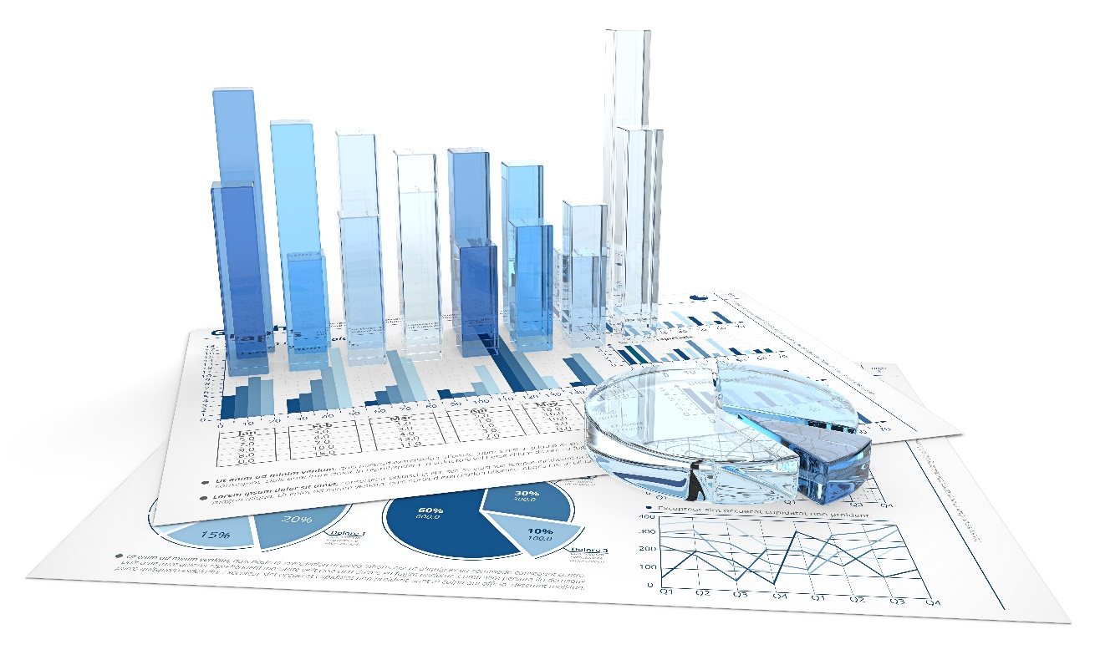
Data Analytics CS40003 Project Assignment -2 2017-2018
14MA20003 Aakash Singh

Slide 2








Report
Data
data (.csv)
Q1
14MA20003
main.py
Q2
results.txt
Graph plots (if any)
Q6

Slide 3
Topic 1 :
MOVIE data with 5043 observations
Tools used :
Methodology :
Reasonable assumptions :
Python-Programming, Spyder, Ubuntu, Python Libraries (pandas, scipy.stats, numpy, math )
- Cleaning of data
- Took sample of 2016 movies
- Calculated population mean, sample mean, population standard deviation and sample standard deviation using python inbuilt functions.
- Calculated Z and T statistics and critical values.
-Data is cleaned by replacing the average of columns
-Alpha value is taken to be .05

Slide 4
Topic 2 :
NUTRITION data with 80 observations
Tools used :
Methodology :
Reasonable assumptions :
Python-Programming, Spyder, Ubuntu, Python Libraries (pandas, matplotlib, numpy )
- Calculated correlation coefficient using inbuilt functions
- Checked non linearity using polyfit and plotted graphs
- Stated inferences using coefficient’s values.
none

Slide 5
Topic 3 :
SALARY data with 1,48,654 observations
Tools used :
Methodology :
Reasonable assumptions :
Python-Programming, Spyder, Ubuntu, Python Libraries (pandas, matplot, numpy )
- Cleaning of data
Plotted the graphs and obtained inferences from it
- Data is cleaned by replacing the empty values with column mean.

Slide 6
Topic 4 :
SNACKS data with 100 observations
Tools used :
Methodology :
Reasonable assumptions :
Python-Programming, Spyder, Ubuntu, Python Libraries (pandas, scipy.stats)
- obtained correlation matrix using scipy.stats.spearmanr
- Calculated coefficients of determination by sqauaring the above matrix
none

Slide 7
Topic 5 :
GAMES data with 16,719 observations
Tools used :
Methodology :
Reasonable assumptions :
Python-Programming, Spyder, Ubuntu, Python Libraries (pandas, numpy)
- Cleaning of data
- Split the data for action and other movies.
- Made the contingency table and tested the hypothesis
Data is cleaned by replacing the empty values with column mean.

Slide 8
Topic 6 :
STOCK data for the year 2016-2017
Tools used :
Methodology :
Reasonable assumptions :
Python-Programming, Spyder, Ubuntu, Python Libraries (pandas, scipy.stats, numpy)
- Predicted the values using Linear regression and OLS in python.
- Plotted graph for each stock
- Predicted the stock only with closing values of the stocks.

