Slide 1
Weekly Team Progress Report
Date Range: Aug 1 – Aug 4

Slide 2
Project Cycle Overview
Transcript upload for students
Audit logging
Course and section bug fixes and UI improvements
Student search for exam improvement

Slide 3
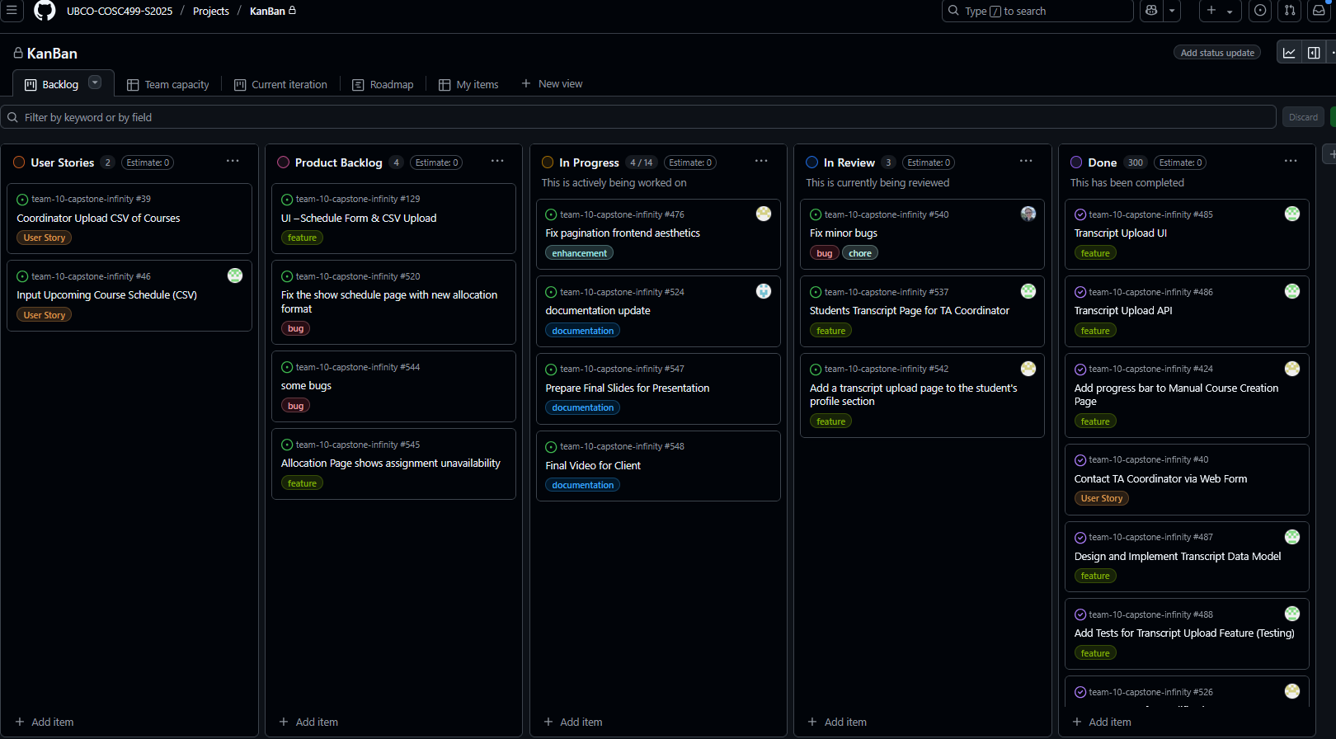
Kanban Board Progress
Visual of GitHub Kanban Board

Slide 4
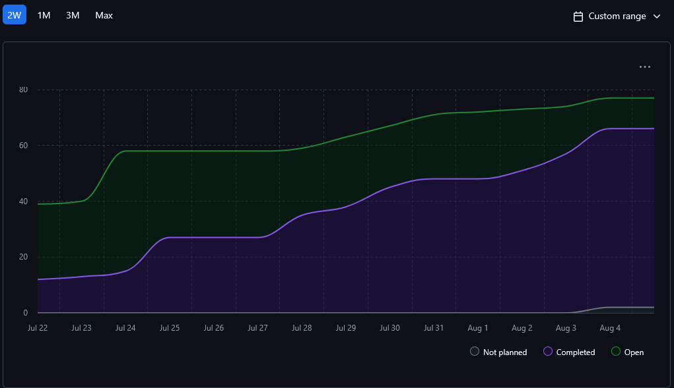
Burn-up Chart (Velocity)
Visual progress overall

Slide 5
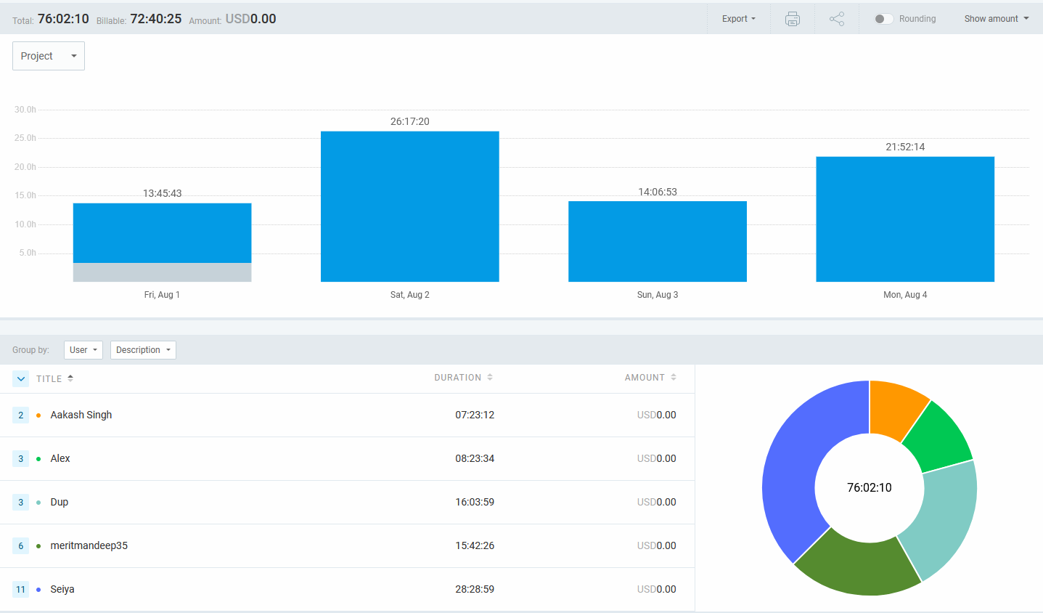
Total Logged hours
Chart from Clockify: Logged hours by member

Slide 6
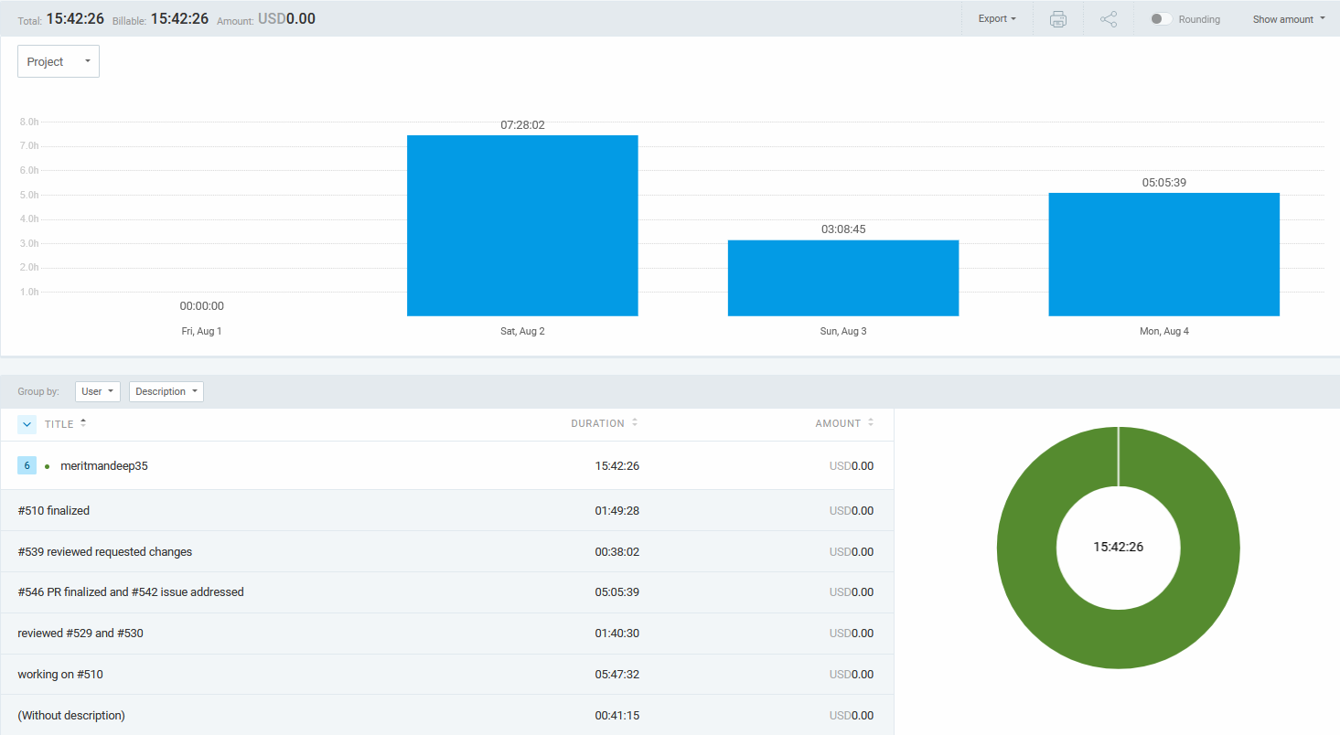
Mandeep’s tracked activites

Slide 7
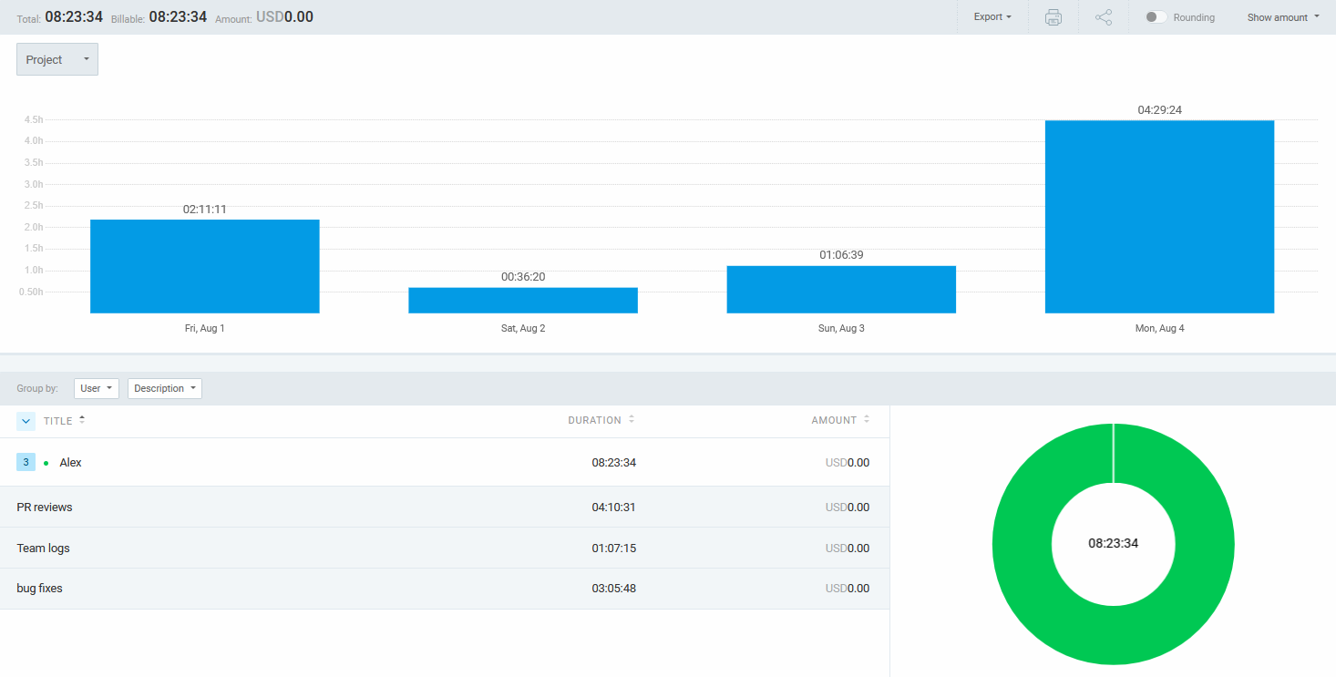
Alex’s tracked activities

Slide 8
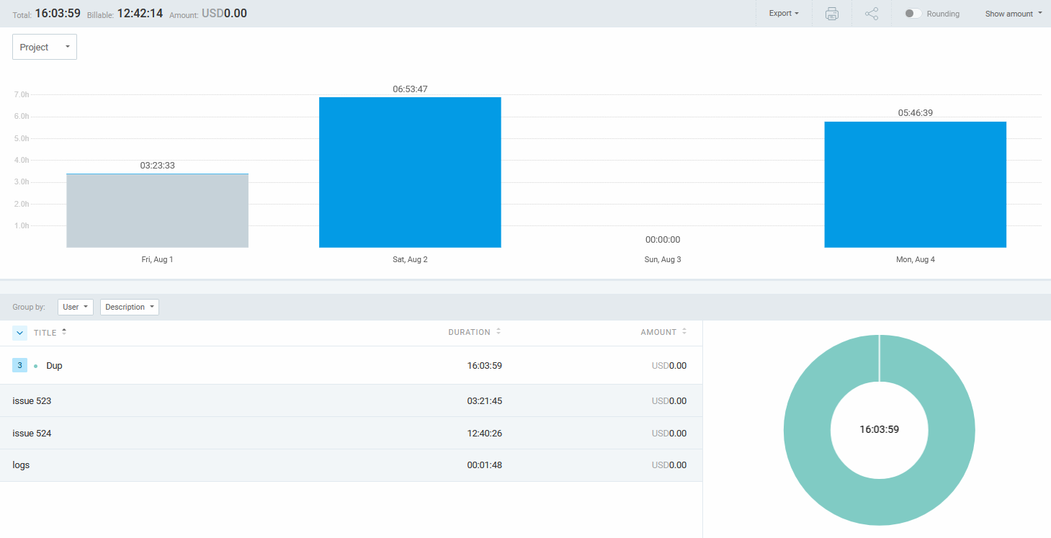
Dup’s tracked activities

Slide 9
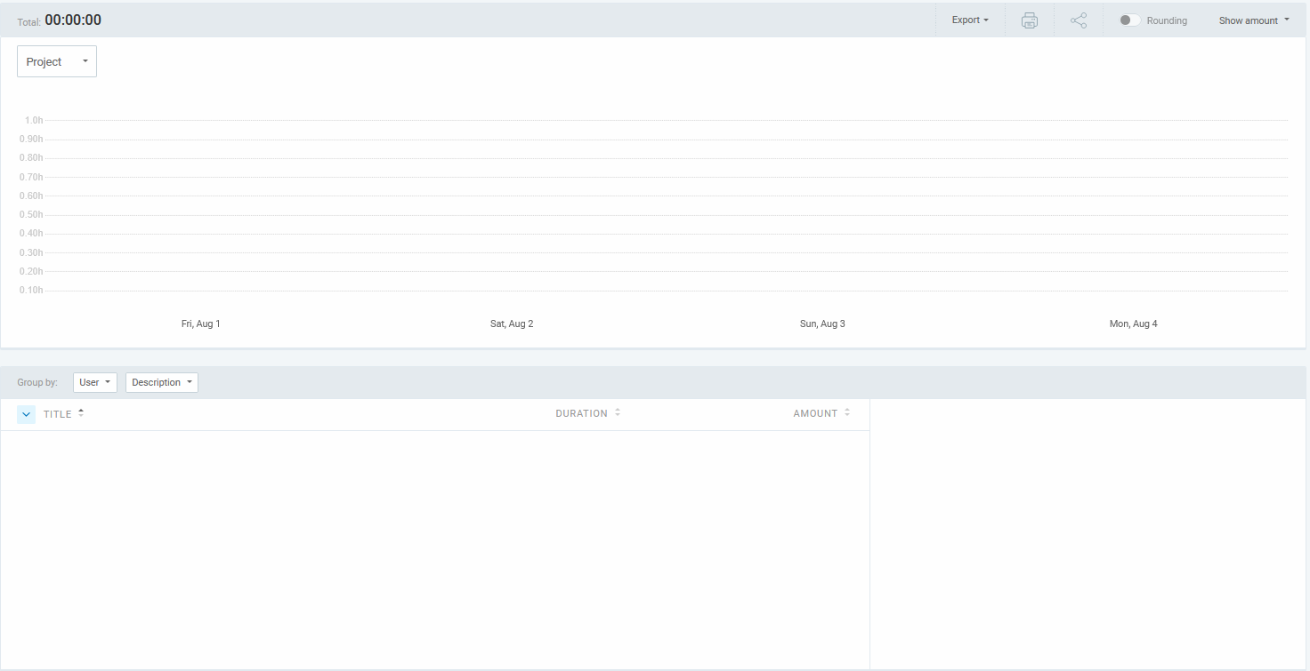
Allen’s tracked activities

Slide 10
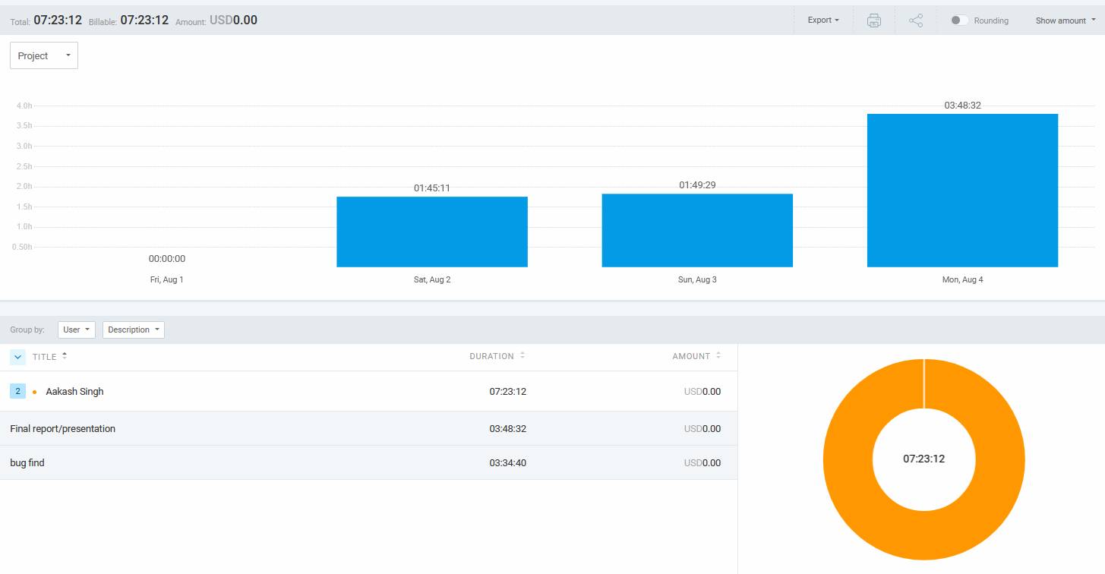
Aakash tracked activities

Slide 11
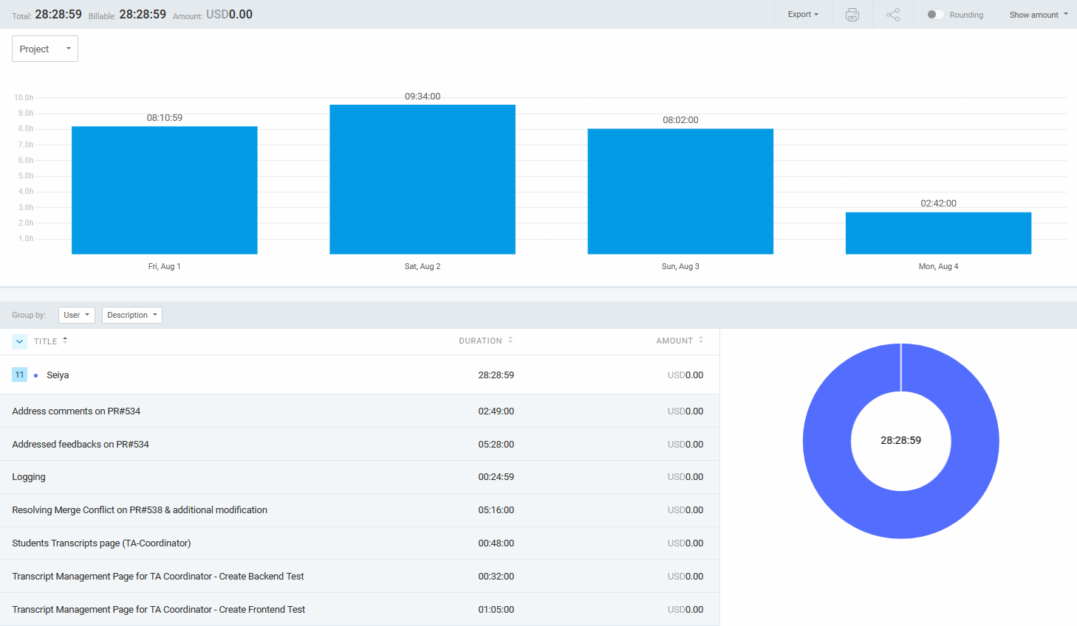
Seiya’s tracked activities

Slide 12
Completed & Ongoing Tasks
✔ Completed:
Student transcript upload
Audit logging
Various UI aesthetic improvements and bug fixes
🔄 In Progress:
Documentation, final slides, final video, final transcript UI and bug fixes

