Slide 1
COSC 499 Group 10
TA Management Program
Alexander Argatoff - Beichen Gu - Seiya Iwama - Du Pyo Park - Aakash Singh - Mandeep Singh - Eddy Tian

Slide 2
Introduction
This TA allocation tool will an organized and centralized system for managing the TA application process and allocation for an upcoming semester. It will provide intuitive and useful features to aid with TA applications, instructor course needs, and allocation of TA’s to course sections.

Slide 3
Student User Experience
Student’s will be able to use this application to create a profile that answers questions that can be reused for numerous application cycles. This will allow them to apply easily year to year only needing to input their subject preferences and available time of work allowed.

Slide 4
Instructor User Experience
Instructors will be able to use the system to track which courses they are teaching and submit needs and requests for TA’s for specific courses. This would give instructors the chance to prefer certain courses to be done, or how many hours of grading they would need.

Slide 5
Coordinator User Experience
This is the main actor in the system, and they would use the system to view students and their applications, and allocate them to appropriate course sections based on the students currently registered courses. They can visually see the times of a course and how a TA could slot in a lab section, and if there’s a match, send an offer to the student. It would keep the process of TA allocation more organized and efficient.

Slide 6
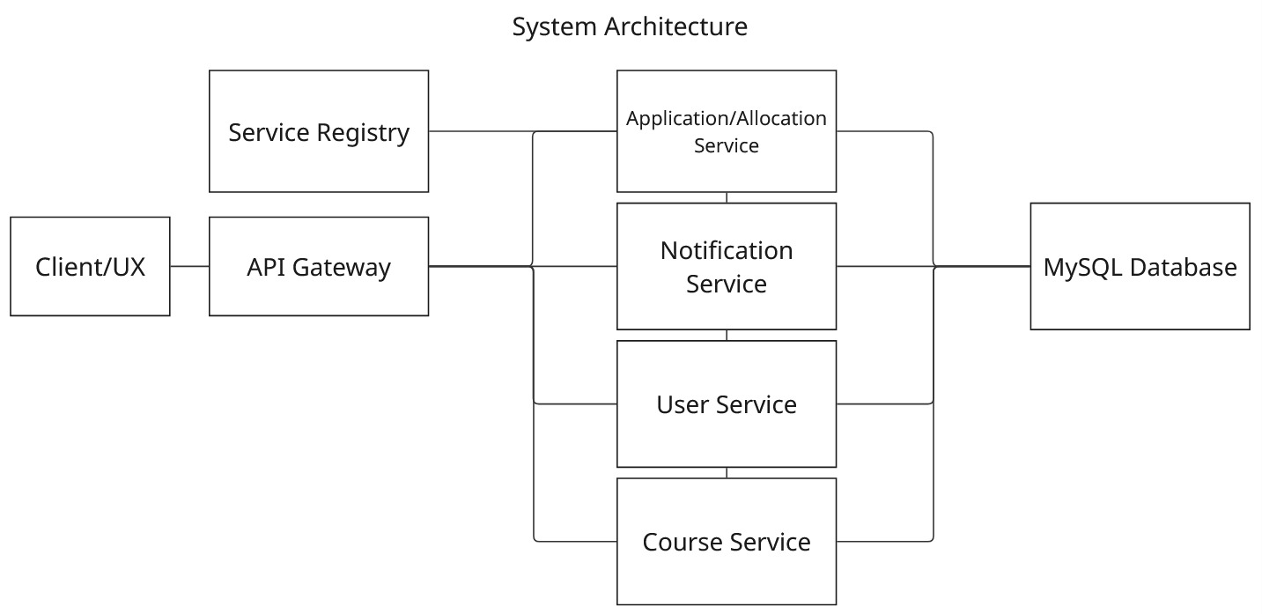
System Architecture

Slide 7
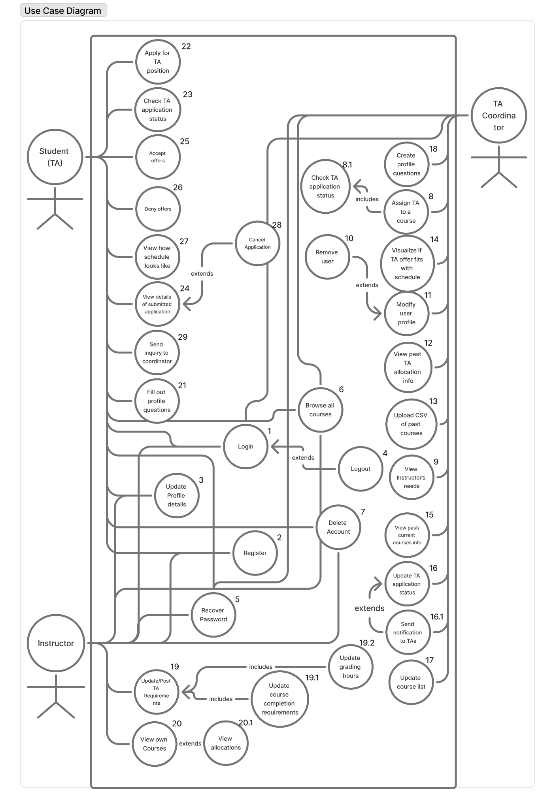
Use Cases

Slide 8
USE CASE - APPLY FOR TA POSITION
Main Scenario
Student clicks on the button to apply for a TA position.
The student fills out a form. The student choose a preference for a subject. The student uploads his or her transcript. The student inputs the courses he or she has done.
Student is prompted to verify the application details.
If application is confirmed, student is sent to the application details page
The application status is updated and the Application database table is updated.

Slide 9
USE CASE - VISUALIZE IF TA OFFER FITS WITH SCHEDULE
Main Scenario
The TA coordinator clicks on the button to visualize the schedule.
The TA coordinator views the scheduler.
The coordinator clicks on the TA to put in the schedule and compare with other TAs or instructor’s needs of a course.
If visualization is successful and the offer fits with TA’s schedule, the offer is sent out.

Slide 10
USE CASE - SEND INQUIRY TO TA COORDINATOR
Main Scenario:
The student clicks on a button to send an inquiry to the coordinator
The student fills out a textbox or form about the inquiry and submits it.
The system sends an email to the coordinator containing the contents of the inquiry and the student who sent it.
The system sends an email to the student containing the contents of the form that he sent to the coordinator.

Slide 11
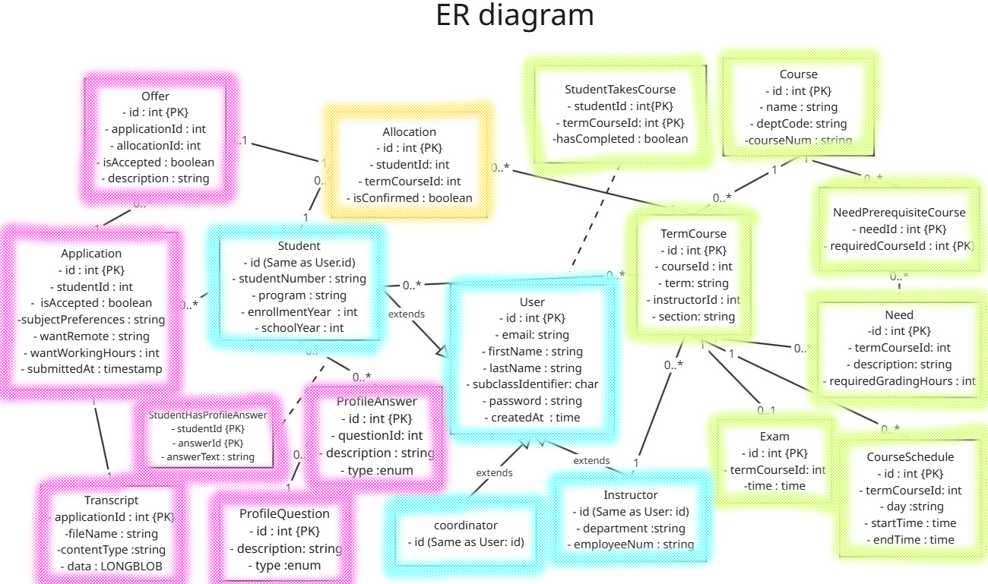
ER DIAGRAM

Slide 12
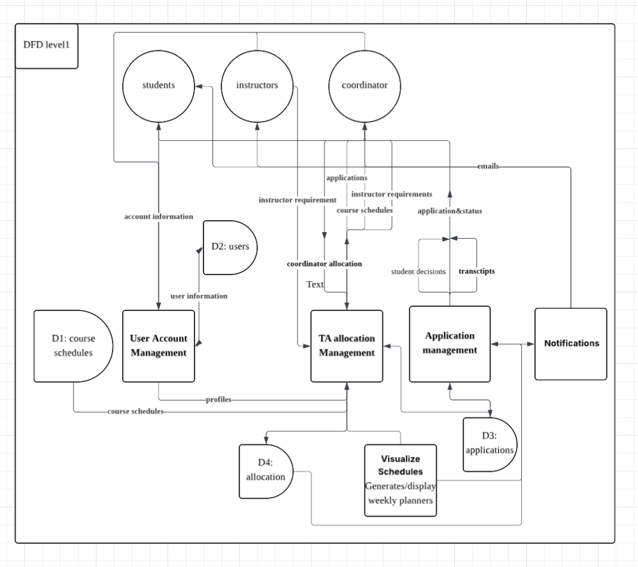
Level 1 Data Flow Diagram

Slide 13
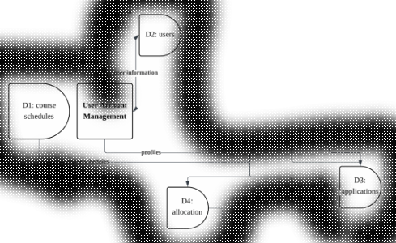
Design Rationale

Slide 16
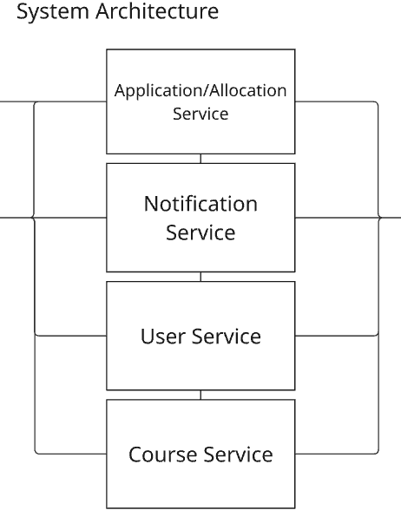

Slide 17
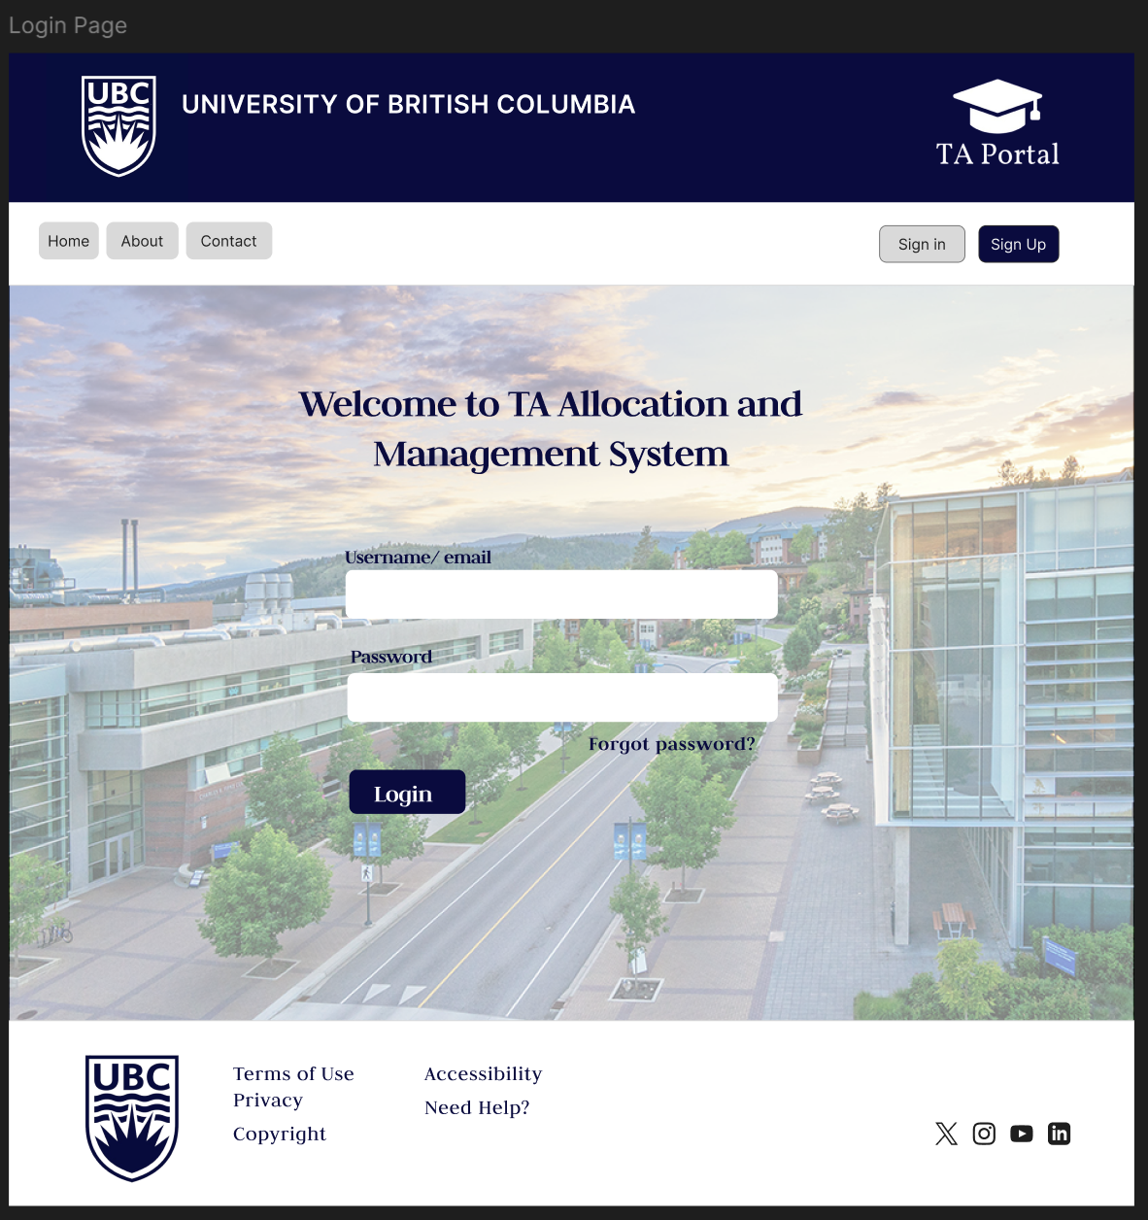
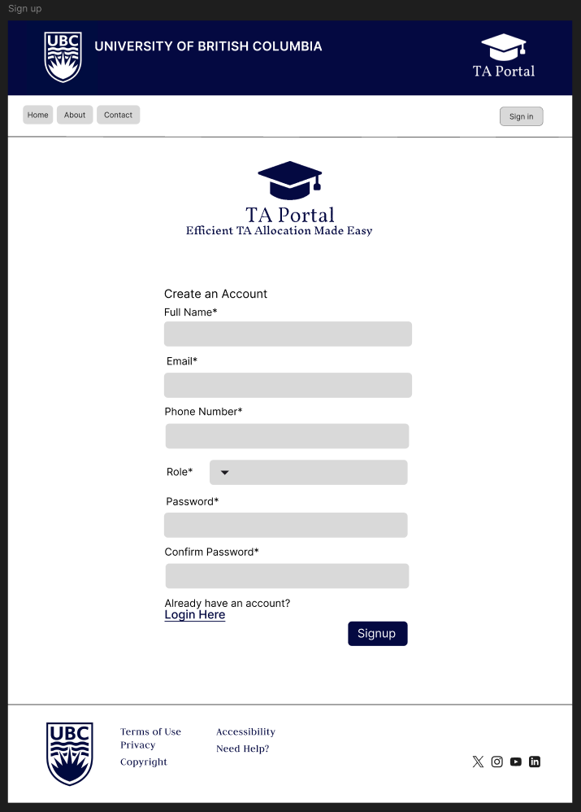
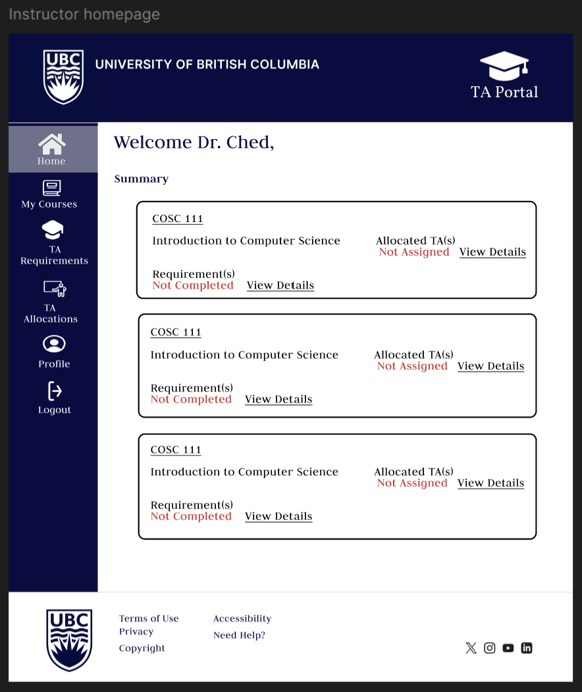
UI Mockups -Instructor Mockups
The Instructor Login and Sign-Up pages provide secure access to the UBC TA Allocation System. Users can log in with email and password or sign up by entering their name, contact details, role, and password. Both pages include navigation links and UBC-branded headers and footers. The Instructor Homepage offers a personalized dashboard showing all assigned courses, along with TA requirement and allocation statuses. Each course card includes “View Details” links for quick access. A sidebar ensures easy navigation to key functions like managing courses, submitting TA requirements, and viewing allocations, helping instructors stay organized and efficient.

Slide 18
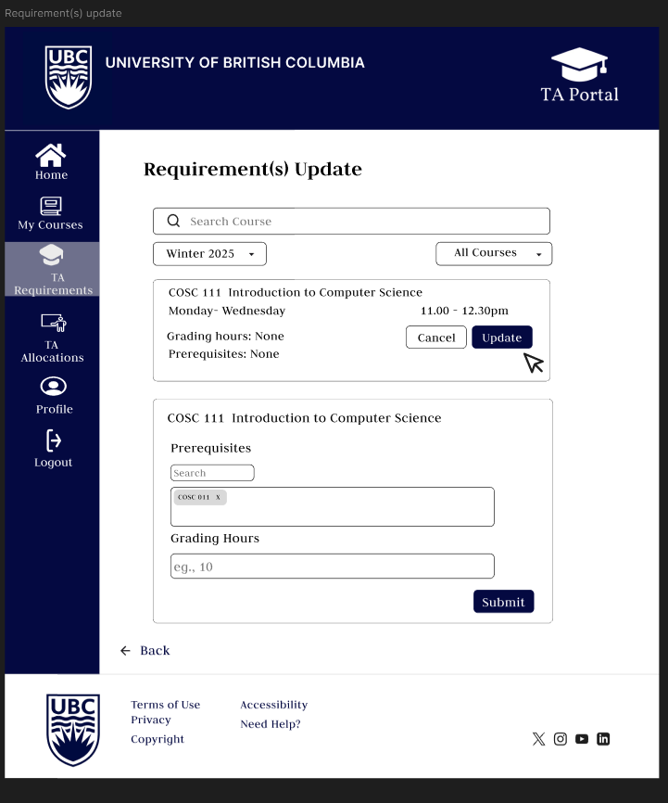
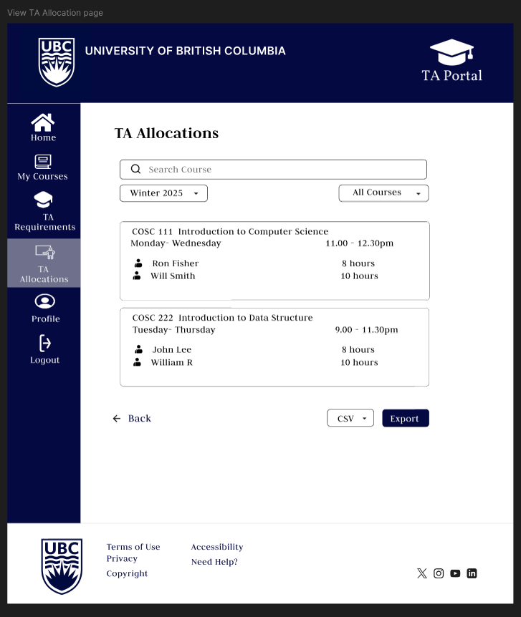
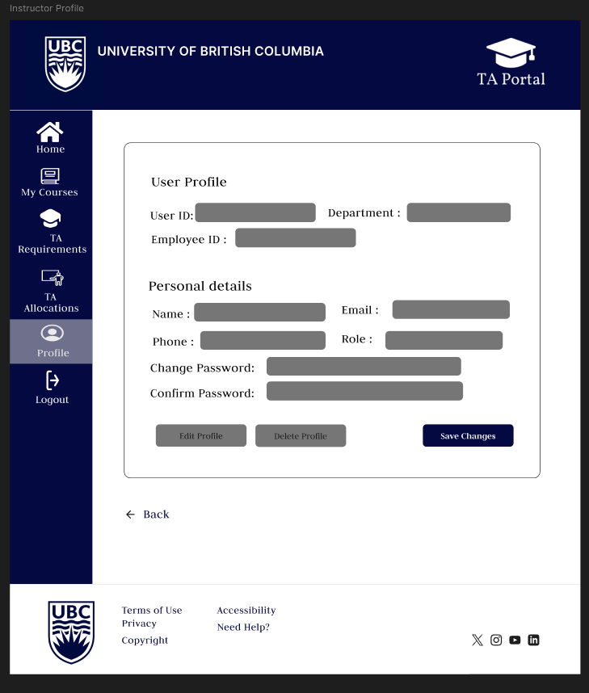
Instructor Mockups
The Instructor interface includes pages for managing TA requirements, allocations, and personal profiles. The Requirement(s) Update page lets instructors define or edit prerequisites and grading hours per course, with filtering options by term or course. The TA Allocations page displays assigned TAs, their schedules, and working hours, with filters and a CSV export option for reporting. The Instructor Profile page allows viewing and editing of account details such as name, email, department, and role. It also supports password changes and profile deletion. Together, these pages help instructors maintain accurate course needs and manage their information efficiently within the system.

Slide 19
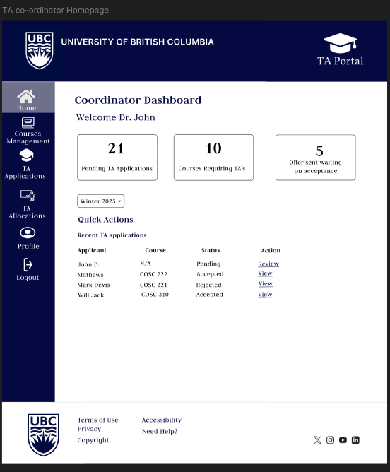
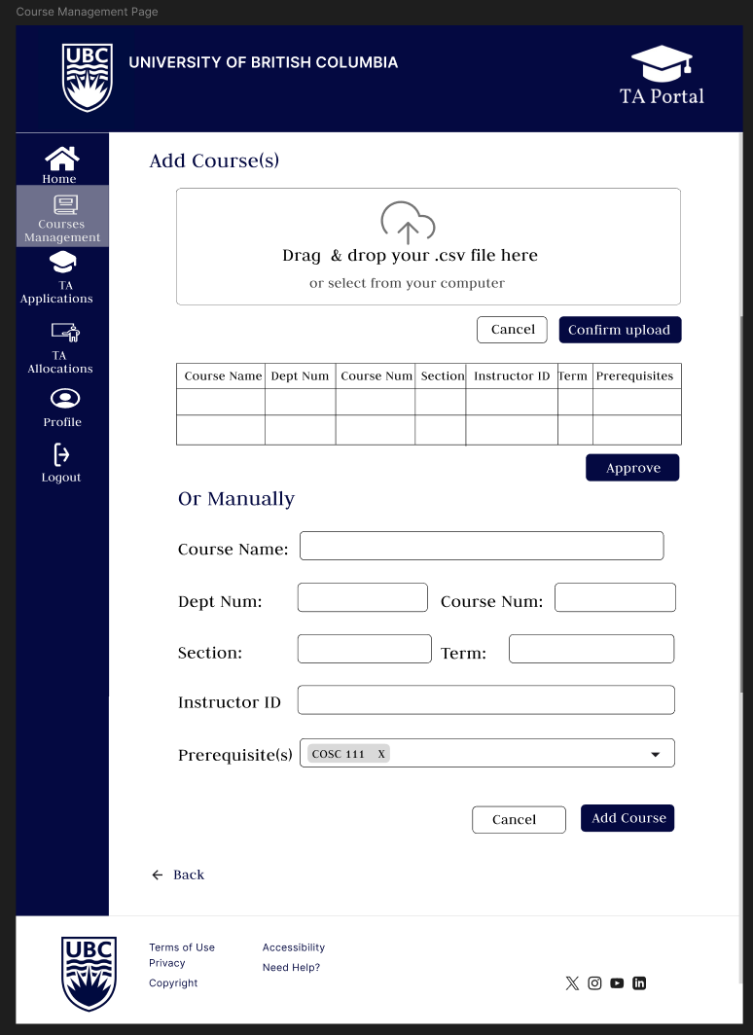
TA Coordinator Mockups
The TA Coordinator Dashboard gives an overview of key metrics and actions. Coordinators can quickly see pending applications, courses needing TAs, and offers awaiting acceptance. A term dropdown enables filtering. The Quick Actions section lists recent applications with applicant info, course assignments, status, and review options. The sidebar links to Courses Management, TA Applications, TA Allocations, Profile, and Logout.
The Course Management page lets the TA Coordinator add new courses. Courses can be uploaded in bulk via .csv (drag-and-drop or file selection), then reviewed in a table before approval. Alternatively, courses can be added manually by entering details like course name, department and course number, section, term, instructor ID, and prerequisites.

Slide 20
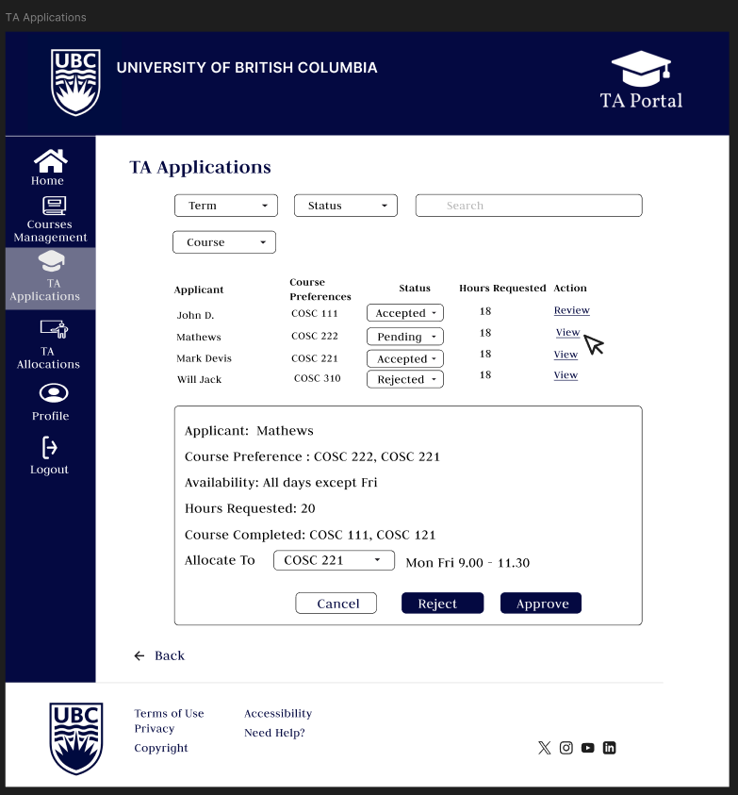
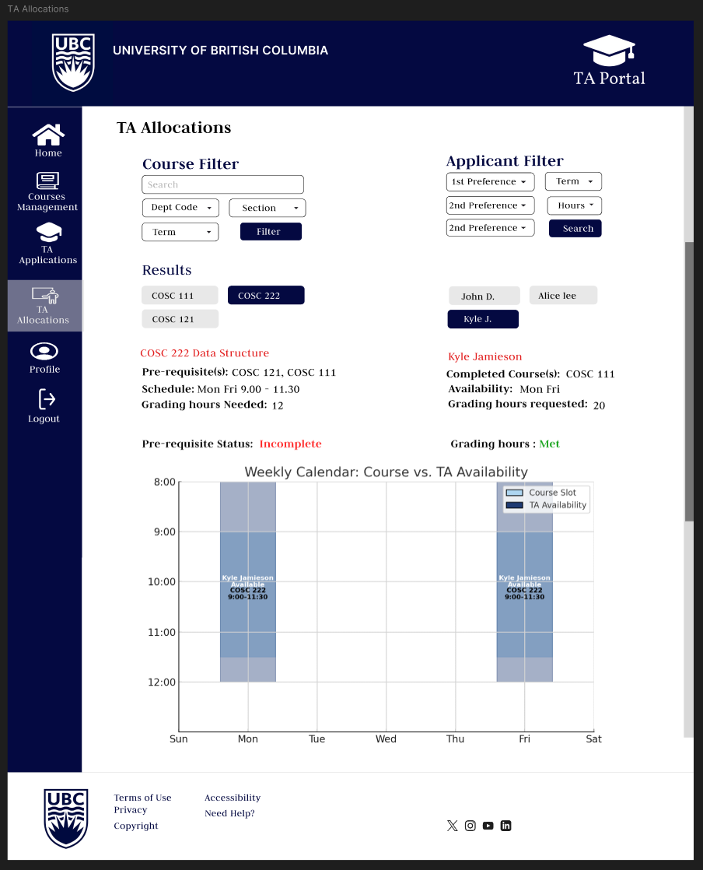
TA Coordinator Mockups
This TA Applications page lets the Coordinator review and manage student applications. Coordinators can filter by term, status, or course and view summaries showing each applicant’s preferences, status, and requested hours. Clicking "View" reveals availability, completed courses, and preferred allocations. Coordinators can assign applicants or update their status with approve/reject options.
The TA Allocations page lets the Coordinator match courses with suitable applicants using filters and availability. Courses can be filtered by department, section, and term; applicants by preferences, availability, and requested hours. It shows detailed info on the selected course and applicant, including prerequisites, schedule, and grading hours. A visual weekly calendar compares course times with TA availability to spot conflicts or ideal matches.

Slide 21
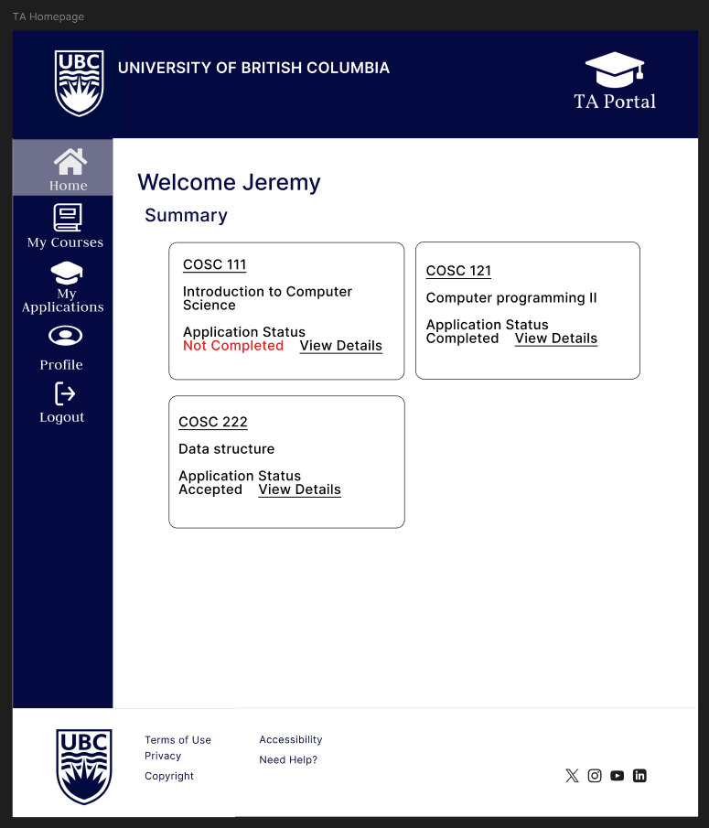
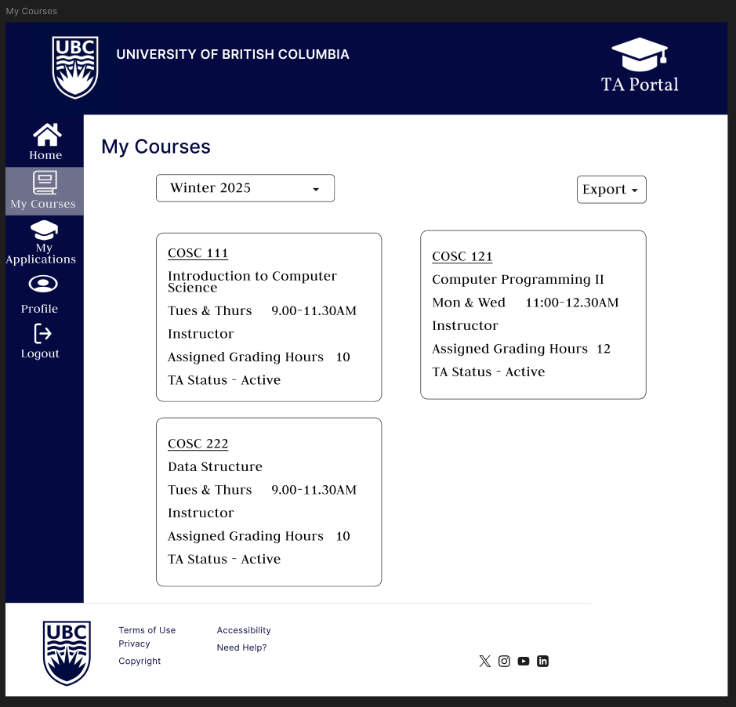
TA Mockups
This TA Homepage provides a personalized summary for teaching assistants. Upon logging in, users can view the status of their TA applications for each course, such as "Not Completed," "Completed," or "Accepted." Each course card includes a “View Details” link for further action or updates
The My Courses page displays a TA's assigned courses for the selected term. Each card shows course name, schedule, assigned grading hours, and TA staand tus. A term filter and export option are available for easy access record-keeping. This page helps TAs quickly view and manage their teaching assignments.

Slide 22
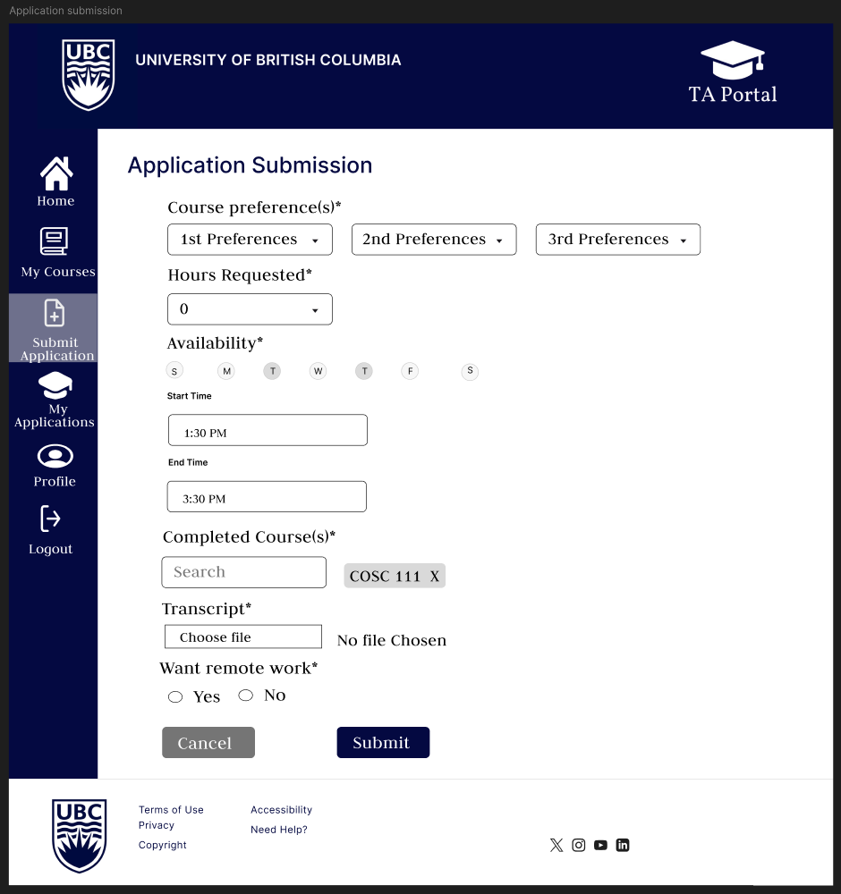
TA Mockups
This Application Submission page allows TAs to apply for a position by filling out essential details. It includes dropdowns for course preferences (1st, 2nd, 3rd), a field for requested working hours, and a weekly availability selector with time slots. TAs can list completed courses, upload their transcript, and indicate whether they prefer remote work. A clear "Submit" button finalizes the application, while "Cancel" lets users exit the form.

Slide 23
Conclusion

