Slide 1
Weekly Team Progress Report
Date Range: July 15 – June 17

Slide 2
Project Cycle Overview
Implement CSV export feature (backend, frontend, tests)
Completed Student and Coordinator Dashboard
Some bugs fixed in change in role in frontend and allocation
Update need hours when accepting an offer
View allocation and export
Backend Frontend Integration - GTA exam availability was completed
Change role in frontend

Slide 3
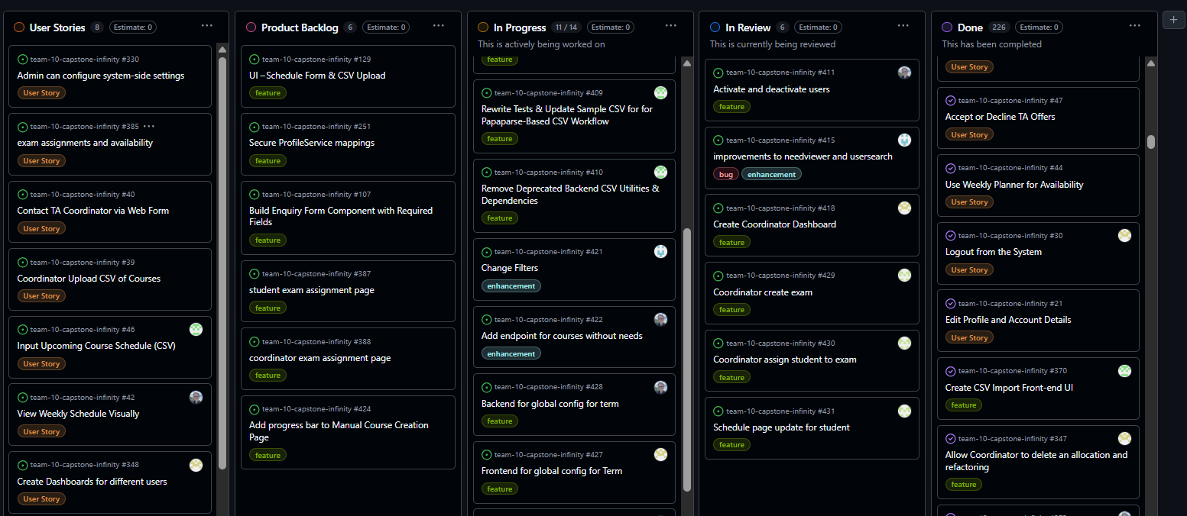
Kanban Board Progress
Visual of GitHub Kanban Board

Slide 4
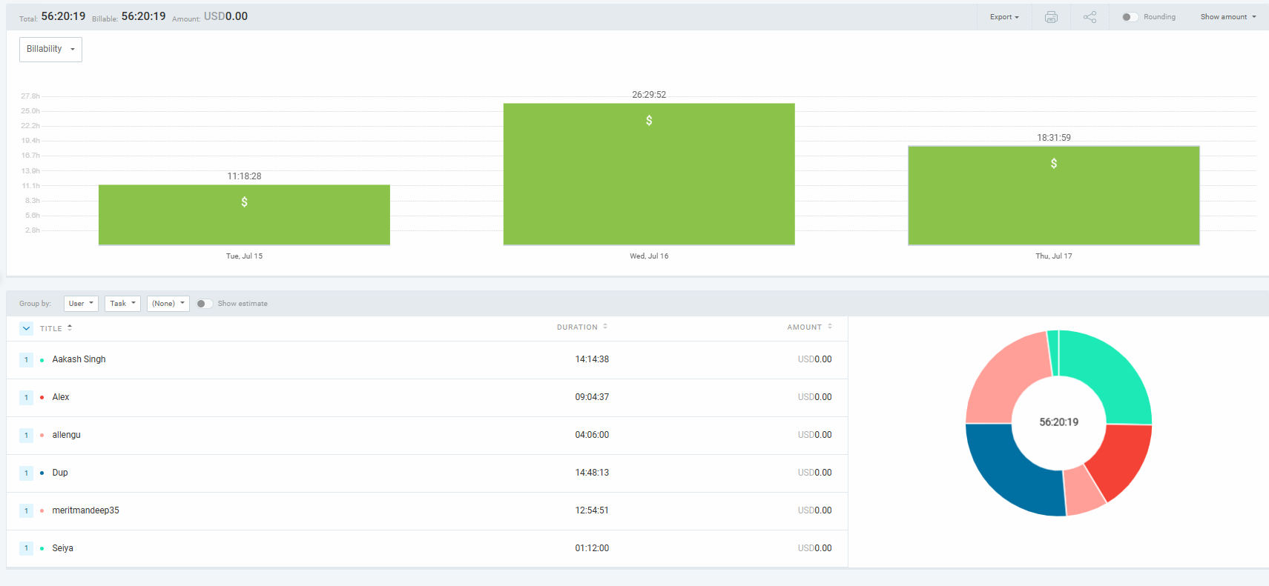
Team Member Logged Hours
Chart from Clockify: Logged hours by member

Slide 5
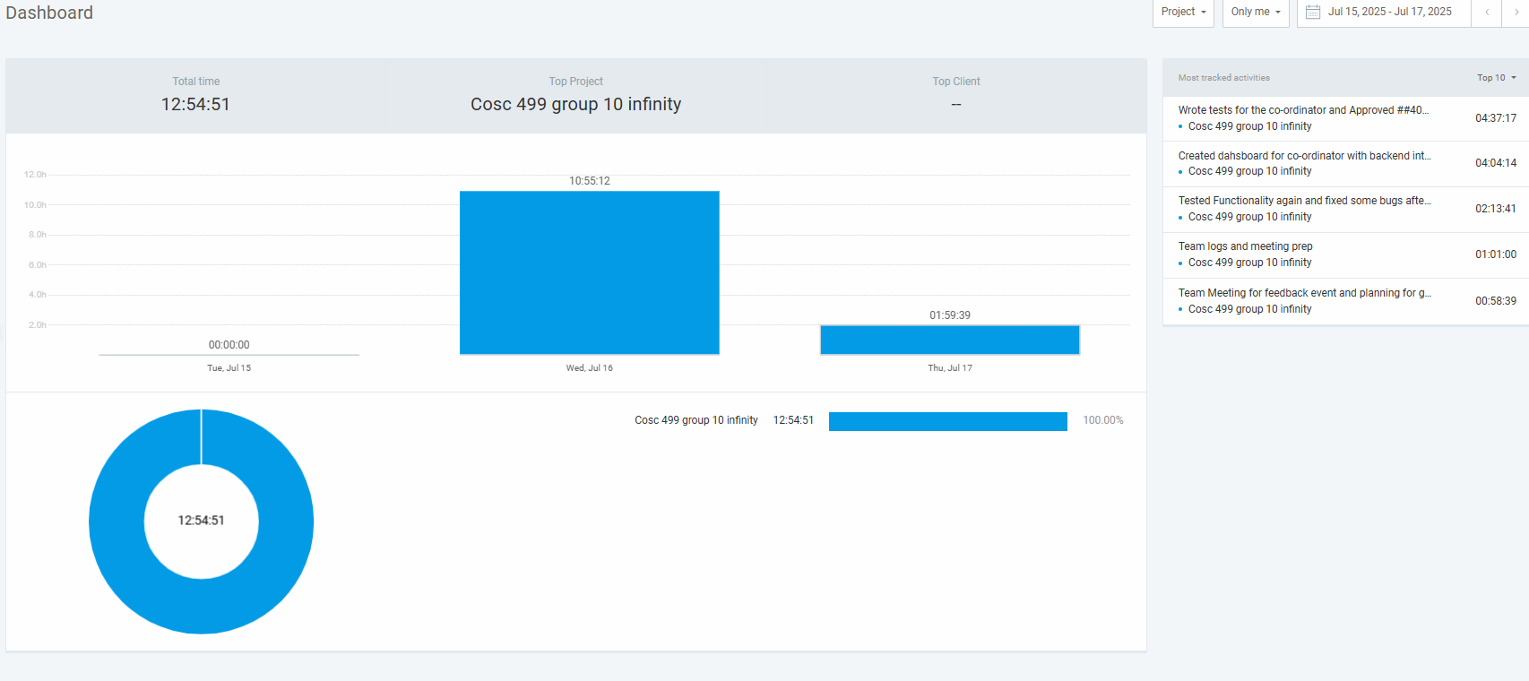
Mandeep’s tracked activites

Slide 6
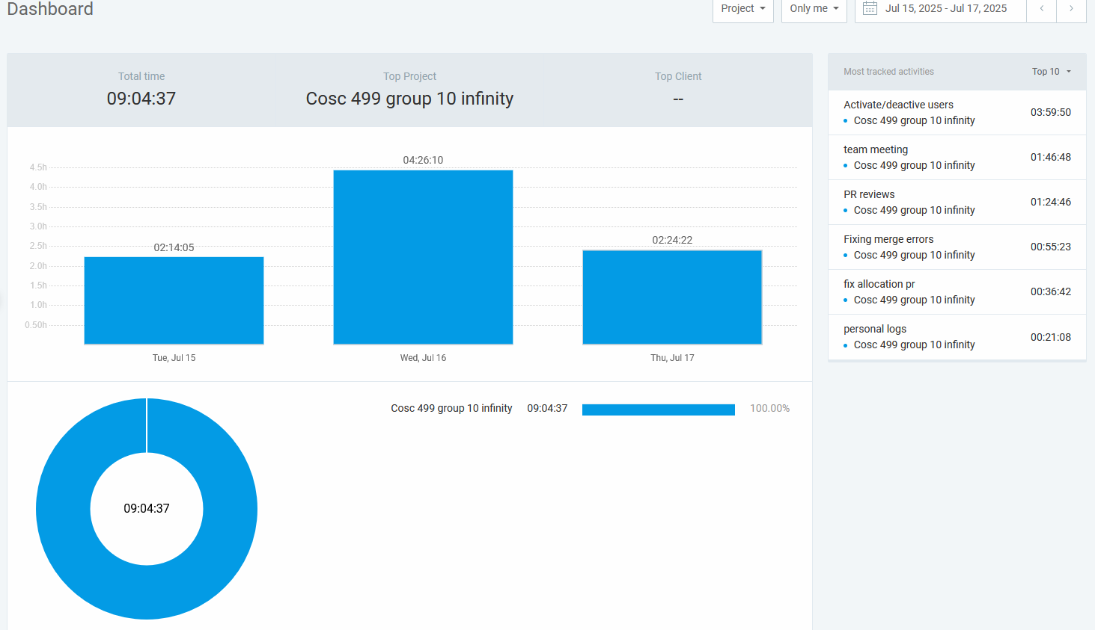
Alex’s tracked activities

Slide 7
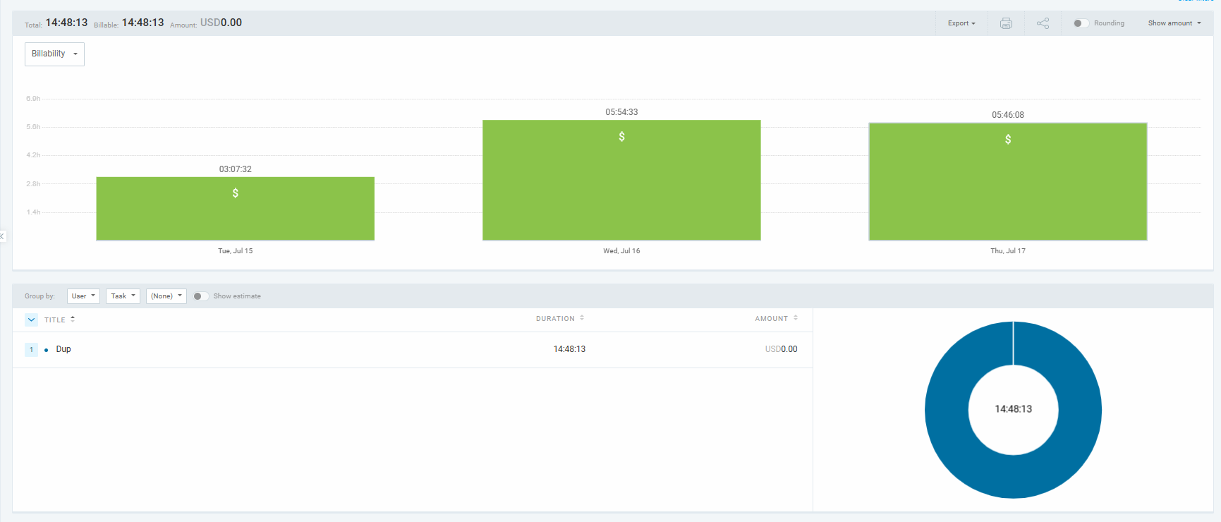
Dup’s tracked activities

Slide 8
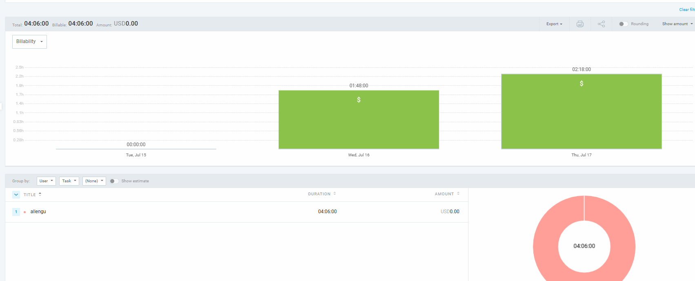
Allen’s tracked activities

Slide 9
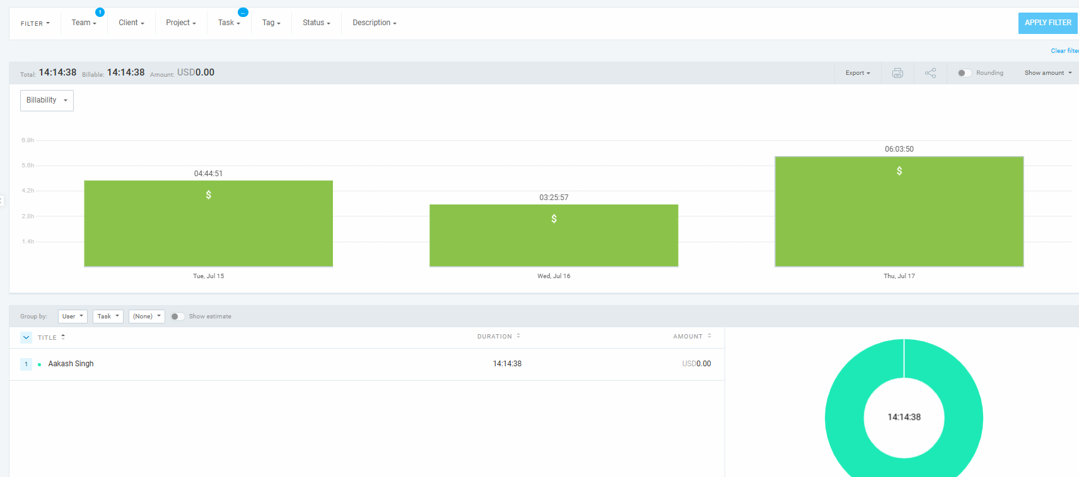
Aakash tracked activities

Slide 10
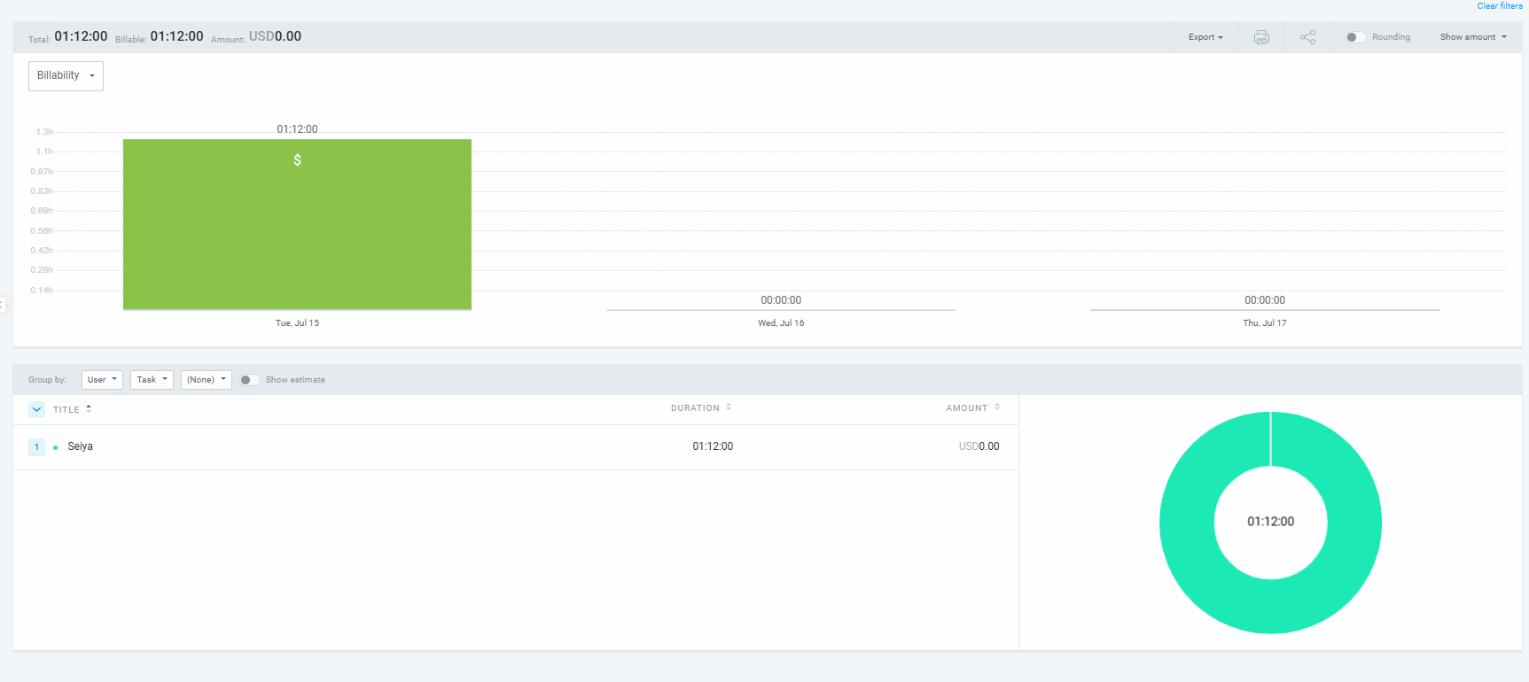
Seiya’s tracked activities

Slide 11
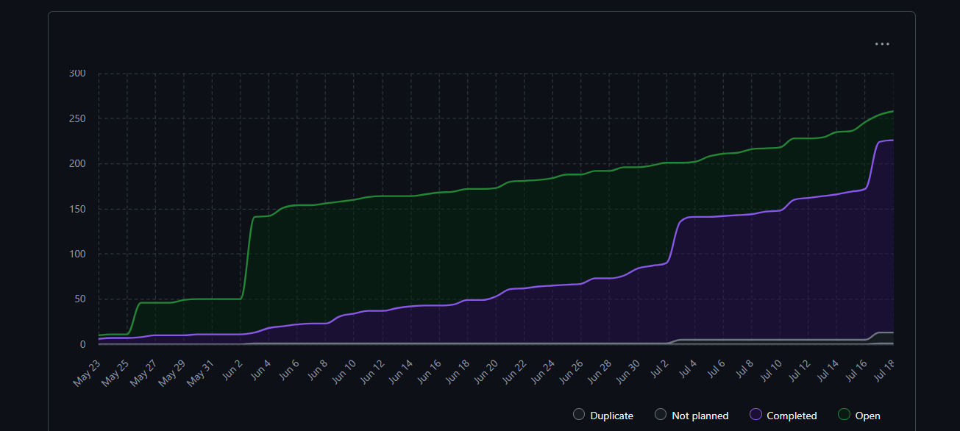
Burn-up Chart (Velocity)
Visual progress

Slide 12
Completed & Ongoing Tasks
Completed :
Some bugs fixed in change in role in frontend and allocation
Update need hours when accepting an offer
view allocation and export
Backend Frontend Integration - GTA exam availability
Change role in frontend
Implement CSV export feature (backend, frontend, tests)
Student and Coordinator Dashboard
In Progress:
Create Instructor Dashboard
Backend and frontend for global config for term
Import csv of course import
Refinement in some the profile pages

