Slide 1



VEDANTU · PRODUCT MANAGEMENT ASSIGNMENT
Consent,
by Design.
Making YouTube's children's-data experience DPDP-compliant without the friction that drives families away.
Gollapalli Aakash Sudheendra Product Thinking Deck · July 2026

Slide 2


THE PROBLEM
YouTube collects children's data. India's law now says: not without a verified parent.
Focus the sign-up & consent flow for under-18 users on YouTube (India).
Legal risk
Child safety
User trust
Mishandling a child's data carries penalties up to ₹200 crore under the DPDP Act.
Under-18s can't be tracked, profiled, or shown targeted ads — the Act's hardest line.
Only ~16% of Indians understand the law. A clear consent flow becomes a trust advantage.
Assumptions YouTube (India) uses self-declared age today · I focus on consumer sign-up, not Workspace/enterprise · DPDP children's rules become enforceable May 2027.

Slide 3

WHO WE'RE DESIGNING FOR
Two people, one account — and both feel the friction.
Meera · 42
Aarav · 14
Parent · Pune
Student · on YouTube daily
Phone-first, time-poor; worries about what her kids see and share online.
Uses YouTube for study and fun; wants to get in fast.
No visibility or control over what data YouTube collects on her 14-year-old.
Consent today is invisible — buried in policies she never reads.
Friction and dead-ends kill his flow.
Will lie about his age to skip barriers — defeating the safeguard.
The tension: if consent is painful for Meera, Aarav routes around it by faking his age. The design must satisfy the parent and respect the teen's time.

Slide 4

TODAY
How consent works now — and where it breaks under DPDP.
TODAY (assumed)
THE GAPS vs DPDP
1
Sign up
No verifiable parental consent for under-18s (Rule 10).
Age is self-declared and unreliable — the law expects real age assurance.
2
Enter a self-declared birthday
Behavioural tracking & targeted ads to minors — now prohibited.
3
Full account: data collected, ads personalised
No plain-language notice or easy, granular consent withdrawal.
Net effect a 14-year-old today gets a fully tracked, ad-personalised account with zero parental involvement — the exact gap DPDP closes.

Slide 5





THE SOLUTION
A parent-verified consent flow that takes under two minutes.
1
2
3
Age gate
Parent invited
Verify via DigiLocker
Real date of birth at sign-up — not skippable.
Under-18 detected; account pauses, parent gets a secure link / OTP.
Aadhaar-linked token confirms an identifiable adult parent.
4
5
6
Plain-language notice
Granular consent
Activate & log
What data, and why — shown in the parent's language.
Tracking & targeted ads OFF by default for the child.
Account goes live; consent stored for audit.
Why DigiLocker tokens, not full ID-upload for everyone? Less data collected (minimisation), lighter UX, and government-grade verification.

Slide 6


MEASURING SUCCESS
One number that matters — guarded by the experience around it.
NORTH STAR METRIC
90%
% of active under-18 accounts with valid, current verified parental consent
target within 6 months
Consent completion rate
Median time-to-consent
Consent-withdrawal rate
Target ≥ 85%
Target < 2 minutes
Monitor for health
Guardrails added sign-up drop-off from the consent step stays < 10% · parent support tickets per 1,000 flows stay low. Success criteria 90% coverage, drop-off under 10%, and median completion under 2 minutes.

Slide 7



IF THE NUMBER DROPS
North Star falls 15% in week 3 — no release shipped. How I'd investigate.
1 · Is it even real?
2 · Is a step broken?
3 · Is it external?
A tracking / logging bug, a renamed event, or a dashboard filter can fake a drop.
A single funnel stage may be leaking — age gate, DigiLocker handoff, notice, or confirm.
A DigiLocker/Aadhaar outage, an app-store update, an OS webview change, or a seasonal sign-up mix.
→ Check raw event counts against the derived metric.
→ Compare step-wise conversion week-over-week.
→ Correlate with app version, region & dependency status.
Data I'd pull: funnel by step × platform × region × app-version; verification-callback error logs; completion by time-of-day. Root cause → next steps: isolate the anomalous step/segment, reproduce, hotfix or escalate the failing dependency, and add alerting on DigiLocker callback success.

Slide 8
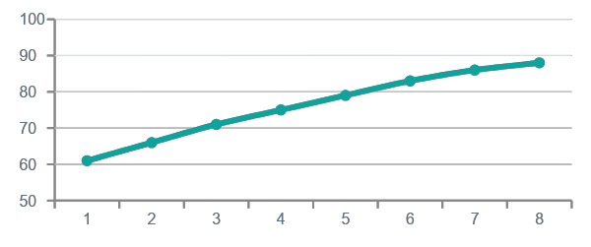
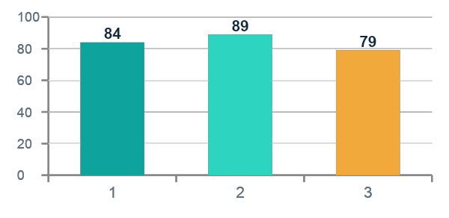
MONITORING
Children's Consent Health — daily dashboard
mock data
Verified-consent coverage
Consent completion rate
Median time-to-consent
88.4%
87%
1m 42s
▲ from 61% at launch
of invited parents
under the 2-min goal
Coverage trend — last 8 weeks
Completion rate by platform

Slide 9




GO-TO-MARKET
Ship it safely: shadow → pilot → ramp.
PHASE 1
PHASE 2
PHASE 3
PHASE 4
Shadow mode
Pilot
Staged ramp
Backfill
Run age detection silently. Size the under-18 base. Zero user impact.
One region, new sign-ups only. Watch completion, drop-off & support load.
5% → 25% → 100% of new minor sign-ups, region by region, with a kill-switch.
Prompt existing minor accounts to complete consent before May 2027.
On A/B testing. You can't withhold consent from a control group — that would mean unlawfully processing minors' data. So I A/B-test the experience (copy, verification method, reminder cadence) — the how — never the whether. The whether is validated through shadow-mode sizing and phased rollout with live guardrail monitoring.

Slide 10

RISKS & TRADE-OFFS
What could go wrong — and the calls I made.
Engineering
Business
DigiLocker integration + immutable consent logs are real work, and lean on a government system's uptime. → Fallback path, caching, alerting.
Extra steps can dent minor sign-up conversion. → Accepted: a smaller compliant, trusted base beats a large one carrying ₹200cr risk.
User
Edge cases
Parents without DigiLocker/Aadhaar, or on shared devices, may struggle. → Offer an alternate verification path + clear help.
Declined consent (safe, restricted mode), deletion requests, under-13 vs 13-17, guardian ≠ account holder — all handled explicitly.
The trade I accepted: a little more onboarding friction for minors in exchange for legal safety and durable family trust. Get children's consent right, and privacy stops being a cost — it becomes why families choose you.

