Slide 1

Stack Overflow Flow Developer Survey Analysis
Aakash Vyishak S
13-07-2025

Slide 2



OUTLINE
Executive Summary
Introduction
Methodology
Results
Visualization – Charts
Dashboard
Discussion
Findings & Implications
Conclusion
Appendix

Slide 3

EXECUTIVE SUMMARY
Provides a structured analysis of insights derived from the Stack Overflow Developer Survey
Current Technology Usage vs Preferences
Identified top 10 languages and databases(current vs Preferences)
Identified top 10 platforms and webframes (current vs Preferences)
Discussion highlighting implications and insights from the analysis.
Final conclusions based on the overall research.
conclusions based on the overall analysis

Slide 4

INTRODUCTION
The Stack Overflow Developer Survey is the most detailed survey of professional and hobbyist developers
The results are not universally representative of all developers.
Survey included nearly 18845 participants.
Trends can help forecast the future of the developer landscape.
Target Audience
Tech leaders, HR teams, educators, and product managers seeking datadriven guidance on developer tools and preference.

Slide 5

METHODOLOGY
Data Source: The analysis is based on responses from the Stack Overflow Developer Survey, which gathers input from thousands of developers globally.
Data Collection: The dataset was downloaded from a public cloud repository using a direct link and was saved as survey-data.csv for further analysis
Data Wrangling
Multi-select fields (e.g., LanguageHaveWorkedWith) contained semicolon-separated values.
These fields were split and exploded into individual rows to enable accurate counting and analysis.
Null or inconsistent entries were cleaned, and whitespace was trimmed.
Exploratory Data Analysis
• Analyzing data distribution
• Handling outliers
• Correlation
Visualization Tools: Cleaned data was imported into IBM Cognos to build a multi-panel interactive dashboard.
Demographics: Survey responses were also grouped by age, education level, and country to provide context for interpreting technology trends.

Slide 6
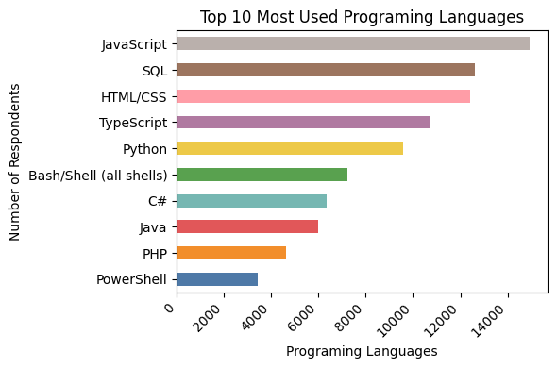
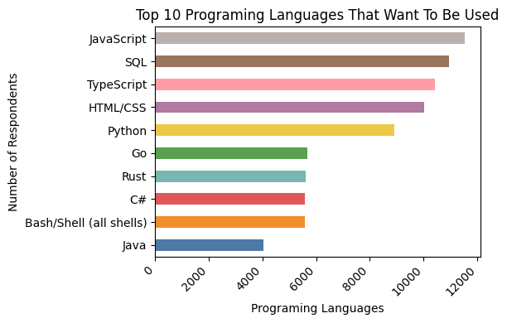
PROGRAMMING LANGUAGE TRENDS
Current Year
Next Year
<Bar chrt of top 10 programming languages for the current year goes here.>
< Bar chart of top 10 programming languages for the next year goes here.>

Slide 7
PROGRAMMING LANGUAGE TRENDS - FINDINGS & IMPLICATIONS
Findings
Javascript and SQl seems to be top two languages
Typescript and Python becoming popular in the future
PHP and Powershell are out whereas GO and Rust will enter top 10
Implications
Organizations should continue to invest in JavaScript and SQL skills
Python is best choice with AI and ML in rising demand
Growing need in systems programming, cloud infrastructure, and backend development

Slide 8
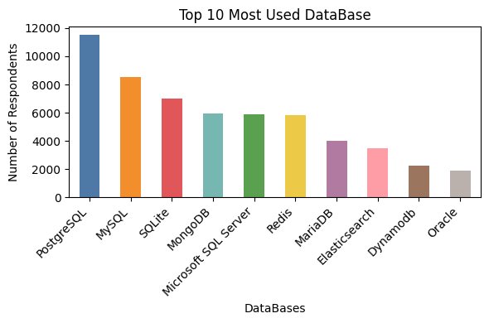
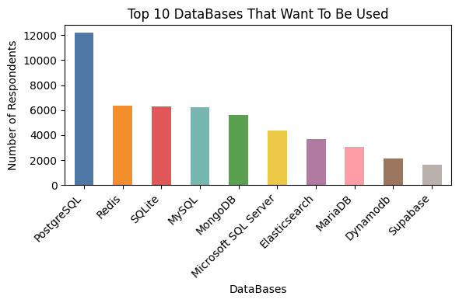
DATABASE TRENDS
Current Year
Next Year
< Bar chart of top 10 databases for the current year goes here >
Bar chart of top 10 databases for the net year goes here.>

Slide 9
DATABASE TRENDS - FINDINGS & IMPLICATIONS
Findings
PostgreSQL seems to be top database used
Declining interests in MySQL and MongoDB
Increasing interest in Redis and Elastic search
Implications
PostgreSQL preferred choice for both startups and enterprises
Redis have speed and efficiency, particularly in caching, real-time analytics, and high-performance applications
ElasticSearch is becoming a goto solution for indexing, logging, and real-time search in data analytics

Slide 10

DASHBOARD
Screenshots of each dashboard are provided in the following slides, and the full PDF version of the dashboard can be accessed through the link below.
Click Here to View Dashboard

Slide 11
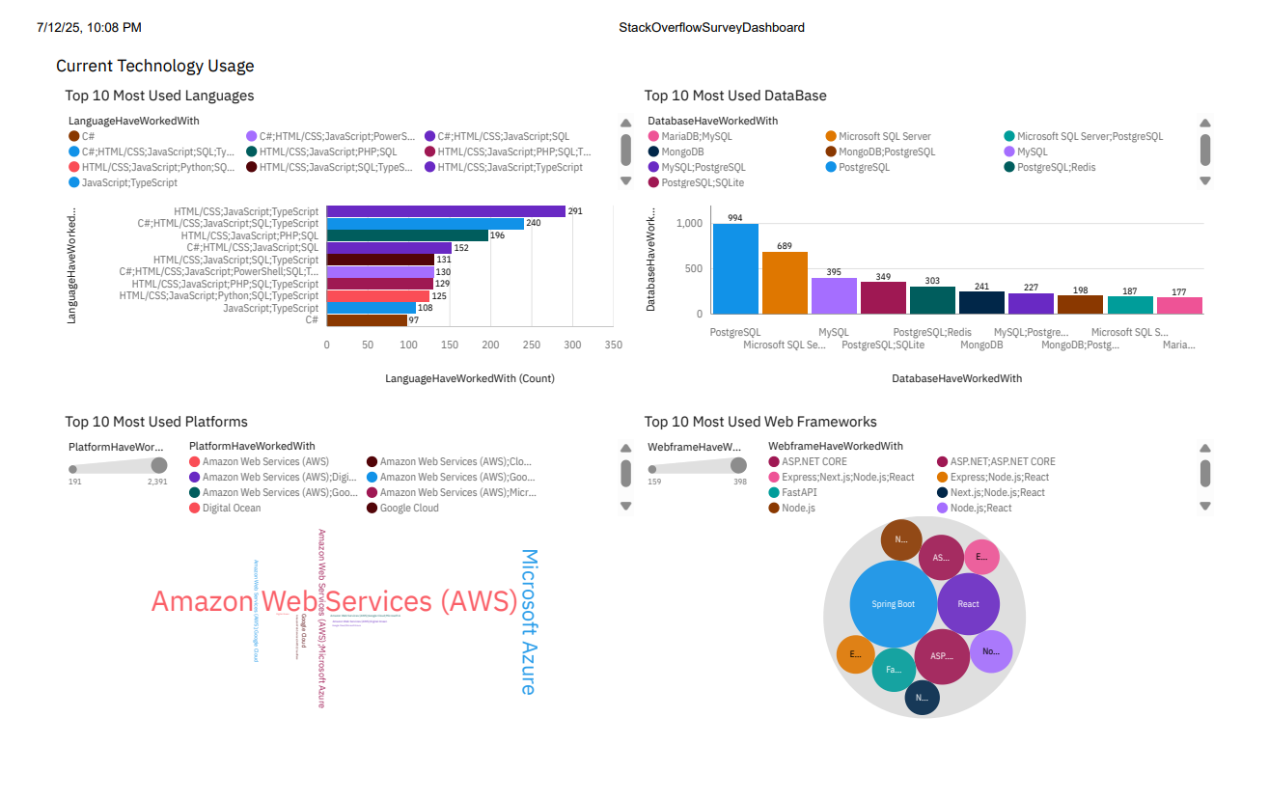
DASHBOARD TAB 1
Screenshot of dashboard tab 1 goes here

Slide 12
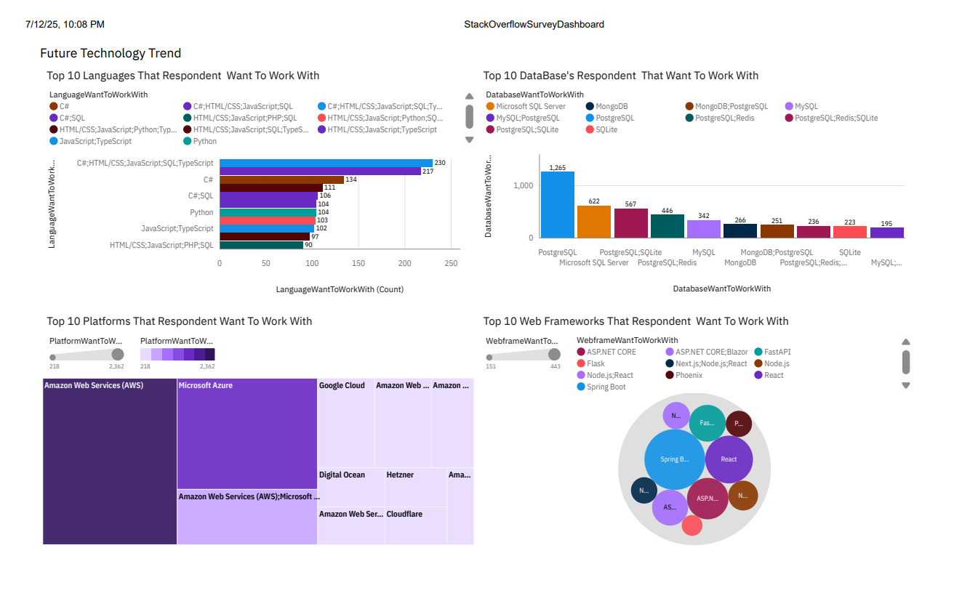
DASHBOARD TAB 2
Screenshot of dashboard tab 2 goes here

Slide 13
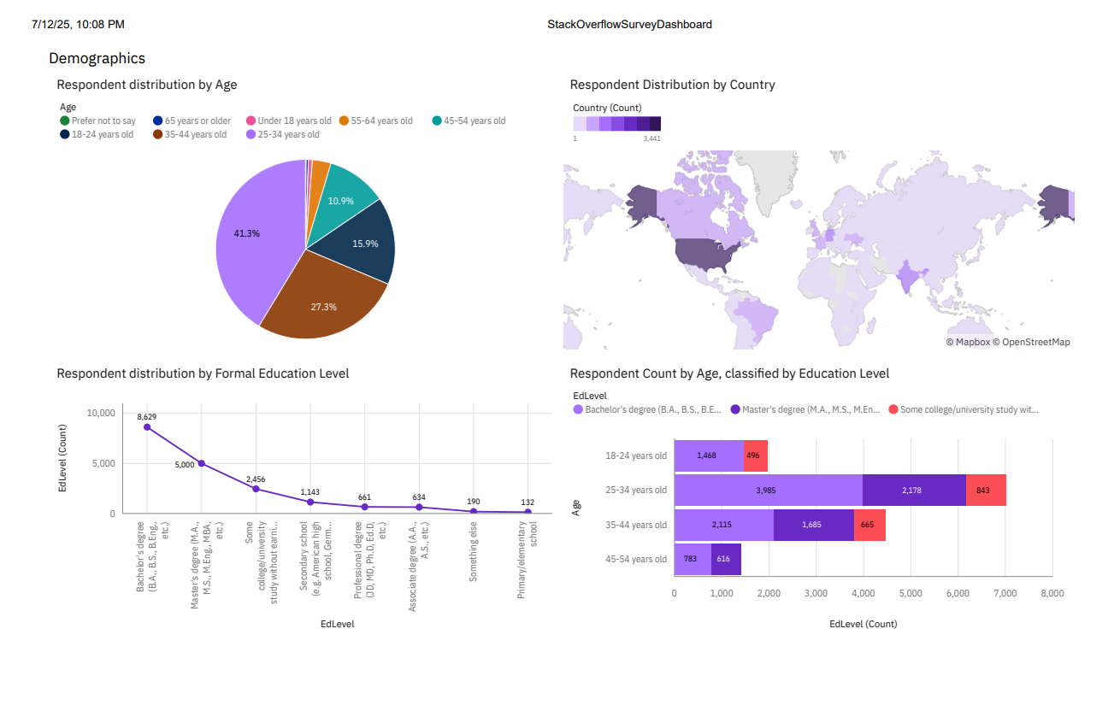
DASHBOARD TAB 3
Screenshot of dashboard tab 3 goes here

Slide 14
DISCUSSION

Slide 15
OVERALL FINDINGS & IMPLICATIONS
Findings
JavaScript is the top language used and TypeScript gains popularity
PostgreSQL has surpassed MySQL in popularity
AWS remains dominant, followed by Azure and Google Cloud
The majority of developers are between 25 and 34 years old indicates emerging young talent into the field
Most developers hold a BA/BS or MA/MS degree
Implications
Cloud-native architectures are now mainstream— organizations must adapt development and DevOps accordingly.
Front-end frameworks are evolving fast (e.g., React + Next.js). Staying updated is crucial for employer attractiveness.
The developer community is young and well educated
Spread of developers is not uniform across the globe

Slide 16

CONCLUSION
JavaScript, SQL, TypeScript and Python continue to dominate in shaping the modern tech landscape
PostgreSQL will remain as a strong Database
AWS is dominating present and future cloud platforms
The developer community remains young and globally diverse
Tech teams should invest in modern stacks (Go, React, PostgreSQL, cloud platforms)

Slide 17
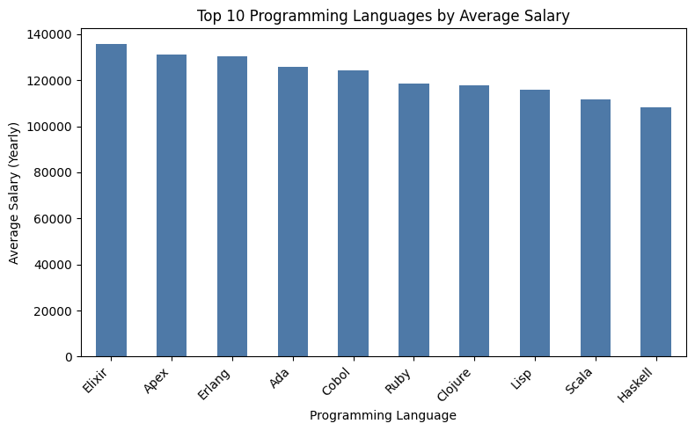
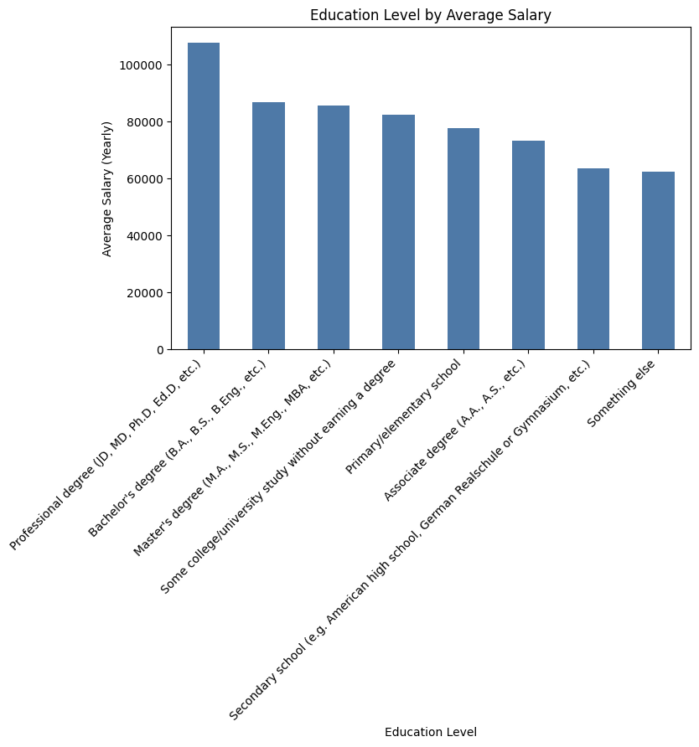

APPENDIX

Slide 18
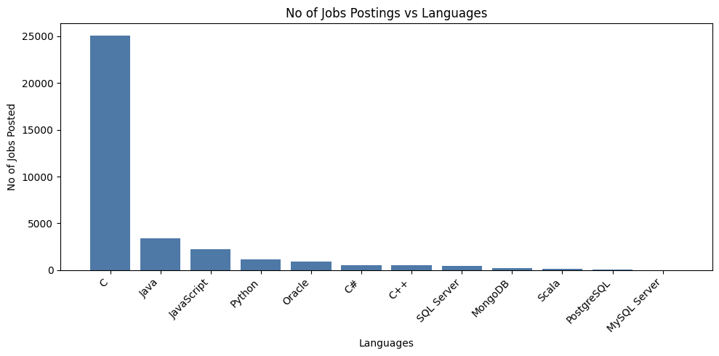
JOB POSTINGS
In Module 1 you have collected the job posting data using Job API in a file named “job-postings.xlsx”. Present that data using a bar chart here. Order the bar chart in the descending order of the number of job postings.

Slide 19
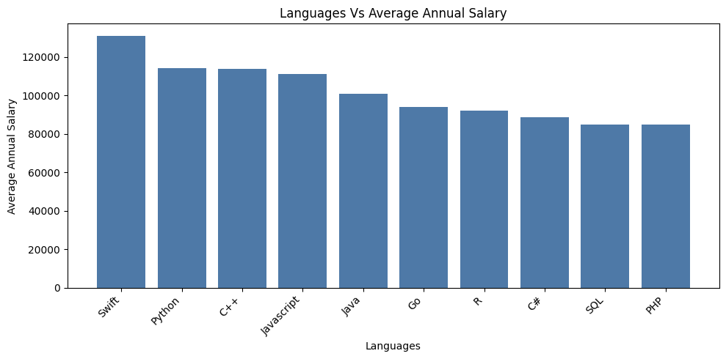
POPULAR LANGUAGES
In Module 1 you have collected the job postings data using web scraping in a file named “popular-languages.csv”. Present that data using a bar chart here. Order the bar chart in the descending order of salary.

