Slide 1
Bank churn Prediction
Mini-Project

Slide 2
Introduction
One of the greatest challenges faced by service companies is to retain its customers.
More customers means more business and revenue to the company.
The cost involved in targeting new customers is a lot more than the effort to retain the existing ones.
Keeping this in mind, companies identify those customers who are likely to leave (churn).

Slide 3

Problem Statement
Our main goal is to retain our customers who will leave the company.
In order to achieve this goal, a predictive model can be built to find out the churn rate of the customers who will leave the company.
What are the key factors that can help us to retain our customers in order to increase the business and revenue.

Slide 4
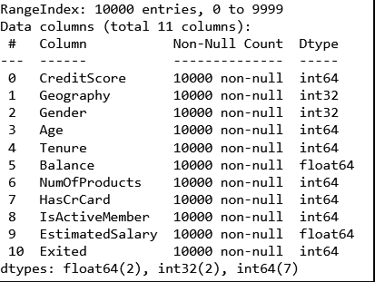
Data

Slide 5
Treatment on data
Missing value treatment: There are no null values in the data.
Duplicate values: No duplicates are their.
Changes in Geography column: 'France', 'Spain', ‘ espanio ’, ‘ fra ', 'Germany', ‘ France ‘, 'ger', ‘ spain ’ , ‘ Germany ', ‘ gernamy ', 'GERMANY’
Feature Selection by finding the fscore
Hot-coding to transform categorical data into numerical data.

Slide 6

MODEL BUILDING steps
Read the data.
Summarize the data.
Data structure (Type of data).
Data Visualization.
Data preprocessing(Missing value treatment , Feature Selection, Hot-coding, Data scaling).
Splitting of data into train and test.
Selecting right algorithm for model building.

Slide 7
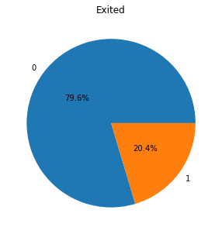
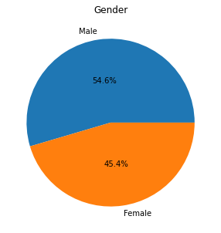
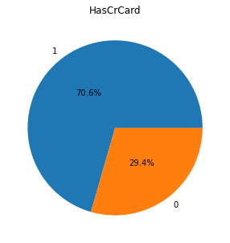
EDA(Exploratory data analysis)
20% customers left the company.
55% are males and 45% are females
70% are having the credit card.

Slide 8
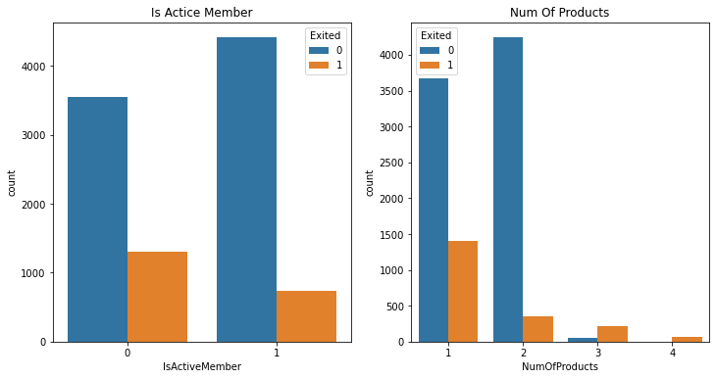
Churn rate of active members and having number of products
Non-Active members are more chances to churn.
Customers who has 2 products are high chances to churn.

Slide 9
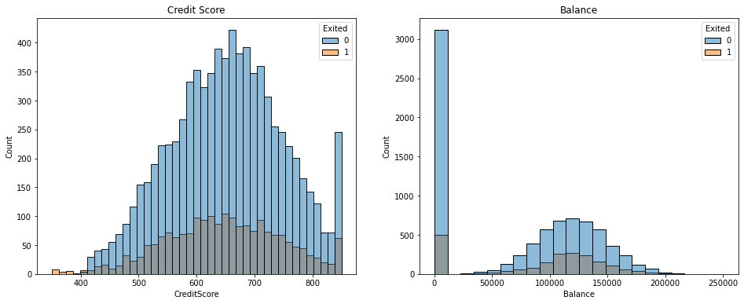
Credit Score and Balance
Customers who have low credit score are high in churn rate.
Customers who have low in balance are high in churn rate.

Slide 10
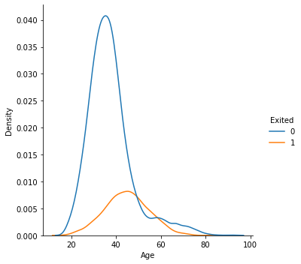
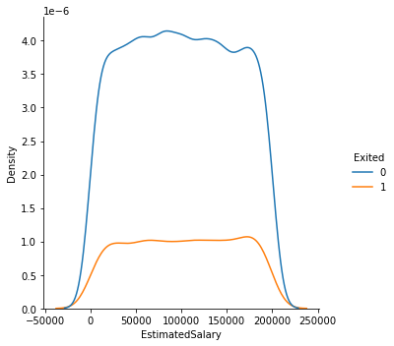
Distribution of Customers age and their Estimated Salary

Slide 11
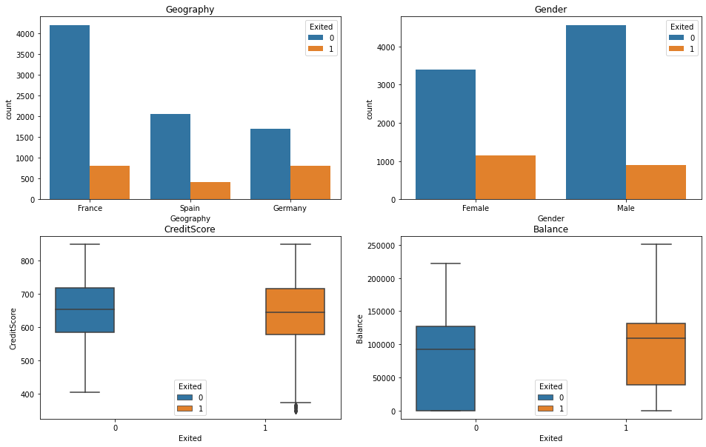
More People are form Germany who left.
Females are more likely to churn than males.
Average balanced is more for who churn out.

Slide 12
Model Building
Logistic regression is a model is a classification algorithm that assigns observations to a discrete set of values.
Naive Bayes Naive Bayes algorithm is a supervised learning algorithm, which is based on Bayes Theorem and used for solving classification problems.
Decision tree classifier observes features of an object and trains a model in the structure of a tree to predict data in the future to produce meaningful continuous output.
Random Forest classifier uses ensemble learning method for classification. Ensemble learning method is a technique that combines predictions from multiple machine learning algorithms to make a more accurate prediction than a single model.
Ada boost stands for Adaptive Boosting and it is widely used ensemble learning algorithm in machine learning. All weak learners are boosted in sequentially.
Knn classifier

Slide 13
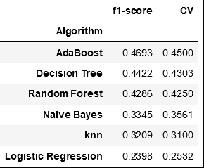
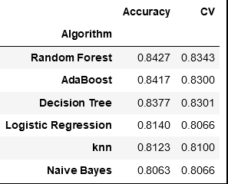
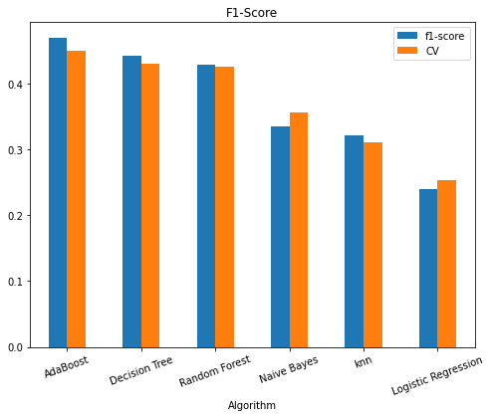
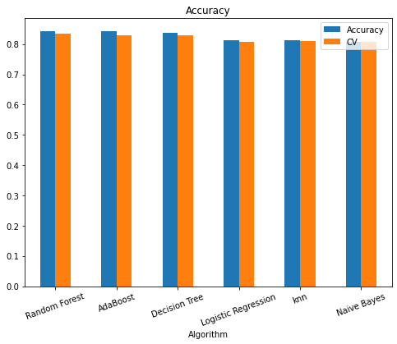
RESULTS

Slide 14
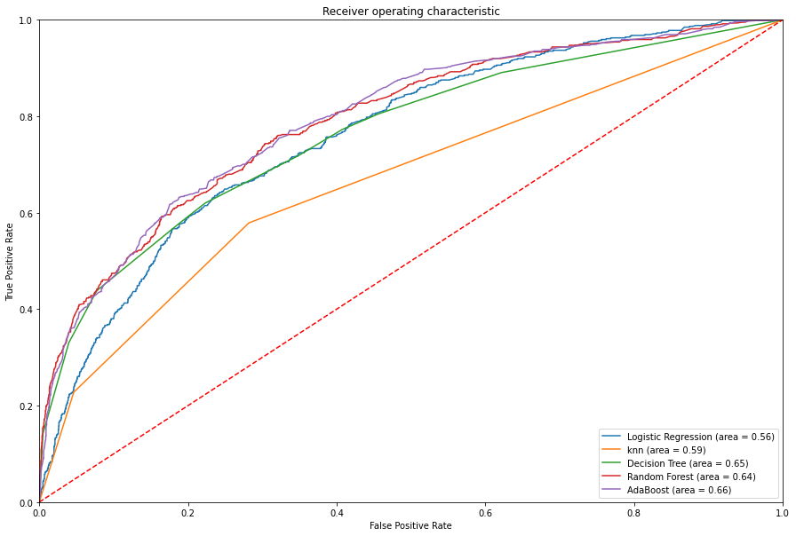
ROC-CURVE

Slide 15
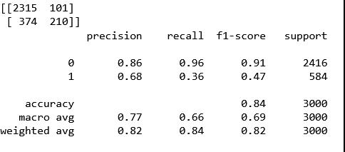
Confusion Matrix and classification report

Slide 16
Conclusion
By comparing all the models with their F1-score values and Accuracy we find that Ada Boost is best model which give better predictions. So, we consider AdaBoost as the best model for this dataset.
Females are more likely to churn as compared to men. To avoid that provide some extra resources to the women.
In order to retain its customers, Bank should provide extra resources, give some extra services and good discounts to them.
Old age customers are more in churn rate. So, to provide some pension schemes to them.

Slide 17
Thank you

