Slide 1
Mall Customers Segmentation
Mini-Project

Slide 2
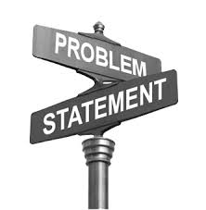
Problem Statement
The main purpose of performing customer segmentation is to group people, who have similar interest so that the marketing team can converge in an effective marketing plan.
In order to achieve this goal, a predictive model can be built to find out the group of customers and find out the right customers for specific products.
What are the key factors that can help mall to increase the sales and profit.

Slide 3
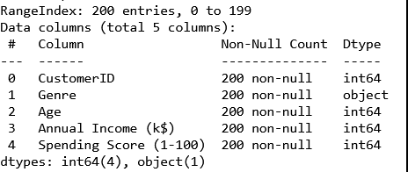
Data

Slide 4
Treatment on data
Missing value treatment: There are no null values in the data.
Duplicate values: No duplicates are their.

Slide 5
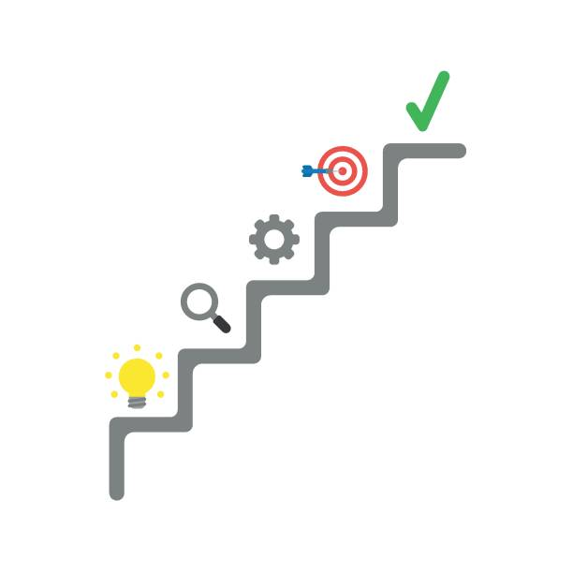
MODEL BUILDING steps
Read the data.
Summarize the data.
Data structure (Type of data).
Data Visualization.
Data preprocessing
Selecting right algorithm for model building.

Slide 6
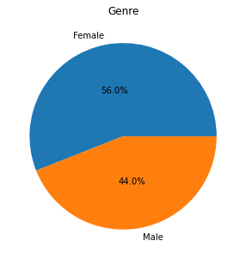
EDA(Exploratory data analysis)
56% are females and 44% are males

Slide 7
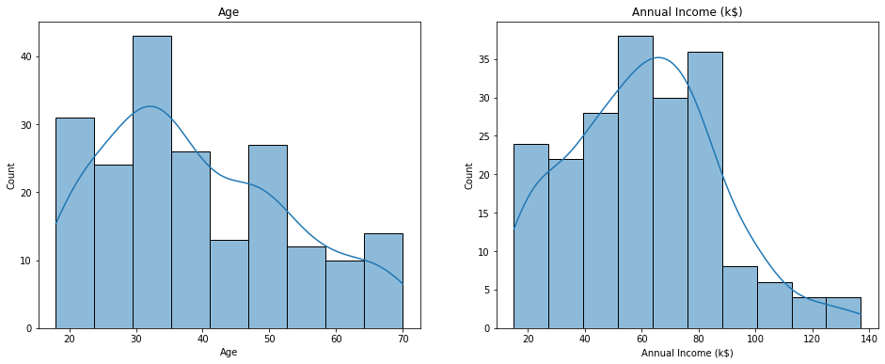
Distribution of Age and Annual Income
Maximum customers are age between 30-35.

Slide 8
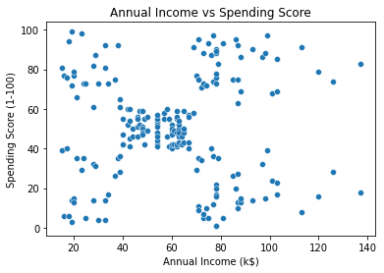
Annual Income vs Spending Score

Slide 9
Models
K-MEANS K-Means clustering is an unsupervised learning algorithm. There is no labeled data for this clustering. K-Means performs the division of objects into clusters that share similarities and are dissimilar to the objects belonging to another cluster.
AGGLOMERATIVE CLUSTERING ALGORITHM Agglomerative Clustering is a type of hierarchical clustering algorithm. It is an unsupervised machine learning technique that divides the population into several clusters.
DBSCAN (DENSITY BASED SPATIAL CLUSTERING OF APPLICATIONS WITH NOISE) DBSCAN is a clustering algorithm that defines clusters as continuous regions of high density .

Slide 10
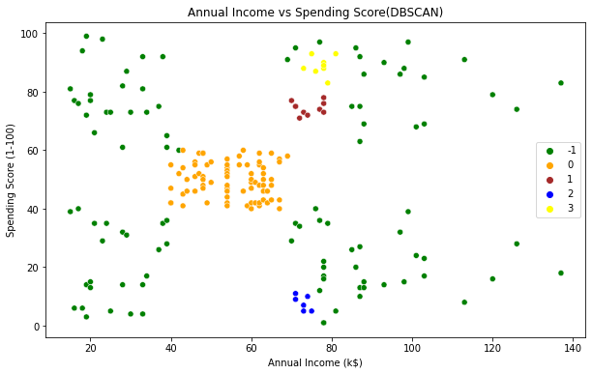
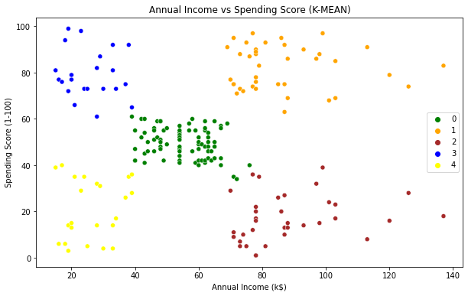
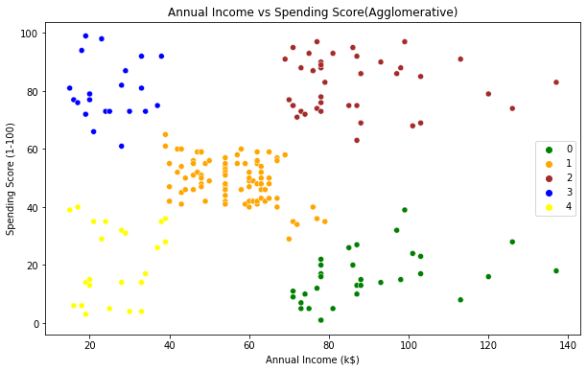
RESULTS

Slide 11
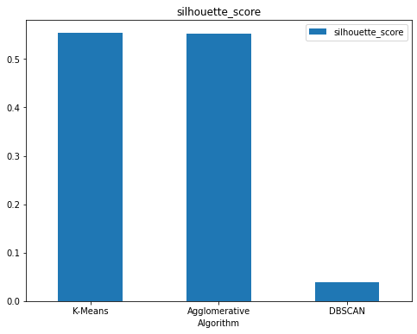
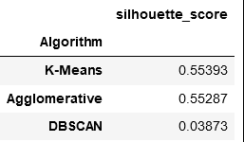
RESULTS

Slide 12
rESULTs
2
In cluster 1 people have high income and high spending scores, these people might be the regular customers of the mall and are convinced by the mall’s services.
In cluster 2 people have low income and high spending scores these people might be the regular customers of the mall and are convinced by the mall’s services.
In cluster 3 people have low annual income and low spending scores, people having low salaries prefer to buy less, The mall will be least interested in people belonging to this cluster.
1
5
3
4

Slide 13
RESULTs
In cluster 4 people have high income but low spending scores, Maybe these are the people who are unsatisfied by the mall’s services. So, we can target these customers because they have the capability to spend more. So, the mall authorities will try to add new facilities so that they can attract these people and can meet their needs.
In cluster 5 people have average income and an average spending score, these are the average peoples again they will be considered and give some offers to increase their spending score.
2
1
5
3
4

Slide 14
Conclusion
By comparing all the models with silhouette score we find that Agglomerative Clustering Algorithm is best model which give better predictions. So, we consider Agglomerative Clustering Algorithm as the best model for this dataset.
By considering all the conditions, we can target cluster 4 and cluster 5 customers because they have the capability to spend more. So , we mall facilities can focus on these customers by giving some extra offers and discounts.

Slide 15
Thank you

