Slide 1
Prediction of store Sales
Mini-Project

Slide 2
Introduction
The success of any retail store depends upon its sales. More the sales made, more is the revenue. With a good customer service and care, the customer too enjoys a good shopping experience. This will lead to more in-flow of customers, opening more store branches across a city / country.
To enable this, store owners rely heavily on past data to predict future sales. This will help them in strategizing their business models and come up with innovative techniques and ideas to attract customers and set realistic goals.

Slide 3

Problem Statement
Our main goal is to predict sales of store on the basis of past data to predict future sales.
In order to achieve this goal, a predictive model can be built to find out the sales for every store.
What are the key factors that can increase their sales and what changes could be made to the product or store’s characteristics to increase the sales.

Slide 4
Data
S.No | Feature | Data Type | Description
1 | Item Identifier | Character | Unique product ID
2 | Item Weight | Numeric | Weight of product
3 | Item_Fat_Content | Numeric | Whether the product is low fat or not
4 | Item Visibility | Numeric | The % of total display area of all products in a store allocated to the particular product
5 | Item Type | Categorical | The category to which the product belongs
6 | Item_MRP | Numeric | Maximum Retail Price of the product
7 | Outlet Identifier | Categorical | Unique store ID
8 | Outlet_Esta._Year | Numeric | The year in which store was established
9 | Outlet size | Categorical | The size of the store in terms of ground area covered
10 | Outlet_location_Type | Categorical | The type of city in which the store is located
11 | Outlet Type | Categorical | Whether the outlet is a grocery store or supermarket
12 | Item_Outlet_Sales | Numeric | Sales of the product
Item_Identifier

Slide 5
Treatment on data
Missing value treatment:
There are 5681 null values in the Item Outlet Sales column. By filling them with mean values of sales and with respect to outlet type, item type, location type. These ways affect the distribution of sales. So, dropping them is right option.
Label encoding to transform categorical data into numerical data.
Hot-coding

Slide 6

MODEL BUILDING steps
Read the data.
Summarize the data.
Data structure (Type of data).
Data Visualization.
Data preprocessing(Missing value treatment, Label encoding, Hot-coding, Data scaling).
Splitting of data into train and test.
Selecting right algorithm for model building.

Slide 7
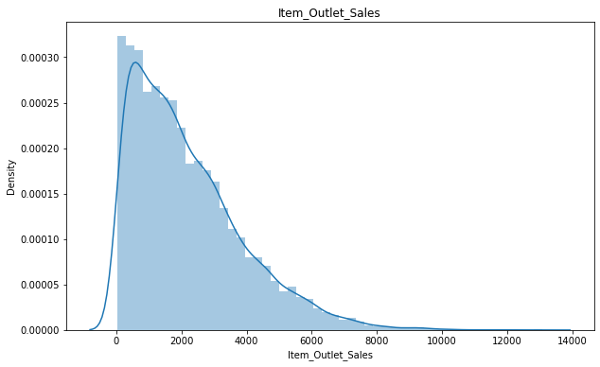
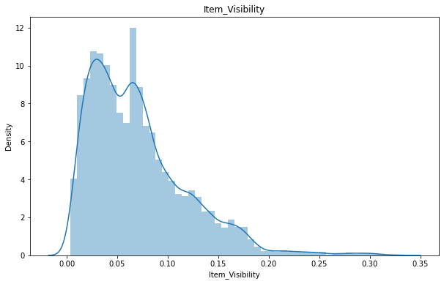
EDA(Exploratory data analysis)
Item outlet Sales and item visibility distribution
Sales data and item visibility is more skewed to right.
Observed that there are so many items which have almost zero visibility to the customers.

Slide 8
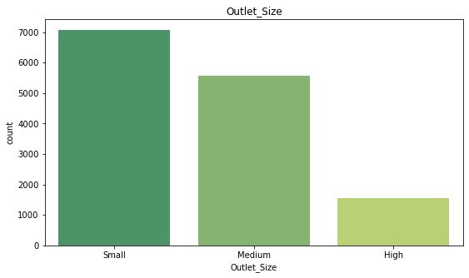
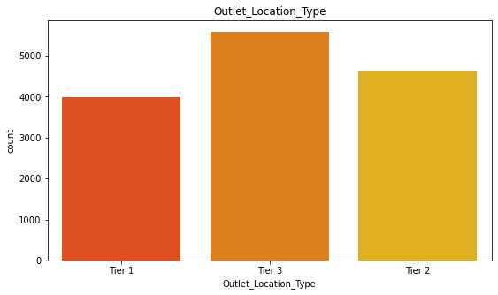
Outlet size and outlet location type
Most of the stores are of small type.
Most of the outlets are present in tier 3.

Slide 9
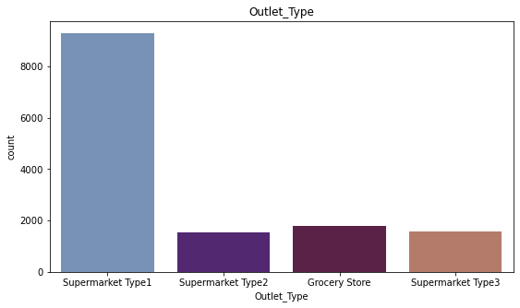
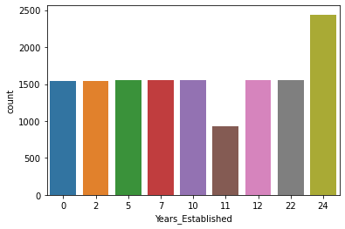
Which Outlet type have more stores and year extiblished
Supermarket Type1 have more stores.
Most of the stores are 24 years

Slide 10
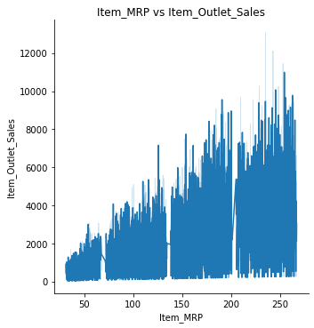
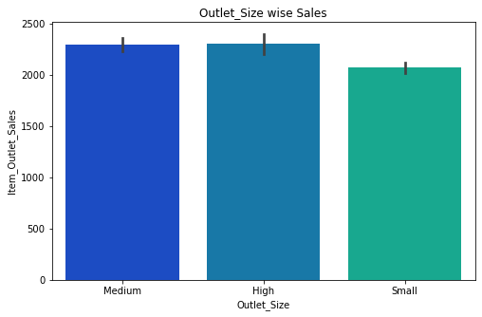
Outlet Sales relation with Item MRP and Outlet Size
Items MRP ranging from 200-250 is having high Sales.
Basically all the outlet size having almost same sales

Slide 11
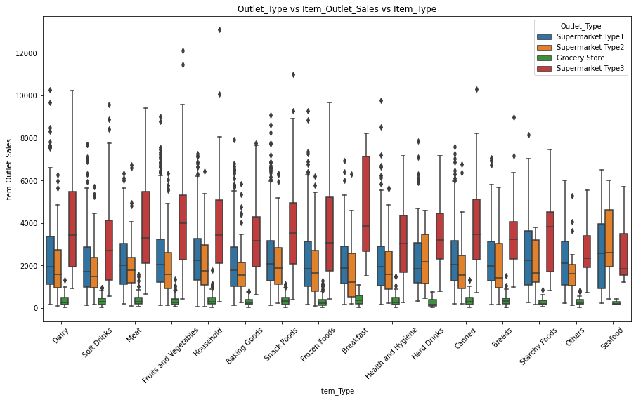
More sales are from supermarkets compared to grocery store

Slide 12
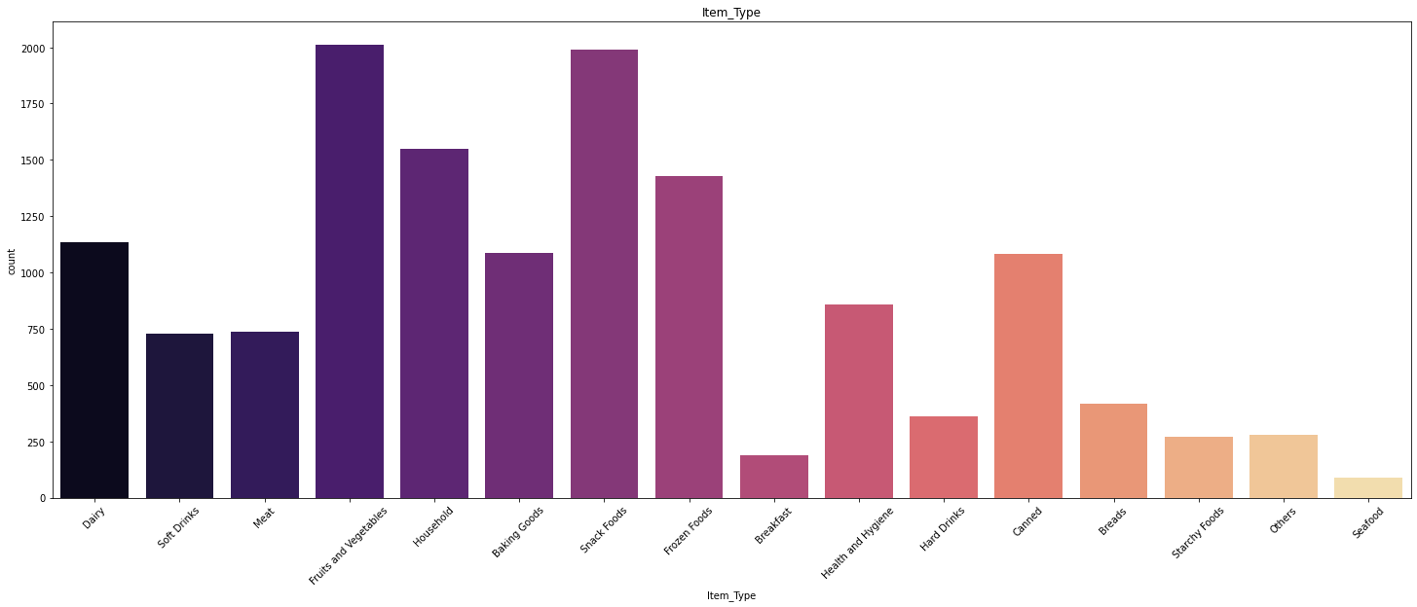
Fruits and Vegetables and snacks food are largely sold as people tend to use them on daily purpose

Slide 13
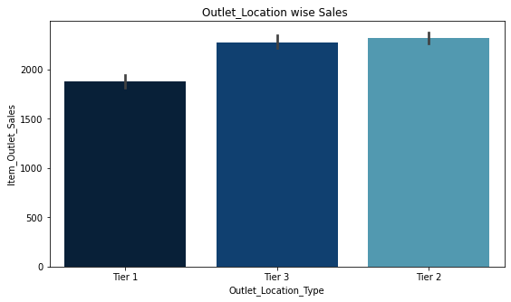
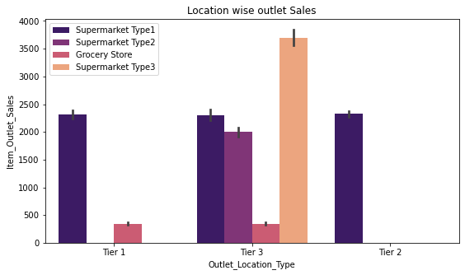
Conclusion:
Most of the sales are form Supermarket Type3 which are located in Tier3.
Items MRP ranging from 200-250 is having high Sales.
Many Items have low visibility (placed them in front to maximize the sale of that product).
Keep daily products more in the store to make more sales like fruits and vegies, snacks foods, household things etc.
Grocery Stores which have low sales can move to the tier 3 for the high sales.

Slide 14
Model Building
Linear regression is a model that defines the relationship between a dependent variable and an independent variable.
Decision tree regression observes features of an object and trains a model in the structure of a tree to predict data in the future to produce meaningful continuous output.
Random Forest Regression uses ensemble learning method for regression. Ensemble learning method is a technique that combines predictions from multiple machine learning algorithms to make a more accurate prediction than a single model.
Ada boost stands for Adaptive Boosting and it is widely used ensemble learning algorithm in machine learning. All weak learners are boosted in sequentially.

Slide 15
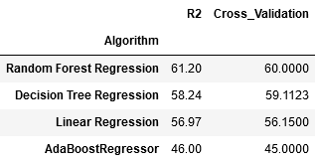
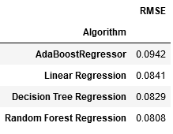
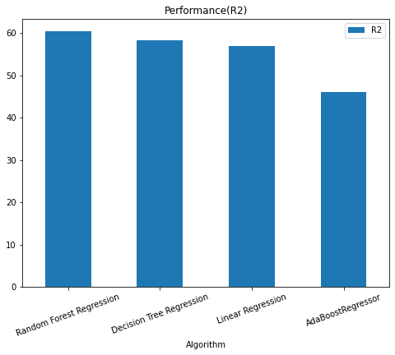
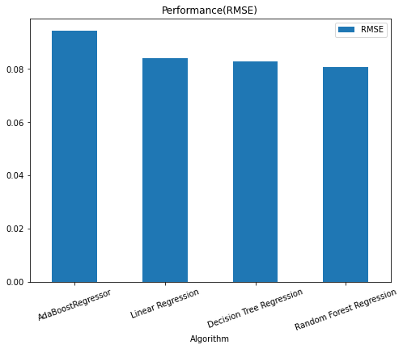
RESULTS

Slide 16
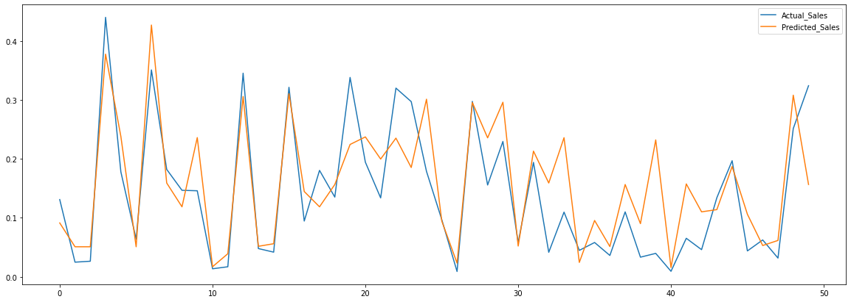
Actual vs Predicted

Slide 17
Conclusion
By comparing all the models with their RMSE values and R-squared values we find that Random Forest Regressor is best model which give better predictions. So, we consider Random Forest Regressor as the best model for this dataset.
As concerned with sales, Many Items have low visibility (placed them in front to maximize the sale of that product).
Keep daily products more in the store to make more sales like fruits and vegies, snacks foods, household things etc.
Grocery Stores which have low sales can move to the tier 3 for the high sales.
Do some advertisement of the products which may increase the sales.
Place some discounts templates that attracts the customers.

Slide 18
Thank you

