Slide 1
TIME SERIES analysis
Mini-Project

Slide 2

Problem Statement
A predictive model can be build to forecast the producer price index.

Slide 3
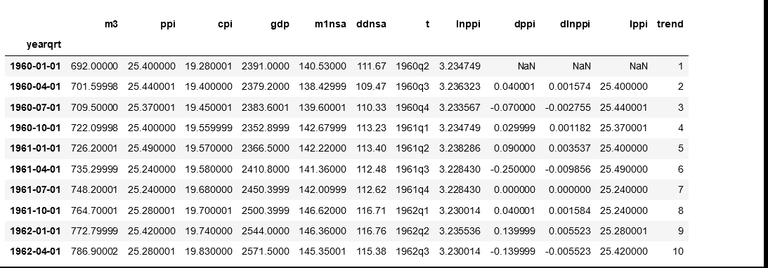
Data

Slide 4

MODEL BUILDING steps
Read the data.
Summarize the data.
Data structure (Type of data).
Data Visualization(check for trend and seasonality).
Check for seasonality.
Split data.
ACF/PACF
Check for ljung_box test
Selecting right algorithm for model building.

Slide 5
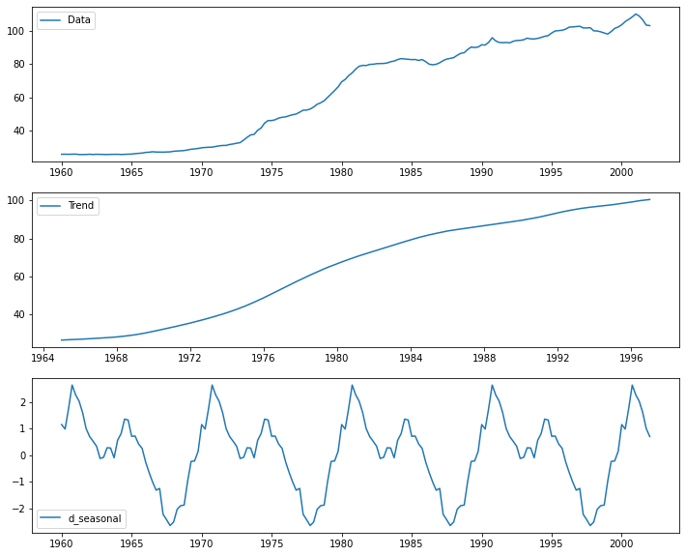
Data visualization

Slide 6
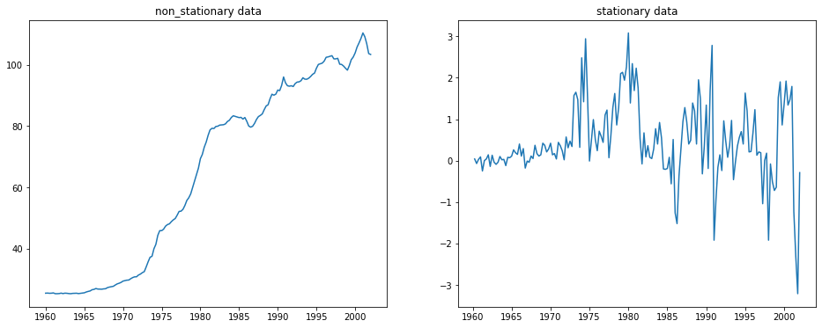
Stationarity

Slide 7
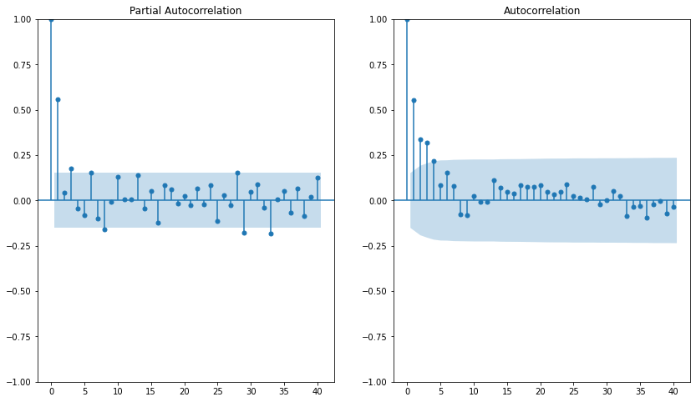
pACF AND ACF

Slide 8
Models
ARIMA.
SARIMA
SARIMAX

Slide 9
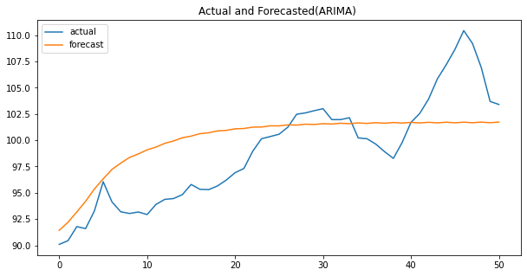
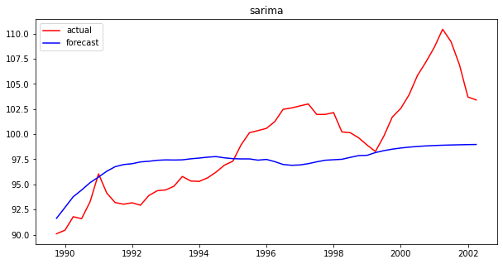
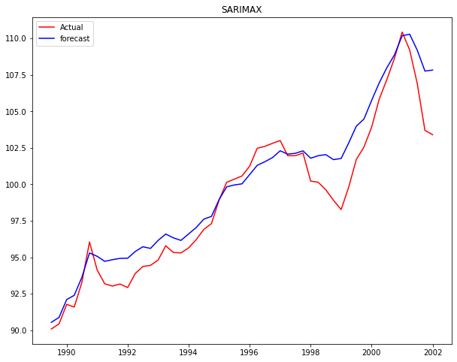
RESULTS

Slide 10
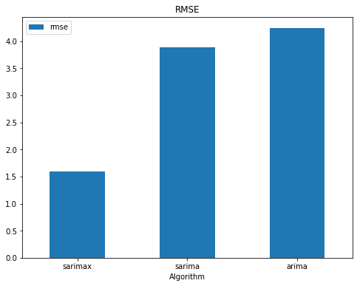
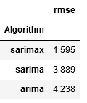
RESULTS

Slide 11
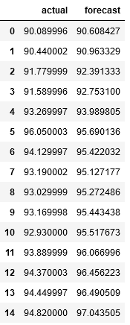
Actual vs forecast values

Slide 12
Conclusion
By comparing all the models with rmse we find that SARIMAX Algorithm is best model which give better predictions. So, we consider SARIMAX Algorithm as the best model for this dataset.

Slide 13
Thank you

