Slide 1
CXR-Net: A Multitask Deep Learning Network for Explainable and Accurate Diagnosis of COVID-19 Pneumonia From Chest X-Ray Images
Mentor: Dr. A Shenbagarajan
-BY
AAKASH K (20BAD022)
YASWANTH B (20BAD048)

Slide 2
INTRODUCTION
SINCE December 2019, the world has been experiencing a global pandemic from the emergence and spread of the potentially fatal COVID-19 (COronaVIrus Disease 2019) caused by severe acute respiratory syndrome coronavirus 2 (SARS-CoV-2) .
To optimise the management of this disease, accurate and rapid diagnosis is essential.
Combining the clinical symptoms with medical images is widely used approach used for diagnosis of COVID19
CXR and computer tomography (CT) are two appropriate imaging modalities

Slide 3
Cont…
Compared to CT, CXR has some advantages: it is faster, cheaper and more widely accessible, and has a low level of radiation exposure to patients .
However, CXR has poor sensitivity and CXR-based medical image analyses have shown high positive predictive values for the detection ofCOVID-19 related pulmonary opacity.
Therefore, developing fast and easily interpretable CXR analysis techniques are extremely useful for timely, trustful and reliable diagnosis of COVID-19.

Slide 4
RELATED WORK
Organ area segmentation:
In order for providing focused and relevant diagnosis of lung images, extracting different areas and lesions from CXR images are used
Deep learning-based image segmentation methods have been used to detect the abnormalities in CXR images.
Gaál et al. proposed an attention U-Net based adversarial architecture for lung areas segmentation using CXR images of COVID and Non-COVID patients.
Vision Pro Deep Learning (A Deep Learning Software from COGNEXs), was used to classify and segment the regions of diseases and lungs from CXR datasets.
The results were compared with various state-of-the-art Deep Learning models from the open-source community and achieved an F-score of 95.3%.

Slide 5
Cont…
A. Transfer Learning:
It is a technique for initializing a model structures and uses the weights ofa pre-trained model instead of using random values
This approach is based on existing model structures and uses the weights pre-trained on a large amount general data.
B. Novel Architectures:
Oztruk et al. developed a Deep Learning model called DarkCovidNet to perform multiple category classification on CXR images of COVID-19 and pneumonia patients
A capsule network based framework (COVID-CAPS) was designed to detect COVID infection from CXR and CT images.

Slide 6
Cont…
B. Lung disease diagnosis:
The deep learning-based classifiers have also been used for the diagnosis of COVID-19.
There are two types of methods for COVID-19 detection, transfer learning/fine-tuning and novel architectures.Transfer learning/fine-tuning is a technique for initialising amodel with the weights of a pre-trained model instead of using random values.
This approach is usually based on existing model structures and uses the weights pre-trained on a large amount of more general data.
Transfer learning/fine-tuning normally performs well with a limited dataset related to more specific problems in the domain of interests.

Slide 7
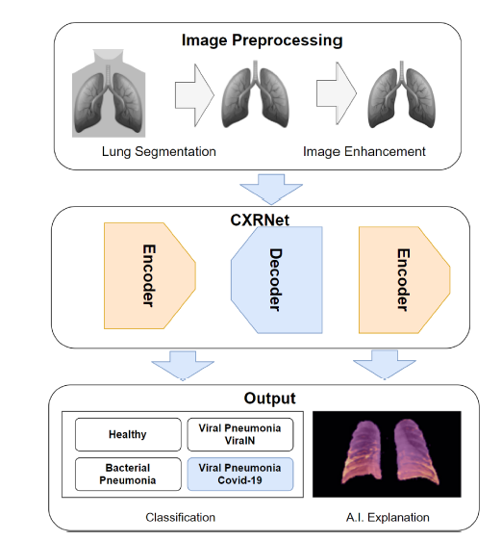
Cont…
Figure 1: The overview of the conceptual framework of the proposed model.

Slide 8
PROPOSED METHOD
Image preprocessing:
1. Lung Segmentation:
To improve the classification performance, the lung areas are extracted before performing image classification
In this study, U-Net, a commonly used deep learning-based image segmentation model, was selected.
It is the first architecture proposed for biomedical image segmentation
It forms a ladder-like structure by concatenating the encoder feature maps with upsampled feature maps from the decoder at each layer.
The U-Net model has a simple and fast design, including a contracting path to capture the environment and a symmetric expanding path to enable accurate localisation.

Slide 9
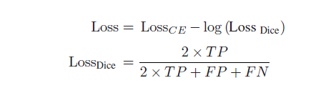
Cont…
A hybrid loss mixed with Dice and Cross entropy (CE) loss was used as the loss function in the semantic segmentation networks.
The loss function in this work is defined as:
where TP, FP and FN are true positive, false positive, and false negative, respectively.

Slide 10
PROPOSED METHOD
2. Image Enhancement:
The grey X-rays images are typically low contrast, which makes their analyses challenging.
Image enhancement is a necessary step for improving the image quality and information content before further processing.
In the process of image enhancement, the most frequent pixel intensity values are often extended to the upper range of the intensity domain [0, 255] by conventional histogram equalisation, bringing their cumulative distribution function (CDF) closer to the uniform distribution.
However, this method might over-amplify noise in near-constant regions.
Instead, in this work, the Contrast Limited Adaptive Histogram Equalization (CLAHE) method was chosen to enhance the contrast of CXR images.

Slide 11
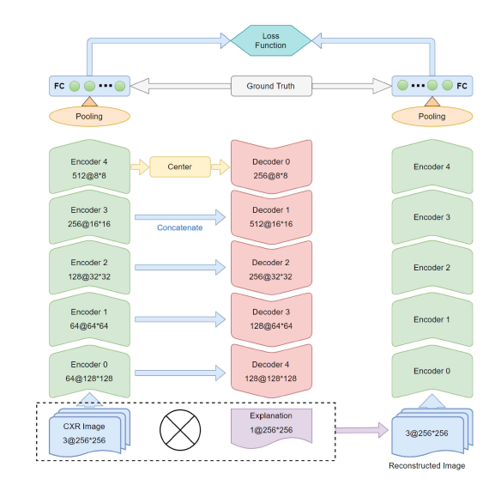
Cont…
Before computing the CDF, it clips the histogram of an image at a predetermined value to spread this portion of the image evenly throughout all histogram bins.
Fig. 2. The architecture of the proposed classification and explanation
model, CXR-Net.

Slide 12
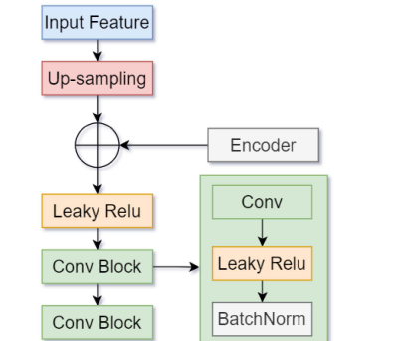
PROPOSED METHOD
B. A CXR Based Multi-Task Deep Neural Network (CXR-Net) for Disease Classification and Explanation:
1. An Encoder Decoder Structure
Fig. 3. The structure of the decoder in the model.

Slide 13
DATASET DESCRIPTION
In this work, 6499 CXR images were used for model training. Among them, there were 636 cases of COVID-19.
The dataset was collected from multiple public and private sources: 5,863 cases from , 116 COVID-19 cases from , , 479 COVID cases from , and 41 images from COVID-19 patients in the Critical Care unit at the Whiston Hospital, St Helen’s & Knowsley NHS Trust, U.K.
This research has been approved by the Health Research Authority (HRA).
All the images were categorised into one of three classes: Healthy, Bacterial Pneumonia and Viral Pneumonia.
The COVID-19 CXR images were labelled as Viral Pneumonia.
In this work we split the cases of Viral Pneumonia into two groups, non-COVID-19 viral pneumonia (ViralN) and COVID-19.
The images from V7lab provided a pixel-level polygonal lung segmentation on CXR images .

Slide 14

PERFORMANCE EVALUATION METRICS
To evaluate the performance of the lung segmentation model, Intersection over Union (IoU), a commonly used metric, was used. It is defined as:
It is the area of overlap between the predicted segmentation and the ground truth divided by the area of union between the predicted segmentation and the ground truth.
These metrics can be calculated from the true positive (TP), the true negative (TN), the false positive (FP) and the false negative (FN).

Slide 15
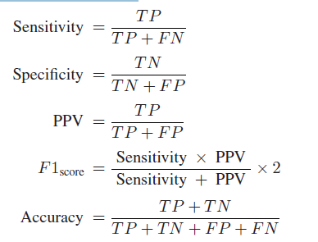
Cont…
The metrics are defined as follows:

Slide 16
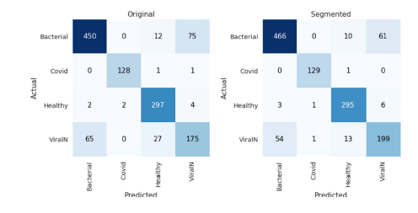
Model Classification Performance
Fig. 4. Confusion matrix from the ResNet50-based model trained on
Original and Lung Segmented CXR images, respectively.

Slide 17
CONCLUSION
In this work, we have proposed a pixel level explainable classification model (CXR-Net) for COVID-19 pneumonia diagnosis, which are validated using real clinical data.
It is based on an encoder-decoder-encoder architecture, enabling a multitask learning for accurate and explainable disease classification.
The experimental results have demonstrated that the proposed method can achieve a reasonably high accuracy on classification using lung segmented CXR images.
The model achieved an average accuracy of 0.879, and the Sensitivity, Specificity, PPV and F1-score of COVID-19 are 0.992, 0.998, 0.985 and 0.989, respectively.

Slide 18
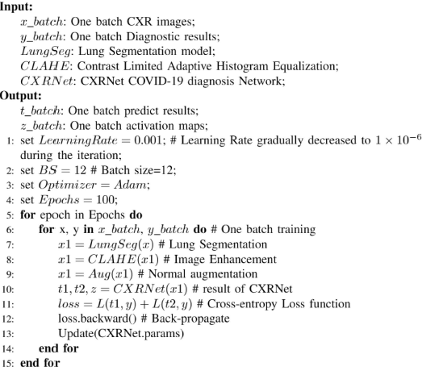
The Pseudo-Algorithm of the model training (CXRNet)

Slide 19
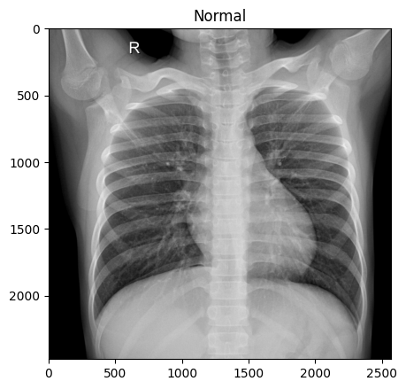
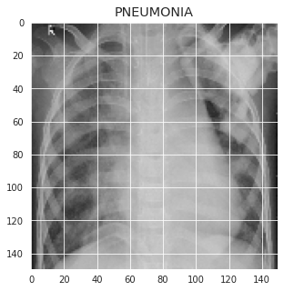
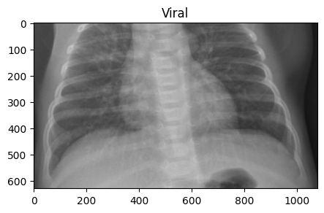
Classes in Dataset
Normal Pneumonia Viral

