Slide 1

BS Project
On
Study of Molecular Dynamics & Non-Equilibrium Phase Transitions in Active Matter using the Vicsek Model
Ponnuru Aakash
Supervisor:Dr.Sunita
Department of Physics
Indian Institute of Technology Jodhpur
Karwar, Jodhpur 342030, Rajasthan, India

Slide 2

OUTLINE
Introduction to Molecular Dynamics.
Introduction to Active matter.
Vicsek Model.
Molecular Dynamics in Vicsek Model.
Implementation.
Results.
Conclusions and Future Works.

Slide 3
Molecular dynamics
A computational method to study classical many-body systems using Newton’s laws, valid when quantum effects are negligible.
MD simulations mirror the methodology of physical lab experiments through a strict procedural pipeline:
Sample Preparation
Equilibration
Measurement
N-body system initialization.
Iterative integration to equilibrium
Post-equilibration measurement of observables.

Slide 4
Implementaion of MD Simulation
Define system parameters.
Initialize random particle positions and velocities.
Compute initial forces.
For each time step:apply periodic boundary conditions, compute forces,update positions & velocities,
sample properties (Radial Distribution Function)
Analyze results.

Slide 5
System Parameters
Global Parameters:
Box Size (L): 24.0
Number Density (ρ): 0.8
Number of Particles (N): 11,059
(Derived dynamically via N=ρ(L^3)
Simulation Parameters:
Total Time Steps: 3000
Equilibration Steps: 1000
Time Step (Δt): 0.005
Interaction Parameters:
Cut-off Radius (rc): 2.5

Slide 6
Initialization
Lattice Setup: Particles are placed iteratively on a 3D grid, ensuring a stable, overlap-free initial geometry that safely "melts" during equilibration.
Momentum Correction: Subtracting the system's mean velocity from all particles enforces zero net momentum, preventing artificial macroscopic drift.

Slide 7
Periodic Boundary Conditions(PBC)
Hard walls cause surface effects; periodic boundaries remove them, making a finite system behave like an infinite bulk fluid.
ensures that system behaves like an “infinite bulk fluid” by eliminating boundary effects.
Minimum Image Convention
to find the distance between particle i and particle j.because of PBCs, the closest version of particle j might actually be across the boundary. to handle this Minimum Image Convention methood is used.
Pairwise interactions are computed only between a particle and the single closest image of its neighbor.Strictly requires the cutoff radius to be less than half the box length (rc <= L/2) to prevent unphysical self-interactions.

Slide 8



Force Calculation
Forces are computed using the Lennard-Jones (LJ) potential
For each particle pair (i,j)(i, j)(i,j):
Apply minimum image convention (PBC)
Compute squared distance
If r<rc (cutoff radius), compute force:

Slide 9


Velocity Verlet Integration
used to evolve the system in time.
requires forces as input
Step 1: Position Update
Step 2:Velocity Update

Slide 10
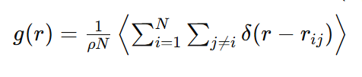

Radial Distribution Function g(r)(RDF)
g(r) is the normalized probability of finding a particle at a distance r from a reference particle compared to an ideal gas
tells how particles are spatially arranged in the system.
Gas: g(r)≈1 everywhere
Liquid: Peaks at short distances, then decays
Solid: Sharp periodic peaks (long-range order)
Sampling is the process of collecting data from multiple configurations of a system to compute average physical properties.

Slide 11
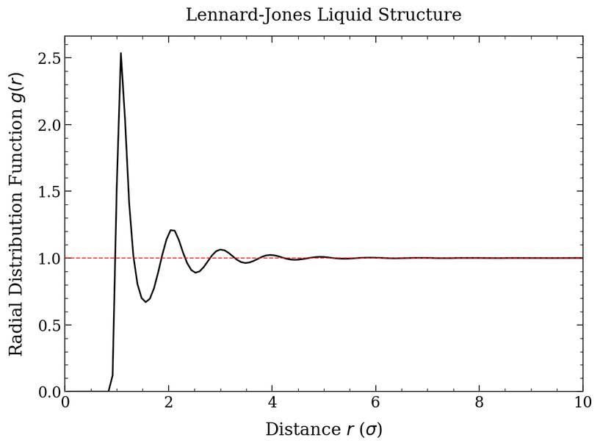
Analysis
for r < 1.0, The repulsive core of LJ potential is working correctly.
The Primary Peak (r approx. 1.1),formation of a stable "first coordination shell".
Decaying Oscillations: system is liquid.
Convergence to 1.0 at Long Distances: system has reached thermal equilibrium
atoms are properly clustering together like a real fluid
Radial Distribution Function g(r) for a well-equilibrated Lennard-Jones liquid.
probability of finding a particle perfectly matches the macroscopic bulk density of the box.

Slide 12




Active matter
class of systems made of individual units that consume energy and generate motion or forces on their own.
Bird flocks
fish shoals

Slide 13

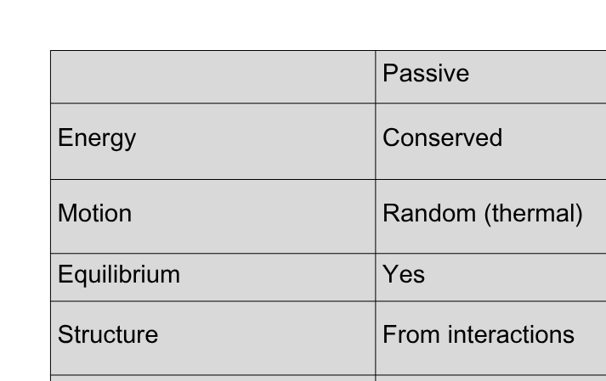
non-equilibrium dynamics and emergent collective behavior.
continuously consume energy
Active matter
self-driven particles

Slide 14
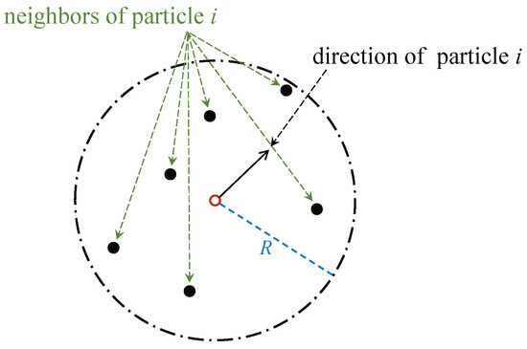
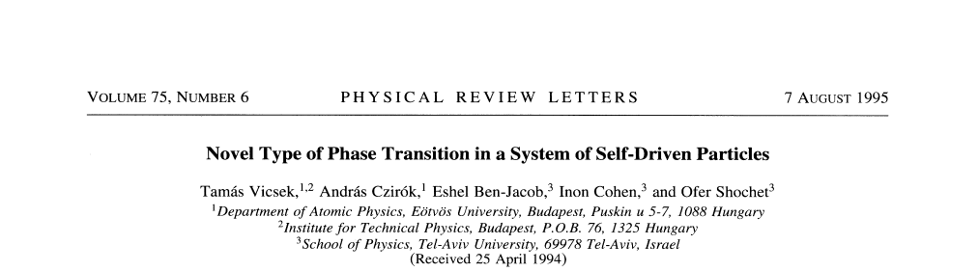
Vicsek Model
A minimal active matter model where self-propelled particles align with neighbors under “noise”, producing a non-equilibrium transition from disorder to flocking.
Each particle Moves with constant speed v &Changes direction based on neighbors & also has noise (randomness)
alignment + noise → collective motion

Slide 15
Role of MD in Vicsek Model
MD simulates particle dynamics over time, allowing us to measure Va​ for different noise values and observe the phase transition.
Initialize particle positions and directions randomly
Apply periodic boundary conditions,evolve system in discrete time steps.
For each time step:
Identify neighbors within interaction radius
Compute average direction of neighbors
Add noise (η) to direction
Update particle positions with constant speed
Allow system to equilibrate, Compute order parameter va at each step, averaging​
Repeat simulation for different parameters: Noise, Density
Perform ensemble averaging over multiple trials

Slide 16
Phase Transition Driven By Noise
Implementaion:
Initialize particles
update directions using neighbor alignment & noise
move particles
measure ordered parameter
vary noise to observe phase transition

Slide 17
Initialization:
System
Parameters
N particles in 2D rectangular box (Lx​×Ly)​
Apply periodic boundary conditions
Assign:Random initial positions
Random initial directions θi∈[−π,π]
Constant speed v=0.03​
Interaction radius rc=1.0
Noise strength η and η∈[−η/2,η/2]

Slide 18
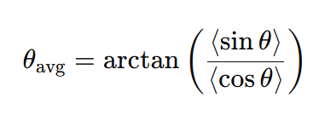
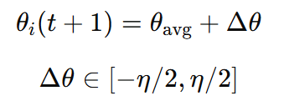
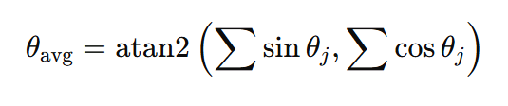
Time Evolution:
1)For each particle:
Find neighbors within radius rc
Compute average direction using:
3)Update position:
2)Add noise
Apply periodic boundary conditions Repeat for Many Time Steps
to reach steady state

Slide 19
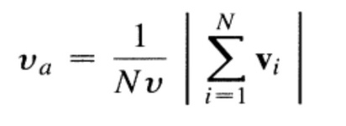
Measure Order Parameter
The order parameter is computed by summing velocity components (cos⁡θ,sin⁡θ) of all particles, taking the magnitude, and normalizing by N
Convert direction to velocity components
Sum all velocities gives total velocity vector
Take magnitude
Normalize by number of particles
Time averaging

Slide 20
Phase Transition Driven By Density
Box is rectangular and Lx​=25 & Ly=16
Sweep density
Update dynamics
Measure va
Average
Plot
Equilibrate

Slide 21
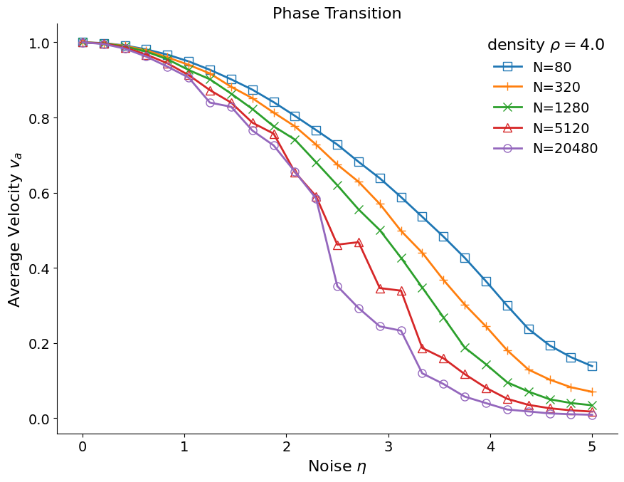
Results
Noise-Driven Transition:
Sweep η from high → low
Low noise (η→0):va≈1,
All particles move in the same direction (flocking)
High noise (η→5):va≈0,
Motion becomes random (disordered)
Transition occurs around:
ηc≈2.5−3.5
noise-driven phase transition where increasing noise destroys collective motion, with sharper transitions for larger system sizes, consistent with Vicsek model predictions.

Slide 22
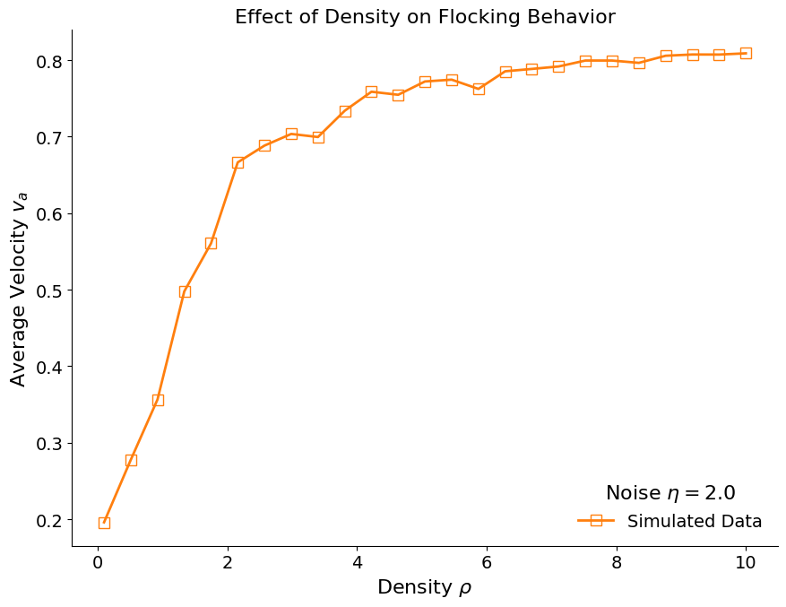
Density-Driven Transition:
At large ρ, va approaches ~0.8
system reaches strongly ordered state
Confirms alignment dominates over noise
Identification of Transition Region around ρ≈1.5−3
results successfully demonstrate a density-driven phase transition with a clear onset, saturation behavior, and smooth convergence

Slide 23
Conclusion
Noise-Driven Transition:
Increasing noise η drives the system from ordered (flocking) to disordered motion.
A clear critical noise ηc​ is observed.
Larger system sizes show sharper transitions, indicating approach to the thermodynamic limit.
Density-Driven Transition:
Increasing density ρ enhances interactions and leads to emergence of collective motion.
A critical density ρc​ is observed for onset of flocking
At high density, the system reaches a saturated ordered state
Confirms existence of non-equilibrium phase transitions in active matter

Slide 24
Future Works
can extend to Larger System Sizes and 3-D models.
Different Interaction Models Include:Variable speed,Anisotropic interactions,External fields.
Growing Interfaces.

Slide 25
Acknowledgements
I would like to sincerely thank my supervisor Dr.Sunita for their guidance and support throughout this project.
I am especially grateful to my Teaching Assistant Rashmi for clarifying doubts and providing valuable guidance during the work.
I acknowledge my institute and department for providing the necessary resources.
I acknowledge the original Vicsek model paper for foundational insights into active matter.

Slide 26
References
Frenkel & Smit – Understanding Molecular Simulation.
Vicsek et al. (1995) – PRL.
NumPy, Matplotlib Documentation.

Slide 27
THANK YOU

