Slide 1

Project report HANDS ON ASPEN AND MATLAB
MENTOR- Devang kumawat
Aakash Saran
210009

Slide 2
OVERVIEW
- Differential equations are essential for modeling and analyzing dynamic systems.
- MATLAB provides powerful tools for numerically solving differential equations.
- This report explores the utilization of MATLAB in solving differential equations and its application in heat conduction problems in chemical engineering.
- The report also discusses the use of Aspen, a process simulation software, for solving reactor problems.
- The report is organized as follows:
- Introduction to differential equations and MATLAB's capabilities in solving ordinary and partial differential equations.
- Application of MATLAB in solving heat conduction problems in chemical engineering, including formulation, boundary conditions, and real-world case studies.
- Introduction to Aspen and its role in modeling and simulating various reactor problems.
- Practical application of Aspen for solving reactor problems, including a step-by-step guide and analysis of simulation outcomes.
- Presentation of case studies demonstrating the combined usage of MATLAB and Aspen.

Slide 3
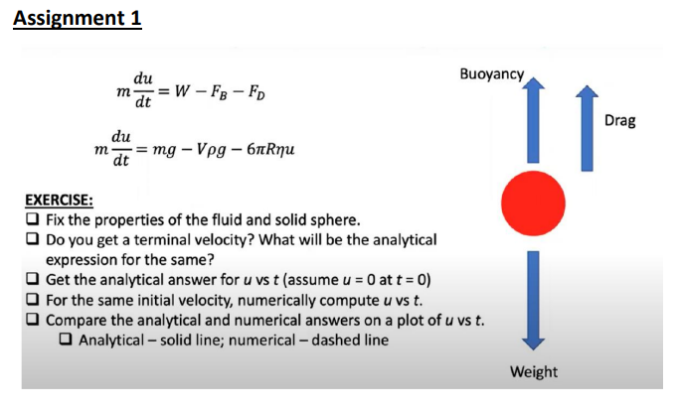
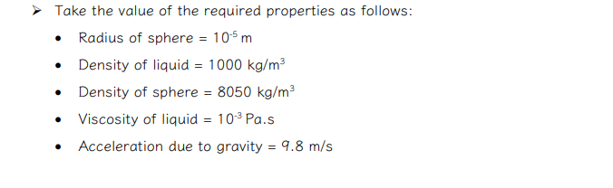
ASSIGNMENT 1 : PROBLEM STATEMENT

Slide 4
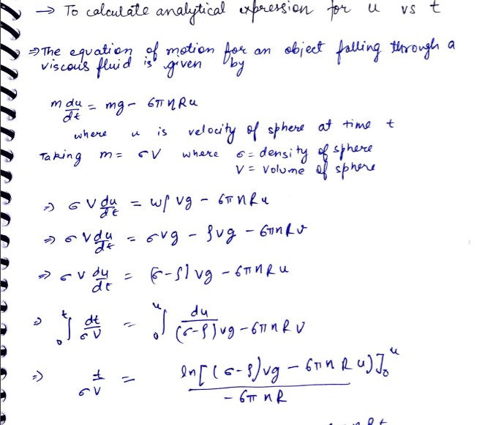
SOLUTION:

Slide 5
Numerical computation of u vs t:
To obtain the numerical solution for u vs t, we can use numerical integration techniques such as Euler's method or the Runge-Kutta method. By discretizing the time interval and approximating the derivative, we can calculate the velocity at each time step.
Comparison of analytical and numerical answers:
Plotting the analytical solution (solid line) and the numerical solution (dashed line) on the same graph will allow us to compare the two solutions and observe any differences or similarities between them.

Slide 6
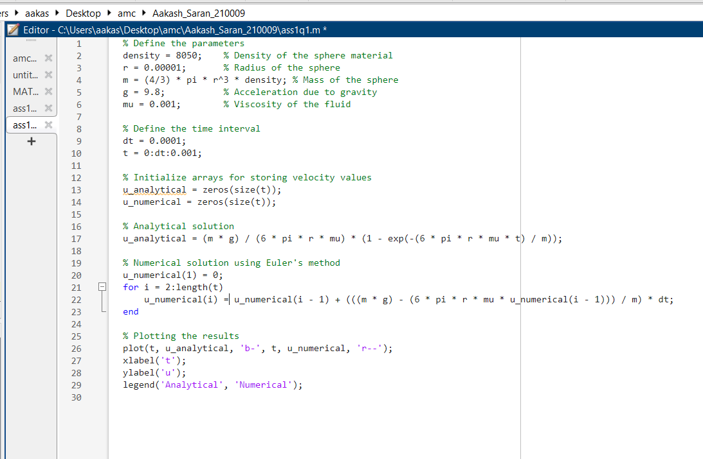
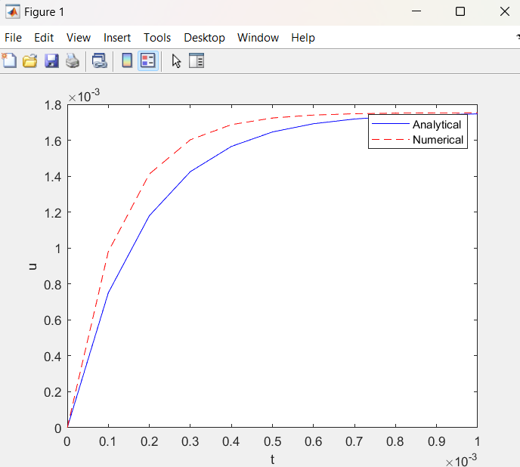

Slide 7
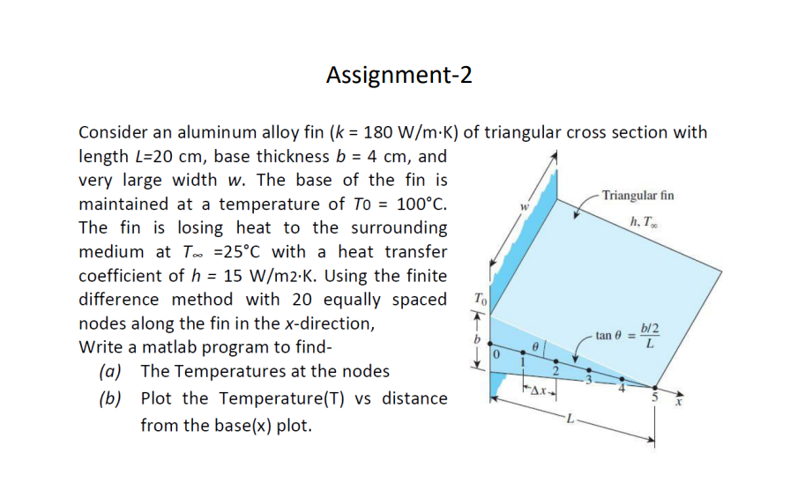
ASSIGNMENT 2: PROBLEM STATEMENT

Slide 8
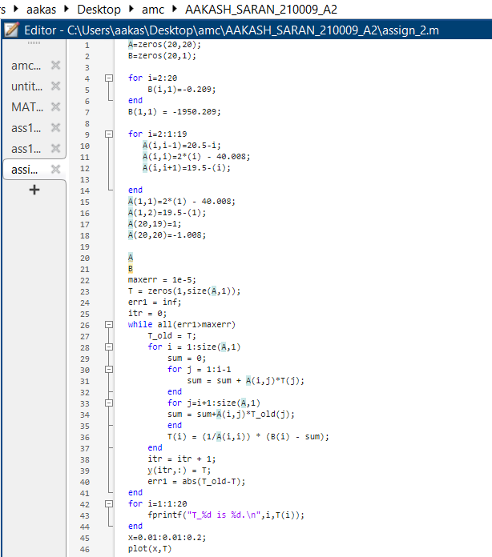
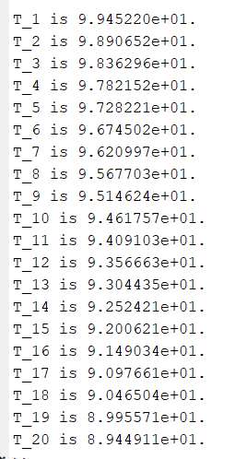

Slide 9
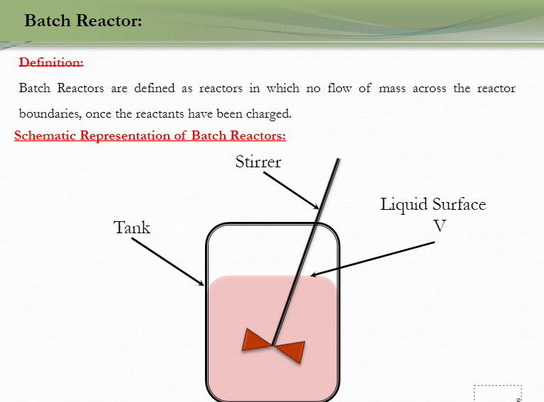
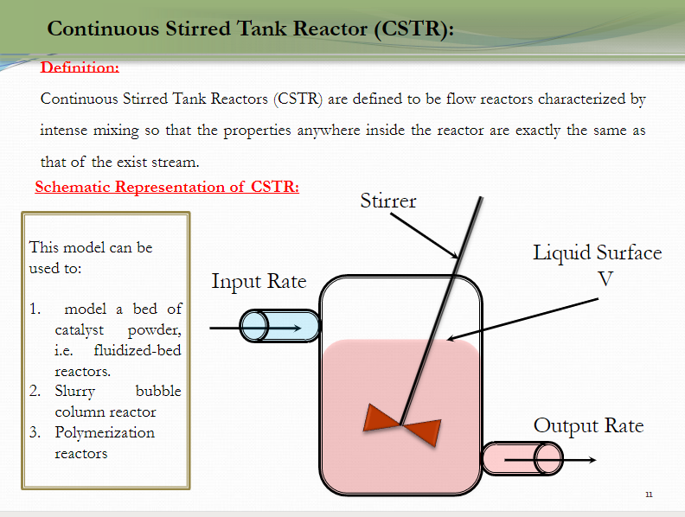
Reactors:

