Slide 1
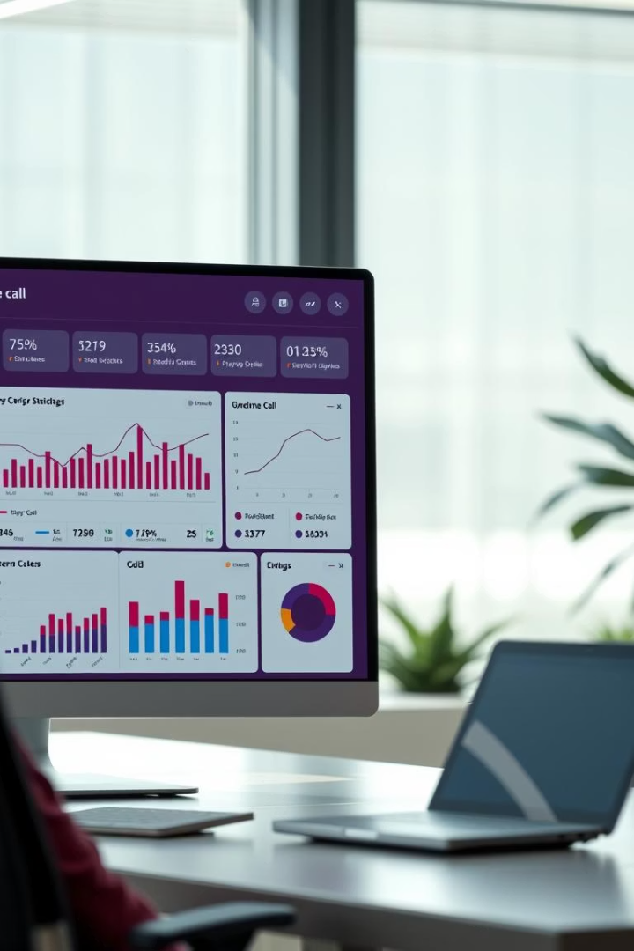
Sales Call Performance Dashboard
Interactive Dashboard for Business Stakeholders
Mohammad Aakhil

Slide 2

Project Objective
Interactive Dashboard Design
Performance Tracking
Built with Power BI to visualize key metrics.
Monitors agents, call pick-up, sales, and duration.
Data-Driven Decisions
Supports stakeholder insights and actions.

Slide 3
Dataset Overview
Dataset Details
Key Columns
File: Product_Sales.csv
Agent ID
Source: Simulated sales & call center
Call Date
10,000 call records from Jan-Dec 2023
Products Sold
Call Duration

Slide 4

Agent Performance Metrics
Calls per Day
Products Sold per Call
Average: 25 calls per agent (benchmark).
Target: 1.5 products. Top agent: 2.1 products.
Call Duration
Goal: Average 5 minutes per call.

Slide 5
Call Pick-Up Rate Metrics
Pick-Up Rate
Abandonment Rate
Wait Time
Peak vs Off-Peak
Target: 85% calls answered of calls offered.
Tolerance: 15% calls abandoned.
Ideal average: 20 seconds.
Off-peak: 92% pick-up rate
Peak: 78% pick-up rate

Slide 6





Product Sales Metrics
Total Revenue per Product
Enables drill down by product category.
Units Sold Seasonality
Analyzes sales fluctuations over time.
Top Selling Products
Tracks trends to spot opportunities.
Q4 Promotion Impact
Product A's sales increased 22%.

Slide 7




Call Duration Metrics
Avg Call Duration by Agent
1
2
Duration vs Conversion
Measure benchmark performance standards.
Identify optimal call length for sales.
Shortest Calls
Longest Calls
Assess missed sales opportunities.
4
3
Analyze bottlenecks and inefficiencies.

Slide 8

Conclusion
Performance Insights
Data-driven strategies improve agent success.
Stakeholder Engagement
Interactive tools enhance decision making.
Actionable Trends
Optimizations boost revenue and productivity.
Next Steps
Refine metrics and expand dashboard features.

