Slide 1
My first Real project:
Project walk-through

Slide 2

Adidas
MFRP
Akash Kadole

Slide 3
Content
Process Layout
List Overview
Order Form
Flow
SPFX
Future Scope

Slide 4
Process layout
Making Lists
Customer, product and Order Lists were to be created, permissions as-well as custom views were also set.
Completing Spfx Webpart
Order sales form form was completed,
also Testing was done to make it more efficient,
Exception handling was also done, To match the Functional Documents
Creating Team Site
Choose Team Site
Making Flows
Two Flows were created, to match the requirements of the Functional Document.
Final Touches.
Designing of the Site was Done only after careful, examination of all the Functionalities.

Slide 5
List overview
Customer List
Product List
Order List
Column Fields
Customer ID
Customer Name
Customer Email Address
Overview:
1. ) Validation is done using PowerApps
2.) Title is hidden as was the requirement.
Column Fields
Product ID
Product Name
Product Unit Price
Product Expiry Date
Product Type
Overview:
1.) Validation is done using PowerApps
2.) Title, Product ID is Hidden in forms So as the User in the current context can not make direct Entry to those fields
Column Fields
Order ID
Customer ID
Customer Name
Product ID
Product Name
Unit Price
Units Sold
Sale Value
Order Status
Overview:
1.) Validations are added in the Client Side SPFx Form
2.) Order ID is Auto Generated.

Slide 6
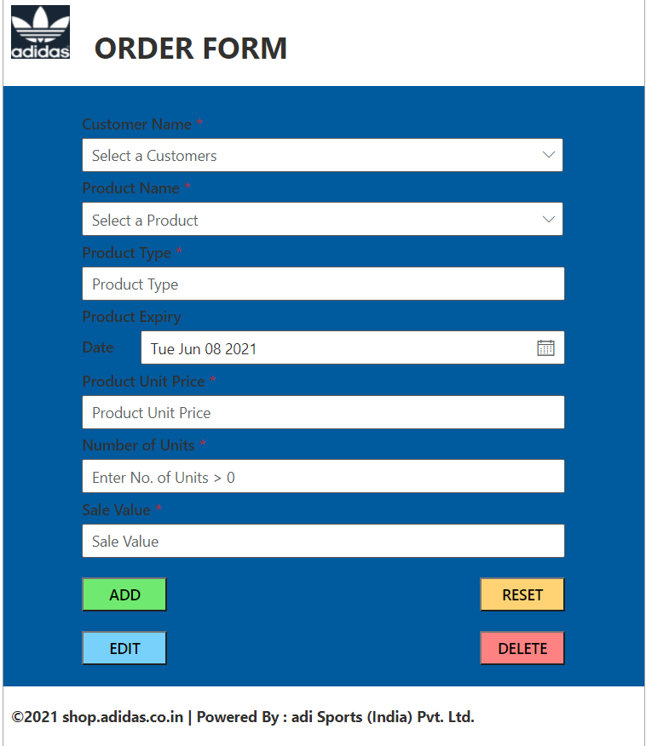
Order form
SPFX
SPFx web-part was laden with C.R.U.D. Operations HTML as well as the Code for components and functions was written in the .tsx file for client-side part. Used Three dropdowns which will auto populate the rest form.
Objective 1: To create SPFx Webpart Order Sales Objective 2: Achieve Validation.
Objective 3: Testing
Objective 4: Deployment
1st Dropdown: Customer Name
2nd Dropdown: Product Name
3rd Dropdown: Order ID
The third Drop down will only be visible if Edit or Delete is clicked on.
Customized the form by using .SCSS file. added CSS code and used classes for customization.
Deployed the SPFx code by using Gulp Commands. Deployed the file first in the Siddharth App catalog and after that added in the site content and then added in the web-part of the site page

Slide 7
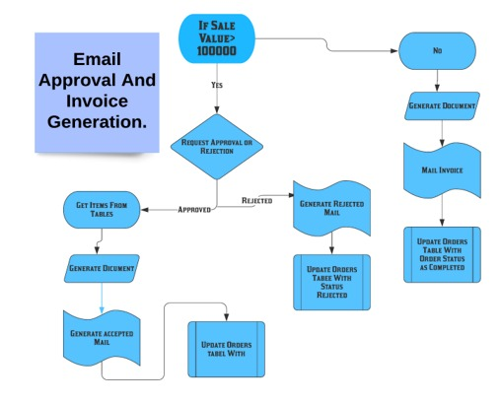
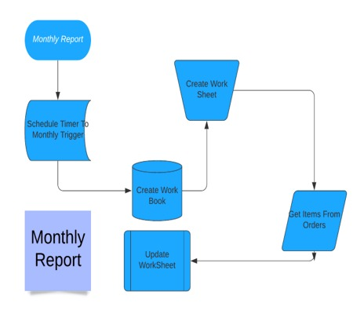
FLOW
Email Approval And Invoice Flow
Monthly Report
It is a Triggered Flow which will provide customized Pdf in the Email to the Customer.
It is a scheduled flow which will trigger every month and put all the data for that month in the Excel Worksheet.

Slide 8
FUTURE Scope
Automatically Remove the Products which are expired from product list
If the Product is Expired we can deploy a column named Project Status and the field will automate to expired

Slide 9

THANK-YOU adidas

