Slide 1
TEST SYSTEM DEVELOPMENT FOR RADIATION EFFECTS ON EDAC
SEMICONDUCTOR LABORATORY – VLSI TESTING DIVISION
PRESENTED BY-
AAKRITI AGRAWAL-2015A3PS276P
A LOHITH -2015A3PS215H
MENTORS-
Mr. PARVEEN RANA
Mr. S.N. MITTAL
SUBMITTED TO-
Dr. RAJEEV TALIYAN

Slide 2
INTRODUCTION
The Digital world is of only 0s and 1s
A : 1010 :some event: 1110 : E
Spacecraft Cassini–Huygens, launched in 1997, contains two identical flight recorders, each with 2.5 gigabits of memory in the form of arrays of commercial DRAM chips.
Thanks to built-in EDAC functionality!
(the spacecraft reported a nearly constant single-bit error rate of about 280 errors per day)
ECC Memory – Error Correcting Code Memory

Slide 3
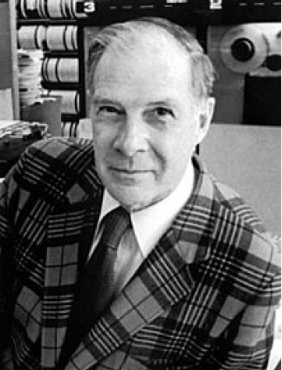
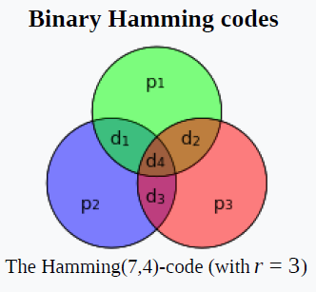
HAMMING CODE
HISTORY
Richard Hamming 1950
American mathematician
BELL LABS
WHAT IS PARITY?
Check bit
Simplest form of error detecting code

Slide 4
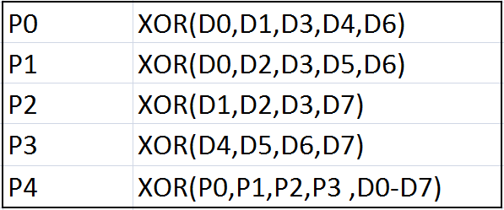
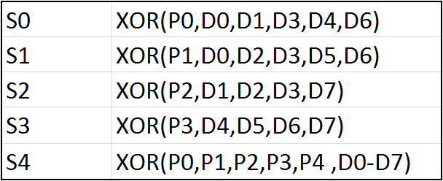
Let’s implement what we have just learnt
01011001
_ _ 0 _ 1 0 1 _ 1 0 0 1 _
P0: XOR(0,1,1,1,0)=1
P1: XOR(0,0,1,0,0)=1
P2: XOR(1,0,1,1)=1
P3: XOR(1,0,0,1)=0
P4: XOR(1,0,0,1,1,0,1,0,1,1,1,0)=1
Lets introduce Error at Position D5
01011101
_ _ 0 _ 1 0 1 _ 1 1 0 1 _
P0: XOR(0,1,1,1,0)=1
P1: XOR(0,0,1,1,0)=0
P2: XOR(1,0,1,1)=1
P3: XOR(1,1,0,1)=1
P4: XOR(0,1,0,1,1,1,0,1,1,0,1,1)=0
2+8=10 => Bit Error at Position 10.

Slide 5
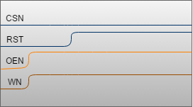
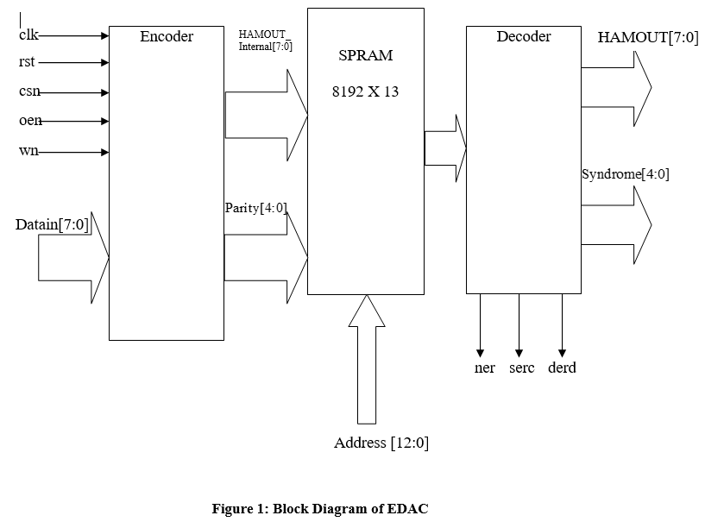
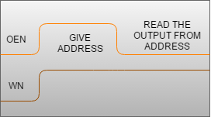
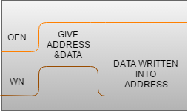
EDAC
CONTROL SIGNALS FOR -
1 MHz
WRITING DATA
READING DATA

Slide 6
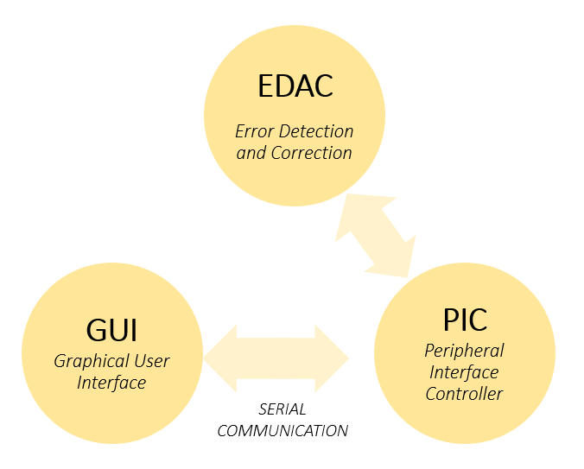
TEST SYSTEM DESIGN
PIC
- Used to control EDAC.
- Send Control Signals to EDAC.
- Sends Data and Address via port.
- Reads output via port.
- Communicates output
via USART.

Slide 7
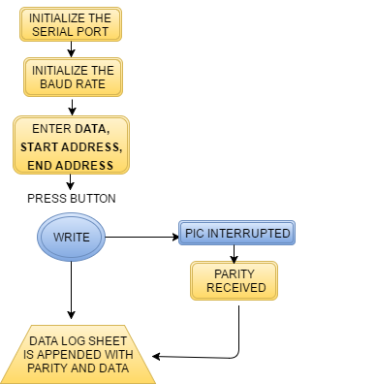
FLOWCHART
WRITE CYCLE AT FRONTEND

Slide 8
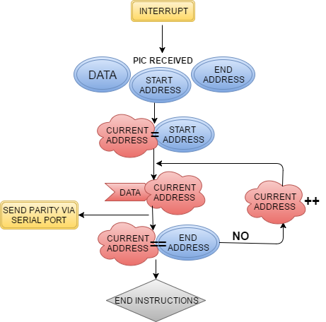
WRITE CYCLE AT BACKEND
Write control signals to EDAC

Slide 9
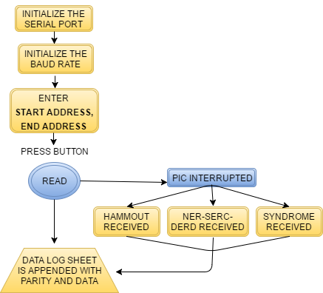
READ CYCLE
AT FRONTEND

Slide 10
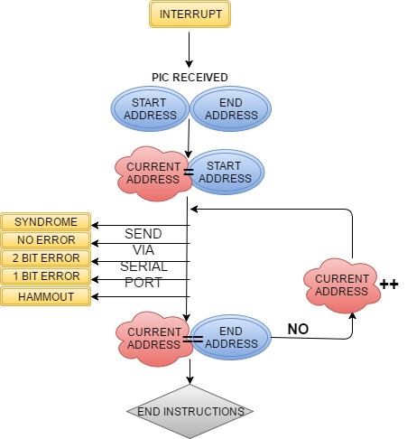
READ CYCLE
AT BACKEND
Read control signals to EDAC

Slide 11
SERIAL COMMUNICATION
DATA
END ADD
$
START ADD
#
Asynchronous serial communication.
USART protocol is used.
Current baud rate is 9600.
8 bits preceded by start bit and succeeded by stop bit is transferred at a time.
WRITE CYCLE FORMAT
START ADD
PARITY
END ADD
END ADD
@
START ADD
#
START ADD
HAMMOUT
END ADD
SYNDROME
NO ERROR
1 BIT ERROR
2 BIT ERROR
PC
PIC
READ CYCLE FORMAT

Slide 12
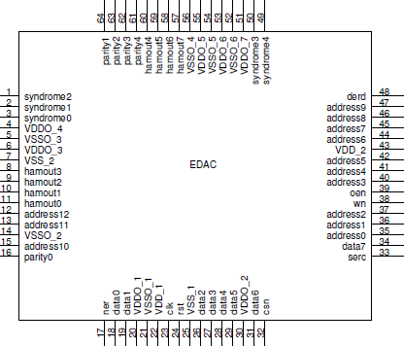
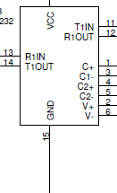
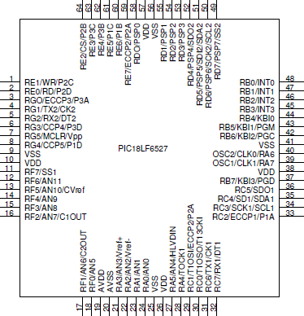
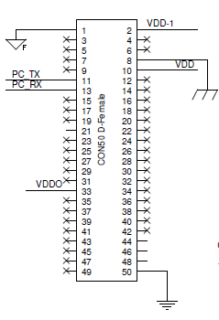
SCHEMATIC
MAX 232
Brings voltage levels of PIC and PC within desired limit to carry out communication between them.
EDAC
POWER SUPPLY
PIC

Slide 13
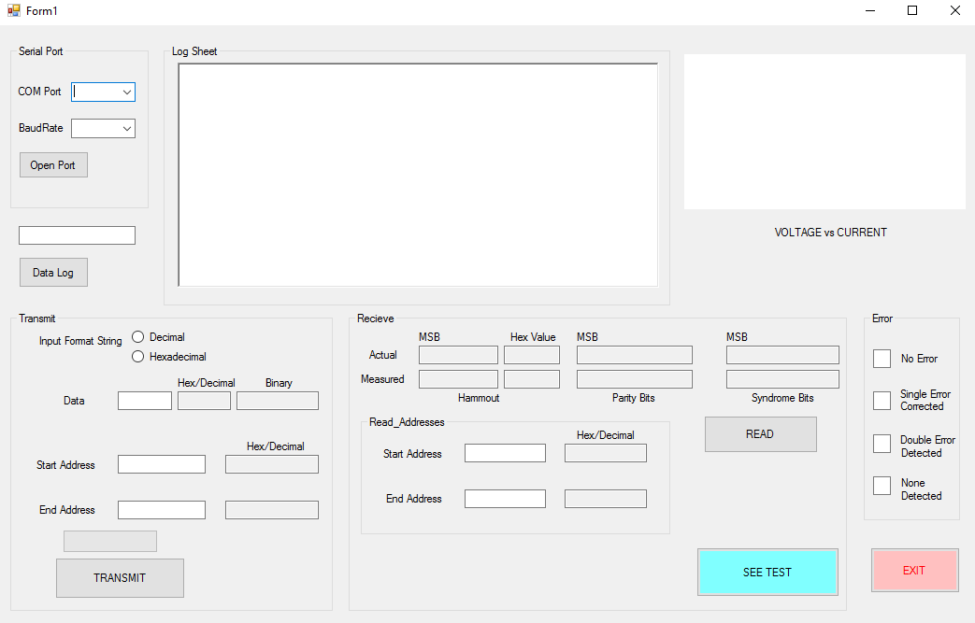
Graphical User Interface

Slide 14
DEMONSTRATION

Slide 15
FURTHER WORK
Increasing Internal clock frequency and Baud Rate.
Maintain a Data Log along with Summary of the test values.
Automate the entire process with a single button for SEE Testing.

Slide 16
Any Questions/Doubts and Suggestions are most welcomed

