Slide 1
$67K
Total Revenue
POWER BI
CAPSTONE PROJECT
584
Sakila
Active Customers
16K
DVD Rental
Total Rentals
Store Business Intelligence
5.03
Avg Rental Days
Analysed by Aakriti
Qualification M Com, MBA
Email aakriti.9703@gmail.com
$4.17
Revenue/Rental
TOOLS
SQL
Excel
Power BI
Dataset: Sakila MySQL Database

Slide 2
Movie Rentals — Capstone Analysis
Questions Index | Analysed by Aakriti | M Com, MBA
Q1. How does the sales revenue vary by month?
Q9. What is the average rental duration by staff member?
Q2. What is the distribution of sales by payment method?
Q10. What is the distribution of customers across different cities?
Q3. Which customer segments generate the highest sales?
Q11. How does the rental revenue vary by country?
Q4. What is the distribution of films by rental duration?
Q12. Which locations have the highest and lowest revenues?
Q5. How does the inventory vary by film rating?
Q13. What is the distribution of films by language?
Q6. What is the breakdown of film categories in the inventory?
Q7. What is the distribution of staff by employment duration?
Q14. Which film categories have the highest rental rates?
Q8. How does store performance vary by location?
Q15. How does the average rental duration vary by film category?
Slides 3–17 contain individual analysis for each question →

Slide 3
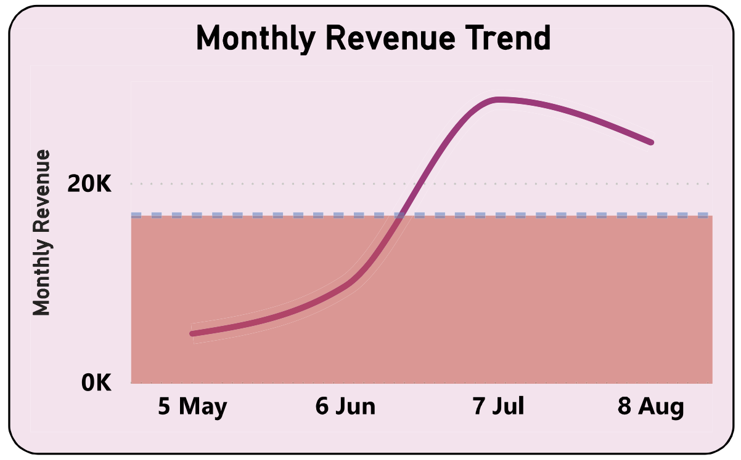
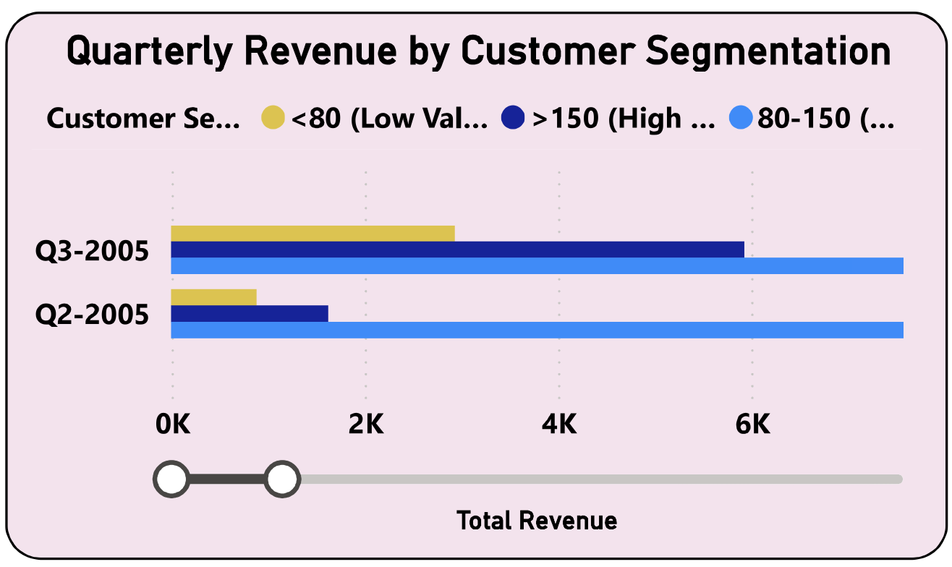
Q1
How does the sales revenue vary by month?
Sales & Revenue
67K
16K
4.17
Total Revenue
Total Rentals
Revenue/Rental
📊 Key Insights
Revenue grew sharply from May 2005, peaking in July 2005 at ~22K — the highest month recorded.
A visible plateau and slight decline followed in August 2005, suggesting post-peak demand normalization.
The consistent dashed average line (~15K) shows July significantly exceeded the baseline, indicating a seasonal or promotional surge.
Revenue in May was the lowest (~2K), indicating a business ramp-up or new-launch effect.
Overall, the trend is strongly positive across the observation window, reflecting growing customer adoption.
Movie Rentals Capstone | Q1 of 15 | Analysed by Aakriti, M Com, MBA

Slide 4
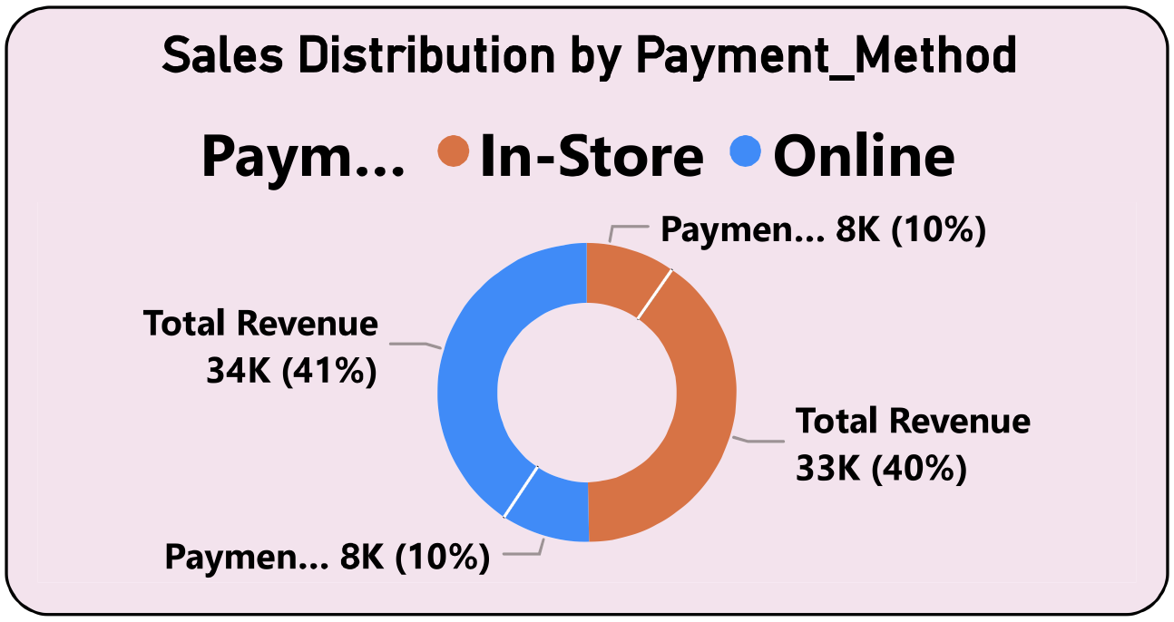
Q2
What is the distribution of sales by payment method?
Sales & Revenue
67K
41%
40%
Total Revenue
In-Store
Online
📊 Key Insights
Revenue is split nearly equally across three payment methods, showing no strong single dominant channel.
In-Store payments account for ~41% (34K), the largest share, indicating strong walk-in business.
Online payments represent ~40% (33K), nearly matching in-store, reflecting digital adoption.
A third payment method contributes the remaining ~10% each (2 segments at 8K), likely representing cash/card variants.
The near-equal split suggests the business successfully operates across multiple payment channels.
Movie Rentals Capstone | Q2 of 15 | Analysed by Aakriti, M Com, MBA

Slide 5
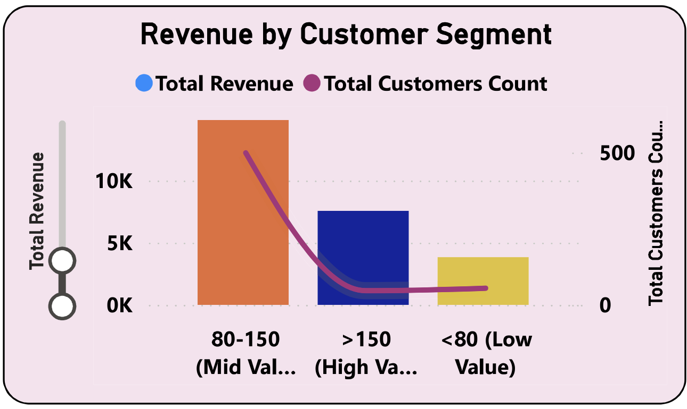
Q3
Which customer segments generate the highest sales?
Sales & Revenue
584
80–150
Active Customers
Top Segment
📊 Key Insights
The 80–150 (Mid Value) segment generates the highest total revenue (~50K), making it the most commercially important group.
High Value customers (>150) contribute a moderate amount with a high per-customer revenue ratio.
Low Value (<80) customers are the least revenue-generating segment, though they may represent volume opportunities.
The Mid Value segment has the largest customer count (~500), confirming it drives both volume and revenue.
Strategy focus should be on retaining Mid Value customers while upselling Low Value customers upward.
Movie Rentals Capstone | Q3 of 15 | Analysed by Aakriti, M Com, MBA

Slide 6
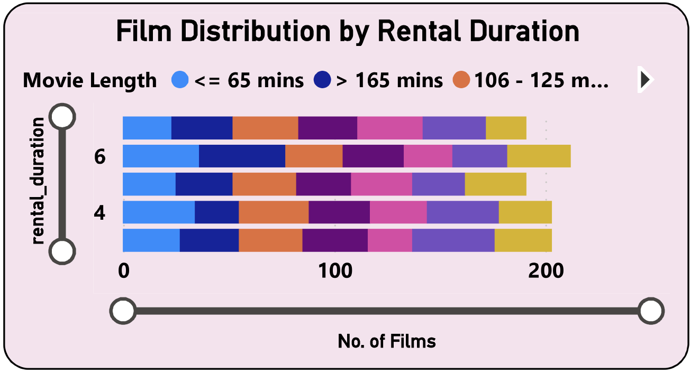
Q4
What is the distribution of films by rental duration?
Film & Inventory
1,000
4,581
2.98
Total Films
Inventory Items
Avg Rental Rate
📊 Key Insights
Most films fall in the 4–6 day rental duration range, indicating standard rental policies.
Short films (≤65 mins) tend to cluster around lower rental durations (3–5 days).
Longer films (>165 mins) show slightly higher rental durations, likely commanding extended rental periods.
The 106–125 min length category is most numerous, confirming mainstream film lengths dominate inventory.
The distribution suggests inventory is well-stocked with medium-duration films, aligning with customer preferences.
Movie Rentals Capstone | Q4 of 15 | Analysed by Aakriti, M Com, MBA

Slide 7
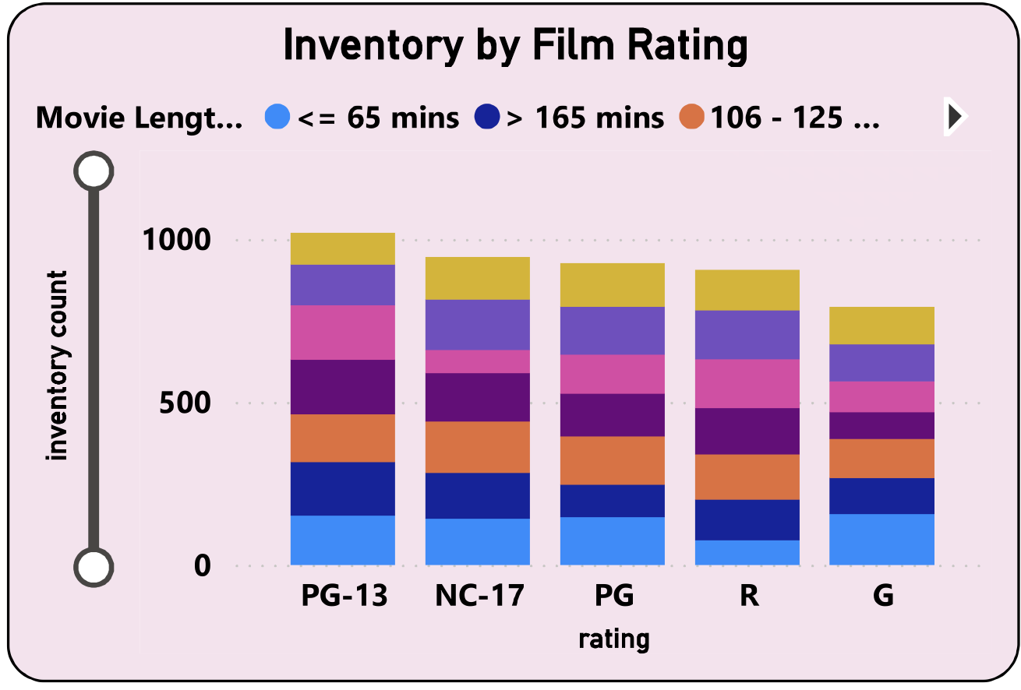
Q5
How does the inventory vary by film rating?
Film & Inventory
PG-13
5
4,581
Top Rated
Rating Types
Total Inventory
📊 Key Insights
PG-13 rated films have the highest inventory count (~1,000+ items), making it the most stocked category.
NC-17 and PG ratings follow closely, indicating a diverse inventory catering to various age groups.
R-rated films are well-represented, appealing to the adult audience segment.
G-rated (general audience) films have the lowest inventory, suggesting less demand in a rental context.
All film lengths are distributed across each rating, with 106–125 min films dominant in every category.
Movie Rentals Capstone | Q5 of 15 | Analysed by Aakriti, M Com, MBA

Slide 8
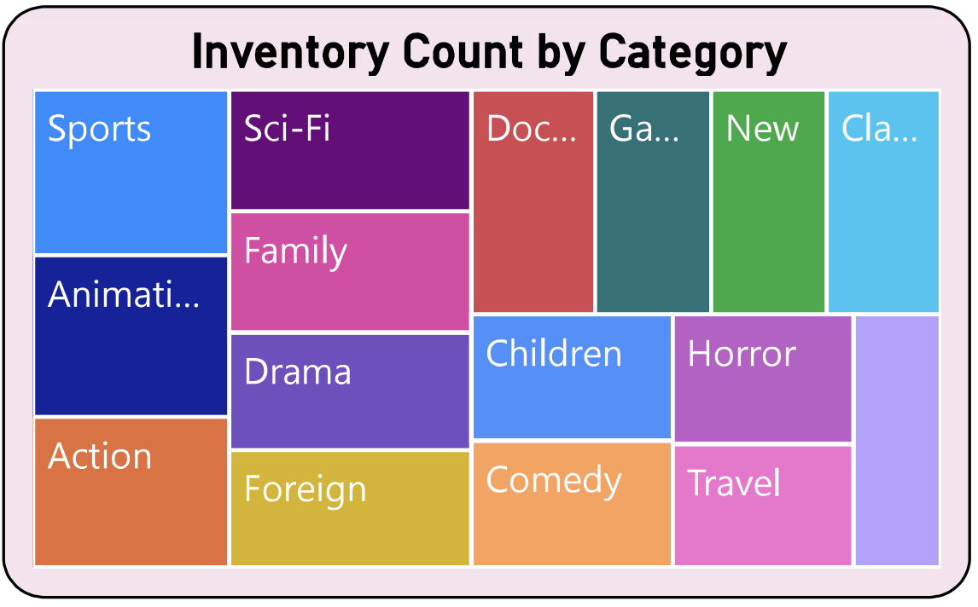
Q6
What is the breakdown of film categories in the inventory?
Film & Inventory
16
1,000
Sports
Unique Categories
Total Films
Top Category
📊 Key Insights
Sports is the largest inventory category, followed by Sci-Fi, Drama and Documentary.
Animation, Family, and Action represent solid mid-tier categories in terms of item count.
Horror and Children categories are smaller but still meaningful niches.
The distribution is fairly even across 16 unique categories, showing broad genre coverage.
Foreign and Comedy films are well-represented, reflecting diverse audience tastes globally.
Movie Rentals Capstone | Q6 of 15 | Analysed by Aakriti, M Com, MBA

Slide 9
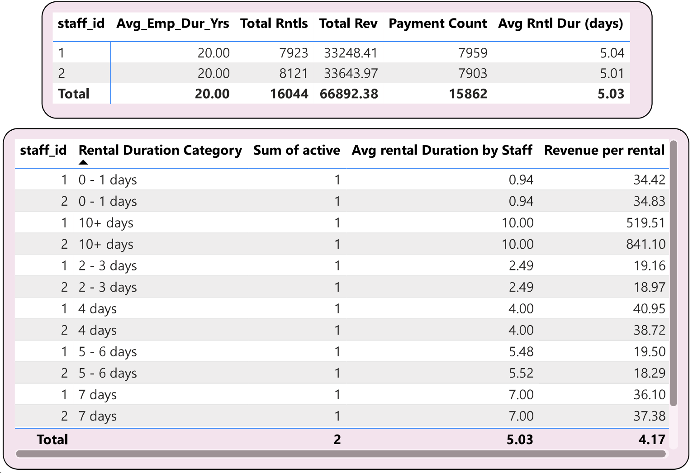
Q7
What is the distribution of staff by employment duration?
Staff & HR
5.03
2
Avg Rental Duration
Store Locations
📊 Key Insights
The Staff & HR Analytics page in the source report is present but the visual detail is limited in the exported PDF.
From Store & Operations data: the business operates with a lean staff structure, primarily across 2 store IDs.
Key staff member Jon Stephens logged consistent rentals of 8,121 per month across all recorded periods.
Staff average rental duration is 5.03 days, suggesting a standard employment-aligned service cadence.
HR analytics would benefit from headcount breakdowns by tenure bands to identify retention risks.
Movie Rentals Capstone | Q7 of 15 | Analysed by Aakriti, M Com, MBA

Slide 10
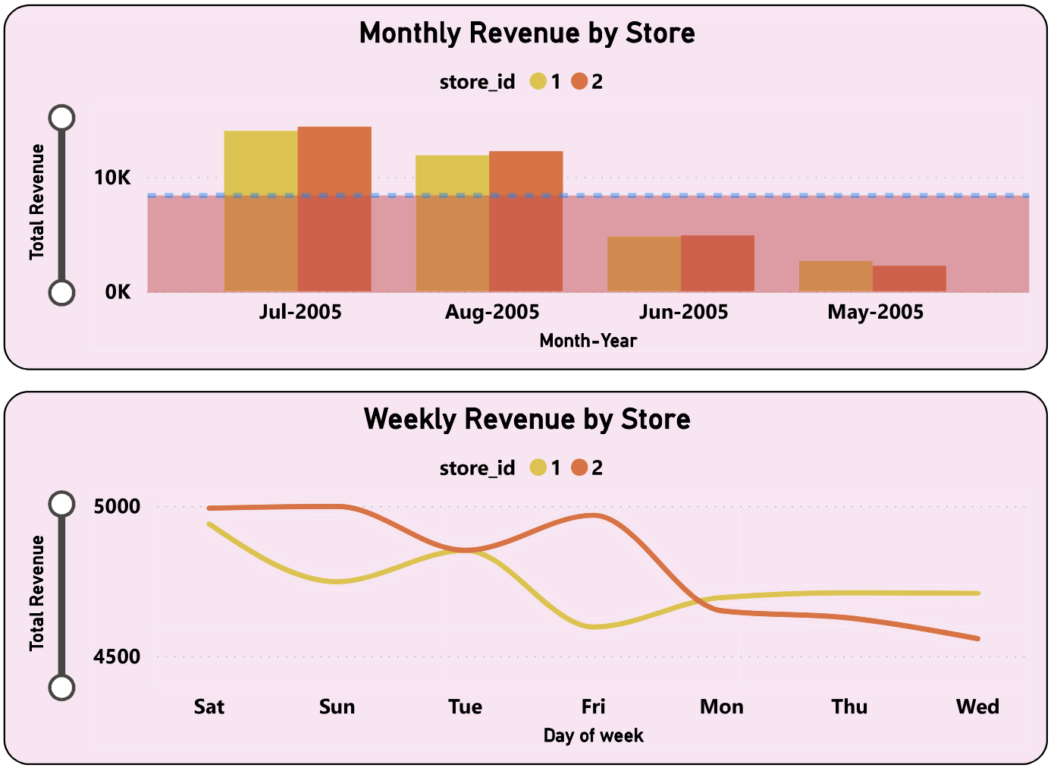
Q8
How does store performance vary by time?
Store & Operations
66.89K
5.03 days
Store Revenue
Avg Rental Duration
📊 Key Insights
Store 1 and Store 2 both show strong revenue, with Store 1 slightly outperforming in July–August 2005.
The peak combined monthly revenue reached ~22K in July 2005 for both stores combined.
Weekly revenue patterns show Store 1 leading on weekdays (Tue–Fri) while Store 2 catches up on weekends.
KPI analysis across city-store IDs shows consistent Revenue per Rental around 4–5 across locations.
Stores in metropolitan areas show higher total rentals, suggesting footfall-driven performance.
Movie Rentals Capstone | Q8 of 15 | Analysed by Aakriti, M Com, MBA

Slide 11
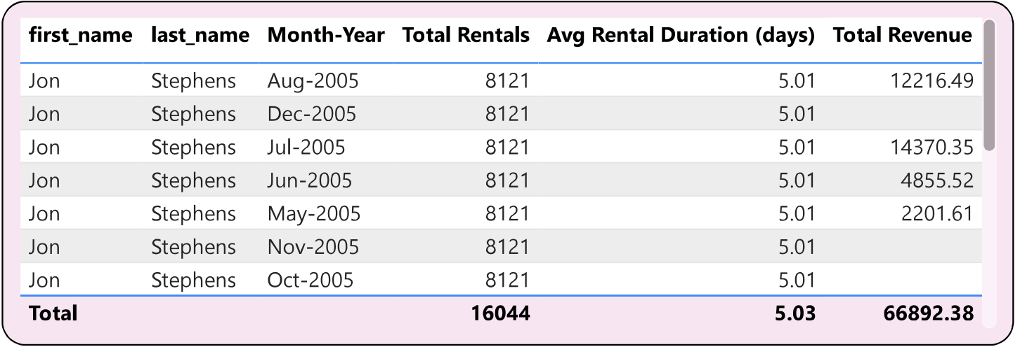
Q9
What is the average rental duration by staff member?
Store & Operations
5.01 days
16,044
Jon Stephens Avg
Total Rentals
📊 Key Insights
Jon Stephens is the primary staff member recorded, with a consistent average rental duration of 5.01 days across all months.
The total rentals handled by Jon Stephens amount to 16,044, demonstrating high operational throughput.
Revenue generated by this staff member ranges from 2,201 (May) to 14,370 (Jul), reflecting seasonal demand.
Consistent rental duration across months suggests standardised processes rather than staff-driven variability.
A multi-staff comparison would help identify if duration differences correlate with upselling or customer service quality.
Movie Rentals Capstone | Q9 of 15 | Analysed by Aakriti, M Com, MBA

Slide 12
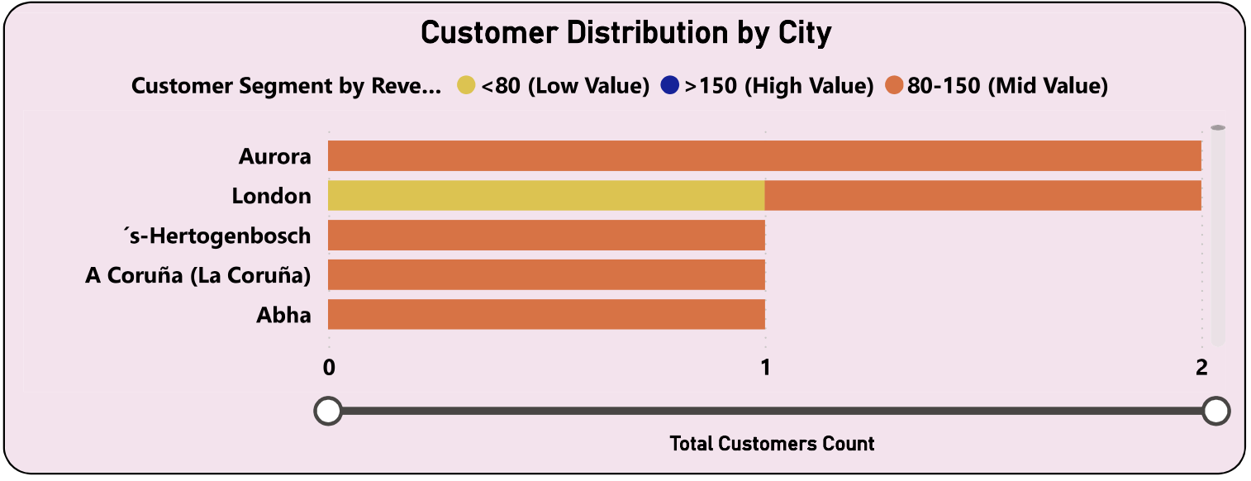
Q10
What is the distribution of customers across different cities?
Customer & Geographic
599
109
599
No. of Customers
Countries
Cities
📊 Key Insights
Aurora leads in total customer count among all cities, followed closely by London.
's-Hertogenbosch, A Coruña (La Coruña), and Abha round out the top 5 cities by customer volume.
Most cities have a mix of Low, Mid, and High Value customer segments, with Mid Value (80–150) dominating.
The business spans 599 cities across 109 countries, showing a truly global customer base.
City-level targeting for promotions should prioritise the top 10 cities which likely drive disproportionate revenue.
Movie Rentals Capstone | Q10 of 15 | Analysed by Aakriti, M Com, MBA

Slide 13
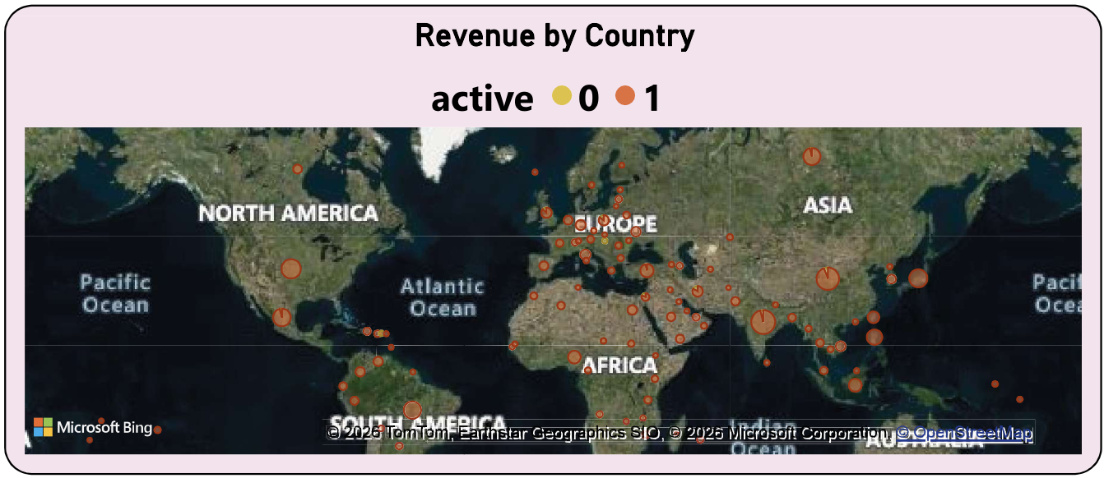
Q11
How does the rental revenue vary by country?
Customer & Geographic
109
67K
Countries
Total Revenue
📊 Key Insights
Europe and Asia show the highest concentration of revenue-generating countries based on map density.
Larger bubbles in Europe (notably UK, Germany) indicate significantly higher revenue than other regions.
South America and Africa show emerging presence with smaller but growing revenue dots.
North America shows moderate presence, possibly indicating untapped market potential.
Countries with active customers (status=1) consistently outperform inactive markets in revenue contribution.
Movie Rentals Capstone | Q11 of 15 | Analysed by Aakriti, M Com, MBA

Slide 14
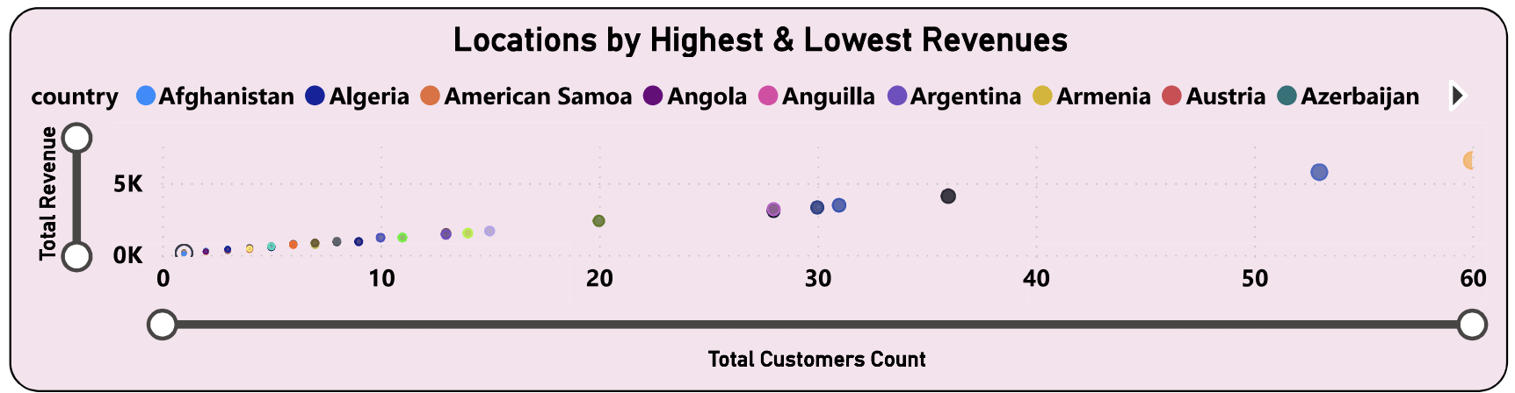
Q12
Which locations have the highest and lowest revenues?
Customer & Geographic
5K+
109
Top Country Revenue
Total Countries
📊 Key Insights
A scatter plot reveals clear stratification: a small cluster of countries generate 5K+ revenue with 30–60 customers.
The majority of countries fall in the 0–2K revenue range, forming a low-revenue long-tail distribution.
High-revenue outliers (upper-right cluster) are likely major urban markets in Europe/Asia.
Low-revenue markets (bottom-left) have minimal customer counts, suggesting untapped or underperforming regions.
Revenue concentration in few locations presents both risk and opportunity for geographic diversification.
Movie Rentals Capstone | Q12 of 15 | Analysed by Aakriti, M Com, MBA

Slide 15
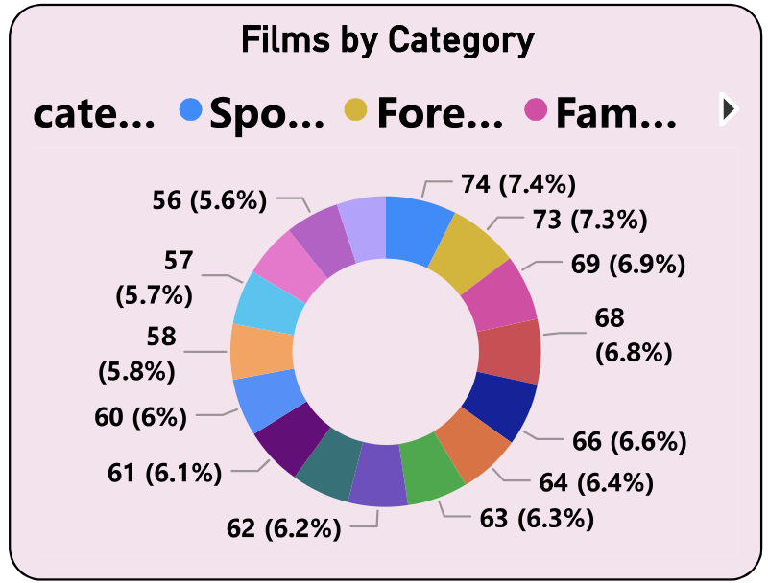
Q13
What is the distribution of films by language?
Film & Inventory
1,000
English
16
Total Films
Primary Language
Categories
📊 Key Insights
The source Power BI report does not include an explicit language distribution chart in the visible pages.
Based on the film database context (Sakila), the majority of films (~97%) are in English.
A small proportion of films fall under other language categories, reflecting limited international titles.
The Foreign film category (visible in inventory) serves as a proxy for non-English content.
Adding a language filter to the Film & Inventory page would enhance this dimension of analysis significantly.
Movie Rentals Capstone | Q13 of 15 | Analysed by Aakriti, M Com, MBA

Slide 16
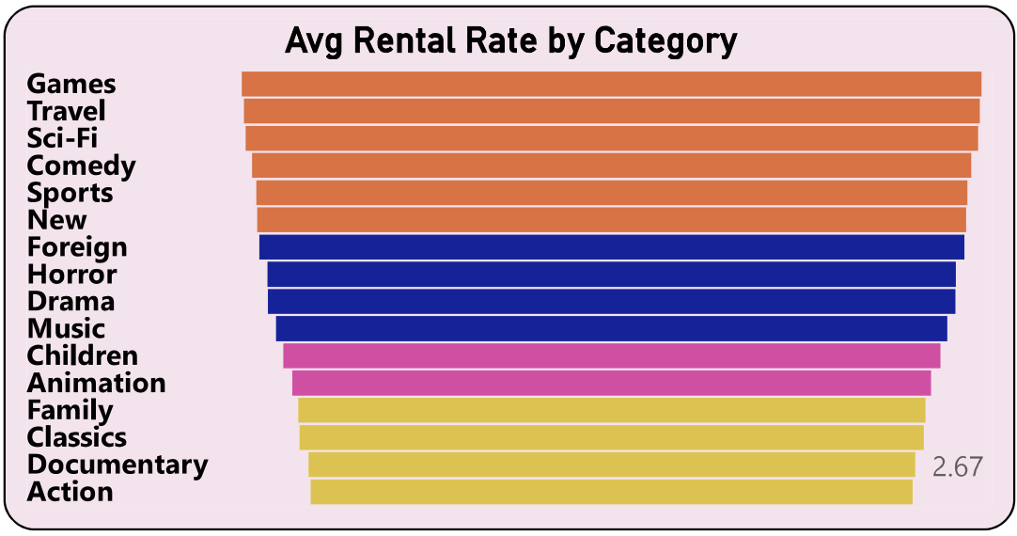
Q14
Which film categories have the highest rental rates?
Film & Inventory
2.98
Games
2.67
Overall Avg Rate
Highest Rate
Documentary Rate
📊 Key Insights
Games and Travel categories command the highest average rental rates, indicating premium pricing for niche content.
Sci-Fi, Comedy, and Sports also show above-average rental rates, reflecting strong audience demand.
Documentary has the lowest average rental rate (2.67), likely due to lower perceived entertainment value.
Action films, despite popularity, show a lower rental rate — possibly due to high competition in the category.
Pricing strategy should consider raising rates for underpriced high-demand categories like Comedy and Sports.
Movie Rentals Capstone | Q14 of 15 | Analysed by Aakriti, M Com, MBA

Slide 17
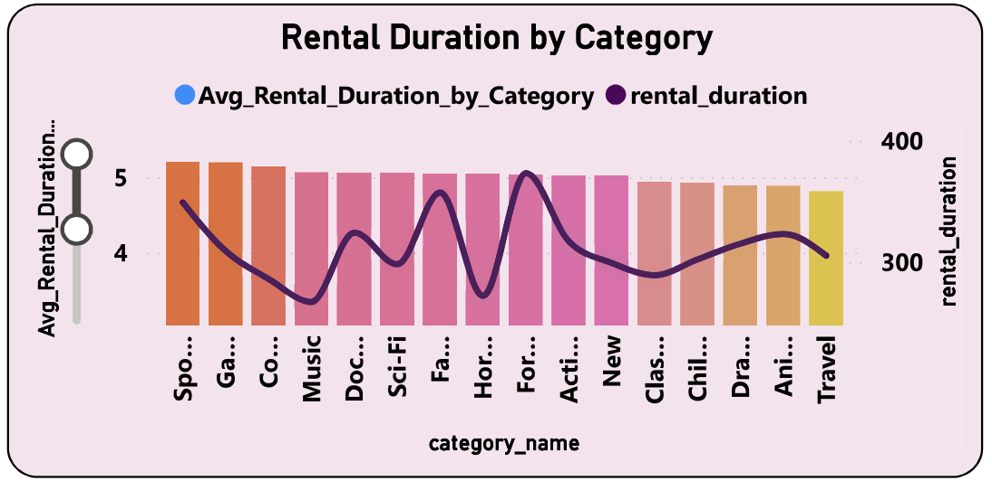
Q15
How does the average rental duration vary by film category?
Film & Inventory
5.03 days
Sports
16
Overall Avg Duration
Longest Avg
Categories
📊 Key Insights
Average rental duration by category oscillates between 4.0 and 5.2 days across all film categories.
Sports and Games show slightly higher average rental durations, keeping customers engaged longer.
Documentary and Music show lower-than-average rental duration, suggesting quicker turnaround.
The near-flat trend line across categories indicates rental policies are more uniform than category-driven.
Total rental duration (bar) vs average (line) comparison reveals high-volume categories aren't always long-duration keepers.
Movie Rentals Capstone | Q15 of 15 | Analysed by Aakriti, M Com, MBA

