Slide 1
$67K
Total Revenue
POWER BI
CAPSTONE PROJECT
584
Sakila
Active Customers
16K
DVD Rental
Total Rentals
Store Business Intelligence
5.03
Avg Rental Days
Analysed by Aakriti
Qualification M Com, MBA
Email aakriti.9703@gmail.com
$4.17
Revenue/Rental
TOOLS
SQL
Excel
Power BI
Dataset: Sakila MySQL Database

Slide 2
02
Problem Statement
Objective
Build a comprehensive Power BI dashboard using the Sakila DVD Rental Database to enable data-driven decisions across customer behavior, film inventory, staff performance, and store operations — with actionable insights for growth.
👥 Customer Segmentation
📈 Sales & Revenue Trends
Classify 584 active customers into Low (<80), Mid (80–150), and High (>150) value tiers across 109 countries and 599 cities.
Track $67K total revenue, $4.17 per rental, YTD revenue, and MoM trends — In-Store (41%) vs Online (40%).
🎬 Film Inventory Intelligence
🏪 Store & Operations
Analyze 1,000 films across 16 categories, 4,581 inventory items, avg rental rate $2.98, and 115.27-min avg duration.
Compare 2 stores and 2 staff managing 16,044 total rentals with 5.03-day average rental duration.
🌍 Geographic Insights
👤 Staff & HR Analytics
Map revenue and customer density across 599 cities in 109 countries to identify expansion markets.
Assess 2 staff with 20-year avg employment, rental productivity by duration buckets, and revenue per staff.

Slide 3
03
Dataset Overview — Sakila Database
A MySQL database representing a DVD rental store — 15+ interconnected tables spanning actors, films, customers, inventory, payments, rentals, staff & stores.
Customer
Rental
Payment
Film
599 customers — ID, Name, Email, Address, Active Status, City
16K rentals — Inventory ID, Customer ID, Rental & Return Dates
16K payments — Amount, Date, Staff ID, Customer ID
1,000 films — Title, Rating, Duration, Rental Rate, Language
Inventory
Staff
Store
Actor/Cat
4,581 items — Film copies per store with availability tracking
2 staff — Login, Store ID, Employment Duration, Rental handling
2 stores — Address, Manager ID, Revenue & operational data
Actors via film_actor; 16 categories via film_category junction tables

Slide 4
04
Tools & Approach
01 SQL
02 Excel
03 Power BI
› Extracted data from 15+ Sakila tables via multi-table JOINs
› EDA with pivot tables for category-level rental volume analysis
› Star schema: fact Rental & Payment linked to 6 dimension tables
› Derived customer segments: <80 Low, 80–150 Mid, >150 High Value
› Validated $66,892.38 total revenue and 16,044 total rental count
› DAX measures: MoM%, YTD, Customer Segments, Duration Buckets
› Aggregated rentals, revenue, avg duration per staff, store & city
› Cross-checked payment splits: In-Store 41% vs Online 40%
› 6 interactive pages: Dashboard, Sales, Film, Store, Geography, Staff
› Built YTD, MoM growth, and employment duration queries
› Cleaned address, city, country data for geographic mapping
› Slicers: Rating, Category, Country, City, Payment channel, Date
SQL → Data Extraction & Segmentation | Excel → EDA & Validation | Power BI → Modeling, DAX & Dashboard

Slide 5
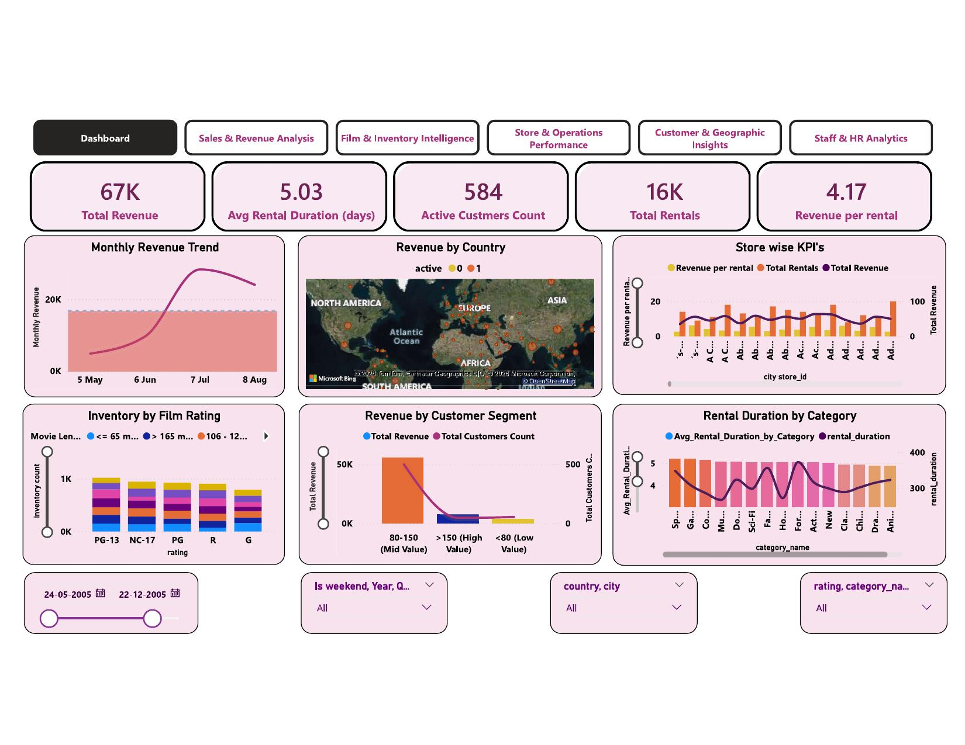
05
Dashboard Overview
$67K
5.03
584
16K
$4.17
Total Revenue
Avg Rental Days
Active Customers
Total Rentals
Rev / Rental
Revenue peaked in July 2005 (~$20K)
Monthly trend shows sharp rise from May, peaking Jul–Aug 2005. Clear seasonality needs off-peak promotions.
Mid-Value segment leads at $10K+
The 80–150 bracket generates the most revenue with ~500 customers — highest retention priority.
PG-13 dominates inventory
PG-13 leads across all movie length buckets, making it the most widely available rating in both stores.
Europe & Asia are top markets
Revenue by Country map shows active clusters concentrated in Europe and South/Southeast Asia.
★ 6 interactive pages with slicers for Rating, Category, Country, Payment Channel & Date — enabling real-time drill-down for store management.

Slide 6
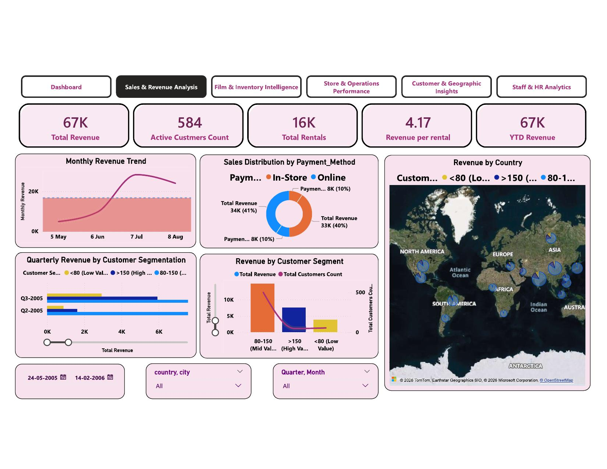
06
Sales & Revenue Analysis
$67K
$67K
584
16K
Total Revenue
YTD Revenue
Active Customers
Total Rentals
Q: How does revenue trend over time, and how is it distributed by segment and payment channel?
Q3-2005 was peak quarter at $6K+
Quarterly Segmentation shows Q3 and Q2 of 2005 as strongest. Q1-2006 drops sharply — signals need for seasonal strategy.
In-Store (41%) and Online (40%) nearly equal
Payment donut shows 8K transactions each channel, $34K vs $33K revenue — a strong omnichannel balance to maintain.
Mid-Value (80–150) leads with $10K+ revenue
80–150 bracket has ~500 customers and the highest revenue bar. Low Value (<80) generates minimal revenue despite volume.
★ Takeaway: YTD = Total Revenue ($67K). Reactivating Low Value customers through targeted promos could unlock the next revenue tier.

Slide 7
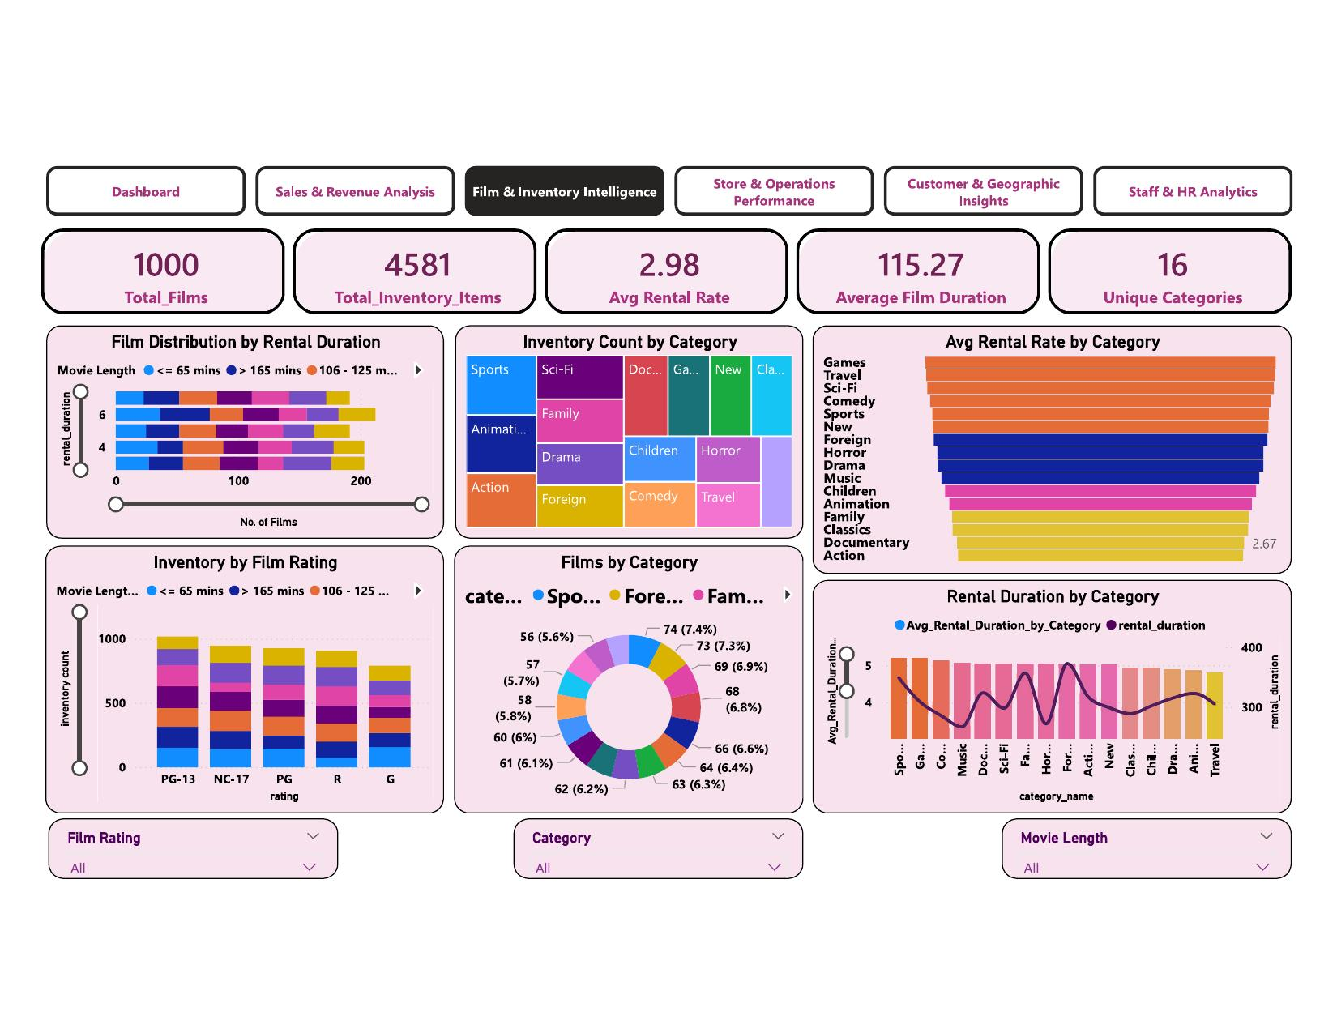
07
Film & Inventory Intelligence
1,000
4,581
$2.98
16
Total Films
Inventory Items
Avg Rental Rate
Categories
Q: Which film categories and ratings drive the most inventory and rentals, and how are they priced?
Sports leads inventory with 344 items
Treemap confirms Sports, Animation (335), Action (312), Sci-Fi & Drama (300) as top 5 — reflecting a broad genre strategy.
Games & Travel command highest avg rental rates
Horizontal bar shows Games and Travel far above the $2.98 benchmark. Action & Documentary lowest at $2.67 — repricing opportunity.
All 16 categories near-equal distribution (5.6–7.4%)
Films by Category donut shows Sports (7.4%), Foreign (7.3%), Family (6.9%) at top — a well-balanced inventory strategy.
★ Takeaway: Games and Travel command premium rates but may be under-stocked — more titles in these 2 categories could directly boost per-rental revenue.

Slide 8
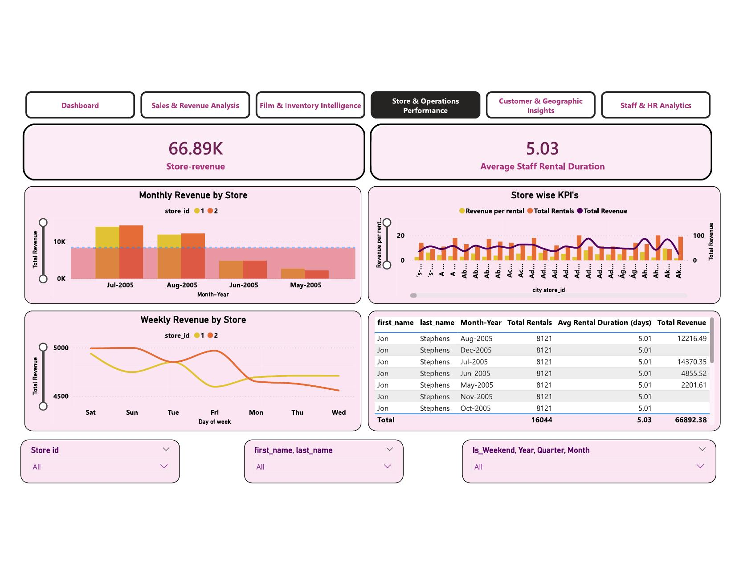
08
Store & Operations Performance
$66.89K
5.03
16,044
2
Store Revenue
Avg Rental Duration
Total Rentals
Stores
Q: How does store revenue vary by month and day of week, and which staff drives the most rentals?
Jul–Aug 2005 are peak months for both stores
Monthly Revenue shows $10K+ combined in Jul and Aug 2005. May-2005 and Feb-2006 are lowest, signaling mid-year peak with early-year decline.
Saturday & Sunday show highest weekly revenue
Weekly Revenue chart shows both stores peak on Sat–Sun. Revenue steadily declines through week; Wednesday is lowest.
Jon Stephens (Staff 2) leads at $14,370 in Jul-2005
Staff table shows Jon Stephens handling 8,121 rentals/month with Jul-2005 as peak ($14,370.35) and avg duration 5.01 days.
★ Takeaway: Both stores show near-identical staff productivity. A weekend-focused promotional strategy could amplify the already-strong Sat–Sun revenue peak.

Slide 9
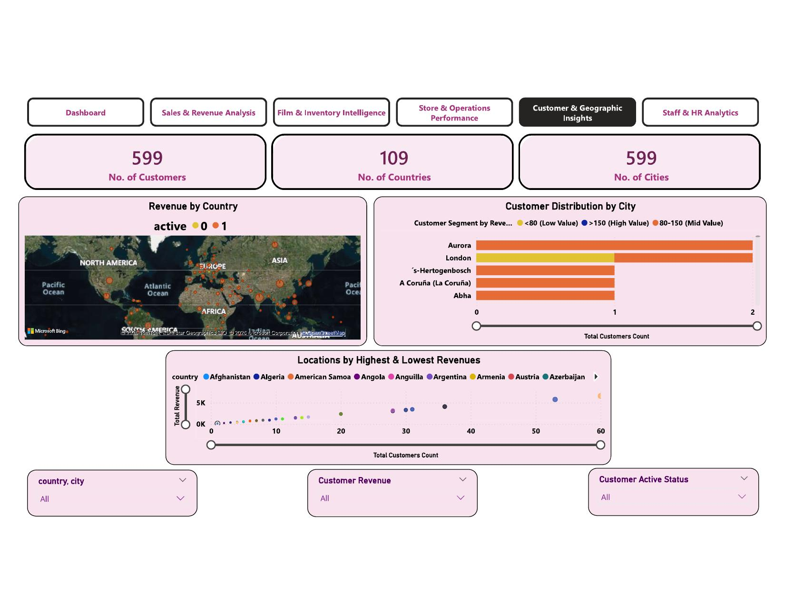
09
Customer & Geographic Insights
599
109
599
3-Tier
Total Customers
Countries
Cities
Segmentation
Q: How are customers and revenue distributed globally, and which cities and segments drive the most value?
Aurora and London top city-level customer counts
Aurora shows widest bar (predominantly Mid-Value 80–150). London is only city with a noticeable High Value (>150) customer segment.
High-Value customers are geographically concentrated
London is the only city with a visible >150 High Value bar. Most other cities show only Mid or Low-Value customers — rare but high-worth accounts.
Revenue vs count is non-linear — quality beats quantity
Scatter shows countries with 20–30 customers generating $5K+ revenue, while 50+ customer countries generate less.
★ Takeaway: Concentrating loyalty investment on Aurora, London, and high revenue-per-customer countries would maximize marketing ROI.

Slide 10
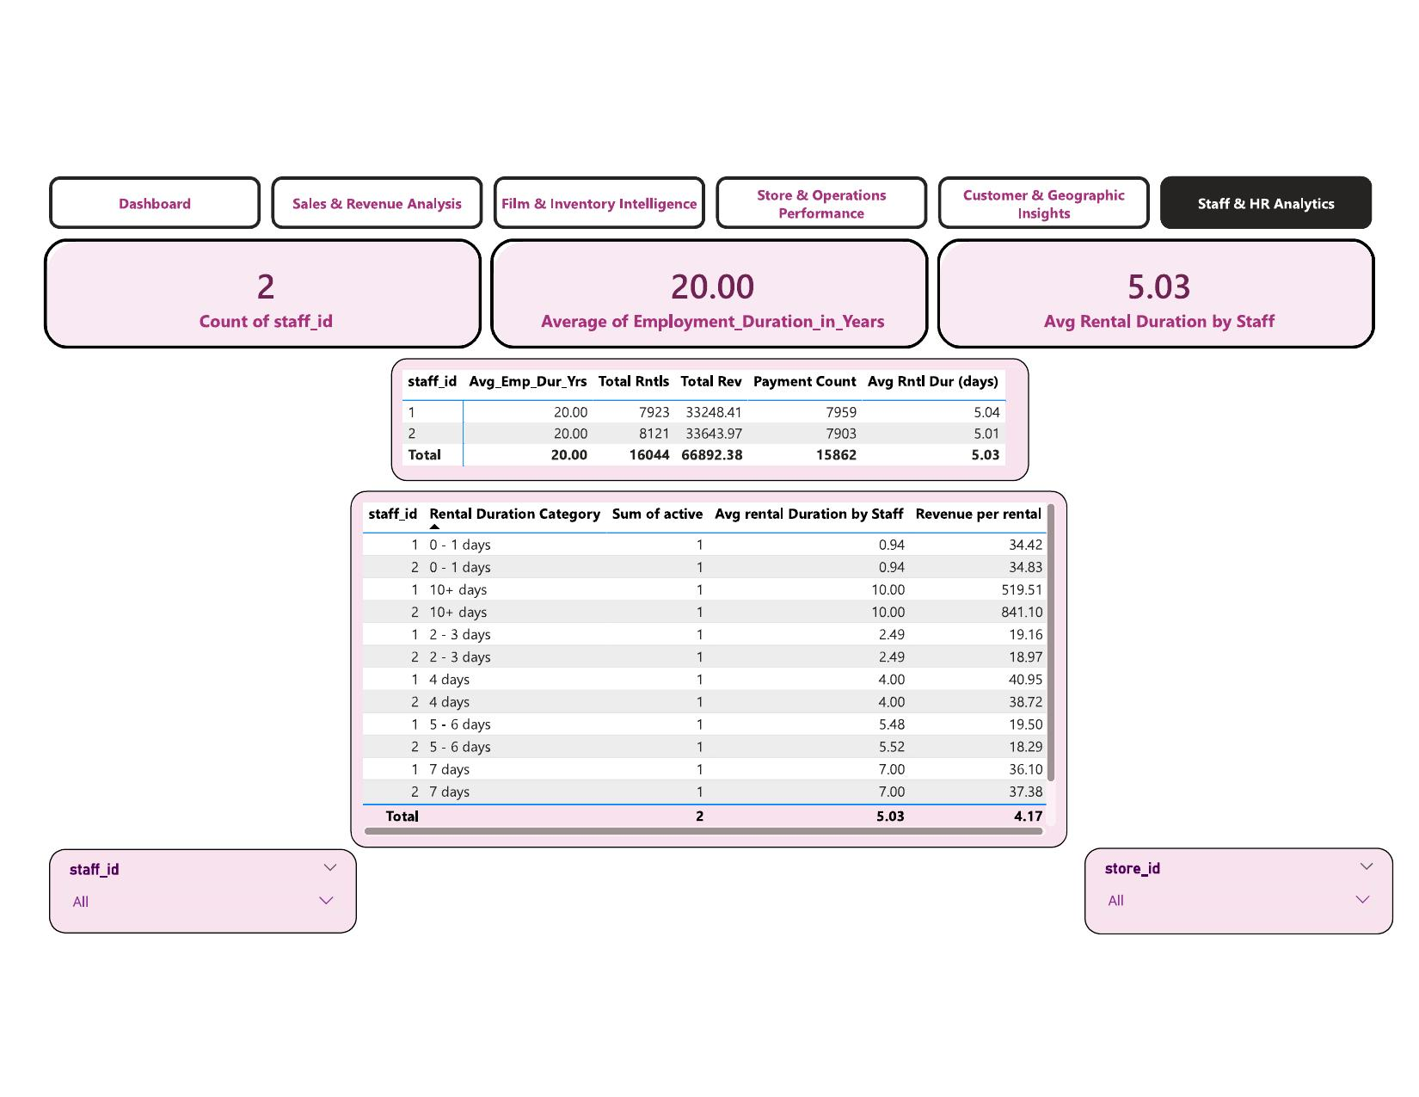
10
Staff & HR Analytics
2
20 yrs
5.03
16,044
Staff Members
Avg Employment
Avg Rental Duration
Total Rentals
Q: How do the two staff compare in rentals, revenue, and which rental duration buckets are most profitable?
Both staff carry identical 20-year employment tenure
Staff 1 and Staff 2 both show Avg Employment Duration of 20.00 years — an experienced, stable team with deep institutional knowledge.
Staff 2 generates slightly higher revenue ($33,643 vs $33,248)
Despite near-equal rental counts (8,121 vs 7,923), Staff 2 earns $395 more — suggesting marginally better ability to handle higher-value rentals.
10+ day rentals generate $519–$841 vs $4.17 average
The '10+ days' bucket delivers Revenue_per_Rental of $519.51 (Staff 1) and $841.10 (Staff 2) — 124×–200× the average. Massive upsell potential.
★ Takeaway: Training both staff to identify and upsell 10+ day rental opportunities could transform low-value customers into high-revenue accounts with minimal cost.

Slide 11
11
Key Insights
Sales & Revenue
$67K total revenue, $4.17/rental. Q3-2005 peak quarter. In-Store (41%) and Online (40%) near-equal — strong omnichannel. Q1-2006 shows sharp decline needing intervention.
Film & Inventory
1,000 films, 16 categories, 4,581 inventory items. Sports leads with 344 items. Games & Travel command the highest rental rates — prime revenue growth levers through increased stocking.
Store Operations
$66.89K store revenue. Jul–Aug 2005 peak. Saturday & Sunday are highest-revenue days. Both stores nearly identical in staff productivity — weekend promotions could amplify the strong peak.
Geography
599 customers across 109 countries and 599 cities. Aurora and London lead city count. Revenue-per-customer is non-linear — quality of customer segment matters more than volume.
Staff & HR
2 staff, 20-year avg tenure, 16,044 rentals. 10+ day rental duration generates $519–$841/rental vs $4.17 average — the single highest-ROI upsell opportunity in the entire business.

Slide 12
12
Business Recommendations
R1
Re-engage Low-Value Customers (<80)
R2
Increase Games & Travel Inventory
Target <80 rental customers with 'rent 5, get 1 free' bundles to move them into the 80–150 Mid-Value bracket, which generates the highest revenue.
Both categories command the highest avg rental rates. Adding 50–80 more titles per store would directly improve revenue per rental without any discounting.
R3
Launch Weekend Rental Promotions
R4
Focus Loyalty Marketing on Aurora & London
Saturday–Sunday already drive peak revenue. Launch 'Weekend Warriors' bundles or 'Buy 2, Get 3rd Free' weekend deals to deepen the revenue window.
These cities lead in customer count and contain the only High-Value (>150) customers. A loyalty rewards program here would protect high-value accounts.
R5
Train Staff to Upsell 10+ Day Rentals
R6
Stabilize Post-Peak Revenue (Q1-2006 Decline)
10+ day rentals generate $519–$841/rental vs $4.17 avg. A structured upsell script during checkout for both staff could dramatically improve per-rental revenue.
Q1-2006 shows a sharp drop. Introduce 'New Year Rental Bundles', extended rental periods at discounted rates, and new category launches in Jan–Feb.

Slide 13
Conclusion
5
Analysis Modules
This Power BI dashboard for Sakila DVD Rental transforms raw transactional data into a fully interactive BI system — covering 5 analysis domains across 599 customers, 16K rentals, 1,000 films, 2 stores, and 109 countries.
1,000
Films Analyzed
16K
› SQL + Excel pipeline: clean, validated data from 15+ Sakila tables
Rentals Processed
› DAX measures: MoM%, YTD, Customer Segments, Duration Buckets
$67K
Total Revenue
› 6 interactive Power BI pages with slicers for Rating, Category, Country
› 5 analysis domains with insights + actionable recommendations
109
Countries Covered
› 6 strategic recommendations to drive revenue, film & customer growth
Aakriti · M Com, MBA · aakriti.9703@gmail.com

