Slide 1
Northwind Traders
Power BI Sales Analysis
End-to-End Data Analysis Using SQL · Excel · Power BI
Analysed by: Aakriti
M.Com | MBA
Tools: SQL · Excel · Power BI
Dataset: Northwind Database (Specialty Foods Global Trade)
Notes:
Welcome everyone. My name is Aakriti and today I will walk you through a comprehensive Power BI Sales Analysis of Northwind Traders – a fictitious specialty foods trading company. This project covers the full analytics pipeline from SQL extraction through to interactive Power BI dashboards, enabling data-driven decision making across sales, customers, orders, suppliers, and employees.

Slide 2
Problem Statement
What business questions does this project solve?
Objective
Key Business Questions
Design an interactive, user-friendly Power BI report for Northwind Traders
Surface key performance metrics across Sales, Customers, Orders, Suppliers & Employees
Enable data-driven decision-making through visual storytelling
Replace static reports with dynamic, filterable dashboards
Who are our most valuable customers and markets?
Which products drive the highest revenue?
How has order volume and revenue trended over time?
Which suppliers offer the best price-to-volume balance?
How is the employee workforce structured and retained?
Notes:
The core problem this project addresses is giving Northwind Traders' leadership a single, consolidated view of their business. Rather than juggling spreadsheets, the goal was to build five interconnected dashboards covering customers, products, orders, suppliers, and employees — each answering a specific business question. The overall aim: move from reactive reporting to proactive, insight-led decisions.

Slide 3
Dataset Overview
Northwind Database – Specialty Foods Global Trading Company
The Northwind database represents a fictitious company that imports and exports specialty food products globally. It is a widely recognised relational dataset with 8 interrelated tables covering the full order-to-delivery lifecycle.
Customers
Orders
Order Details
Products
Demographics & location
Transaction records
Product-level line items
Details & pricing
Suppliers
Employees
Shippers
Categories
Supplier information
Roles & hierarchy
Shipping companies
Product categories
🔧 SQL
🔧 Excel
🔧 Power BI
Notes:
The Northwind dataset contains 8 relational tables. The core fact table is Order Details, which links orders to products. Surrounding it are dimension tables for Customers, Employees, Suppliers, Shippers, and Categories. The pipeline started with SQL for data extraction and exploratory analysis, moved to Excel for cleaning and validation, and finally into Power BI for interactive visualisation.

Slide 4
Data Processing Pipeline
SQL → Excel → Power BI
SQL
Excel
Power BI
Multi-table JOINs (INNER, LEFT) across Orders, Products, Customers
Aggregations: SUM, COUNT, AVG for revenue, order count, shipping days
Window functions for YoY & MoM growth calculations
Filtering & sub-queries for late shipments and top products
Validation of row counts vs. SQL output
Removal of duplicates & null handling
Data type corrections (dates, numeric fields)
Pivot tables for preliminary sanity-checking
Power Query for final data shaping & relationships
DAX measures: Total Revenue, Avg Shipping Days, MoM %, YoY %
Star schema data model linking all 8 tables
Six interactive dashboard pages with cross-filter slicers
Outcome: Clean, modelled dataset powering 6 interactive dashboards with 15+ DAX measures
Notes:
The data processing phase followed three structured stages. In SQL, I wrote multi-table joins combining Orders, Customers, Products, and Employees, and computed aggregations for revenue, order counts, and shipping metrics. In Excel, I validated the output and cleaned data types. In Power BI, I built a star schema, wrote DAX measures including MoM and YoY growth rates, and designed the six dashboard pages. This end-to-end control ensured data integrity throughout.

Slide 5
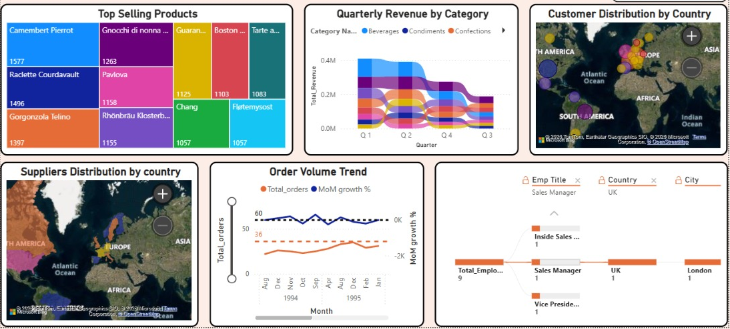
Dashboard Overview
Six Interconnected Pages · Northwind Traders Report
830
90
1.27M
8.49
Total Orders
Total Customers
Total Revenue ($)
Avg Shipping Days
Notes:
The report is structured across six pages. The main Dashboard page provides a high-level KPI summary: 830 orders, 90 customers, 1.27 million in total revenue, and an average shipping time of 8.49 days. Each subsequent page drills deeper — from customer geography and product performance, through order trends and logistics, to supplier pricing and employee structure. All pages are connected through shared slicers, enabling cross-dimensional filtering.

Slide 6
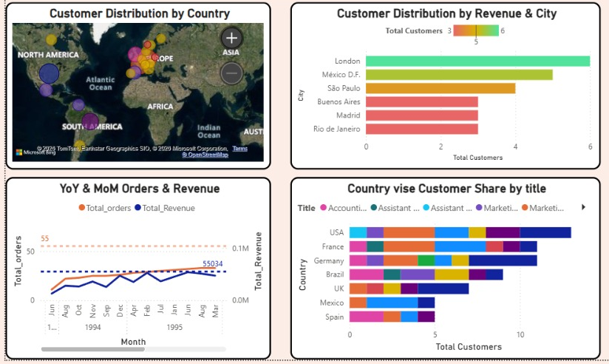
Customer Analysis
SLIDE 6 / 13
90 Customers · $1.27M Revenue · 21 Countries
90
1.27M
170%
55
Total Customers
Total Revenue
Orders YoY Growth
Peak Monthly Orders
Key Findings
Business Insights
London leads city-level customer count (6), indicating a concentrated UK market presence
USA, France & Germany collectively represent the majority of customer share by country
Europe clusters ~6+ countries with moderate but fragmented customer distribution
South America & Asia show minimal penetration — clear expansion opportunities
Top 2–3 countries account for a disproportionate share of total revenue
Concentration Risk: Over-reliance on London/USA suggests need to diversify market strategy
Untapped Potential: Low bubble density in Asia & South America signals underdeveloped markets
Revenue Skew: A highly skewed distribution means a small customer base drives the bulk of revenue
Notes:
The customer analysis reveals both strengths and concentration risks. London is the single largest city by customer count at 6 customers, and the USA dominates at the country level. Europe shows broad but fragmented presence across 6 or more countries. The YoY order growth of 170% is impressive, but it's largely driven by a concentrated customer base. South America and Asia represent the biggest untapped expansion opportunities based on the low bubble density in the map visual.

Slide 7
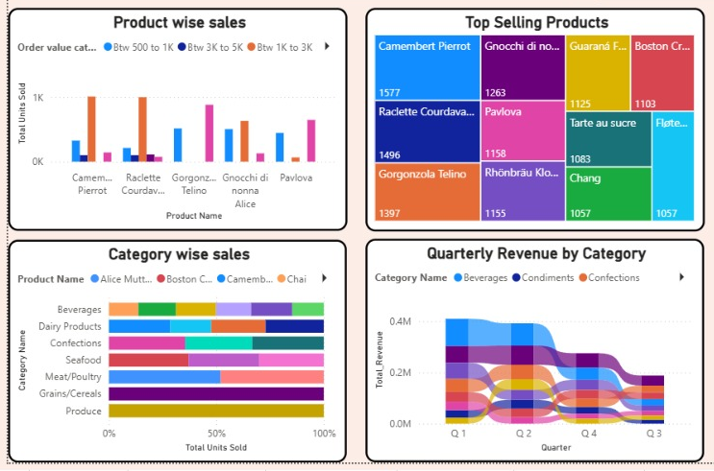
Product Analysis
SLIDE 7 / 13
Top Selling Products · Category Revenue · Pricing Distribution
77
1,577
8
$28.87
Total Products
Top Product Units (Camembert)
Product Categories
Avg List Price
Key Findings
Business Insights
Business Insights
Camembert Pierrot leads sales volume at 1,577 units, followed by Raclette Courdavault (1,496) & Gorgonzola Telino (1,397)
Beverages, Condiments & Confections drive the largest share of quarterly revenue
Revenue peaks in Q1–Q2, suggesting seasonal demand patterns in specialty foods
Dairy products and niche items show consistent but lower contribution volumes
Category diversification ensures no single product segment creates over-dependence
Portfolio Strength: Top 3 products are all dairy/cheese — a defensible niche in specialty foods
Revenue Seasonality: Q1–Q2 peak indicates promotional timing opportunities for slower quarters
Pricing Breadth: $28.87 average price masks a wide range (low: $4.50 → premium: $140.75)
Notes:
The product analysis shows a clear leader in Camembert Pierrot at 1,577 units. The top three products are all from the dairy/cheese category, indicating a strong niche. Beverages and Confections contribute meaningfully to quarterly revenue. One strategic insight is the price range: the average list price of $28.87 masks a wide spread, with premium products above $100 representing margin expansion opportunities. The Q1–Q2 revenue peak is worth investigating for demand planning.

Slide 8
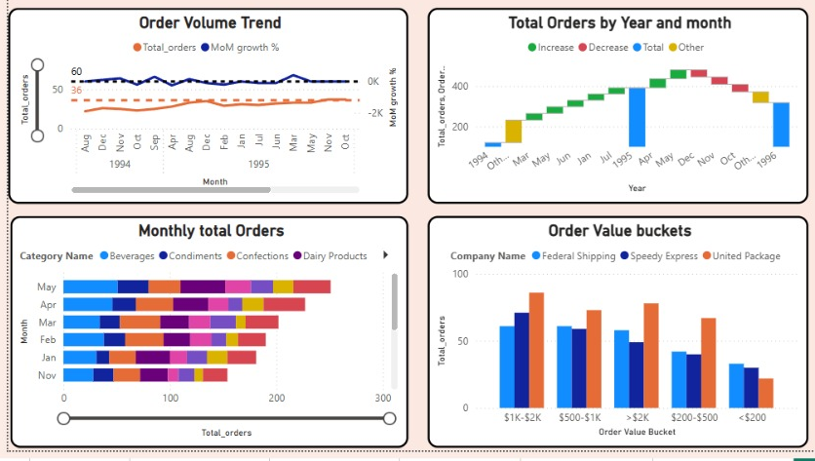
Order Analysis
SLIDE 8 / 13
830 Orders · Order Volume Trends · Shipping Performance
830
$1.53K
8.49
37
223%
Total Orders
Avg Order Value
Avg Shipping Days
Late Shipments
Orders YoY Growth
Key Findings
Business Insights
Orders grew steadily from ~25–30/month (1994) to 35–40/month (1995), confirming demand expansion
Sharp 1996 decline followed by ~100% MoM spike — suggests external disruption, not structural weakness
May records the highest monthly order volume, April second — seasonal demand concentration
$1K–$2K bucket dominates order value distribution across all three shipping partners
37 late shipments out of 830 represent a 4.5% late rate — moderate but improvable
Resilience Signal: Post-decline recovery with 100% MoM growth confirms business resilience
Shipping Bottleneck: Belgium and Ireland average 13–15 days — above-average inefficiency requiring process review
Carrier Gap: Speedy Express consistently shows higher delivery times than peers across regions
Notes:
Order analysis paints a picture of a growing but slightly volatile business. The 223% YoY growth confirms strong underlying demand. The 1996 sharp drop followed by an immediate spike is an anomaly worth investigating — possibly a data gap or seasonal disruption. The average order value of $1,530 indicates a healthy mid-market positioning. The 37 late shipments are manageable but the carrier-level data reveals Speedy Express as an underperformer worth addressing.

Slide 9
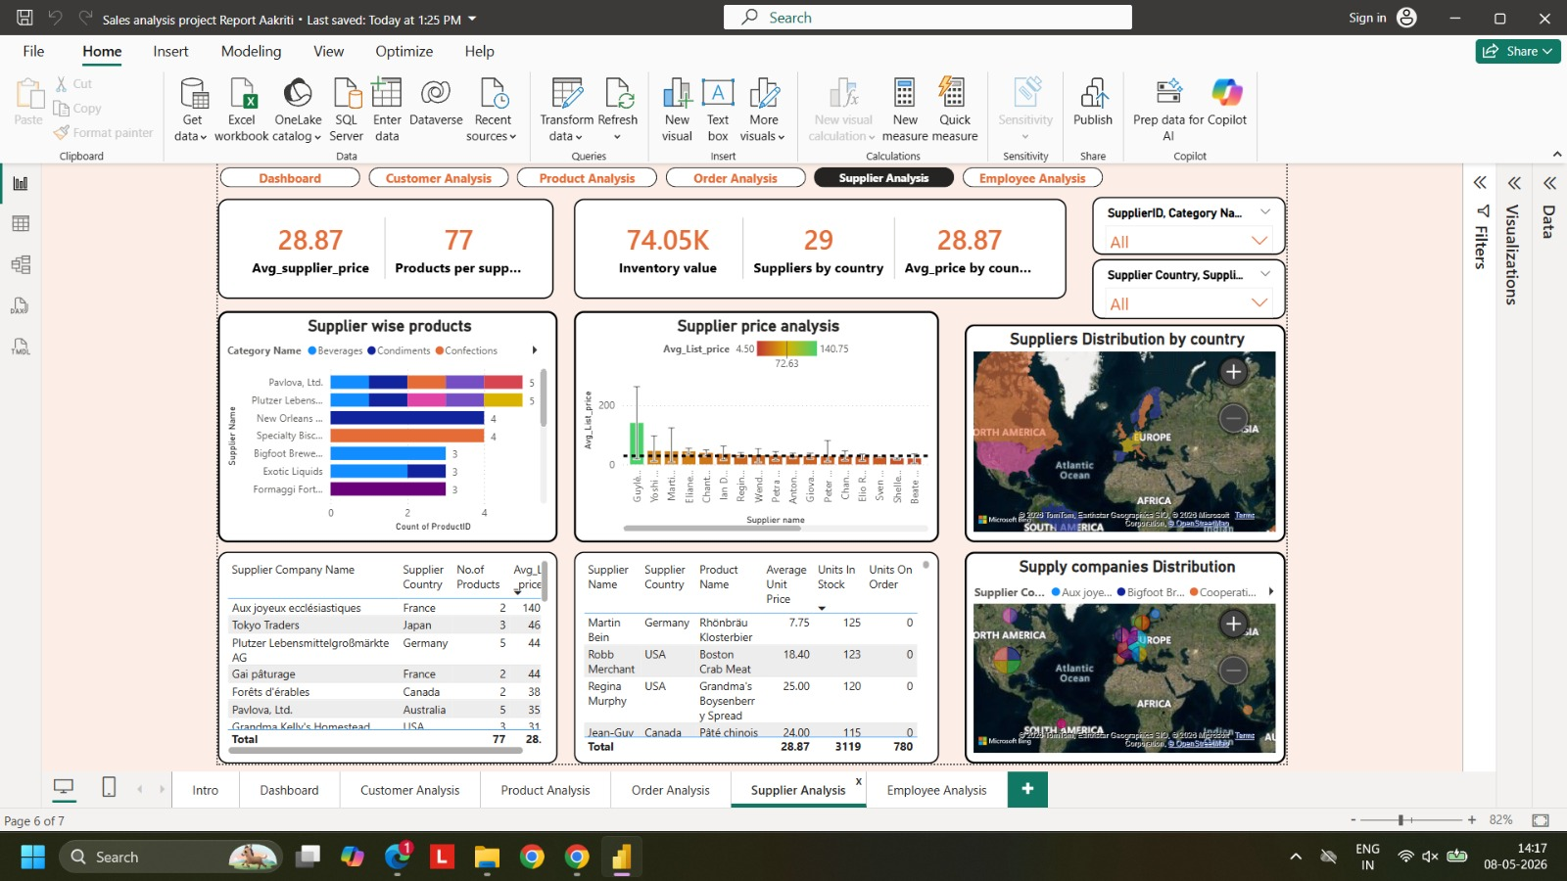
Supplier Analysis
SLIDE 9 / 13
29 Countries · 77 Products · $74.05K Inventory Value
28.87
77
74.05K
3,119
780
Avg Supplier Price ($)
Products Supplied
Inventory Value ($)
Total Units in Stock
Units on Order
Key Findings
Business Insights
Pavlova Ltd. & Plutzer Lebensmittel each supply 5 products — the broadest product portfolios
Price range: $4.50 (min) to $140.75 (max), average $28.87 — highly skewed by premium outliers
USA suppliers: 4 companies, 244 total orders, strong operational hub
Australia suppliers: 2 companies, 95 orders, higher avg price ($33 vs USA's $20)
North America & Europe hold the highest supplier density; South America & Asia are secondary
Tiered Pricing Strategy: Low-tier ($2.50–$10) for volume, Mid-tier ($15–$40) for stability, Premium (>$100) for margin expansion
Supply Chain Balance: Multi-region sourcing reduces single-point dependency
Inventory Risk: 780 units on order vs. 3,119 in stock — re-order triggers need review
Notes:
The supplier analysis reveals a well-structured but geographically concentrated supply chain. Pavlova Ltd. from Australia and Plutzer from Germany are the broadest suppliers at 5 products each. The tiered pricing model is clear — volume-driven low-cost products, a stable mid-range, and premium items for margin. The 780 units currently on order versus 3,119 in stock indicates a reasonable inventory buffer, but individual SKU-level analysis may reveal stockout risks.

Slide 10
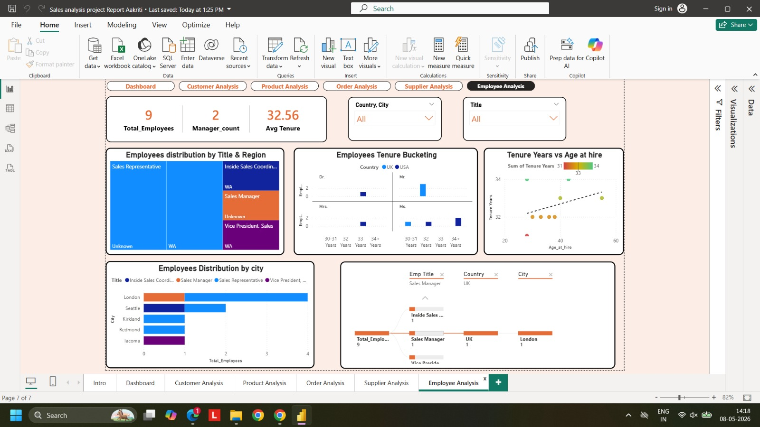
Employee Analysis
SLIDE 10 / 13
9 Employees · Flat Hierarchy · Long-Term Retention
9
2
32.56
4
Total Employees
Managers
Avg Tenure (yrs)
London-based
Key Findings
Business Insights
9 employees operate across UK (London) and USA (Seattle, Kirkland, Redmond, Tacoma)
Flat hierarchy: ~1 employee per title — minimal managerial layers, lean structure
Tenure tightly clustered between 31–34 years, reflecting uniform long-term retention
Positive correlation between age at hire (30–55) and tenure — consistent retention regardless of hire age
Sales Representatives make up the largest role group; London has the highest headcount (4)
Retention Strength: 32.56-year average tenure signals very high employee loyalty and institutional knowledge
Succession Risk: With 2 managers and no layered hierarchy, any attrition creates immediate coverage gaps
Geographic Bottleneck: Reporting is concentrated in UK/London — limited geographic leadership diversity
Notes:
The employee analysis reveals a compact, experienced team. With only 9 employees and an average tenure of 32.56 years, this team has deep institutional knowledge. The flat hierarchy works for the current scale but creates succession risk — if either manager leaves, there is no obvious internal pipeline. The geographic concentration in London also means the business is heavily dependent on one city for its operational leadership.

Slide 11
Key Insights Summary
Cross-Domain Findings at a Glance
Customers
Products
Orders
Suppliers
Employees
London & USA dominate; Europe is fragmented
170% YoY order growth reflects strong demand momentum
Asia & South America are largely untapped
Top 3 products all dairy/cheese — strong defensible niche
Beverages drive the highest quarterly revenue
Premium tier (>$100) products create margin upside
223% YoY growth; 8.49-day avg shipping indicates scale-up demand
37 late shipments — Speedy Express is a weak-link carrier
May–April seasonality drives over 50% of monthly peak volume
Multi-region supply chain reduces single-point risk
Tiered pricing strategy supports volume + margin goals
780 units on order — inventory replenishment is active
32.56-year average tenure signals exceptional retention
Flat structure — lean but succession risk is real
Geographic concentration in London/UK
All insights are backed by data extracted via SQL, validated in Excel, and visualised through Power BI's interactive dashboards.
Notes:
This summary consolidates the five major findings. Customers show geographic concentration with growth momentum. Products have a defensible dairy niche with premium pricing upside. Orders confirm strong YoY growth but reveal a carrier performance gap. Suppliers are well-distributed globally with a multi-tier pricing approach. And employees bring exceptional institutional knowledge but face succession and geographic concentration risks. Together, these insights frame the business recommendations on the next slide.

Slide 12
Business Recommendations
Actionable Strategies Derived from Data Analysis
01
Market Expansion
02
Carrier Performance Review
Develop targeted campaigns for Asia & South America where customer density is low but growth potential is significant. Start with distributors in Japan and Brazil.
Replace or renegotiate with Speedy Express, which consistently exceeds average shipping days across multiple regions. Benchmark against Federal Shipping SLAs.
03
Seasonal Demand Planning
04
Supplier Consolidation
Capitalise on the May–April peak by increasing inventory buffer and promotional activity in Q1. Create demand-stimulation strategies for Q3–Q4 low periods.
Identify mid-tier suppliers with overlapping product ranges and consolidate orders to achieve volume discounts. Focus on suppliers with >3 products listed.
05
Succession Planning
06
Premium Product Promotion
With only 2 managers and high avg tenure (32.56 yrs), initiate succession planning. Identify Sales Representatives with leadership potential for future managerial roles.
Products priced >$100 represent high-margin opportunities. Create targeted B2B campaigns for premium specialty products to increase contribution to overall revenue.
Notes:
The six recommendations follow directly from the data. First, geographic expansion in Asia and South America. Second, addressing Speedy Express's carrier underperformance through SLA review or replacement. Third, leveraging the seasonal pattern in May/April to pre-load inventory. Fourth, supplier consolidation for volume discounts. Fifth, beginning succession planning given the aging workforce. And sixth, developing premium product campaigns given their high margin potential. Each recommendation is traceable back to a specific data insight.

Slide 13
Conclusion & Project Impact
From Raw Data to Business Intelligence — End-to-End Power BI Analysis
End-to-End Pipeline
Business Coverage
Actionable Insights
SQL extraction → Excel validation → Power BI dashboards; a reproducible analytics workflow
Five analytical domains: Customers, Products, Orders, Suppliers, and Employees in one unified report
6 data-backed recommendations covering market expansion, logistics, inventory, pricing & HR strategy
Project
Summary
Analysed 830 orders, 90 customers, 77 products, 9 employees across $1.27M in total revenue
Built 6 interactive dashboard pages with 15+ DAX measures and cross-filter slicers
Identified 6 strategic growth areas including expansion markets and logistics improvements
Demonstrated proficiency in full-stack analytics: SQL · Excel · Data Modelling · Power BI · DAX
Aakriti · M.Com, MBA · aakriti.9703@gmail.com · Tools: SQL | Excel | Power BI
Notes:
To summarise: this project demonstrates a complete analytics pipeline — starting from raw relational data in SQL, through cleaning in Excel, all the way to a six-page interactive Power BI report covering every key dimension of Northwind Traders' business. The analysis produced 6 concrete, data-backed business recommendations. It reflects not just technical skills in SQL and Power BI, but the ability to translate data into strategic business language. Thank you — I'm happy to take any questions.

