Slide 1
EULERITY
Turning 8 Years of Contacts
Into a Revenue Engine
An AI-powered GTM automation system that enriches, personalizes,
and autonomously converts your 8–10k HubSpot database.
Designed by Aakash Sethi · April 2026

Slide 2
THE PROBLEM
A goldmine sitting idle
What Eulerity has:
What's broken:
Same template email sent to everyone
Sales team manually handling all follow-ups
Hot leads treated the same as cold ones
No behavior-based triggers
8 years of data not enriched
8–10k contacts in HubSpot
Built over 8 years from seminars, events, inbound
Mixed quality: warm, cold, and dead leads
Zero segmentation
No personalization beyond first name
The database exists. The intent exists. The system to activate it does not — yet.

Slide 3
THE SYSTEM
Six-phase GTM automation engine (Interactive Deep Dive)
01
02
03
Email Validation
Clay Enrichment
AI Email Send
→
→
ZeroBounce cleans 8-10k contacts. Dead emails removed. Valid list ready.
Company size, industry, franchise count, LinkedIn pulled via Clay waterfall.
Claude writes hyper-personalized emails. HubSpot sends and tracks.
04
05
06
Lead Scoring
AI Reply Agent
Sales Handoff
→
→
Call booking triggers the sending of a full briefing packet to the sales team.
Opens +10, clicks +25, replies +50. Scores update in HubSpot in real time.
Agent reads reply, classifies intent, and responds autonomously. Without the sales team intervening.

Slide 4
THE STACK
How information moves through the system
HubSpot
ZeroBounce
Clay
Claude AI
HubSpot
Send
Source of truth
8–10k contacts
→
Email validation
removes dead leads
→
Data enrichment
75+ providers
→
Email writing
+ reply agent
→
Tracks opens,
clicks, replies
n8n will be orchestration layer connecting every tool, handling all logic, running every automation
Demo uses Google Sheets + Gmail + ngrok · Production replaces with HubSpot API + Claude API + cloud n8n

Slide 5
THE RESULT
What this system produces
Day 10
Day 30
Day 60
Clean database
Pipeline moving
Autonomous system
Lead interaction scoring, AI reply agent, and sales handoff are running without human involvement.
Dead emails removed. Every contact is enriched with company size, industry, franchise count, and LinkedIn. Segmented.
Personalized emails are going to the right people weekly. Open rates, clicks, and replies are tracked with AI agents that handle every response.
I built a working demo of this system. Ready to build the full version as your Growth member.

Slide 6
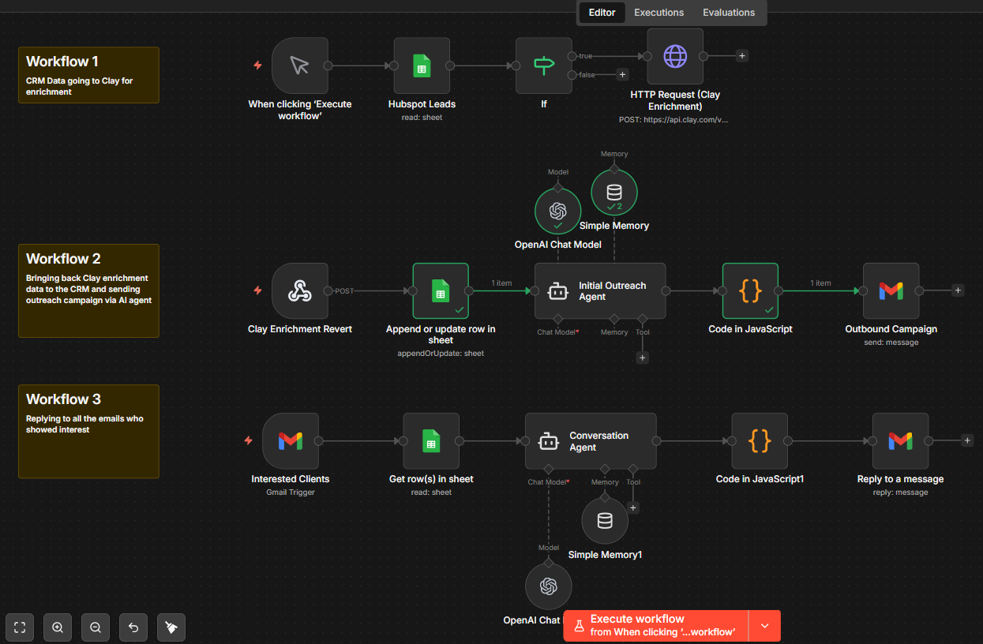
THE n8n PROTOTYPE
Prototype uses Google Sheets + Gmail + ngrok · Production replaces with HubSpot API + Claude API + cloud n8n

