Slide 1

Prototyping in Design and Development
Group Members:
BSEF21M022
BSEF21M027
BSEF21M034

Slide 2
What is Prototyping?
Definition
Purpose
Prototyping is a fundamental practice in Human-Computer Interaction (HCI) that plays a crucial role in the design and development of digital products and systems
Explore design ideas, test functionality, and gather user feedback.

Slide 3

Objectives of Prototyping
1
Gather Feedback
2
Test Design Ideas
Collect quick and continuous feedback from users to improve
the design.
Experiment with different designs and interactions to find the best solution.
3
Improve the Design
4
Validate the Design
Refine the design based on user feedback.
Ensure the design meets user needs and project goals.
5
Improve Communication
6
Reduce Development Risks:
Facilitate communication between stakeholders, designers, and developers by visualizing design concepts
Identify and address potential issues early in the design process to minimize risks during development.

Slide 4
Types of Prototyping
Low-Fidelity Prototypes
Medium-Fidelity Prototypes
Low-fidelity prototypes are quick and easy to create, often using simple tools like paper, markers, or digital wireframing software.
Medium-fidelity prototypes are more detailed than low-fidelity prototypes but less polished than high-fidelity prototypes.
These prototypes focus on conveying basic design concepts and interactions without getting into detailed visuals or functionality.
It's not as basic as a simple drawing, but it's also not as fancy as a fully finished product.
Medium-fidelity prototypes are used to test more complex interactions, gather more detailed feedback from users, and validate design decisions..

Slide 5

High-Fidelity Prototypes
High-fidelity prototyping is like creating a highly detailed and realistic version of your design idea. It closely resembles the final product in terms of appearance and functionality, but it's not fully functional.
In a high-fidelity prototype, you would use software tools to create a digital version of your design that looks and behaves almost like the real thing.

Slide 6
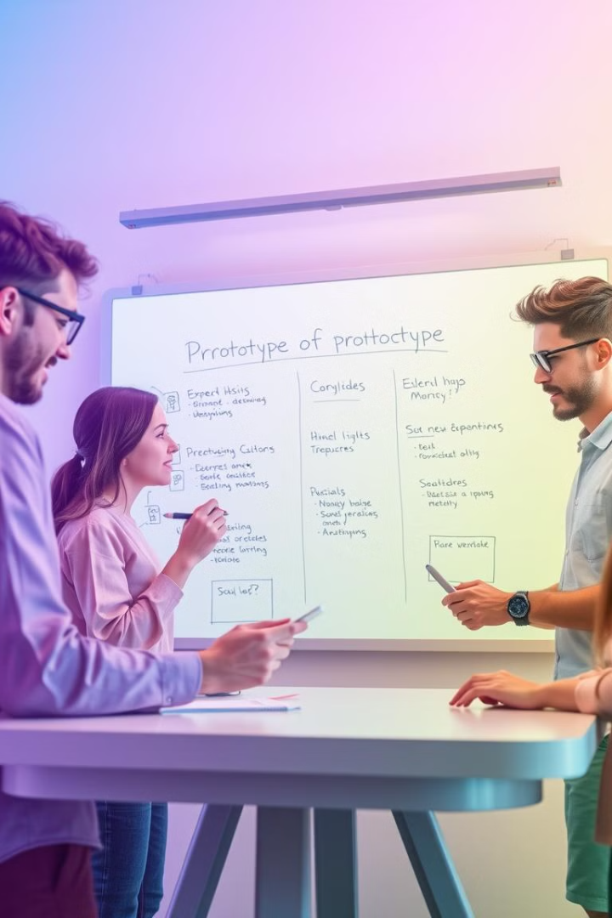
Advantages of Prototyping
User Feedback
Error Detection
Improves user experience by incorporating feedback early on.
Identifies flaws and potential problems early in the development process.
Collaboration
Time and Cost Efficient
Aligns team efforts by providing a shared understanding of the design.
Saves resources by identifying and addressing issues before full development.

Slide 7
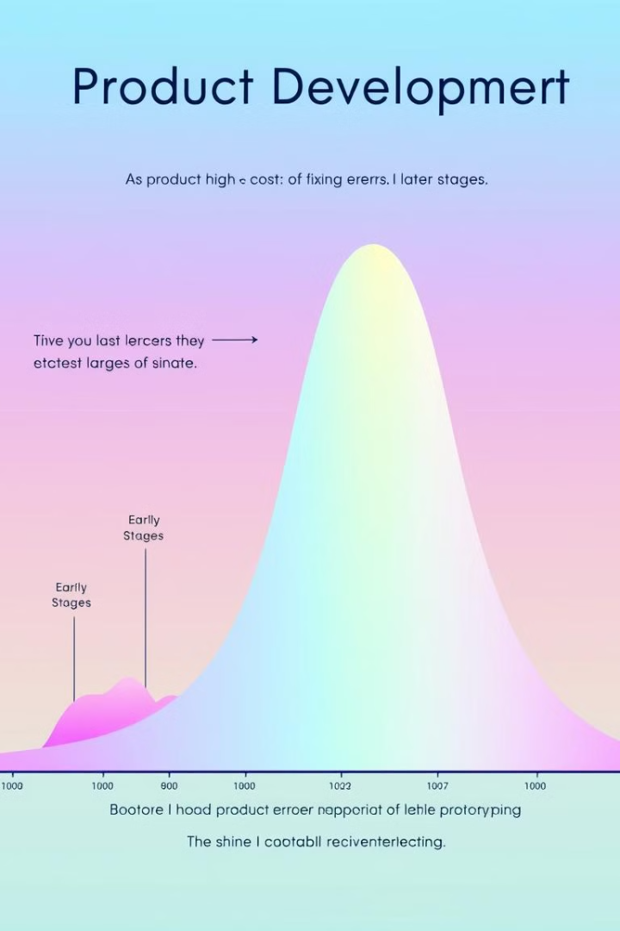




Disadvantages of Prototyping
Time-Consuming
Costly
Can be time-consuming if not planned well.
Can be costly if multiple iterations are needed.
Unrealistic Expectations
Limited Functionality
Prototypes may set unrealistic expectations about functionality.
Prototypes may not have all the features of the final product.

Slide 8

Conclusion
Prototyping plays a crucial role in the design and development process, enabling us to build better products by gathering user feedback, testing ideas, and ensuring the final product meets user needs.

