Slide 1

AI-Based Fruit Freshness and Expiry Prediction Using Images

Slide 2
Introduction
AI-Based Fruit Freshness and Expiry Prediction Using Images
Food freshness plays an important role in consumer health, food quality, and reducing food waste. Fruits are highly perishable and spoil quickly due to natural biological processes after harvesting. Traditional freshness checking methods rely on manual inspection, which is subjective and inconsistent. Sensor-based systems provide accuracy but are costly and complex. Recent advancements in Artificial Intelligence (AI) and Computer Vision allow automated freshness detection using images.
This project proposes an AI-Based Fruit Freshness and Expiry Prediction Using Images.

Slide 3
Literature Review
Existing Research Studies
1. Multi-Task CNN for Fruit Freshness Detection
Used shared CNN architecture for freshness and fruit classification.
Achieved good accuracy.
Limitation: Works mainly in controlled environments and cannot estimate expiry days.
2. Machine Learning Approach for Fruit Freshness
Used image processing to classify freshness based on visual features.
Focused mainly on tomatoes.
Limitation: Limited fruit types and poor generalization.
3. AI + IoT Based Food Spoilage Detection
Combined CNN with sensors (gas, humidity, temperature).
Provided accurate spoilage monitoring.
Limitation: Expensive hardware and complex setup.

Slide 4
Problem Identification
Current methods to check fruit freshness are not very reliable because they depend on human judgment, which can be wrong sometimes. Better systems do exist, but they are often expensive, complicated, or work only in limited situations. So, there is a need for a simple, affordable, and automatic system that can easily detect fruit freshness and estimate expiry days.

Slide 5
Objectives
To detect fruit freshness using deep learning.
To Classify fruits into fresh and rotten categories.
To estimate remaining days to expiry.

Slide 6
Scope
The scope of this project involves developing an AI-based system that can automatically detect fruit freshness and estimate expiry using image data. It focuses on applying computer vision and deep learning techniques to classify fruits into fresh and rotten categories across multiple types such as apple, banana, mango, orange, and grape. The system processes fruit images as input and produces accurate and consistent classification results, thereby reducing the errors and limitations associated with manual inspection.

Slide 7
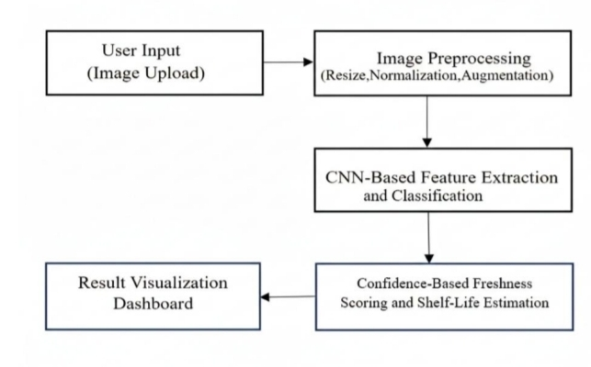
Block Diagram
This diagram shows the workflow of an AI-based freshness detection system. The user uploads an image, which is preprocessed using resizing, normalization, and augmentation techniques. A CNN model then extracts features and classifies the image. Based on the prediction confidence, the system estimates freshness and shelf life. Finally, the results are displayed on a visualization dashboard.

Slide 8
Methodology & Technologies
Methodology (Working Process) :
Image Upload
-User uploads fruit image via web application.
Image Preprocessing
-Resize and normalize images.
-Apply augmentation for better learning.
CNN Model Classification
-Deep learning model extracts features like color, texture, and damage.
Freshness & Expiry Days Estimation
-Confidence score converted into freshness percentage and grades.
Result Visualization
-Dashboard shows prediction, quality grade, and expiry estimation.

Slide 9
Methodology & Technologies
Technologies :
Python & Jupyter Notebook for development and model training
TensorFlow & Keras (CNN) for fruit freshness classification
OpenCV for image preprocessing
NumPy & Pandas for data handling
Matplotlib for performance visualization
Flask for web-based user interface and deployment
Data Augmentation & Preprocessing to improve accuracy
Softmax, Cross-Entropy, Adam Optimizer for model training
Rule-based system for freshness grading and expiry prediction
👉 Overall, the system combines AI, computer vision, and web technologies to create an automated fruit freshness detection solution.

Slide 10
Implementation Details
Developed using CNN (TensorFlow/Keras) for fruit classification
Flask web app for user interaction
Image preprocessing using OpenCV (resize, normalize, RGB conversion)
Data augmentation (rotation, flipping, zoom) to improve accuracy
Model classifies into 10 categories (Fresh/Rotten: Apple, Banana, Orange, Grape and Mango)
Softmax output used to get prediction confidence
Confidence converted into:
Freshness percentage
Quality grades (A+, A, B, Reject)
Estimated expiry days
Rule-based system used for expiry prediction
Results displayed on interactive dashboard (class, confidence, grade, expiry)
Achieved ~89.8% accuracy with strong performance metrics

Slide 11
Results
Results
Model Accuracy: ~89.8%
Successfully classified:
Fresh Apple / Rotten Apple
Fresh Banana / Rotten Banana
Fresh Orange / Rotten Orange
Fresh Grape/ Rotten Grape
Fresh Mango /Rotten Mango
Performance Metrics
Precision: 90.15%
Recall: 89.77%
F1 Score: 89.67%

Slide 12
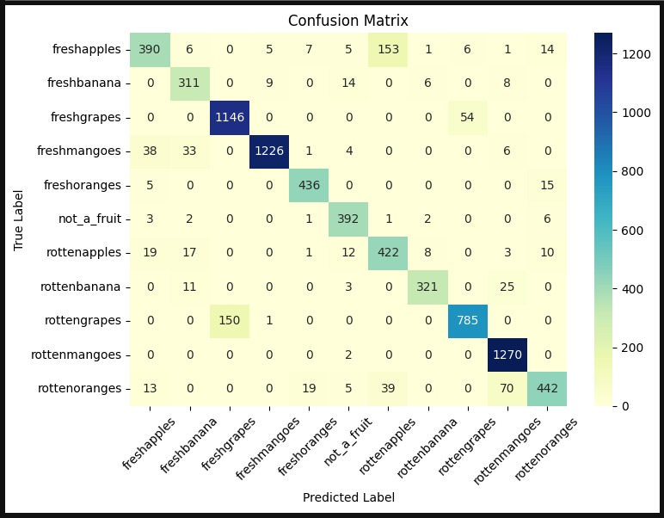
Result - Confusion Matrix:
The confusion matrix shows very high accuracy, with most predictions correctly classified. The model reliably distinguishes between fresh and rotten fruits across all categories.

Slide 13
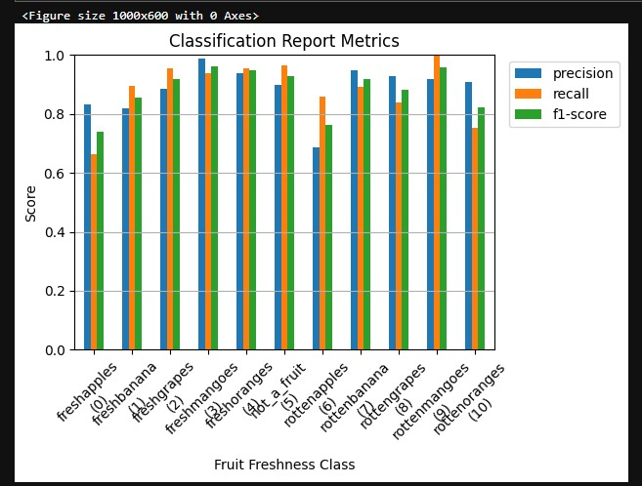
Result - Classification Report Metrics:
The classification report shows that the model performs consistently well across all ten fruit categories. This indicates highly accurate, balanced, and reliable classification of fruit freshness.

Slide 14
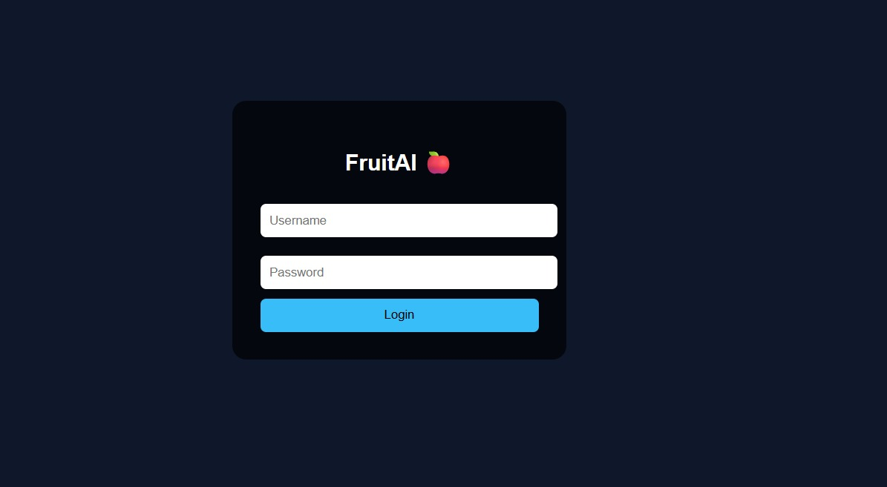
Result- Login Page:
A user authentication interface for secure system access.

Slide 15
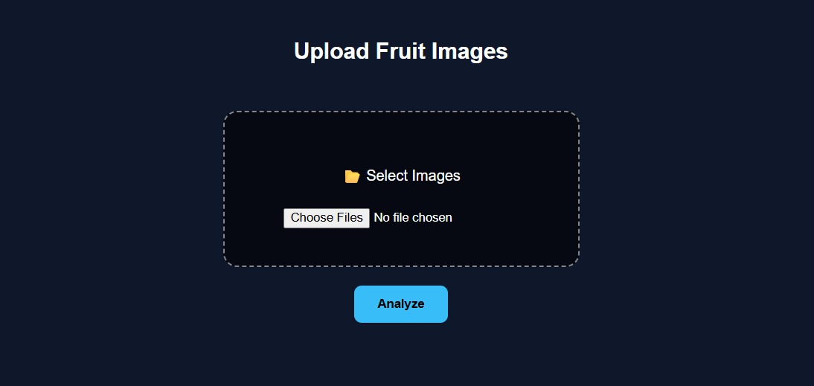
Result - Dashboard Upload Screen :
A user-friendly upload interface that makes analyzing fruit quality and expiry prediction simple, fast, and visually engaging.

Slide 16
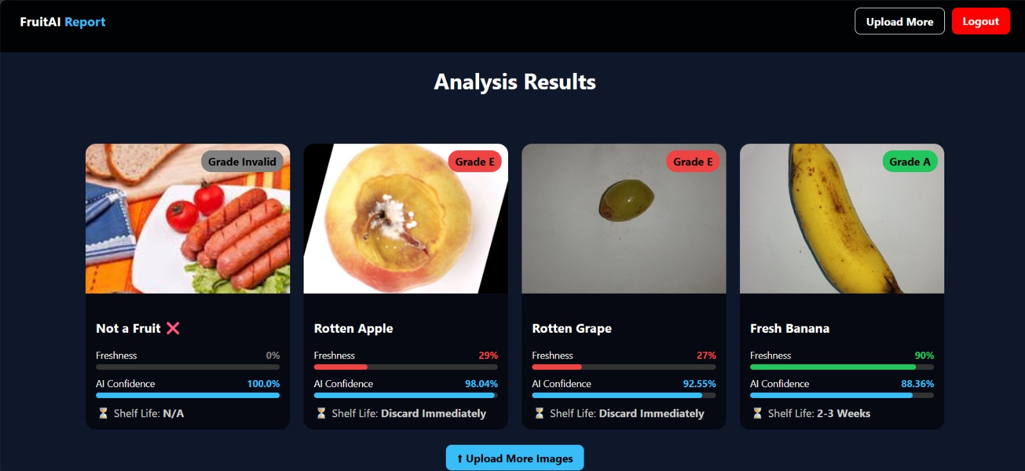
Result - Analysis Results :
A smart results screen displaying freshness grades, confidence levels, and expiry days insights with clarity and precision.

Slide 17
Future Scope
Expand the system to detect more fruits and vegetables.
Develop a mobile application for easy access.
Improve accuracy under different lighting and environmental conditions.
Use advanced deep learning models to improve performance.

Slide 18
Conclusion
The AI-based Fruit Freshness and Expiry Prediction Using Images System uses deep learning and computer vision to detect whether fruits are fresh or rotten and estimate their remaining expiry days from images. Using a CNN model, it achieves about ~89.8% accuracy, reduces manual inspection, is cost-effective, and helps improve quality control while reducing food waste.

