Slide 1
Autoencoder-Based Anomaly Detection
By Ali Raza
Course: Introduction to AI

Slide 2
What is Anomaly Detection?
Identifying unusual patterns not conforming to expected behavior.
Critical in cybersecurity, fraud detection, intrusion detection.
Autoencoders learn normal patterns and detect deviations.

Slide 3
Introduction to Autoencoders
Neural networks trained to reconstruct input data.
Encoder compresses data → latent space.
Decoder reconstructs data from latent space.
Poor reconstruction indicates anomalies.

Slide 4
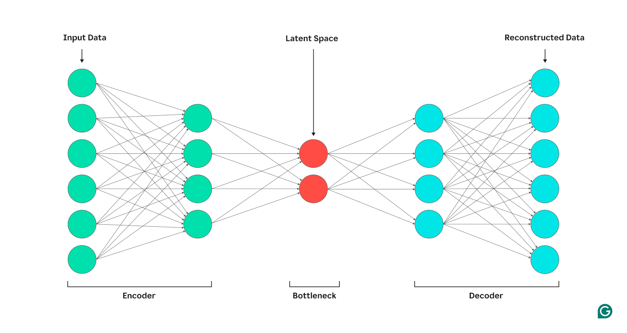
Autoencoder Architecture
Input Layer → Hidden Layers → Bottleneck (latent) → Hidden → Output.
Bottleneck forces model to learn key features.

Slide 5
Training Autoencoders
Train only on normal (non‑anomalous) data.
Loss function: Mean Squared Error (MSE).
Model learns compressed representation of normal patterns.
High reconstruction error → anomaly.

Slide 6
Why Autoencoders for Cybersecurity?
Malware/attack behavior differs from normal system behavior.
Autoencoders detect unusual API calls, traffic patterns, file features.
Scale well to large datasets.

Slide 7
Reconstruction Error
Compute:
error = ||x - x_reconstructed||²
Set threshold using validation data.
error > threshold → anomaly.

Slide 8
Evaluation Metrics
Precision, Recall, F1-Score
ROC-AUC
Confusion Matrix
PR Curve — useful for imbalanced datasets.

Slide 9
Example Autoencoder (Keras)
from keras.models import Model
from keras.layers import Input, Dense
input_dim = X_train.shape[1]
input_layer = Input(shape=(input_dim,))
encoded = Dense(64, activation='relu')(input_layer)
latent = Dense(16, activation='relu')(encoded)
decoded = Dense(64, activation='relu')(latent)
output = Dense(input_dim, activation='sigmoid')(decoded)
autoencoder = Model(input_layer, output)
autoencoder.compile(optimizer='adam', loss='mse')

Slide 10
Detecting Anomalies
Train autoencoder on normal data only.
Compute reconstruction error for each sample.
Compare with anomaly threshold.
Flag anomalous samples.

Slide 11
Applications
Network intrusion detection.
Malware detection.
Fraud detection.
Sensor malfunction detection.

Slide 12
Practice
Implement an autoencoder on any anomaly dataset.
Plot reconstruction error distribution.
Set threshold and evaluate anomalies.
Submit report with visualizations.

Slide 13
Thank You!

