Slide 1
JAVA WEB BASED PROJECT SUBMISSION
RecipeHub
Online Recipe Sharing System
A Full-Stack MVC Web Application Built with Jakarta Servlets, JSP & MySQL JDBC
Submitted by: Aalok Kumar | GitHub: https://github.com/Aalok-web/RecipeHub
Evaluated under: Java Web Based Projects Marking Rubric (33 Marks Total)

Slide 2
RUBRIC COMPONENT 1: 8 MARKS
Problem Understanding & Solution Design
Formulating culinary community challenges into a decoupled enterprise software solution
The Real-World Problem
• Traditional recipe sharing is fragmented across blogs, chat groups, and physical notebooks.
• Users lack structured searchability by meal categories (Breakfast, Lunch, Dinner, Dessert).
• Inability to easily bookmark, curate, and edit personalized culinary collections in one secure place.
Proposed Solution & Objectives
• RecipeHub delivers a centralized, responsive web platform for culinary enthusiasts.
• Enables seamless CRUD (Create, Read, Update, Delete) for recipes with ingredient & instruction breakdowns.
• Role-based authentication (Admin vs. Standard User) with password management.
• Dynamic social bookmarking via a 1-click Favorites system.
Architectural Principles
• Strict Model-View-Controller (MVC) separation of concerns.
• Thin controller architecture using modular Jakarta Servlets (@WebServlet).
• Dynamic view templates using JSP, JSTL 3.0, and Expression Language (EL).
• Encapsulated Data Access Object (DAO) pattern isolating SQL operations from business controllers.

Slide 3
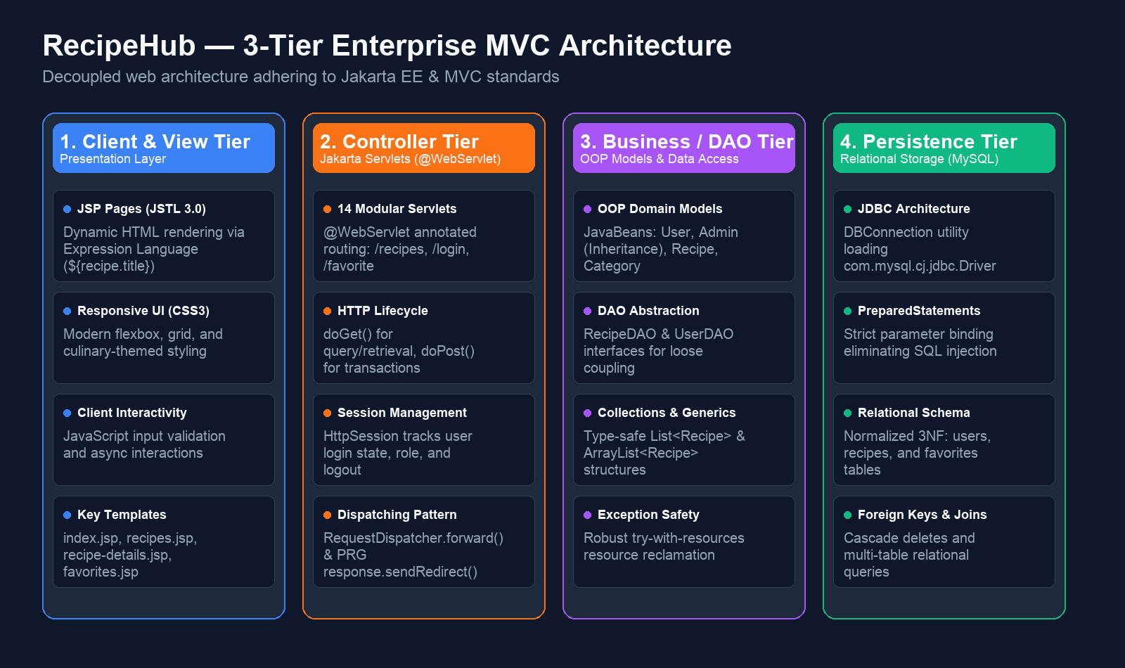
RUBRIC COMPONENT 1: 8 MARKS
3-Tier MVC System Architecture
Decoupled web architecture ensuring high modularity, testability, and maintainability

Slide 4
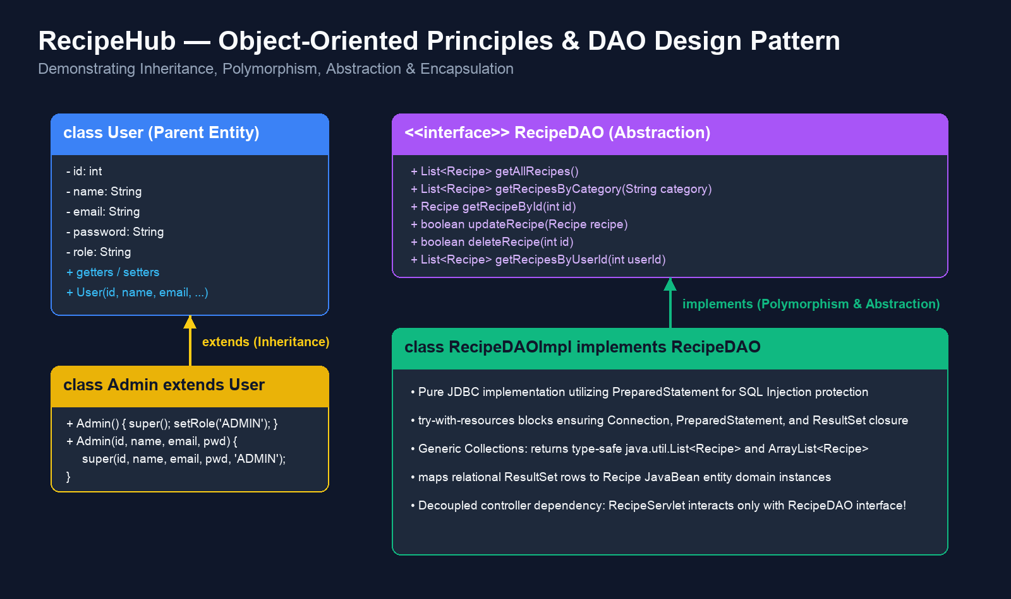
RUBRIC COMPONENT 2: 10 MARKS
Core Java Concepts — OOP Principles & DAO Pattern
Leveraging Inheritance, Abstraction, Polymorphism, and Encapsulation

Slide 5
RUBRIC COMPONENT 2: 10 MARKS
Collections, Generics & Exception Handling
Type safety, memory efficiency, and robust resource management in Java
Collections & Generics (Type Safety)
• Type-Safe Generic Collections: Extensive utilization of java.util.List<Recipe> and ArrayList<Recipe> across DAO and Servlet layers.
• Compile-Time Verification: Completely eliminates legacy raw types and suppresses runtime ClassCastException risks.
• Dynamic Data Transfer: Recipe lists dynamically passed via request.setAttribute("recipes", recipes) and processed in JSTL loops.
• Efficient Memory Allocation: ArrayList provides fast O(1) indexed random access for gallery and category browsing.
Robust Exception Handling & Safety
• Automatic Resource Management: Strict implementation of try-with-resources across all database calls.
• Connection Leak Prevention: Guarantees deterministic closure of Connection, PreparedStatement, and ResultSet objects even upon SQL errors.
• Checked Exception Strategy: Gracefully handles SQLException and ClassNotFoundException with proper error logging (e.printStackTrace()).
• Safe User Fallback: Controller redirects users gracefully with feedback flags rather than exposing stack traces.

Slide 6
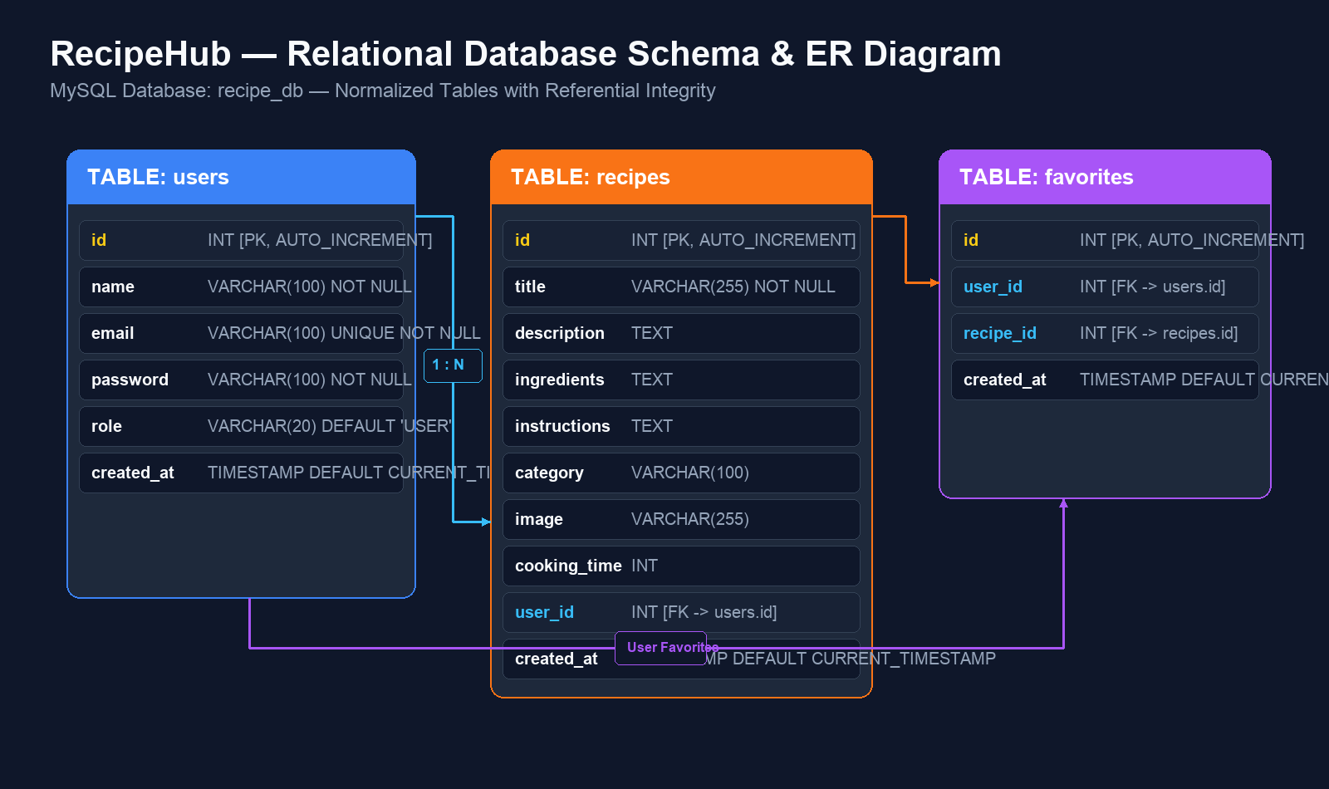
RUBRIC COMPONENT 3: 8 MARKS
Database Integration & JDBC Architecture
Normalized relational database design, PreparedStatement security, and CRUD implementation

Slide 7
RUBRIC COMPONENT 4: 7 MARKS
Servlets & Web Integration
Annotation-based routing, HTTP request lifecycle, session control, and view rendering
Annotation Routing (@WebServlet)
• Modern Jakarta Servlet 6.0 annotations eliminating verbose XML boilerplate.
• 14 Specialized Servlets: Dedicated handlers for /login, /register, /recipes, /add-recipe, /edit-recipe, /favorite, /profile, etc.
• Clear RESTful Verb Separation: doGet() handles data fetching; doPost() processes mutations.
Session & State Management
• HttpSession Tracking: Maintains authenticated session credentials across pages.
• Access Protection: Checks session user attributes before allowing recipe modifications or bookmarking.
• Secure Termination: /logout servlet calls session.invalidate() to eliminate session hijacking.
Dynamic Presentation (JSP & JSTL)
• Request Forwarding: Servlets forward models via RequestDispatcher.forward(request, response).
• Post-Redirect-Get (PRG): response.sendRedirect() prevents accidental duplicate form submissions.
• JSTL & EL: Uses <c:forEach>, <c:if>, and ${recipe.title} to render clean, logic-free HTML templates.

Slide 8
SYSTEM CAPABILITIES
RecipeHub Feature Modules & User Journey
End-to-end functionality supporting everyday culinary sharing and community exploration
🔐 Authentication & Profiles
• Registration & Login with validation
• Role-based identification (User / Admin)
• Profile view & Change Password flow
• Forgot Password recovery workflow
🍲 Recipe Management (CRUD)
• Add Recipe with title, description, image
• Structured ingredients & instruction lists
• Cooking time duration tracker
• Edit & Delete recipes owned by user
🏷️ Categorization & Search
• Dynamic category grouping
• Breakfast, Lunch, Dinner, Dessert filters
• SQL-driven parameterized filtering
• Detailed single-recipe showcase view
⭐ Favorites & Bookmarking
• One-click recipe bookmarking
• Dedicated My Favorites dashboard
• SQL JOIN queries linking users & recipes
• Duplicate favorite protection (UNIQUE KEY)

Slide 9
SOFTWARE ENGINEERING BEST PRACTICES
Code Quality & Coding Standards
Adherence to clean code, modular architecture, and industry standards
Modular Directory Architecture
• com.recipehub.model: Clean POJO JavaBeans encapsulating business state.
• com.recipehub.dao: Abstract interfaces & JDBC implementations isolating persistence.
• com.recipehub.servlet: Controller endpoints managing request/response cycles.
• com.recipehub.util: Shared utilities for database connection lifecycle.
Strict Separation of Concerns
• Zero SQL in Servlets: Servlets only invoke DAO methods, keeping controllers lightweight.
• Zero Business Logic in JSPs: Views solely present transferred request attributes.
• Clean Dependency Injection: Servlets depend on DAO interfaces rather than concrete classes.
Documentation & Readability
• Javadoc Comments: Detailed class-level and method-level documentation across all source files.
• Standard Naming Conventions: CamelCase classes, meaningful method and variable identifiers.
• Parameterized SQL: Zero string concatenation in database statements, eliminating injection attacks.

Slide 10
RUBRIC EVALUATION BREAKDOWN
Academic Marking Rubric Compliance Matrix
Direct mapping of project deliverables to the official 33-mark Java Web rubric
Rubric Criteria | Marks | Implementation Highlights & Proof Points | Key Source Files
Problem Understanding & Solution Design | 8 | Full 3-Tier Enterprise MVC architecture; clear user requirements formulation; separated presentation, controller, business, and persistence layers; comprehensive ER and workflow models. | README.md, architecture_diagram.png, er_diagram.png
Core Java Concepts | 10 | Inheritance (Admin extends User); Abstraction & Polymorphism (RecipeDAO, UserDAO interfaces); Encapsulation (JavaBeans); Type-safe Generics (List<Recipe>); Robust Exception Handling & try-with-resources. | Admin.java, User.java, RecipeDAO.java, RecipeDAOImpl.java
Database Integration (JDBC) | 8 | MySQL recipe_db with users, recipes, favorites; JDBC driver loading via DBConnection; PreparedStatement SQL injection protection; Full CRUD operations; Multi-table JOIN queries. | DBConnection.java, schema.sql, RecipeDAOImpl.java, FavoriteDAO.java
Servlets & Web Integration | 7 | 14 modern @WebServlet endpoints; HTTP GET/POST handling; Session control via HttpSession and secure invalidation; RequestDispatcher.forward() and PRG pattern; JSTL 3.0 dynamic view rendering. | RecipeServlet.java, LoginServlet.java, recipes.jsp, recipe-details.jsp

Slide 11
CONCLUSION & DELIVERABLES
Project Summary & Submission Details
Everything required for project evaluation is ready and public
📦 Submission Checklist & Verification
✅ Public GitHub Repository:
https://github.com/Aalok-web/RecipeHub
✅ Presentation File Included:
RecipeHub_Project_Presentation.pptx (and PDF)
✅ Clear README with setup instructions, prerequisites, ER diagrams, and endpoint listings
✅ Ready-to-Run SQL Schema:
database/schema.sql with tables and sample seed records
✅ Well-Commented, Clean Source Code adhering strictly to Java standards and MVC separation
⚡ Quick Execution Summary
1. Clone Repository:
git clone https://github.com/Aalok-web/RecipeHub.git
2. Database Setup:
mysql -u root -p < database/schema.sql
3. Open in IntelliJ IDEA / Eclipse Enterprise:
Maven automatically resolves Jakarta & MySQL dependencies
4. Deploy to Apache Tomcat 10.1+:
Context path: /RecipeHub
5. Launch Browser:
http://localhost:8080/RecipeHub/

