Slide 1
Voice Conversion
GROUP NO 25 MODI AKSHAY,2021166
KANISHK GOEL,2021325
AALOKIK SINGH,2021223
AINDRILA MAJUMDER,MT23109
JAFREEN RIZVI,MT23040

Slide 2
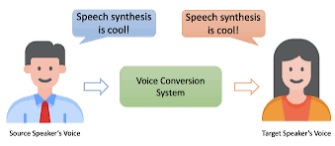
PROBLEM STATEMENT Voice Conversion using classic Machine Learning
By transforming one person's voice into another, voice conversion has the power to enhance accessibility for individuals with speech impairments, safeguard privacy and security in sensitive communication environments. Furthermore, voice conversion can play a significant role in language learning and education ,more effectively providing engaging language acquisition processes.

Slide 3
DATASET DESCRIPTION Common Voice Mozilla cv-corpus-14-en
The given dataset was mixed with multiple clients and sentences
From the given dataset, we extracted parallel utterances for some client pairs which consist of atleast 30 common sentences
We took the following audios as well for the respective sentences of the clients

Slide 4
EXPLOLATORY DATA ANALYSIS
Features Used- Spectogram, mfcc, chroma_stft, zero_crossing_rate
Spectrogram- a visual representation of the spectrum of frequencies in a signal as they vary with time
MFCC- derived from the mel-frequency scale, which is a perceptual scale of pitches that approximates the human ear's response to different frequencies
Chroma STFT- Short-Time Fourier Transform (STFT) is a technique used to analyze the frequency content of a signal over short, overlapping time windows
Zero Crossing Rate- it is a measure of how frequently the signal changes its sign (crosses the zero amplitude axis) within a given time frame

Slide 5
METHODOLOGY
Extracted features of source and target and combined them to make a joint feature
Trained Gaussian Mixture model (GMM)model for each source and target speakers combination
Applied MLPG to estimate the converted features
Applied synthesizers to reconstruct the audio back
At last, plotted spectrogram for the source, converted and target audio

Slide 6
RESULTS
By the qualitative analysis, through listening the audio samples after it was converted we found noises in the samples
We also tried using different models and features but we got noises in the converted samples
By looking at the spectrogram of the sample we found a change in energy and amplitude in them

Slide 7
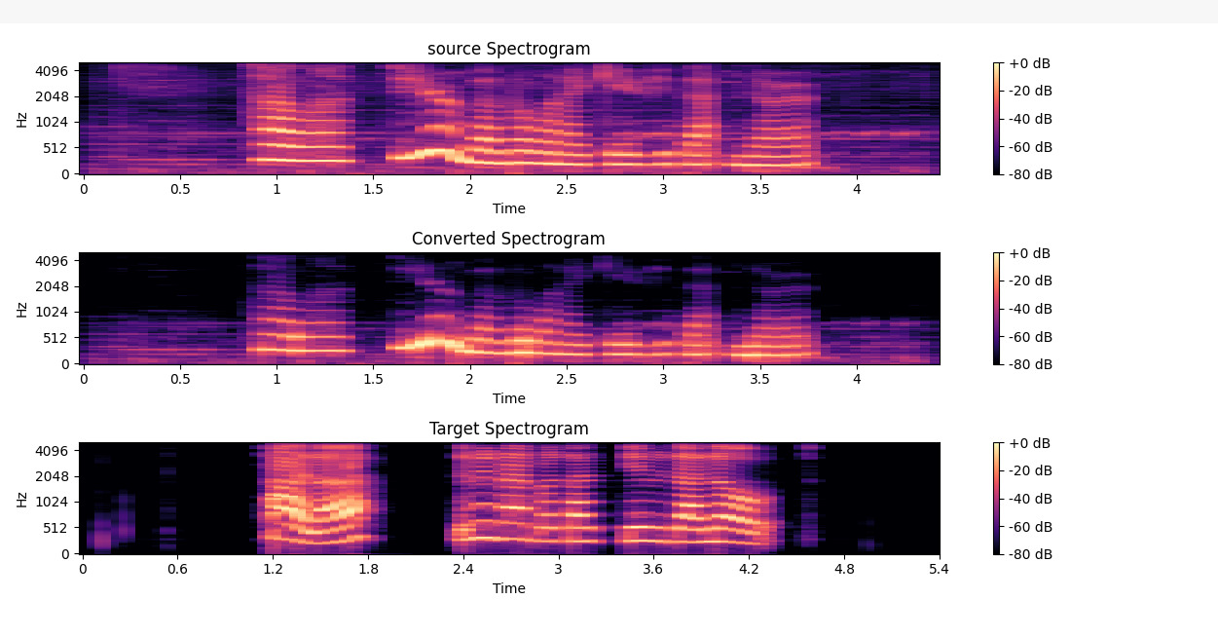
CONCLUSION
In this project, we used a GMM-based voice conversion system that can transform the voice of a source speaker to that of a target speaker. The project consists of three modules: feature extraction, GMM-based mapping of source and target features, and reconstruction. We evaluate the project qualitatively to demonstrate its effectiveness. We show that the GMM-based system is not much capable of producing good quality converted speech samples that are perceptually similar to the target speaker’s speech.

Slide 8
THANK YOU

