Slide 1
CS-E5360 Systems of Systems Practical Session
Asad Javed
PhD Researcher
Computer Science
Avleen Malhi
Postdoctoral Researcher
Computer Science
Notes:
10 s.

Slide 2
Agenda
Introduction
O-MI/O-DF Reference Implementation
How to run O-MI node
Live demos
(Scripts and Slides are available at: https://github.com/AaltoAsia/SoS-Scripts)

Slide 3
Introduction
This session will address the practical aspects of using IoT technology to deliver smart city solutions.
Goal of the session:
Install O-MI Node reference implementation
Use an IoT device to send sensor values to your Node
Make a data subscription to send value from your Node to our Node
We will have live visualization of all the data coming to our O-MI Node

Slide 4
O-MI/O-DF Reference Implementation
Open source implementation developed at Aalto University
Available at: https://github.com/AaltoAsia/O-MI
Enable fast deployment of IoT node

Slide 5
How to run O-MI node?
Dependency Java JDK 1.8
Run pre-compiled node:
Download the latest release version and unpack it. Available at: https://github.com/AaltoAsia/O-MI/releases
For Windows: Use “o-mi-node-1.0.9.zip” (Don’t use deep directory structure)
For MAC/Linux: Use “o-mi-node-1.0.9.tgz”
To allow write requests from other machines you need to modify file “<Extracted folder>/conf/application.conf”.
Change the setting “allowRequestTypesForAll”, add “write” to the list, such that the result looks like this:
allowRequestTypesForAll = ["read", "cancel", "call", "write"]
For Windows: Go to the <Extracted folder>/bin and click on o-mi-node.bat For MAC/Linux: cd <Extracted folder>/bin and add execute instructions “chmod +x o-mi-node” and then run “./o-mi-node”
The server can now be accessed with URL http://localhost:8080/ and click on “O-MI Test Client WebApp” (the second link) on this URL

Slide 6
Open Firewall port for O-MI in Windows
Navigate to Control Panel -> System and Security -> Windows Firewall
Select ‘Advanced settings’ from the left menu and highlight Inbound Rules in the left pane
Right click Inbound Rules and select New Rule
Select ‘Port’ and click Next
Add the port you need to open and click Next
Select TCP protocol and add ’8080’ in the port field and click Next
Select ‘Allow the connection’ in the next window and hit Next
Select the network type (tick all three) and click Next
Name the rule something meaningful and click Finish

Slide 7
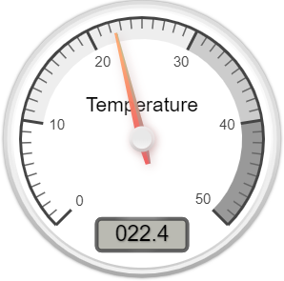
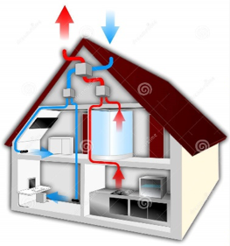
Case Study: Smart Home
O-MI/O-DF Node Server
O-MI
Write
Request
O-MI
Subscription
Agent Manager 1
Wrapper
Agent 1
Agent 2
Monitoring Unit
O-MI
Response
O-MI/O-DF Web Client
Data Publisher
O-MI/O-DF Reference
Implementation
Data Analytics

Slide 8
Smart Home Scenario Description
Smart Home equipped with
Temperature and Humidity sensor (SHT-20)
CO2 sensor (S-100)
Wrapper to publish smart home data to O-MI node
Read sensor value
Translate it to O-DF
Put it in O-MI Write request
Send with HTTP POST request
Developer can test the system using web-client
Data consumer (Monitoring unit) might be interested in these sensor values for analyzing the required object values. It can subscribe to the objects of interest

Slide 9
Hardware and Sensors Provided
ESP8266 WiFi development modules
SHT20 Temperature and humidity sensor
S-100 CO2 sensor

Slide 10
Live Demo
Implementation Using ESP8266

Slide 11
Download Scripts
Connect to our WiFi “TP-LINK_C5E618”
Open new termial and download the provided scripts from https://github.com/AaltoAsia/SoS-Scripts

Slide 12
ESP8266 Arduino Configuration
The ESP8266 is a very low-cost Wi-Fi microchip with full TCP/IP stack and microcontroller capability.
Arduino is an open-source electronics platform based on easy-to-use hardware and software.
Install latest Arduino IDE from https://www.arduino.cc/en/main/software
Start Arduino and open Preferences window.
Enter https://arduino.esp8266.com/stable/package_esp8266com_index.json into Additional Board Manager URLs field.
Open Boards Manager from Tools > Board menu and install esp8266 platform
For MAC machine, download and install the driver ”CH34x_Install_V1.5.pkg” from https://github.com/adrianmihalko/ch340g-ch34g-ch34x-mac-os-x-driver
Restart the Arduino IDE

Slide 13
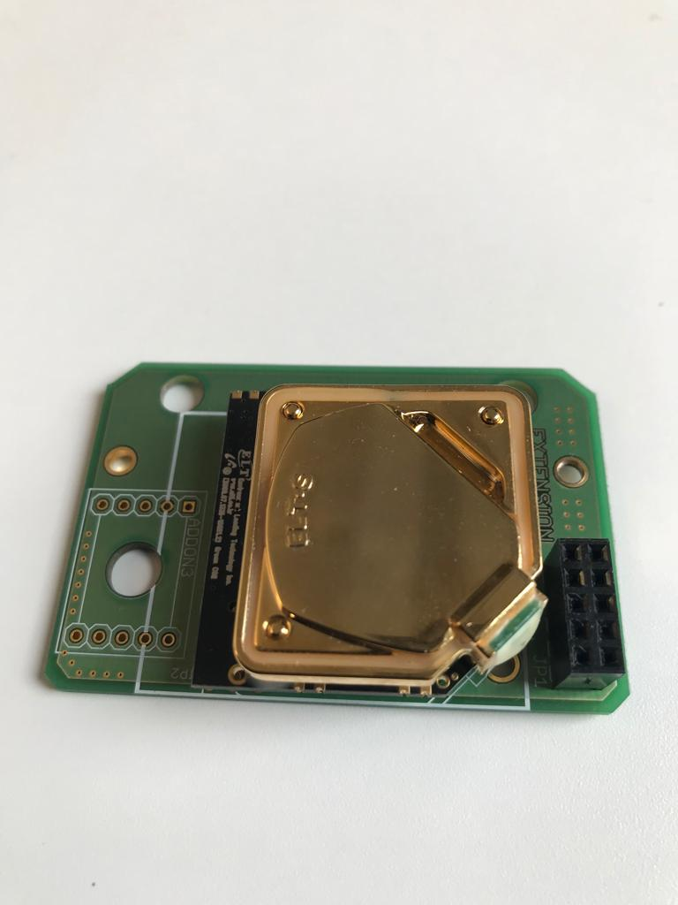
CO₂ Sensor (Model: S-100)
TX
GND
5V
Connect jumper cables:
Sensor TX -> ESP RX
Sensor GND -> ESP GND
Sensor 5V -> ESP 5V

Slide 14

Interfacing CO₂ Sensor with ESP8266
Connect ESP chip with your laptop USB port.
Start Arduino IDE and select the following board from Tools -> Board
LOLIN (WEMOS) D1 R2 and Mini
Select the port in Arduino using Tools -> Port (the port where ESP is connected)
Open SoS-Scripts/CO2_test (test scripts for CO2 sensor)
Open create_odf tab in Arduino and change <id> of the Object to something unique and change the url to your O-MI Node (http://yourIP:8080/)
Note: Disconnect the RX of ESP8266 while uploading the code.
Press Upload button
Connect RX of ESP8266 again after uploading is done.
If it fails you might have wrong port or too high upload speed
View the output through Tools -> Serial Monitor
Select baud rate as 38400

Slide 15
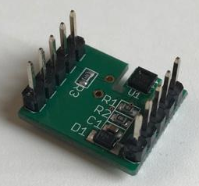
Temperature and Humidity Sensor (Model: SHT-20)
# ? * ?
+ GND * ?
*? * 3v3
*? * SDC
*? * SDA
GND
SDA
SDC
3.3V
Connect jumper cables:
Sensor SDA -> ESP SDA (D2)
Sensor SDC -> ESP SDL (D1)
Sensor GND -> ESP GND
Sensor 3.3V -> ESP 3V3

Slide 16
Interfacing SHT20 Sensor with ESP8266
Download the library for SHT20 from https://github.com/DFRobot/DFRobot_SHT20 into the ’libraries’ folder of your Arduino installation directory (Documents/Arduino/libraries/).
Restart the Arduino IDE
In Arduino IDE, select the following board from Tools -> Board
LOLIN (WEMOS) D1 R2 and Mini
Select the port in Arduino using Tools -> Port (the port where ESP is connected
Open SoS-Scripts/temp_humi_test (test scripts for SHT20 sensor)
Open create_odf tab in Arduino and change <id> of the Object to something unique and change the url to your O-MI Node (http://yourIP:8080/)
Press Upload button
View the output through Tools -> Serial Monitor
Select baud rate as 115200

Slide 17
Create a subscription for our visualization Node
Go to http://localhost:8080/ and go to ”O-MI Test Client WebApp”
Check that your data have been received correctly with a Read request, after that, continue with subscription:
Select ”Objects” from the O-DF tree
Select ”Subscription” request
Open ”Optional parameters”
Put address of the visualization node to ”callback” field
Press ”Send” and see if your value shows on the visualization (after it changes next time)

Slide 18

Questions

