Slide 1



INTELLIGENT PHYSICIAN ASSISTANT SYSTEM for the Myocardial Ischemia Classification
of Myocardial Perfusion Imaging by Machine Learning
Presented by : Hataichanok Sakkara
Email : hataichanok@it.kmitl.ac.th
Faculty of Information Technology
King Mongkut's Institute of Technology Ladkrabang

Slide 2
Outline
1
2
Intelligent
physician
assistant system
Introduction
3
The Predictive Model
4
Conclusion

Slide 3
Outline
1
2
Intelligent
physician
assistant system
Introduction
The Predictive Model
3
The Predictive Model
4
Conclusion

Slide 4
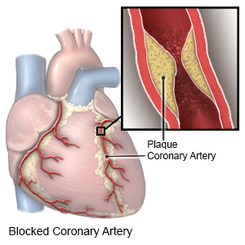
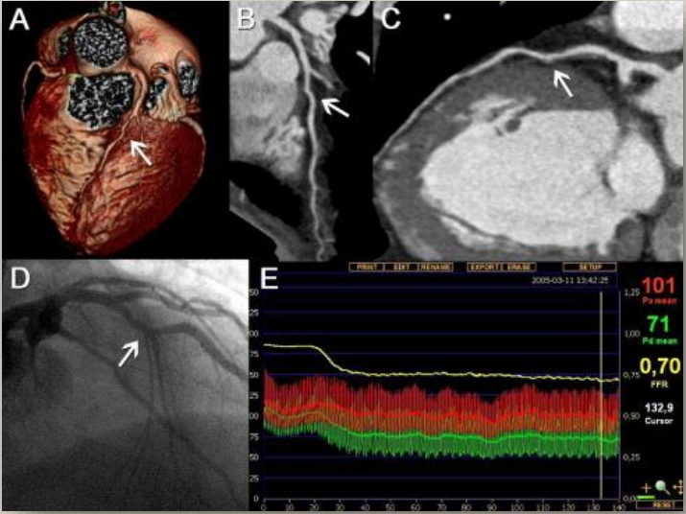
Myocardial Ischemia
What is
is a condition when myocardium
(heart muscle) does not receive
sufficient oxygen and nutrients
from blood supply.

Slide 5
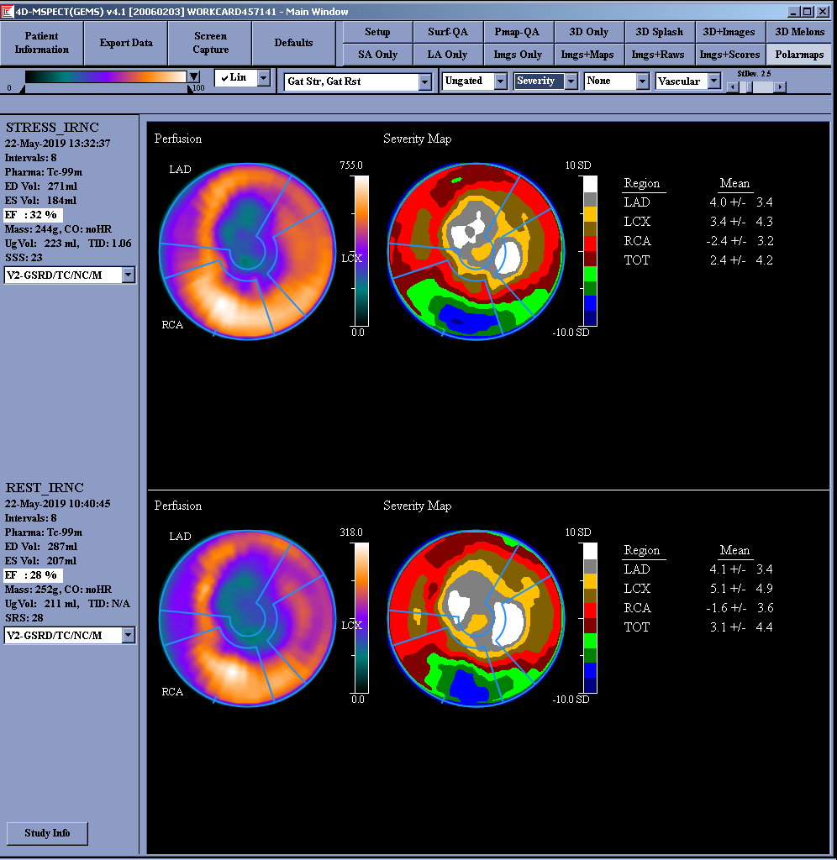
Diagnostic Procedures
Two Types of
1
Step
Non-invasive
Diagnosis by using
Radionuclide Myocardial
Perfusion Imaging (rMPI)
2
Step
Invasive
Diagnosis by Coronary Angiography (CAG) with contrast dye to confirm the degree of the stenosis.
Radionuclide Myocardial Perfusion Imaging (rMPI)

Slide 6
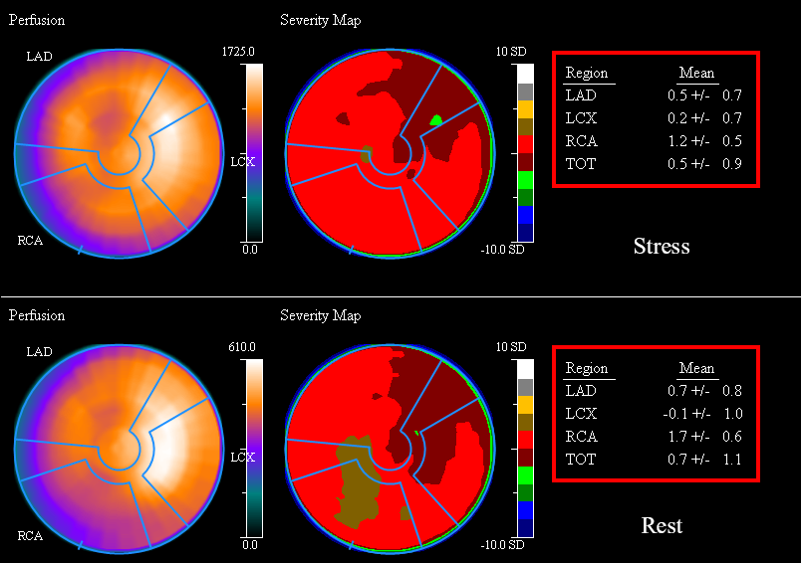
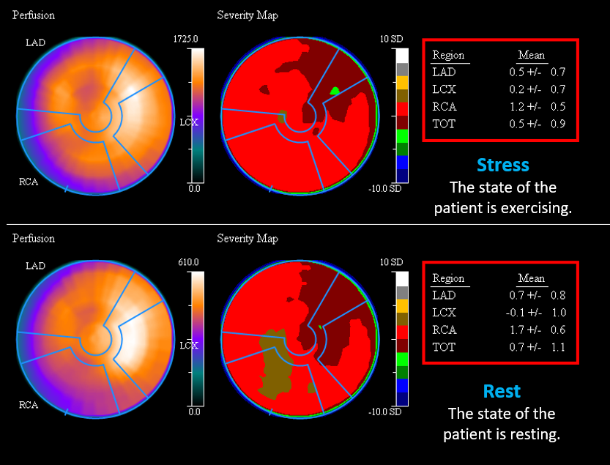
Two Methods to Interpret rMPI
Quantitative
Analysis
Stress
The state of the patient is exercising.
no prior research by using severity scores, and in particular that based on machine learning.
Qualitative
Analysis
(visual assessment by doctors)
is a common method to interprete rMPI, but is subjective and suffers from
suboptimal reproducability.
Rest
The state of the patient is resting.
Radionuclide Myocardial Perfusion Imaging (rMPI)

Slide 7
Outline
1
2
Intelligent
physician
assistant system
Introduction
3
The Predictive Model
4
Conclusion

Slide 8


Workflow
Forward to
Invasive step
Not forward to
Invasive step

Slide 9
Workflow
Not forward to
Invasive step

Slide 10

Workflow
Forward to
Invasive step
Not forward to
Invasive step
Physician Assistant System

Slide 11
Intelligent Physician Assistant System
processing by the predictive model
Stress
The state of the patient is exercising.
Rest
The state of the patient is resting.
Result
Radionuclide Myocardial Perfusion Imaging (rMPI)

Slide 12
Outline
1
2
Intelligent
physician
assistant system
Introduction
3
The Predictive Model
4
Conclusion

Slide 13
Quantitative Analysis
Procedure
1. Data scraping of stress and rest severity scores by UIPATH
Stress
The state of the patient is exercising.
2. Data ETL and augmentation
3. Traning with Individual and Stacked Ensemble Models
4. Mixing modalities and features
5. Performance study
LAD
Left anterior descending coronary artery
LCX
Left circumflex coronary artery.
RCA
Right coronary artery.
Rest
The state of the patient is resting.

Slide 14
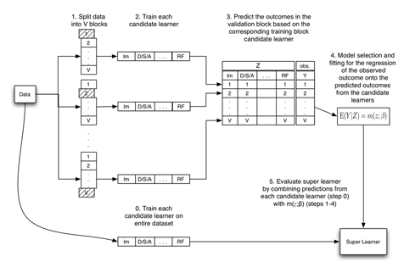
Classification models
Ensemble models
Stacked Ensemble
models
Random Forest
Hyperparameter : n_estimators,
max_features, max_depth, criterion
Adaptive Boosting (AdaBoost)
Hyperparameter : n_estimators,
base_estimator
XGBoost
Hyperparameter : nthread, objective, learning_rate, max_depth, subsample, colsample_bytree, n_estimators, seed
Gradient Boosting
Hyperparameter : loss, learning_rate, max_depth, max_features, criterion, subsample, n_estimators
Stacking/Super Learner
Hyperparameter : metalearner_algorithm,
metalearner_params
Individual models
K-Nearest Neighbors (K-NN)
Hyperparameter : n_neighbors
Logistic Regression
Hyperparameter : multi_class, C, solver, max_iter
Multilayer Perceptron (MLP)
Hyperparameter : hidden_layer_size, alpha
Decision Tree
Hyperparameter : criterion, max_depth, min_samples_split
Support Vector Machine (SVM)
Hyperparameter : kernel, gamma, C

Slide 15
Quantitative Analysis Datasets & Labels
Dataset 1
Labels
rest rMPI + PC**
rest rMPI
10 Features
CAG
4 Features
PC
7 Features
Shape :
164 x 20
rest
LADCAG
Age
Gender
BMI
DM
HT
DLP
CKD
LAD4dmspect
LCXCAG
CAG :
RCACAG
LADWallthick
CAG : 97
Non-CAG : 67
LADWallmotion
LCX4dmspect
Gender :
LCXWallthick
Male : 49
Female : 115
LCXWallmotion
RCA4dmspect
RCAWallthick
RCAWallmotion
rest rMPI
10 Features
CAG
3 Features
PC
7 Features
LVEF
**PC denotes Patient Characteristics. (Medical Records)

Slide 16

The Predictive Model Compare To Clinical Professional
Tests | Sensitivity* | Specificity**
Prediction Model | 80% | 71%
Clinical Professional | 88% | 77%
*Sensitivity measures the ability of, the predictive models to correctly identify patients with a disease
*Specificity to correctly determine those without a disease. Lower Sensitivity means that our tests or the models are not good for catching actual cases of the disease

Slide 17
Outline
1
2
Intelligent
physician
assistant system
Introduction
3
The Predictive Model
4
Conclusion

Slide 18
Conclusion
rMPI features and patient characteristics have been employed to train and test prediction models.
The performance of the predictive model acceptable compared to to clinical professional.
Thank you for your attention
Hataichanok Sakkara
Email : hataichanok@it.kmitl.ac.th

Slide 19
Related Works
Predicted by Radionuclide Myocardial Perfusion Imaging (rMPI) data
e.g,
L.-H. Hu et al. (2019),
A. H. Gonsalves et al. (2019)
J. Betancur et al (2018)
R. Arsanjani et al. (2015)
P. Slomka, Y. Xu, D. Berman, and G. Germano. (2012)
Prediction of Diseases with Machine Learning
e.g,
A. J. Ramon et al. (2018)
K. Antczak, and L. Liberadzki. (2018)
H. A. Kirişli et al. (2013)
S. C. Bagley et al. (2001)

