Slide 1

SCALABLE PARALLEL FRAMEWORK FOR UPDATING SSSP IN DYNAMIC NETWORKS
Based on: “A Parallel Algorithm Template for Updating Single-Source Shortest Paths in Large-Scale Dynamic Networks”
By: Arindam Khanda , Sriram Srinivasan , Sanjukta Bhowmick,
Boyana Norris , and Sajal K. Das , Fellow, IEEE
Presentors:
Syed Aalyan Raza - 22i-0833
Aashir Hameed - 22i-0920
Najamuddin Hassan - 22i-1332

Slide 2

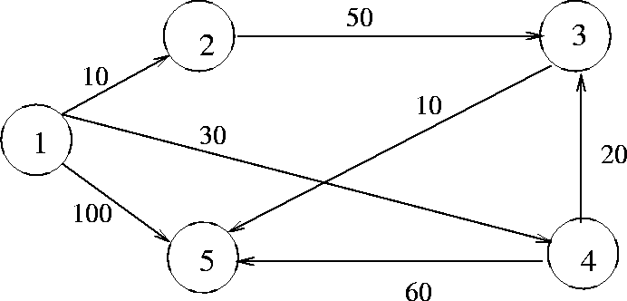
Problem:
Finding the Single-Source Shortest Path (SSSP) as it is crucial in transportation, social, and communication networks.

Slide 3



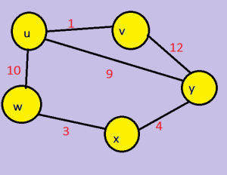
Challenge
Our Goal
Real-world networks evolve (e.g., edge insertions/deletions), while most SSSP algorithms assume static graphs
Build upon their work to extend the framework to distributed-memory environments.
Paper’s Goal
Efficiently update SSSP in dynamic graphs using parallelism, not recomputation

Slide 4
Paper’s Core Contributions
BACK TO AGENDA PAGE
Parallel SSSP Update Framework
Architecture Specific Optimizations
1.
2.
3
Performance
Two-step approach:
Identify affected vertices/subgraphs due to edge updates.
Update only those subgraphs, using a rooted tree data structure for distances and parent-child relationships.
GPU Implementation:
Introduces VMFB (Vertex Marking Functional Block) to reduce atomic operations and increase data-parallelism.
CPU (Shared-Memory):
Uses OpenMP with dynamic scheduling and asynchronous updates for scalability.
Achieves up to 5.6× speedup compared to full recomputation (Gunrock/Galois).
Efficient with 100M+ edge updates.

Slide 5

Our Proposed Extension: Distributed Parallelization

Slide 6




Our Proposed Extension:
Inter-Node Parallelism (MPI)
Intra-Node Parallelism
Graph Partitioning with METIS
Design:
Master node coordinates and distributes edge updates.
Worker nodes update local SSSP trees.
Communication:
MPI passes affected vertices between partitions.
Use non-blocking MPI (MPI_Isend, MPI_Irecv) to avoid synchronization bottlenecks.
OpenMP (Multicore CPU):
Parallel updates using #pragma omp parallel for on affected vertices.
Dynamic scheduling ensures load balancing.
OpenCL or CUDA (GPU):
Extend VMFB to multi-GPU clusters.
Each GPU updates a partition; MPI handles inter-GPU communication.
Objective: Minimize inter-node communication.
How:
METIS partitions the graph into subgraphs.
Each MPI process handles a subgraph.

Slide 7
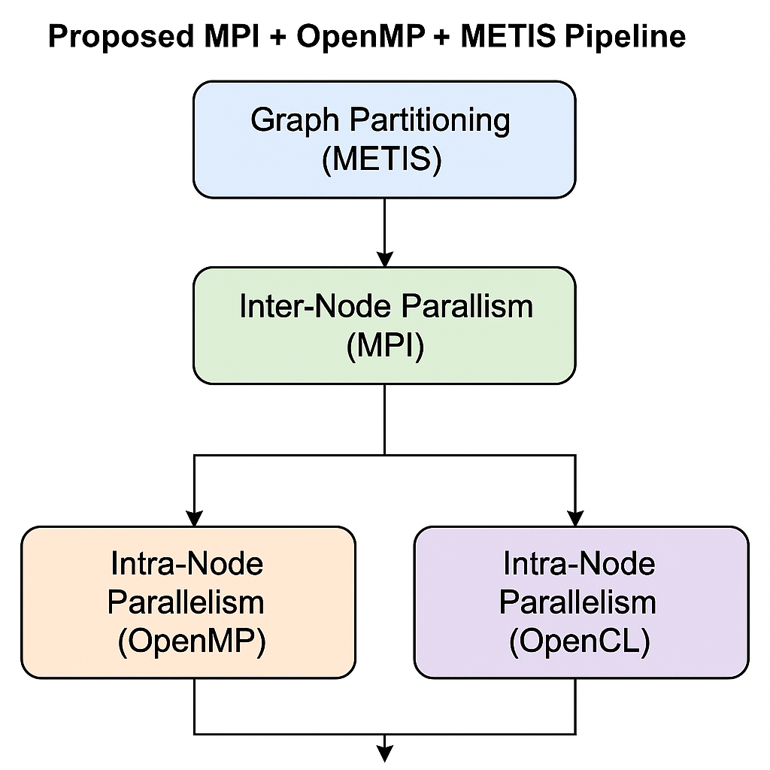

Our Proposed Extension:

Slide 8
Asynchronous Updates
Reduce synchronization frequency between update phases
Batch Processing
Handle edge updates in chunks to manage memory & parallelism efficiently.
Optimization Techniques
Dynamic Load Balancing:
Reassign work if one node's partition is much larger.

Slide 9

Metric | Benefits
Scalability | Distributed across CPUs/GPUs.
Speedup | Faster than full recomputation, especially for frequent small updates.
Flexibility | Easy to reassign failed partition with MPI.
Fault Tolerance | Easy to reassign failed partition with MPI.

Slide 10

Conclusion
The Paper: Pioneered a GPU/Shared-memory SSSP update framework that beats recomputation.
Our Contribution: A scalable, hybrid parallel strategy (MPI + OpenMP/OpenCL + METIS) for billion-scale graphs.
Future Work:
Adaptive strategies (switch between update/recompute).
Support for negative weights via Bellman-Ford variants.
Real-time edge streaming with predictive partitioning.

Slide 11
THANK YOU!
DO YOU HAVE ANY QUESTIONS?

