Slide 1
Lecture 2a: Multiple and Poly Linear Regression

Slide 2
Multiple Linear Regression
If you have to guess someone's height, would you rather be told
Their weight, only
Their weight and gender
Their weight, gender, and income
Their weight, gender, income, and favorite number
Of course, you'd always want as much data about a person as possible. Even though height and favorite number may not be strongly related, at worst you could just ignore the information on favorite number. We want our models to be able to take in lots of data as they make their predictions.

Slide 3
Response vs. Predictor Variables
X
predictors
features
covariates
Y
outcome
response variable
dependent variable
TV | radio | newspaper | sales
230.1 | 37.8 | 69.2 | 22.1
44.5 | 39.3 | 45.1 | 10.4
17.2 | 45.9 | 69.3 | 9.3
151.5 | 41.3 | 58.5 | 18.5
180.8 | 10.8 | 58.4 | 12.9
n observations
p predictors

Slide 4
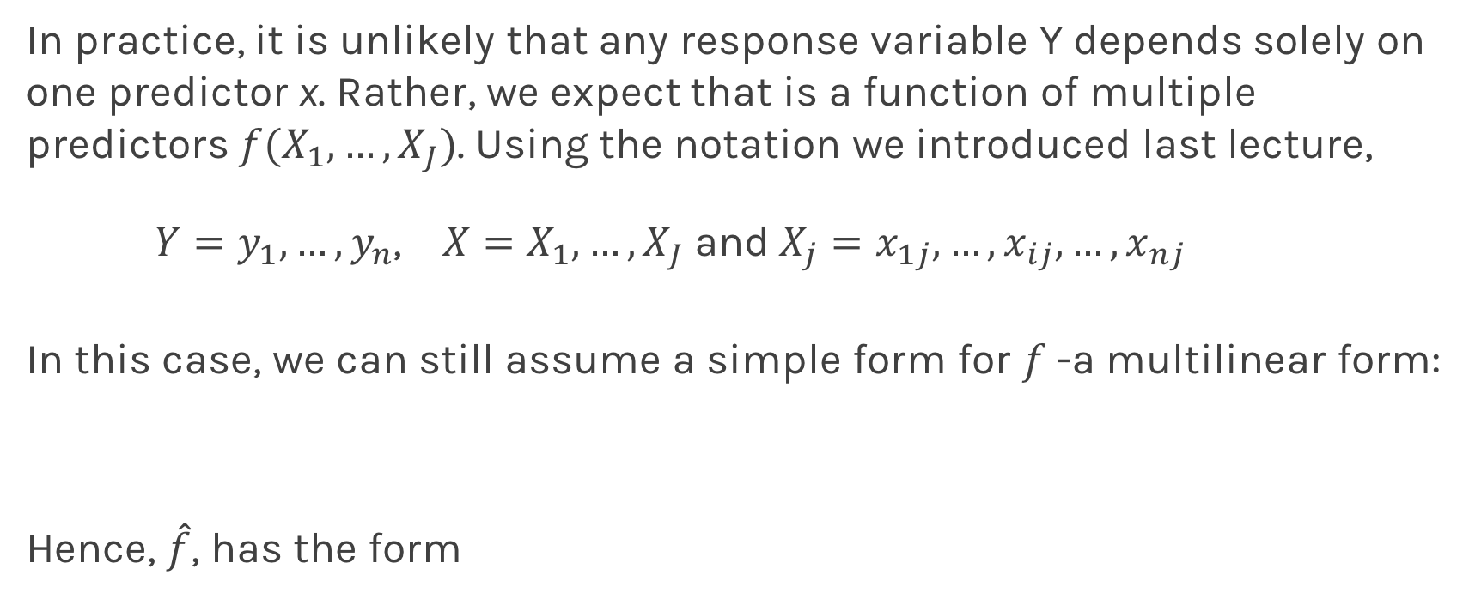
Multilinear Models
In practice, it is unlikely that any response variable Y depends solely on one predictor x. Rather, we expect that is a function of multiple predictors $f(X_{1},…,X_{J})$. Using the notation we introduced last lecture,
$Y=y_{1},…,y_{n}$, $X=X_{1},…,X_{J}$and$X_{j}=x_{1j},…,x_{ij},…,x_{nj}$
In this case, we can still assume a simple form for $f$-a multilinear form:
Hence, $\hat{f}$, has the form

Slide 5
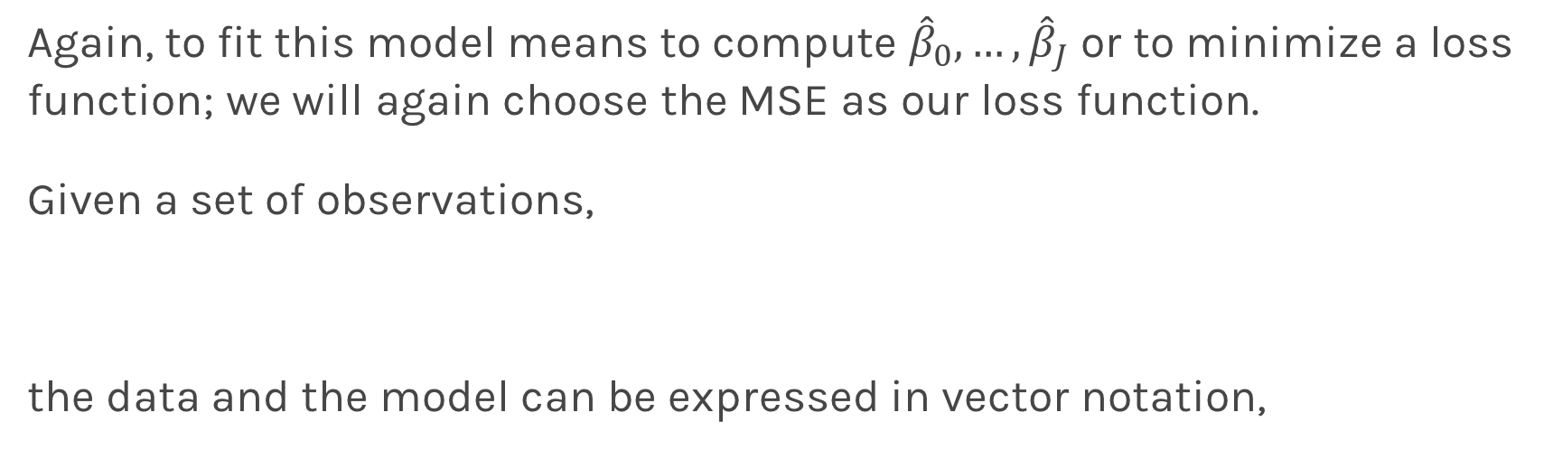
Multiple Linear Regression
Again, to fit this model means to compute ${\hat{β}}_{0},…,{\hat{β}}_{J}$ or to minimize a loss function; we will again choose the MSE as our loss function.
Given a set of observations,
the data and the model can be expressed in vector notation,
Notes:
We need a figure here

Slide 6
Multiple Linear Regression
The model takes a simple algebraic form:
Thus, the MSE can be expressed in vector notation as
Minimizing the MSE using vector calculus yields,
Notes:
We need a figure here

Slide 7
Collinearity
Collinearity refers to the case in which two or more predictors are correlated (related).
We will re-visit collinearity in the next lectures, but for now we want to examine how does collinearity affects our confidence on the coefficients and consequently on the importance of those coefficients.
First let’s look some examples:
Notes:
We need a figure here

Slide 8
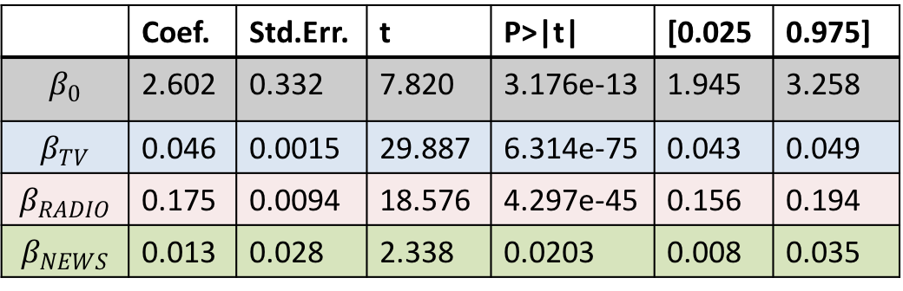
Collinearity
Three individual models
One model
TV
Coef. | Std.Err. | t | P>|t| | [0.025 | 0.975]
6.679 | 0.478 | 13.957 | 2.804e-31 | 5.735 | 7.622
0.048 | 0.0027 | 17.303 | 1.802e-41 | 0.042 | 0.053
RADIO
 | Coef. | Std.Err. | t | P>|t| | [0.025 | 0.975]
$$β_{0}$$ | 2.602 | 0.332 | 7.820 | 3.176e-13 | 1.945 | 3.258
$$β_{TV}$$ | 0.046 | 0.0015 | 29.887 | 6.314e-75 | 0.043 | 0.049
$$β_{RADIO}$$ | 0.175 | 0.0094 | 18.576 | 4.297e-45 | 0.156 | 0.194
$$β_{NEWS}$$ | 0.013 | 0.028 | 2.338 | 0.0203 | 0.008 | 0.035
Coef. | Std.Err. | t | P>|t| | [0.025 | 0.975]
9.567 | 0.553 | 17.279 | 2.133e-41 | 8.475 | 10.659
0.195 | 0.020 | 9.429 | 1.134e-17 | 0.154 | 0.236
NEWS
Coef. | Std.Err. | t | P>|t| | [0.025 | 0.975]
11.55 | 0.576 | 20.036 | 1.628e-49 | 10.414 | 12.688
0.074 | 0.014 | 5.134 | 6.734e-07 | 0.0456 | 0.102

Slide 9
Collinearity
Collinearity refers to the case in which two or more predictors are correlated (related).
We will re-visit collinearity in the next lectures, but for now we want to examine how does collinearity affects our confidence on the coefficients and consequently on the importance of those coefficients.
Assuming uncorrelated noise then we can show:
Notes:
We need a figure here

Slide 10

Finding Significant Predictors: Hypothesis Testing
For checking the significance of linear regression coefficients:
we set up our hypotheses $H_{0}$:
we choose the F-stat to evaluate the null hypothesis,

Slide 11

Finding Significant Predictors: Hypothesis Testing
we can compute the F-stat for linear regression models by
If $F=1$ we consider this evidence for $H_{0}$; if $F>1$, we consider this evidence against $H_{0}$.

Slide 12
Qualitative Predictors
So far, we have assumed that all variables are quantitative. But in practice, often some predictors are qualitative.
Example: The Credit data set contains information about balance, age, cards, education, income, limit , and rating for a number of potential customers.
Income | Limit | Rating | Cards | Age | Education | Gender | Student | Married | Ethnicity | Balance
14.890 | 3606 | 283 | 2 | 34 | 11 | Male | No | Yes | Caucasian | 333
106.02 | 6645 | 483 | 3 | 82 | 15 | Female | Yes | Yes | Asian | 903
104.59 | 7075 | 514 | 4 | 71 | 11 | Male | No | No | Asian | 580
148.92 | 9504 | 681 | 3 | 36 | 11 | Female | No | No | Asian | 964
55.882 | 4897 | 357 | 2 | 68 | 16 | Male | No | Yes | Caucasian | 331

Slide 13
Qualitative Predictors
If the predictor takes only two values, then we create an indicator or dummy variable that takes on two possible numerical values.
For example for the gender, we create a new variable:
We then use this variable as a predictor in the regression equation.

Slide 14

Qualitative Predictors
Question: What is interpretation of $β_{0}$ and $β_{1}$?

Slide 15
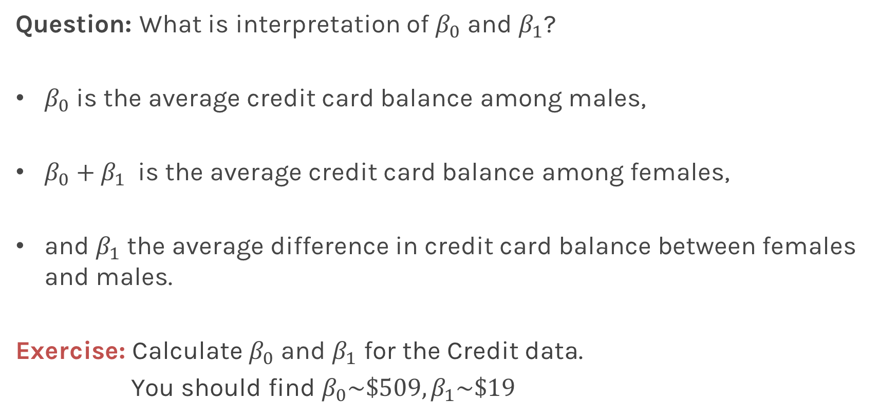
Qualitative Predictors
Question: What is interpretation of $β_{0}$ and $β_{1}$?
$β_{0}$ is the average credit card balance among males,
$β_{0}+β_{1}$ is the average credit card balance among females,
and $β_{1}$ the average difference in credit card balance between females and males.
Exercise: Calculate $β_{0}$ and $β_{1}$ for the Credit data.
You should find $β_{0}\sim \$509,β_{1}\sim \$19$

Slide 16
More than two levels: One hot encoding
Often, the qualitative predictor takes more than two values (e.g. ethnicity in the credit data).
In this situation, a single dummy variable cannot represent all possible values.
We create additional dummy variable as:

Slide 17
More than two levels: One hot encoding
We then use these variables as predictors, the regression equation becomes:
Again the interpretation
Notes:
[ADD interpretation and ONE HOT ENCODING]

Slide 18
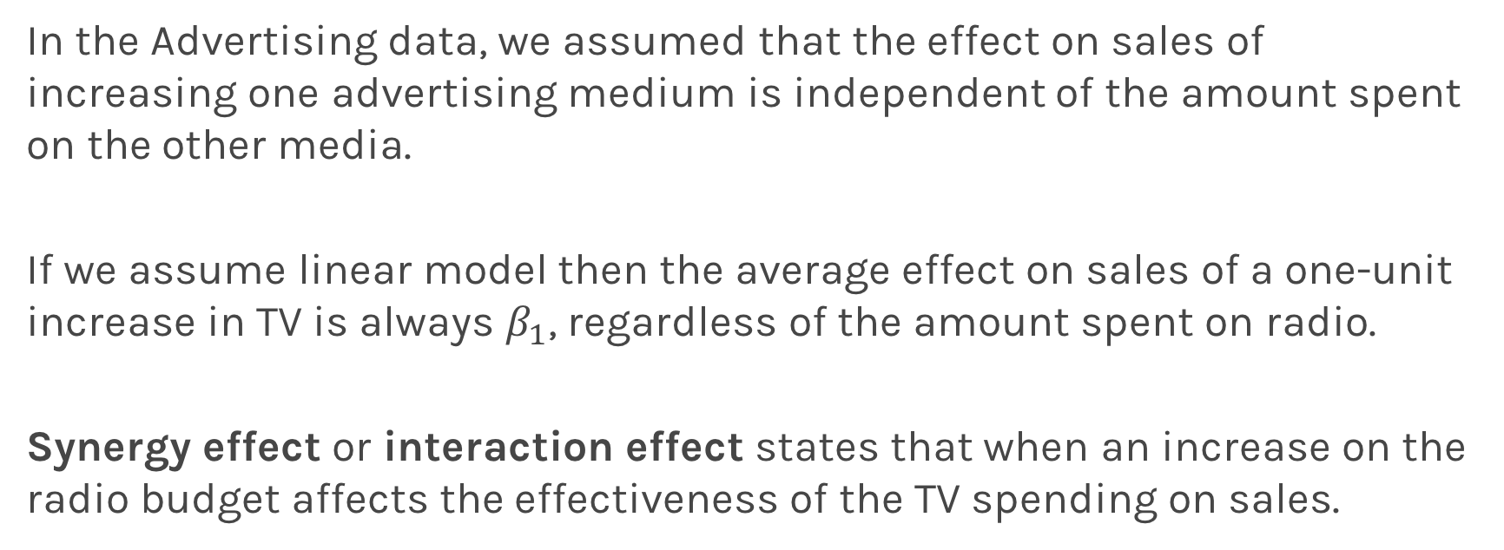
Beyond linearity
In the Advertising data, we assumed that the effect on sales of increasing one advertising medium is independent of the amount spent on the other media.
If we assume linear model then the average effect on sales of a one-unit increase in TV is always $β_{1}$, regardless of the amount spent on radio.
Synergy effect or interaction effect states that when an increase on the radio budget affects the effectiveness of the TV spending on sales.

Slide 19
Beyond linearity
We change
To

Slide 20
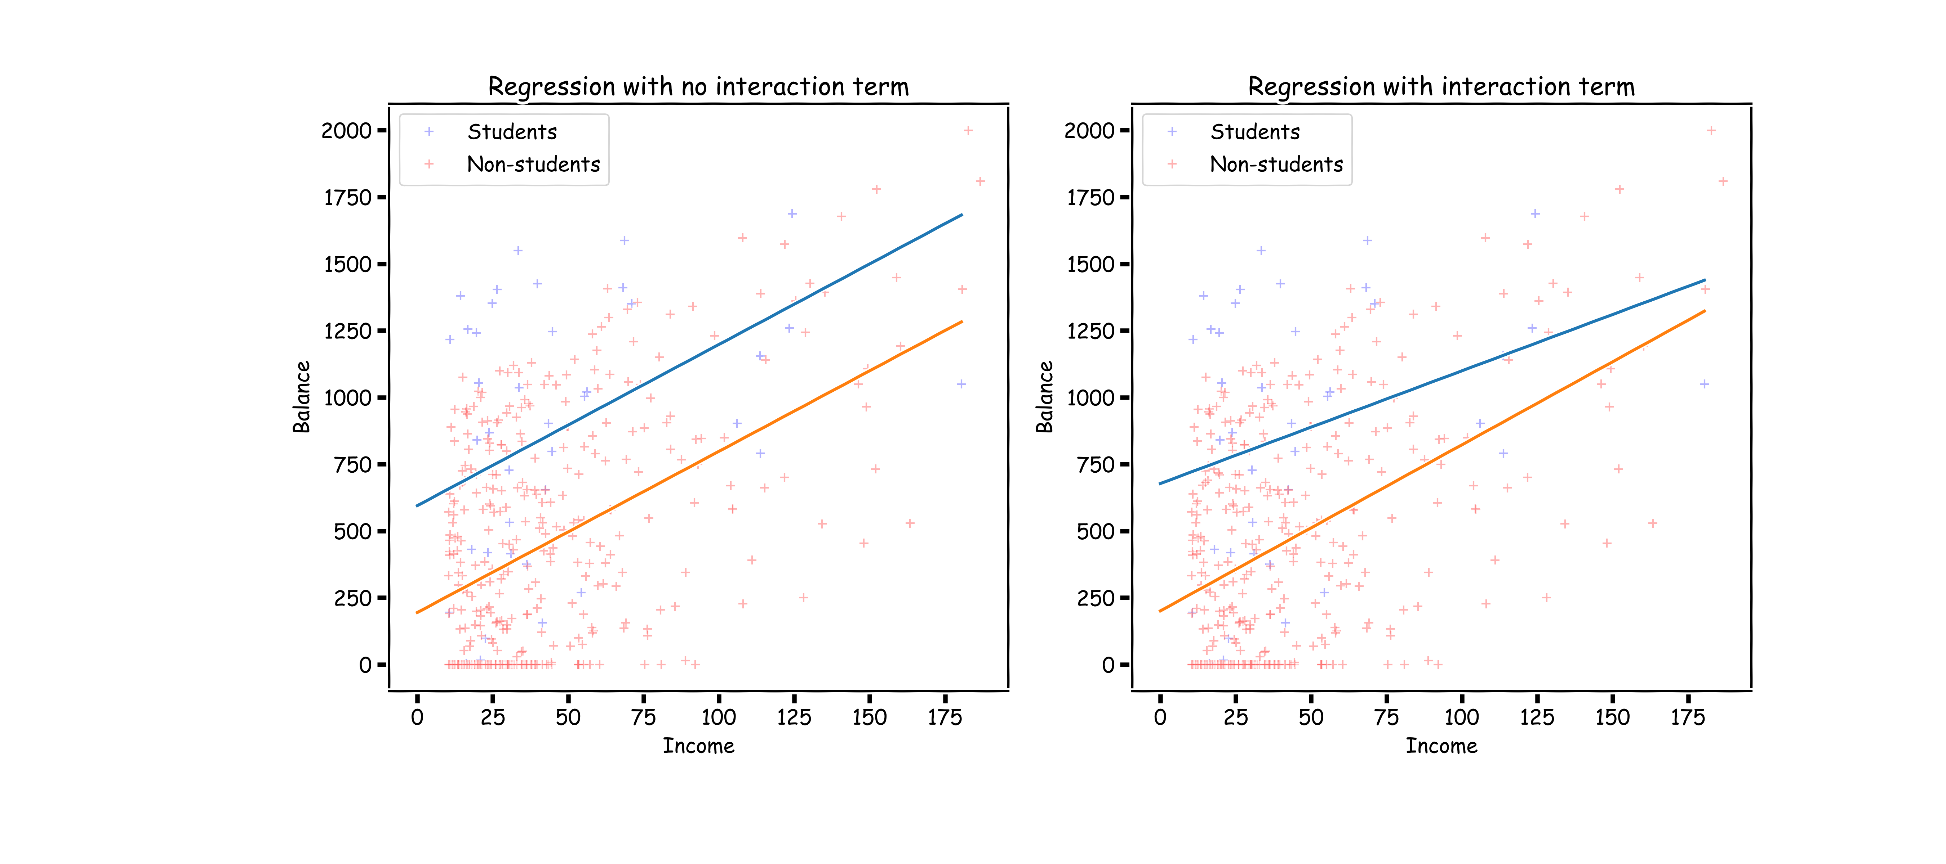
What does it mean?

Slide 21
Predictors predictors predictors
We have a lot predictors!
Is it a problem?
Yes: Computational Cost
Yes: Overfitting
Wait there is more …

Slide 22
Polynomial Regression

Slide 23
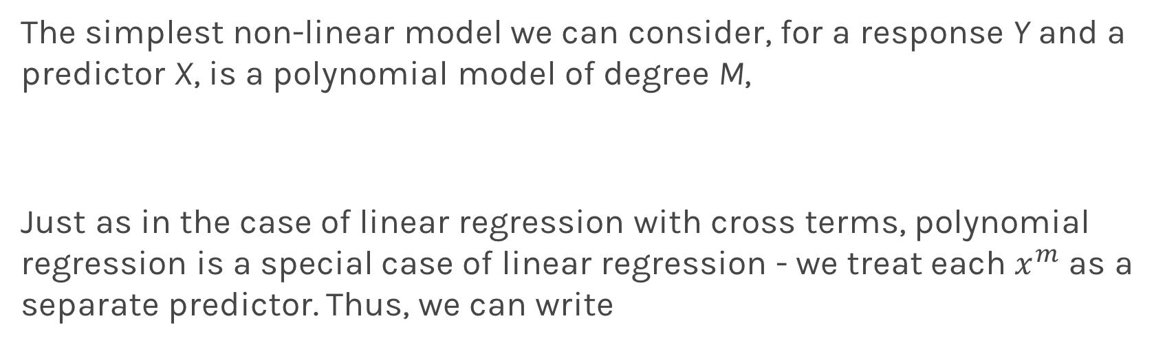
Polynomial Regression
The simplest non-linear model we can consider, for a response Y and a predictor X, is a polynomial model of degree M,
Just as in the case of linear regression with cross terms, polynomial regression is a special case of linear regression - we treat each $x^{m}$ as a separate predictor. Thus, we can write

Slide 24
Polynomial Regression
Again, minimizing the MSE using vector calculus yields,

