Slide 1

BEM Architecture
&
Pre-Processor
Aamer Qanadilo

Slide 2
What is BEM ?
Why BEM ? It's so ugly !
The good stuffs about BEM
CONTENTS
How does it works ?
BEM & Pre-Processor

Slide 3
What is BEM?
BEM was created by Yandex, the "Russian Google" in 2009.
It is a component based architecture and naming convention. It stand for Block / Element / Modifier.
Why do we use it?
One of the most common critic for BEM is that it is ugly, and that those long classes names are making the markup hard to read.It's very sad because the true beauty of BEM is hidden.

Slide 4

The good stuffs about BEM
you can know which classes are related to others
you can also know in which file they are declared, reducing headache
you can understand the role of the class (And therefore better follow the SRP)
SRP: Single Responsibility Principle

Slide 5

The benifits of using BEM
get self documented code, and logically reduce the need for CSS documentation
keep specificity low (because most of your selectors will only be composed of one classe)
make class colision almost impossible (all classes will be uniques)
making it safer to have multiple sources of code (any CSS frameworks mixed with your own)

Slide 6
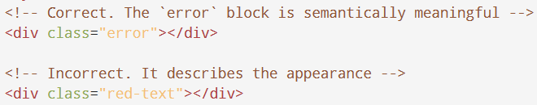
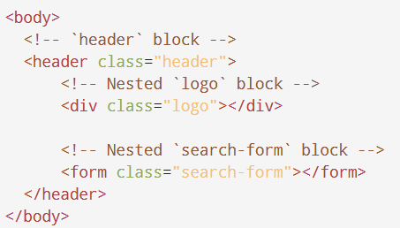
Guidelines for using Blocks
The block name describes its purpose ("What is it?" — menu or button), not its state ("What does it look like?" — red or big).
Blocks can be nested in each other.

Slide 7
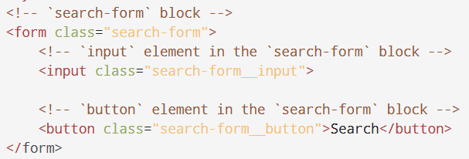
Guidelines for using Elements
The Element name describes its purpose ("What is it?" — item or text), not its state ("What does it look like?" — red or big).
The structure of an element's full name is block-name__element-name. The element name is separated from the block name with a double underscore (__).

Slide 8
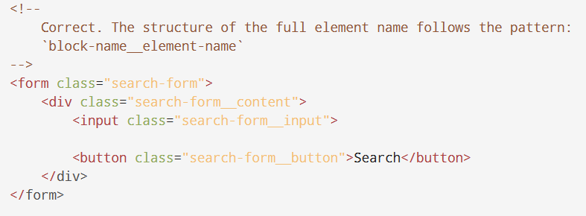
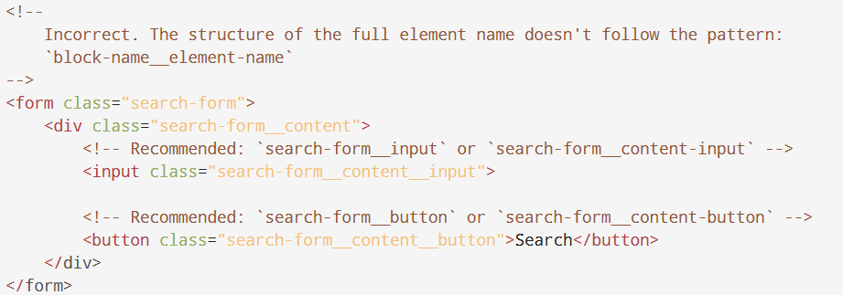
Guidelines for using Elements cont.
An element is always part of a block, not another element. This means that element names can't define a hierarchy such as block__elem1__elem2.

Slide 9
Should I create a Block or an Element
Create a Block If a section of code might be reused and it doesn't depend on other page components being implemented.
Create an Element If a section of code can't be used separately without the parent entity (the block).

Slide 10
Guidelines for using Modifier
The modifier name describes its appearance ("What size?" or "Which theme?" and so on — size_s or theme_islands), its state ("How is it different from the others?" — disabled, focused, etc.) and its behavior ("How does it behave?" or "How does it respond to the user?" — such as directions_left-top).
The modifier name is separated from the block or element name by a single underscore (_).

Slide 11
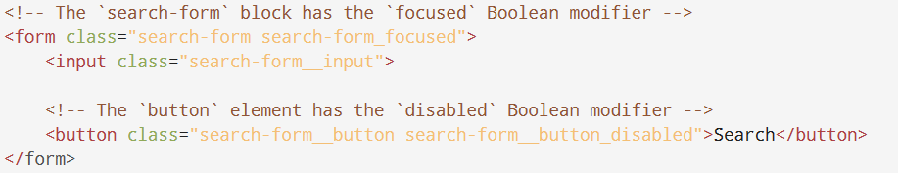
Types of Modifier
Boolean, The structure of the modifier's full name follows the pattern:
block-name_modifier-name
block-name__element-name_modifier-name

Slide 12
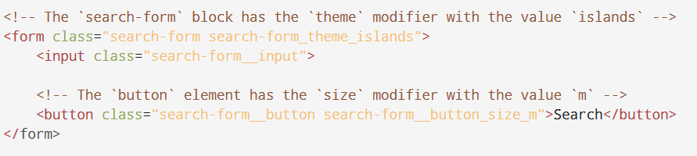
Types of Modifier cont.
Key-value, The structure of the modifier's full name follows the pattern:
block-name_modifier-name_modifier-value
block-name__element-name_modifier-name_modifier-value

Slide 13
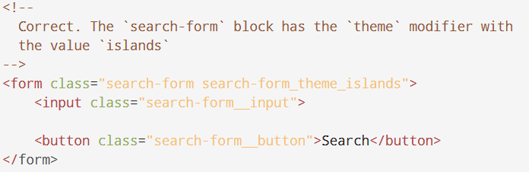
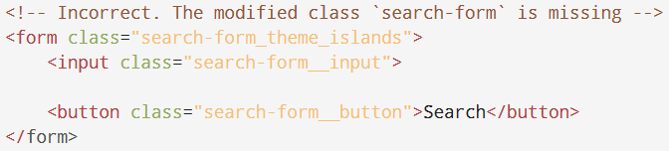
Modifiers can’t be used alone
From the BEM perspective, a modifier can't be used in isolation from the modified block or element. A modifier should change the appearance, behavior, or state of the entity, not replace it.

Slide 14
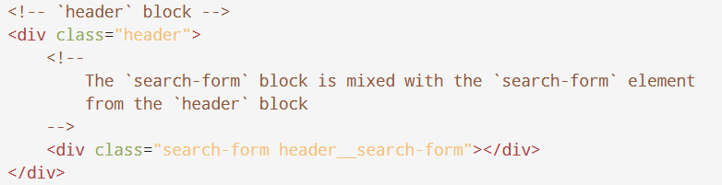
Mixing the BEM entities
Combine the behavior and styles of multiple entities without duplicating code.
Create semantically new UI components based on existing ones.

Slide 15
File Structure
A single block corresponds to a single directory.
The block and the directory have the same name. For example, the header block is in the header/ directory, and the menu block is in the menu/ directory.
A block's implementation is divided into separate technology files. For example, header.css and header.js.
The block directory is the root directory for the subdirectories of its elements and modifiers.

Slide 16
File Structure cont.
Names of element directories begin with a double underscore (__). For example, header/__logo/ and menu/__item/.
Names of modifier directories begin with a single underscore (_). For example, header/_fixed/ and menu/_theme_islands/.
Implementations of elements and modifiers are divided into separate technology files. For example, header__input.js and header_theme_islands.css.

Slide 17
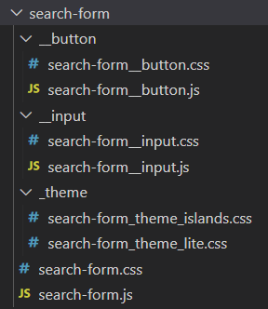
File Structure cont.

Slide 18
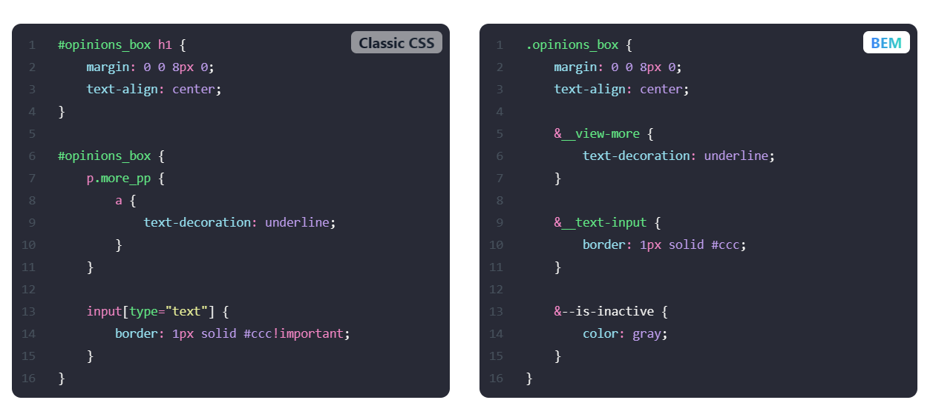
BEM & Pre-Processors
BEM can make it easier to use preprocessors like Sass or Less by allowing you to nest selectors and create variables for commonly used values. This can help you write more maintainable and reusable code

Slide 19
THANKS
Aamer Qanadilo
Foothill Technology Solutions

