Slide 1


The concept of Proxy-Chains
18th February, 2017 A.D
LEVEL | BASIC

Slide 2
Who am I
Offensive Security Consultant @ Mercedes-Benz R&D, India.
Researcher, Enthusiast, Developer and BB-Hunter.
Chess, Photography.
Site: www.aamer.me.pn

Slide 3
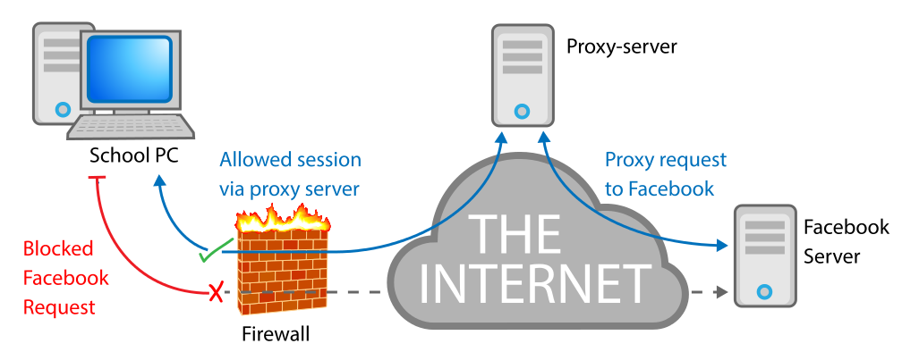
Proxy Server
In computer networks, a proxy server is a server (a computer system or an application) that acts as an intermediary for requests from clients seeking resources from other servers.
PROXY
Facebook Inc

Slide 4
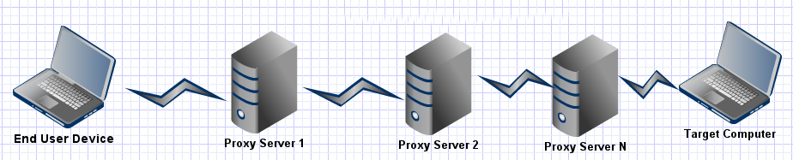
Proxy Chaining
IP Address

Slide 5
Proxychains (utiliy)
Utility to chain multiple proxies and route traffic through multiple (2 or more) proxy servers.
Proxychaining tools: Proxychains, Proxifier.
Proxychains utility is already installed in Kali.
Reference: Usage of proxifier >> http://proxifier.com/

Slide 6
How to set Proxychains (linux) Part - 1
Use Proxychains in tandem with cntlm, TOR or / and privoxy.
<text editor> /etc/proxychains.conf
The conf. file contains documentation.
How to get proxies.
Online web-portals / websites (Google, samair.ru)
Proxy syntax: [type]<space>[host IP]:<port><space>[user]<space>[pass]
Example : http 10.20.30.40:80 socks4 1.2.3.4:8080 socks5 1.2.7.9:8081

Slide 7
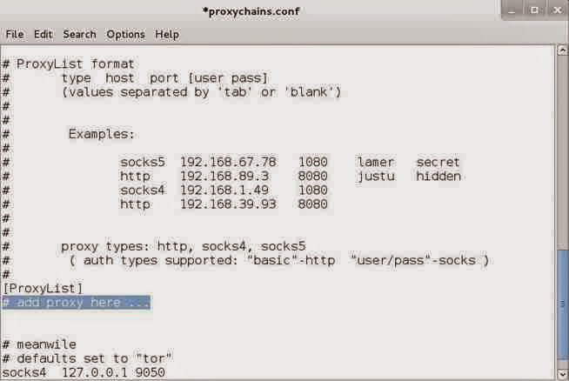
How to set Proxychains (linux) Part - 2
Key Points:
Strict Chain
Random Chain
Dynamic Chain

Slide 8
Additional Info
Choose multi-nation proxy list (based on political differences)
Check if it works…
Grabify.link, ip.filefab.com, google + whois
Drawbacks
Improper setup may compromise your anonymity.
Net Speed (Upload / Download) will suffer.
Advanced anti-proxy tools (IDPSs) might drop your packets.

Slide 9
Proxychains utility (usage)
/bin/bash /bin/dash
Examples:
proxychains nmap -sS 127.0.0.2 -p-
proxychains firefox aamer.me.pn
proxychains hydra 127.90.2.2 -l admin -p /secret/Ashley_Maddison.txt ssh2
proxychains msfconsole

Slide 10
End

