Slide 1
SSRF
Server-Side Request Forgery

Slide 2
? | self
Offensive Security Researcher
Worked: Mercedes Benz, Ola, Temenos, Spectrami, Ooredoo, Etisalat.
Reach me at null@AamerShah.com or twitter.com/Aamer_Sha
Follow up: t.me/cKure

Slide 3
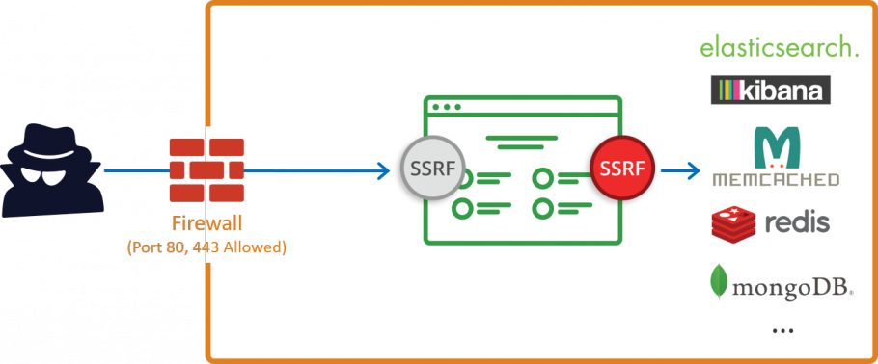
What [in a nutshell]

Slide 4
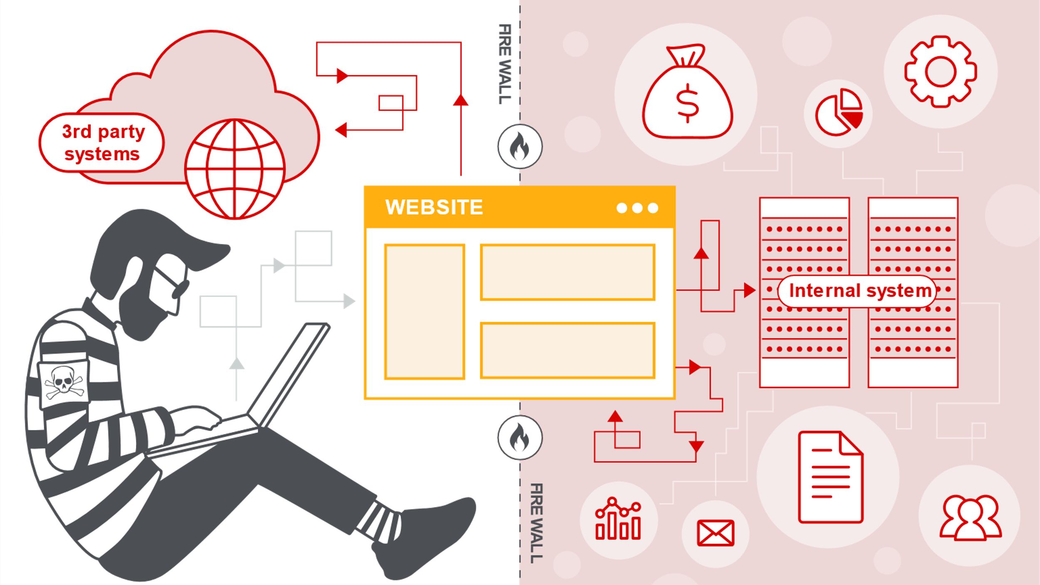
A bit more attack surface

Slide 5
Where to find
URL parameters
File Upload parameters
File Fetching parameters
Gopher, dict, ldap
XML parsers (XSD, DTD, XSLT), open office, processing libraries, TCPDF, lib-www-Perl

Slide 6
Types
Normal (like reflection)
Blind (without output)
Internal (services and files)
External (port scan, proxy)
SSRF as a genuine functionality

Slide 7
Further Reading
https://www.acunetix.com/blog/articles/server-side-request-forgery-vulnerability/
https://portswigger.net/web-security/ssrf
https://www.slideshare.net/d0znpp/ssrf-workshop
https://docs.google.com/document/d/1v1TkWZtrhzRLy0bYXBcdLUedXGb9njTNIJXa3u9akHM/edit#heading=h.32e0l76l6a6k
https://www.postgresql.org/docs/8.4/dblink.html

Slide 8
Demo
No Filming
Sanitization by BlackBox approach

