Slide 1
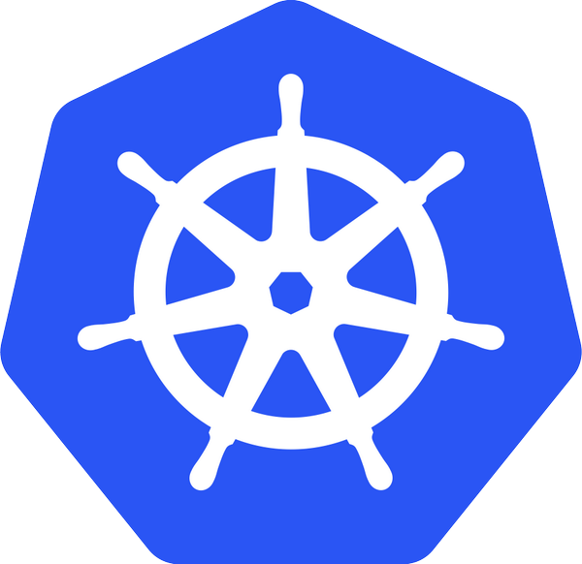
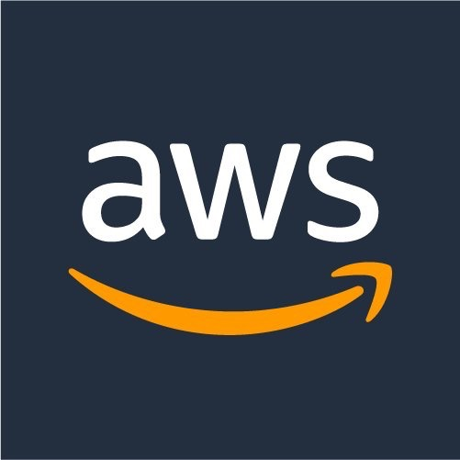
Kubernetes on AWS Workshop
Presenter Name:
Date:

Slide 2
Agenda
Title
Introduction to Kubernetes [Concepts, Cluster Deployments (Heptio, Kops, Tectonic etc.)]
Beginners tutorials [Setup Dev Environment, Install K8s Cluster, Deployment Concepts]
Kubernetes Ecosystem (Networking, Storage)
Mid-level tutorials [Service Discovery, Cluster-* (Monitoring, Logging, Upgrades, Scaling), Helm Charts, App Scaling, Configuration and Secrets Management)
Kubernetes Ecosystem (Service Discovery, Service Mesh, Distributed Tracing)
Advanced tutorials (Network policies with Calico, IAM roles with kube2iam, Statefulsets with EBS, Service mesh with Linkerd)

Slide 3
What is Kubernetes?
Ancient greek for “Helmsman”. Root of the word “Governor”, “Cybernetics”
Open source orchestration system for containers
Docker, rkt, OCI, …
A Cloud Native Computing Foundation project
Active open source project and growing ecosystem
>27K stars, >1900 contributors
Written in Go
Provide declarative primitives for the “desired state”
Self-healing
Horizontal scaling
Automatic binpacking
Service discovery and load balancing

Slide 4
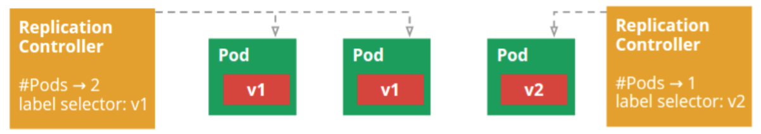
Kubernetes Concepts - Developer
Pods: colocated group of containers that share an IP, namespace, storage volume
Service: Single, stable name for a set of pods, also acts as LB
Replication Set: manages the lifecycle of pods and ensures specified number are running
Label: used to organize and select group of objects
Node
Docker
Pod
Containers
“web”
port 8080
port 8080

Slide 5
Kubernetes Concepts - Developer
Namespaces: Isolated workspaces for users/projects
Ingress controller: L7 load balancing
Deployments: Declarative version updates
Jobs: Run to completion
Autoscale: Automatically adjust number of Pods
Network Policies: aka Security Groups for Pods
StatefulSet: Support for long term stateful distributed systems
More …

Slide 6
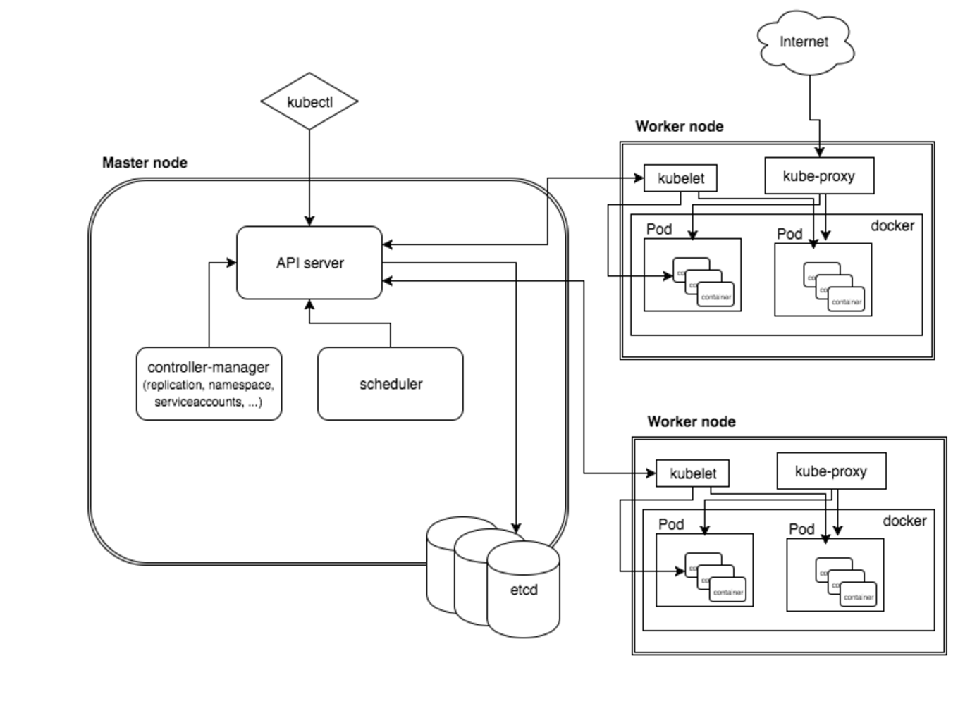
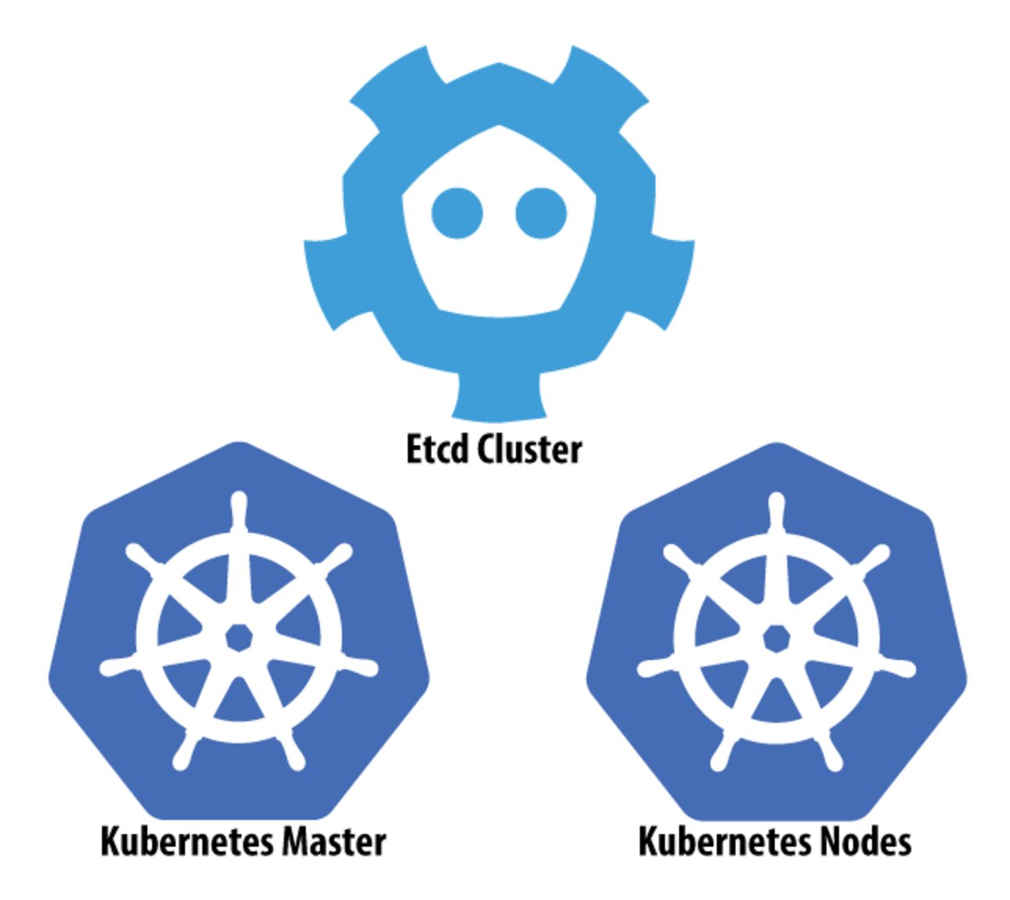
Architecture
Notes:
** Provides a series of loosely coupled and extensible components that can apply to a wide range of differing workloads

Slide 7
Kubectl
CLI for running commands against Kubernetes cluster
CRUD Kubernetes resources
kubectl [ create | get | describe | delete ] – f <file> | <resource>
kubectl scale –replicase=3 rs/<name>

Slide 8
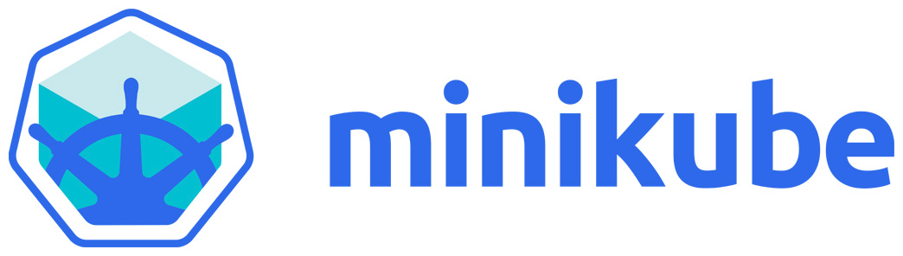
Minikube
Runs a single node cluster in a VM
OSX: xhyvve, VirtualBox or VMWare Fusion
Linux: VirtualBox or kvm
Windows: VirtualBox or Hyper-V
Targeted for local development
Flow
brew cask install minikube
minikube start
kubectl create –f <file>
https://github.com/kubernetes/minikube

Slide 9
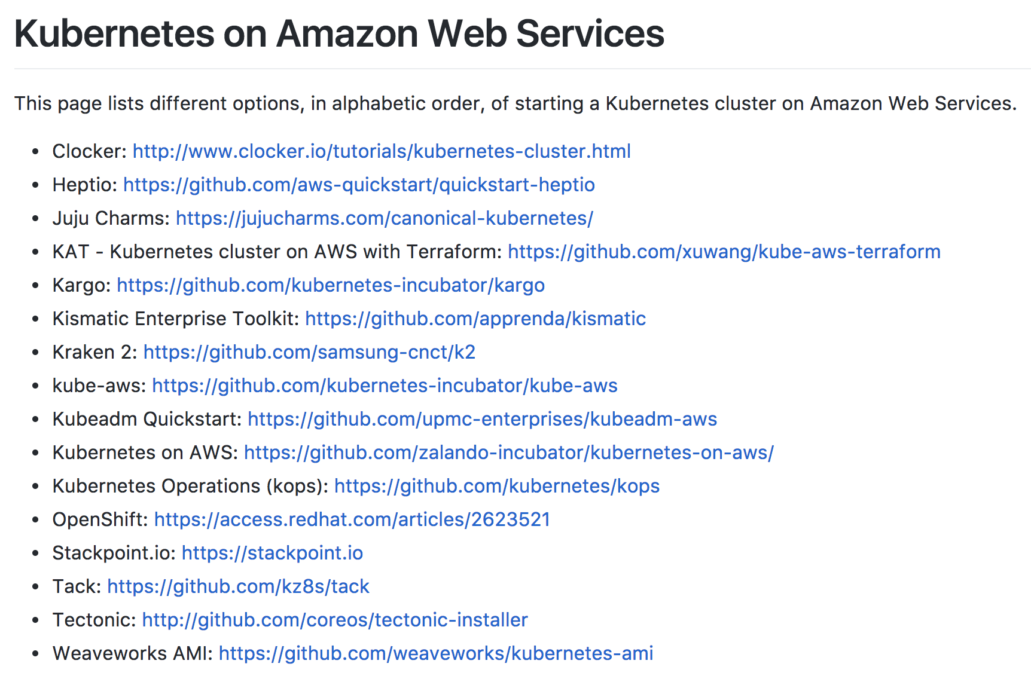
Kubernetes on AWS – Getting Started
kubernetes-aws.io

Slide 10
Networking

Slide 11
CNI Plugins
The Container Network Interface is a set of specs and libs for writing networking plugins
Handles standards around namespace and interface configuration
Configured by passing “—networking CNI” flag in cluster spec; then installing the desired plugin as a daemonset (run once on all hosts)
CNI standards have allowed for a number of networking approaches in Kubernetes, each with their own advantages and disadvantages
https://github.com/containernetworking/cni/blob/master/SPEC.md ← you should read this
Notes:
Each CNI plugin is implemented as an executable that is invoked by the container management system (e.g. rkt or Docker).
A CNI plugin is responsible for inserting a network interface into the container network namespace (e.g. one end of a veth pair) and making any necessary changes on the host (e.g. attaching other end of veth into a bridge). It should then assign the IP to the interface and setup the routes consistent with IP Address Management section by invoking appropriate IPAM plugin.
The intention is for the container runtime to first create a new network namespace for the container. It then determines which networks this container should belong to and for each network, which plugin must be executed. The network configuration is in JSON format and can easily be stored in a file. The network configuration includes mandatory fields such as "name" and "type" as well as plugin (type) specific ones.

Slide 12
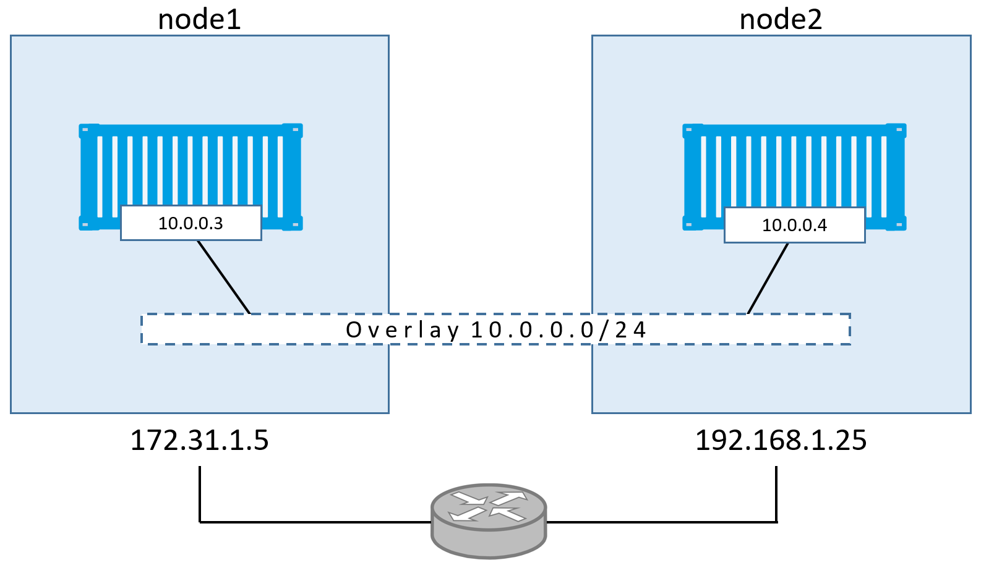
Overlay Networks
http://blog.nigelpoulton.com/demystifying-docker-overlay-networking/
Notes:
Overlay networks implement a common network address space across the entire cluster on which containers can communicate. Most overlays use the Docker0 bridge interface, but they “extend” the bridge network by providing information about the Docker0 network on other hosts, and coordinate IP addressing to prevent conflicts. Information about the network is commonly stored in a backing key/value datastore like Etcd, with the one exception being Weave Net, in which information about the overlay is stored in-memory and replicated across the cluster.
One advantage of overlay networks is that the container orchestration platform maintains complete control over the networking functionality and feature set. This makes overlay networks platform agnostic, and doesn’t require custom integration development when workloads are deployed across networks with different features and capabilities.

Slide 13
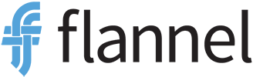
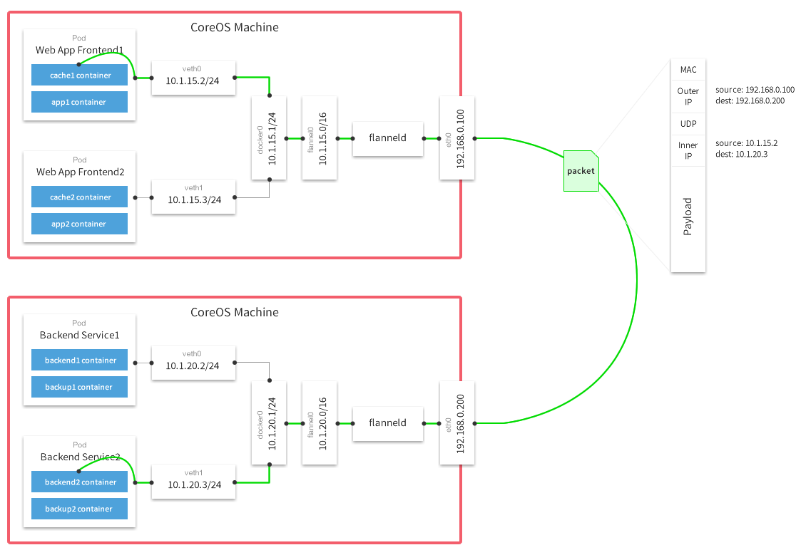
CoreOS project
Stores configuration data in etcd
VXLan for L2 encap (default)
Each pod gets a /24 subnet on the flannel /16 overlay

Slide 14

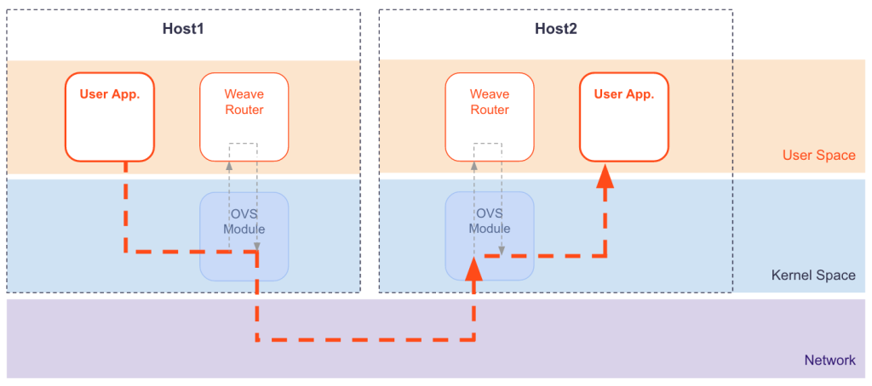
Open source project owned by Weaveworks
No backing k/v store required; cluster state replicated in memory
Supports multicast + NaCL encryption
Has DNS service discovery and load balancing built in
Notes:
https://github.com/weaveworks/weave/issues/2045

Slide 15
Overlay Networks
Pros:
Cons:
Agnostic to underlying topology and platform
Can easily span networks and platforms
Some offer cool functionality (encryption, multicast)
No cluster size limitations due to routes or hosts
Can be difficult to troubleshoot due to encapsulation
Require port mapping on host or load balancers for access from other networks
Performance overhead
Can’t use security groups
Notes:
Overlay networks implement a common network address space across the entire cluster on which containers can communicate. Most overlays use the Docker0 bridge interface, but they “extend” the bridge network by providing information about the Docker0 network on other hosts, and coordinate IP addressing to prevent conflicts. Information about the network is commonly stored in a backing key/value datastore like Etcd, with the one exception being Weave Net, in which information about the overlay is stored in-memory and replicated across the cluster.
One advantage of overlay networks is that the container orchestration platform maintains complete control over the networking functionality and feature set. This makes overlay networks platform agnostic, and doesn’t require custom integration development when workloads are deployed across networks with different features and capabilities.

Slide 16
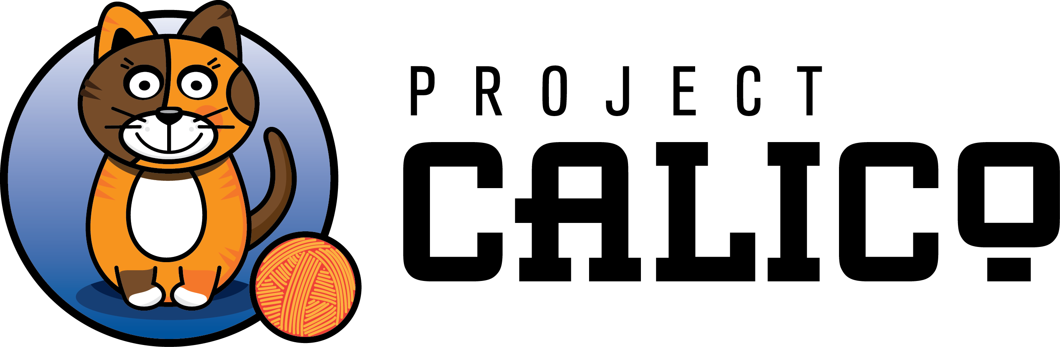
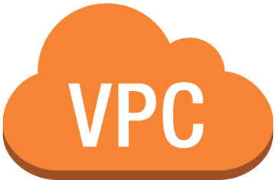


Calico Subnet – 172.16.1.0/16
172.16.0.1/24
172.16.0.2/24
Src/dst disabled
instance1
instance2
10.0.0.10
10.0.0.12
Calico BGP daemon
IF on Calico Subnet –
172.16.0.2/24
Calico IPIP tunnel across subnets
instance3
Instance2 route table:
172.16.0.1/24 via 10.0.0.10
10.0.1.20
instance4
10.0.1.22
instance2
10.0.0.12
172.16.0.3/24
172.16.0.4/24
Calico Subnet – 172.16.1.0/16
VPC – 10.0.0.0/16

Slide 17
Layer 3 networking (Calico)
Pros:
Cons:
No encap/decap overhead*
Easier debugging, well known tools/protocols (iptables, BGP)
Uses BGP for routing - supports large clusters
No cluster size limitations due to routes or hosts
Limited to UDP/ICMP/TCP protocol support
Uses BGP for routing - complexity
Can’t use security groups*
*except across subnets

Slide 18
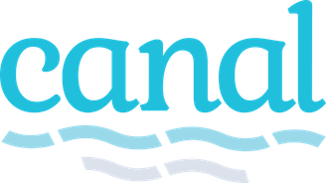
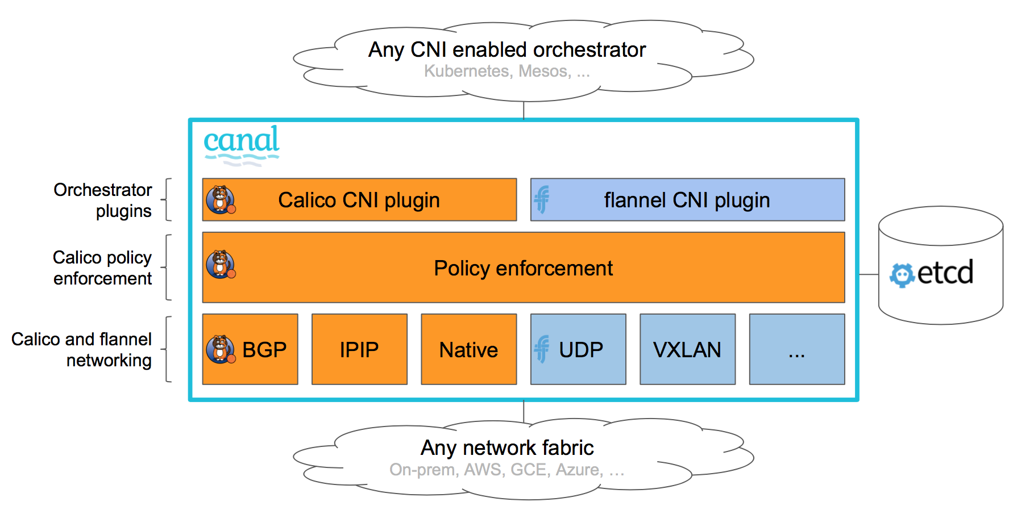

Slide 19
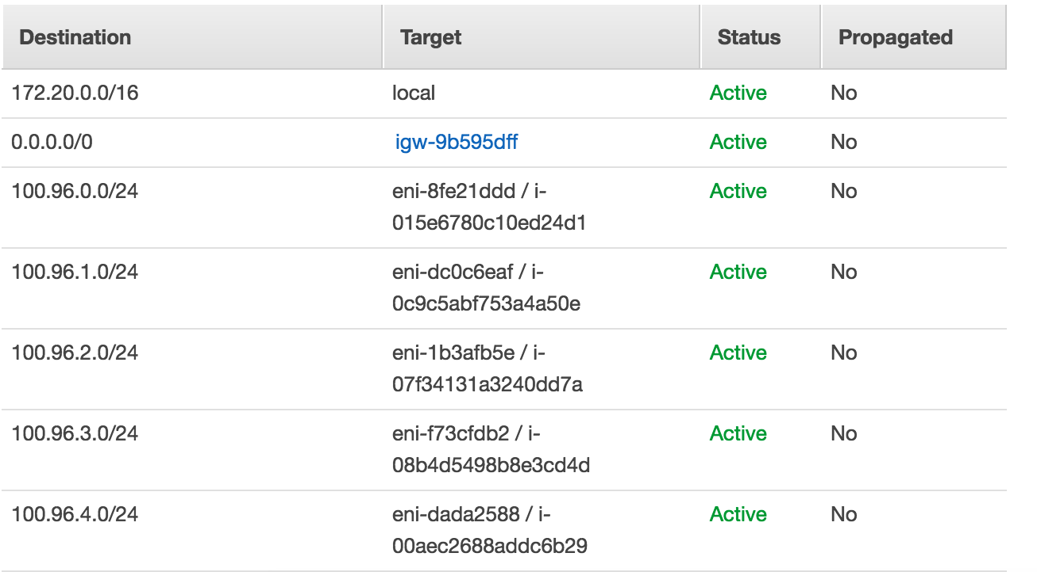
VPC Networking (Kubenet)
Default networking mode for KOPS
--network-plugin=kubenet
Creates a bridge called cbr0; connects a Veth pair to each pods
Manages an out-of-band subnet across the cluster (like Calico, so src/dst = disabled is required)

Slide 20
VPC Networking (Kubenet)
Pros:
Cons:
Interacts directly with the VPC
No encap/decap overhead
Easier debugging
Uses VPC routing tables*
Cluster size limited to number of routes per subnet
Can’t use security groups
Doesn’t automatically update routes on scaling events (userdata/lifecycle hooks?)
Is recommended to be used in its own subnet to prevent route table conflicts
*maybe also a negative

