Slide 1


“IMPORT EXPORT MANAGEMENT SYSTEM”
A
MINI PROJECT REPORT
SUBMITTED FOR THE COURSE
“DATABASE MANAGEMENT SYSTEM”
Submitted By
AAMIR HAFIEZ – 1614110182
AMAR NATH PANDEY - 1614110174
B. Tech Sem - V Computer-I
Under: PROF. S.B. Nikam
DEPARTMENT OF COMPUTER ENGINEERING
BHARATI VIDYAPEETH
(DEEMED TO BE UNIVERSITY)
COLLEGE OF ENGINEERING, PUNE - 43

Slide 2
IMPORT EXPORT MANAGEMENT SYSTEM

Slide 3
INDEX
1.1INTRODUCTION…………………………………………………………………4
2.SYSTEMANALYSIS…………………………………………………………… ..….5
3.DBMS ARCHITECTURE………………………………………………………….….6
4.DATA MODELLING………………………………………………………………...7
5.DATABASE DESIGN…………………………………………………………….......8
6.MODEL MAPPING……………………………………………………………....…11
7.USER INTERFACE DESIGN…………………………………………………………13
8.DATABASE CONNECTIVITY………………………………………………………..15
9.SYSTEM IMPLEMENTATION………………………………………………………17
10.REFERENCE POWERPOINT PRESENTATION ON OPTED PROJECT………..........…26

Slide 4
INTRODUCTION
OBJECTIVE: To create a GUI of Database with for IMPORT AND EXPORT MANAGEMENT SYSTEM using MySQL and VB.Net.
ABOUT:
As your business takes on new staff, implements new processes and expands its operations, it’s important to have a robust business system that supports growth. If your goal is for your business to grow into a large enterprise, the best thing you can do is to start running it like one. This will help you improve productivity, cut costs, and keep your business running smoothly.
Thus this project will help an entrepreneur to develop their business at a vast and efficient scale.
The main aim of this project is to combat daily import and export database management.
The project is solely based on form application that is robust and mesmerizing in its own way which will help the user to effectively store information into the database.
This project has been developed with hard work and dedication so that its GUI shall be easier to understand even without the knowledge of its internal coding.

Slide 5
SYSTEM ANALYSIS
Here are the Projects system requirements (minimum)
CPU: Intel Core 2 Quad CPU Q6600 @ 2.40GHz (4 CPUs) / AMD Phenom 9850 Quad-Core Processor (4 CPUs) @ 2.5GHz
CPU SPEED: Info
RAM: 512 MB
OS: Windows 10 64 Bit, Windows 8.1 64 Bit, Windows 8 64 Bit, Windows 7 64 Bit Service Pack 1, Windows Vista 64 Bit Service Pack 2*, 32-bit also Supported.
VIDEO CARD: NVIDIA 9800 GT 1GB / AMD HD 4870 1GB (DX 10, 10.1, 11)
FREE DISK SPACE: 6.21 MB
Projects Recommended Requirements
CPU: Intel Core i5 3470 @ 3.2GHz (4 CPUs) / AMD X8 FX-8350 @ 4GHz (8 CPUs)
CPU SPEED: Info
RAM: 2 GB
OS: Windows 10 64 Bit, Windows 8.1 64 Bit, Windows 8 64 Bit, Windows 7 64 Bit Service Pack 1, 32-bit also Supported.
VIDEO CARD: NVIDIA GTX 660 2GB / AMD HD 7870 2GB
FREE DISK SPACE: 7.00 MB

Slide 6
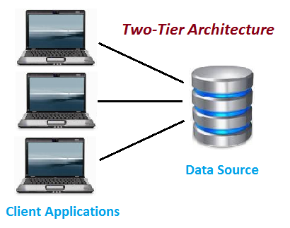
DBMS ARCHITECTURE
2-Tier Architecture
The 2-Tier architecture is same as basic client-server. In the two-tier architecture, applications on the client end can directly communicate with the database at the server side. For this interaction, API's like: ODBC, JDBC are used.
The user interfaces and application programs are run on the client-side.
The server side is responsible to provide the functionalities like: query processing and transaction management.
To communicate with the DBMS, client-side application establishes a connection with the server side.
Two tier architecture is similar to a basic client-server model. The application at the client end directly communicates with the database at the server side. API’s like ODBC, JDBC are used for this interaction. The server side is responsible for providing query processing and transaction management functionalities. On the client side, the user interfaces and application programs are run. The application on the client side establishes a connection with the server side in order to communicate with the DBMS. An advantage of this type is that maintenance and understanding is easier, compatible with existing systems. However, this model gives poor performance when there are a large number of users.

Slide 7
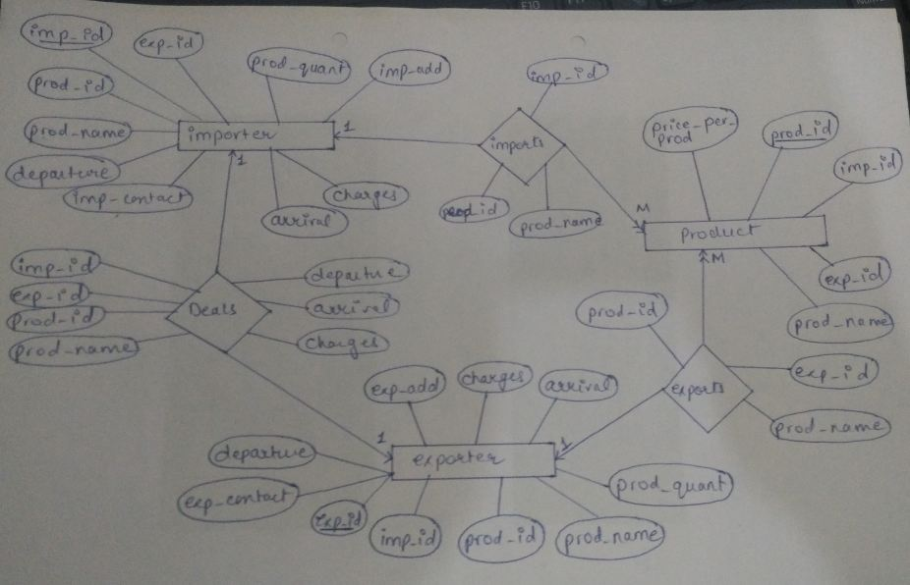
DATA MODELLING

Slide 8
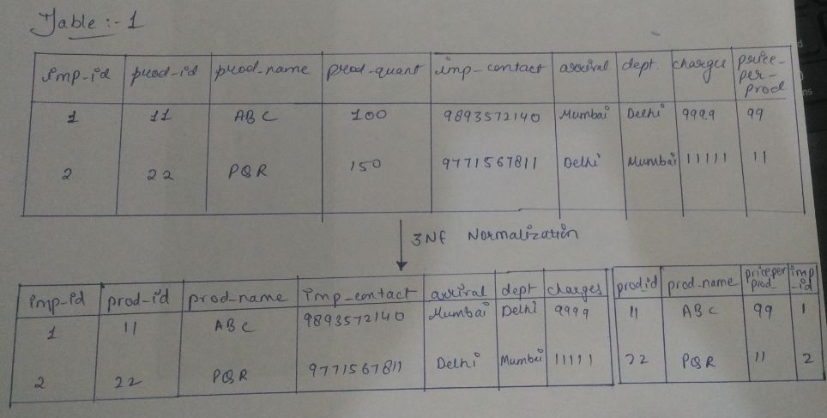
DATABASE DESIGN

Slide 9
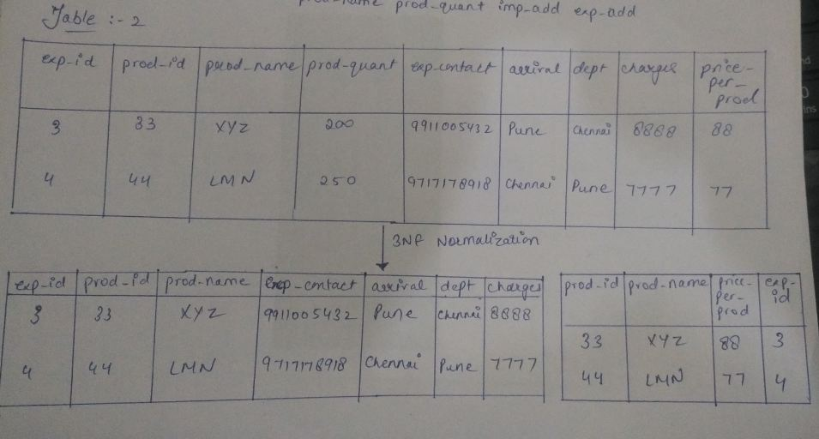

Slide 10
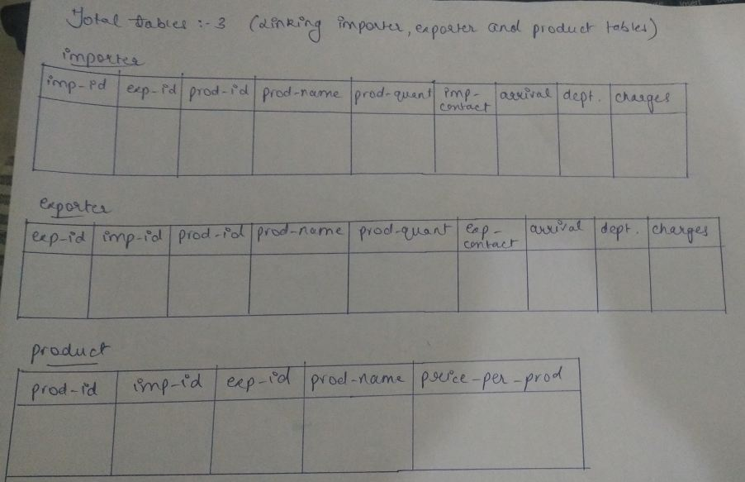

Slide 11
MODEL MAPPING
ER Model, when conceptualized into diagrams, gives a good overview of entity-relationship, which is easier to understand. ER diagrams can be mapped to relational schema, that is, it is possible to create relational schema using ER diagram. We cannot import all the ER constraints into relational model, but an approximate schema can be generated.There are several processes and algorithms available to convert ER Diagrams into Relational Schema. Some of them are automated and some of them are manual. We may focus here on the mapping diagram contents to relational basics.ER diagrams mainly comprise of −
Entity and its attributes
Relationship, which is association among entities.
Mapping Entity
An entity is a real-world object with some attributes.
Mapping Process (Algorithm)
Create table for each entity.
Entity's attributes should become fields of tables with their respective data types.
Declare primary key.
Mapping Relationship
A relationship is an association among entities.
Mapping Process
Create table for a relationship.
Add the primary keys of all participating Entities as fields of table with their respective data types.
If relationship has any attribute, add each attribute as field of table.
Declare a primary key composing all the primary keys of participating entities.
Declare all foreign key constraints.
Mapping Weak Entity Sets
A weak entity set is one which does not have any primary key associated with it.
Mapping Process
Create table for weak entity set.
Add all its attributes to table as field.
Add the primary key of identifying entity set.
Declare all foreign key constraints.

Slide 12
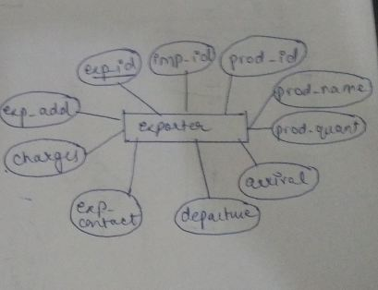
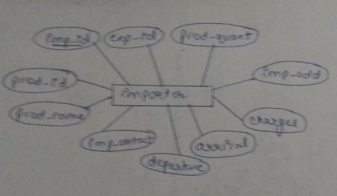
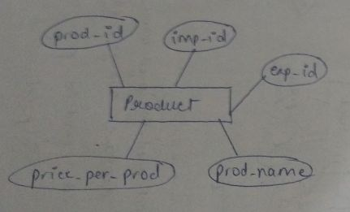

Slide 13
USER INTERFACE DESIGN
The integrated development environment used to build the GUI of this project is VB.Net.
Visual Basic .NET (VB.NET) is a multi-paradigm, object-oriented programming language, implemented on the .NET Framework. Microsoft launched VB.NET in 2002 as the successor to its original Visual Basic language. Although the ".NET" portion of the name was dropped in 2005, this article uses "Visual Basic [.NET]" to refer to all Visual Basic languages releases since 2002, in order to distinguish between them and the classic Visual Basic. Along with Visual C#, it is one of the two main languages targeting the .NET framework.
Microsoft's integrated development environment (IDE) for developing in Visual Basic .NET language is Visual Studio. Most Visual Studio editions are commercial; the only exceptions are Visual Studio Express and Visual Studio Community, which are freeware. In addition, the .NET Framework SDK includes a freeware command-linecompiler called vbc.exe. Mono also includes a command-line VB.NET compiler.
Let's start with creating a Window Forms Application by following the following steps in Microsoft Visual Studio - File → New Project → Windows Forms Applications

Slide 14
VB.Net - Basic Controls
An object is a type of user interface element you create on a Visual Basic form by using a toolbox control. In fact, in Visual Basic, the form itself is an object. Every Visual Basic control consists of three important elements −
Properties which describe the object,
Methods cause an object to do something and
Events are what happens when an object does something.
Control Properties
All the Visual Basic Objects can be moved, resized or customized by setting their properties. A property is a value or characteristic held by a Visual Basic object, such as Caption or Fore Color.
Properties can be set at design time by using the Properties window or at run time by using statements in the program code.
Control Methods
A method is a procedure created as a member of a class and they cause an object to do something. Methods are used to access or manipulate the characteristics of an object or a variable. There are mainly two categories of methods you will use in your classes −
If you are using a control such as one of those provided by the Toolbox, you can call any of its public methods. The requirements of such a method depend on the class being used.
If none of the existing methods can perform your desired task, you can add a method to a class.

Slide 15
DATABASE CONNECTIVITY
Select
The SQL SELECT Statement
The SELECT statement is used to select data from a database.
The data returned is stored in a result table, called the result-set.
SELECT Syntax
SELECT column1, column2, ... FROM table name;
Here, column1, column2, ... are the field names of the table you want to select data from. If you want to select all the fields available in the table, use the following syntax:
SELECT * FROM table name;
Update
The SQL UPDATE Statement
The UPDATE statement is used to modify the existing records in a table.
UPDATE Syntax
UPDATE table name SET column1 = value1, column2 = value2, ... WHERE condition;

Slide 16
Inner join
SQL INNER JOIN Keyword
The INNER JOIN keyword selects records that have matching values in both tables.
INNER JOIN Syntax
SELECT column name(s) FROM table1 INNER JOIN table2 ON table1.column_name = table2.column_name;
Delete
The SQL DELETE Statement. The DELETE statement is used to delete existing records in a table.
DELETE Syntax
DELETE FROM table_name WHERE condition;
Where
The SQL WHERE Clause
The WHERE clause is used to filter records.
The WHERE clause is used to extract only those records that fulfill a specified condition.
WHERE Syntax
SELECT column1, column2, ... FROM table_name WHERE condition;

Slide 17
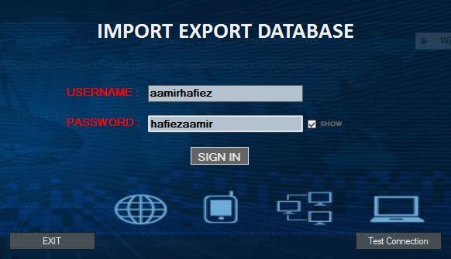
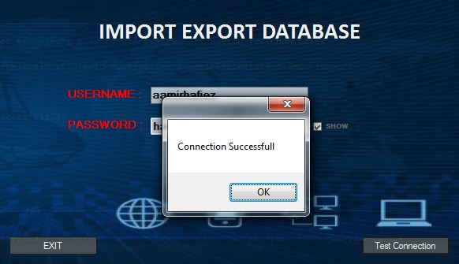

Slide 18
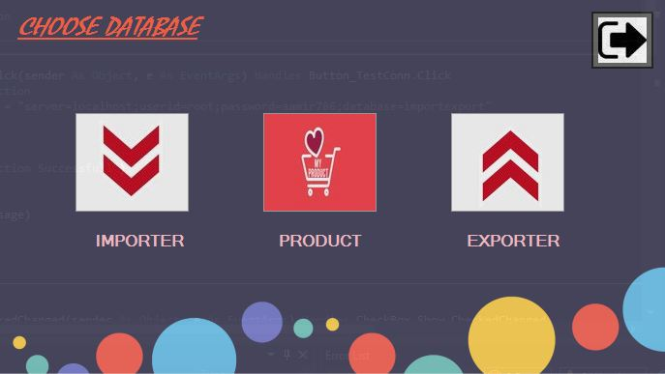
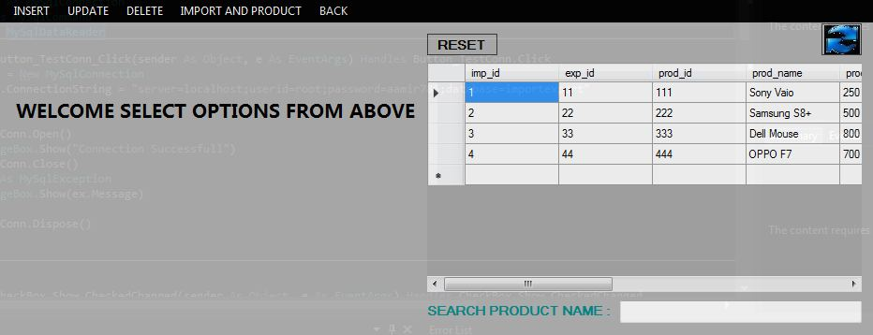

Slide 19
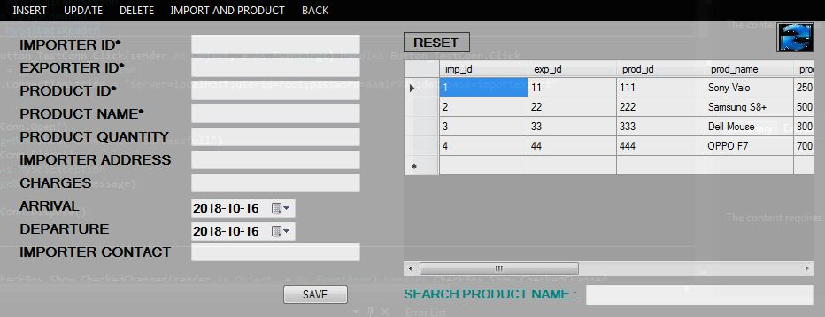
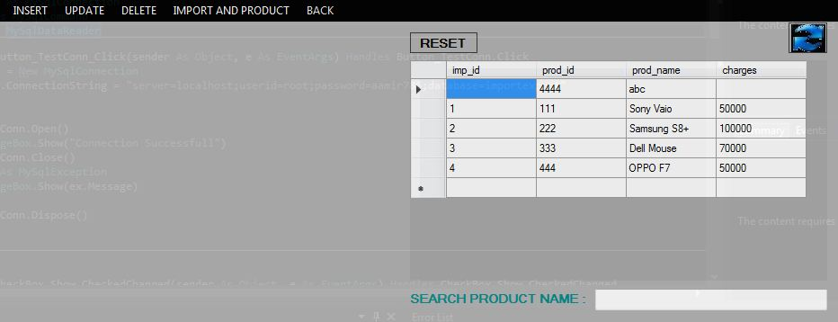

Slide 20
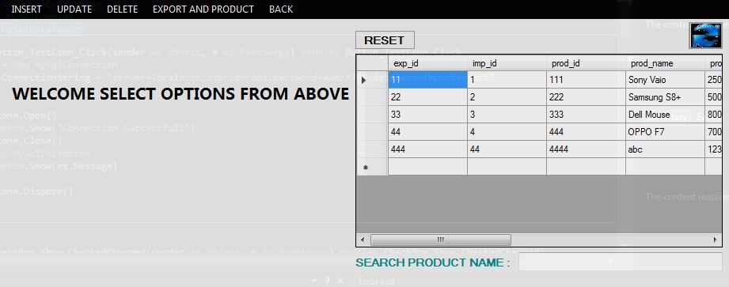
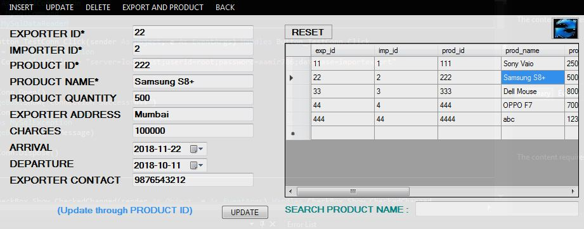

Slide 21
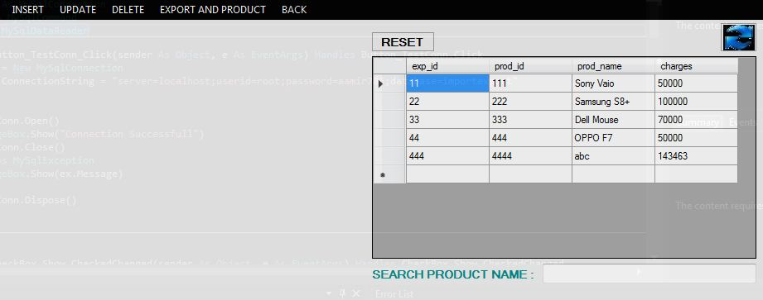
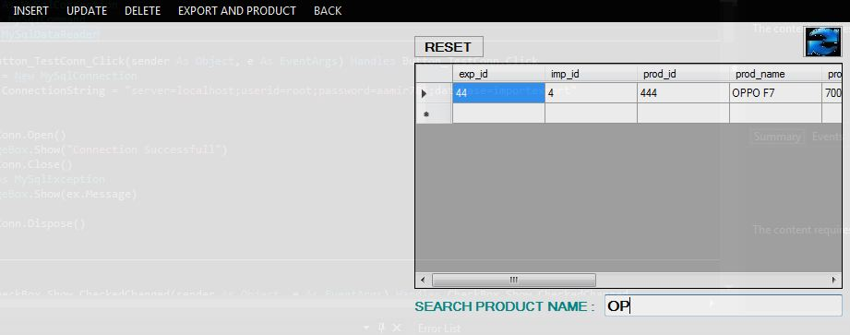

Slide 22
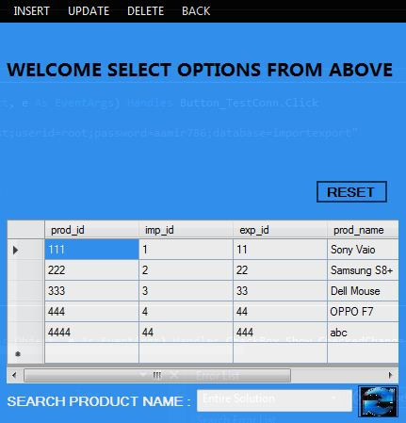
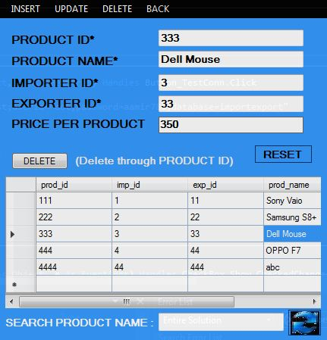

Slide 23
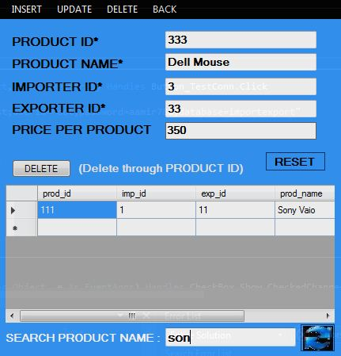
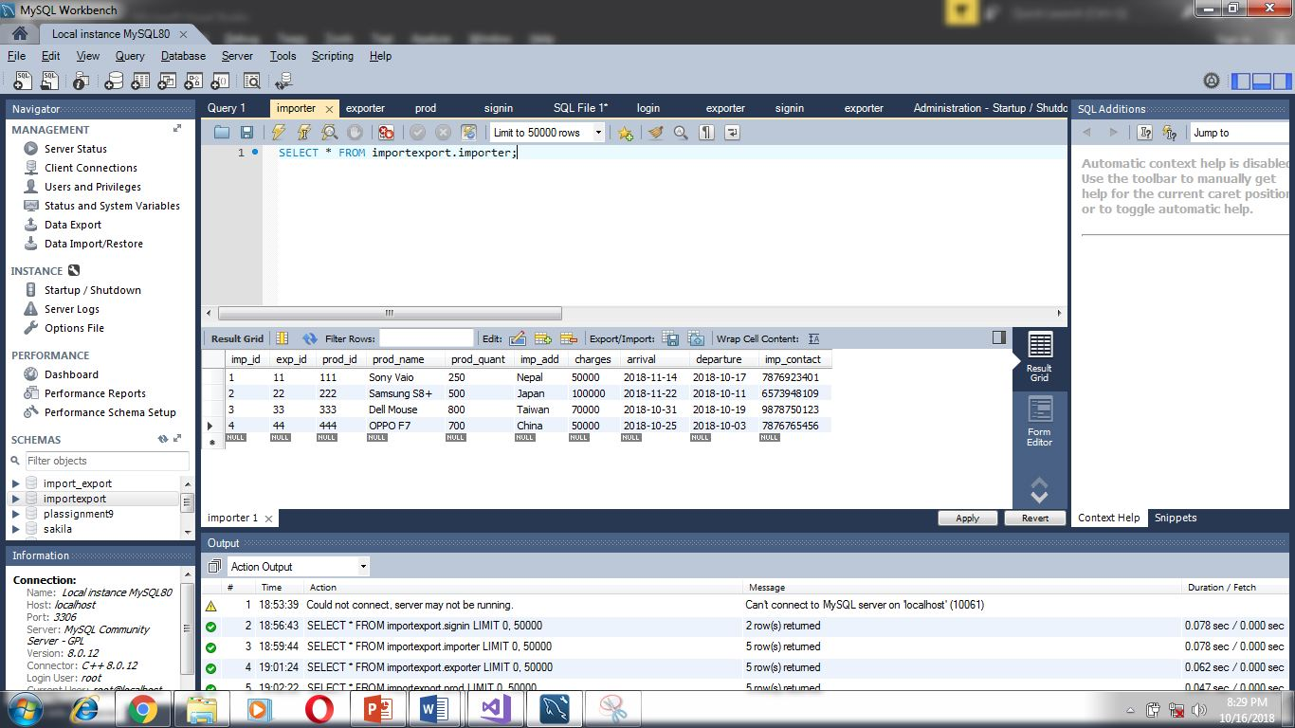

Slide 24
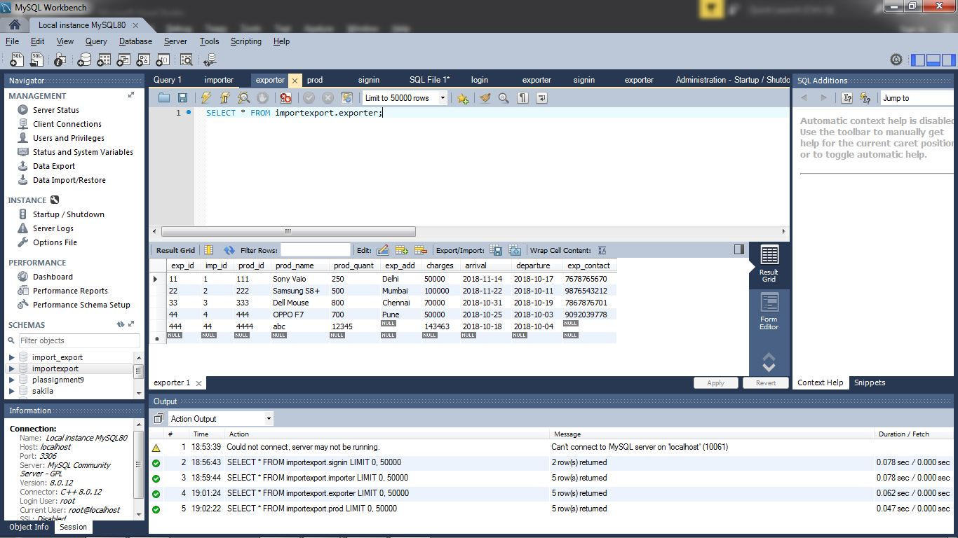
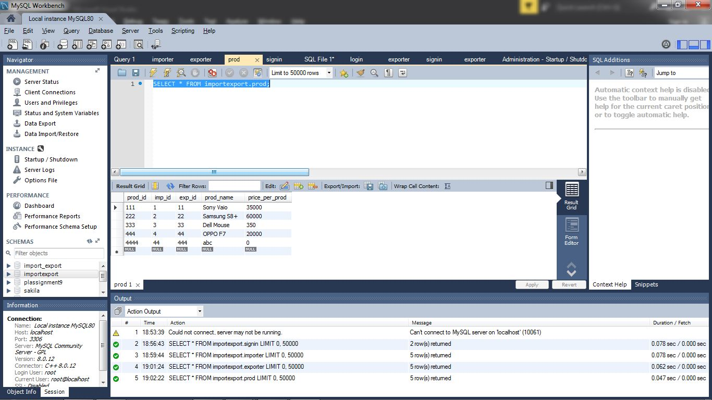

Slide 25
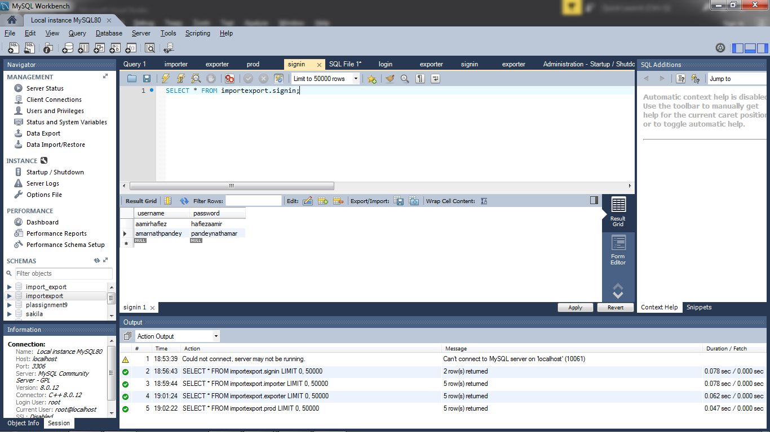

Slide 26
REFRENCES
http://www.indiantradeportal.in/
https://www.w3schools.com/sql/
https://www.tutorialspoint.com/
https://www.wikipedia.org/
https://stackoverflow.com/
https://www.youtube.com/

