Slide 1


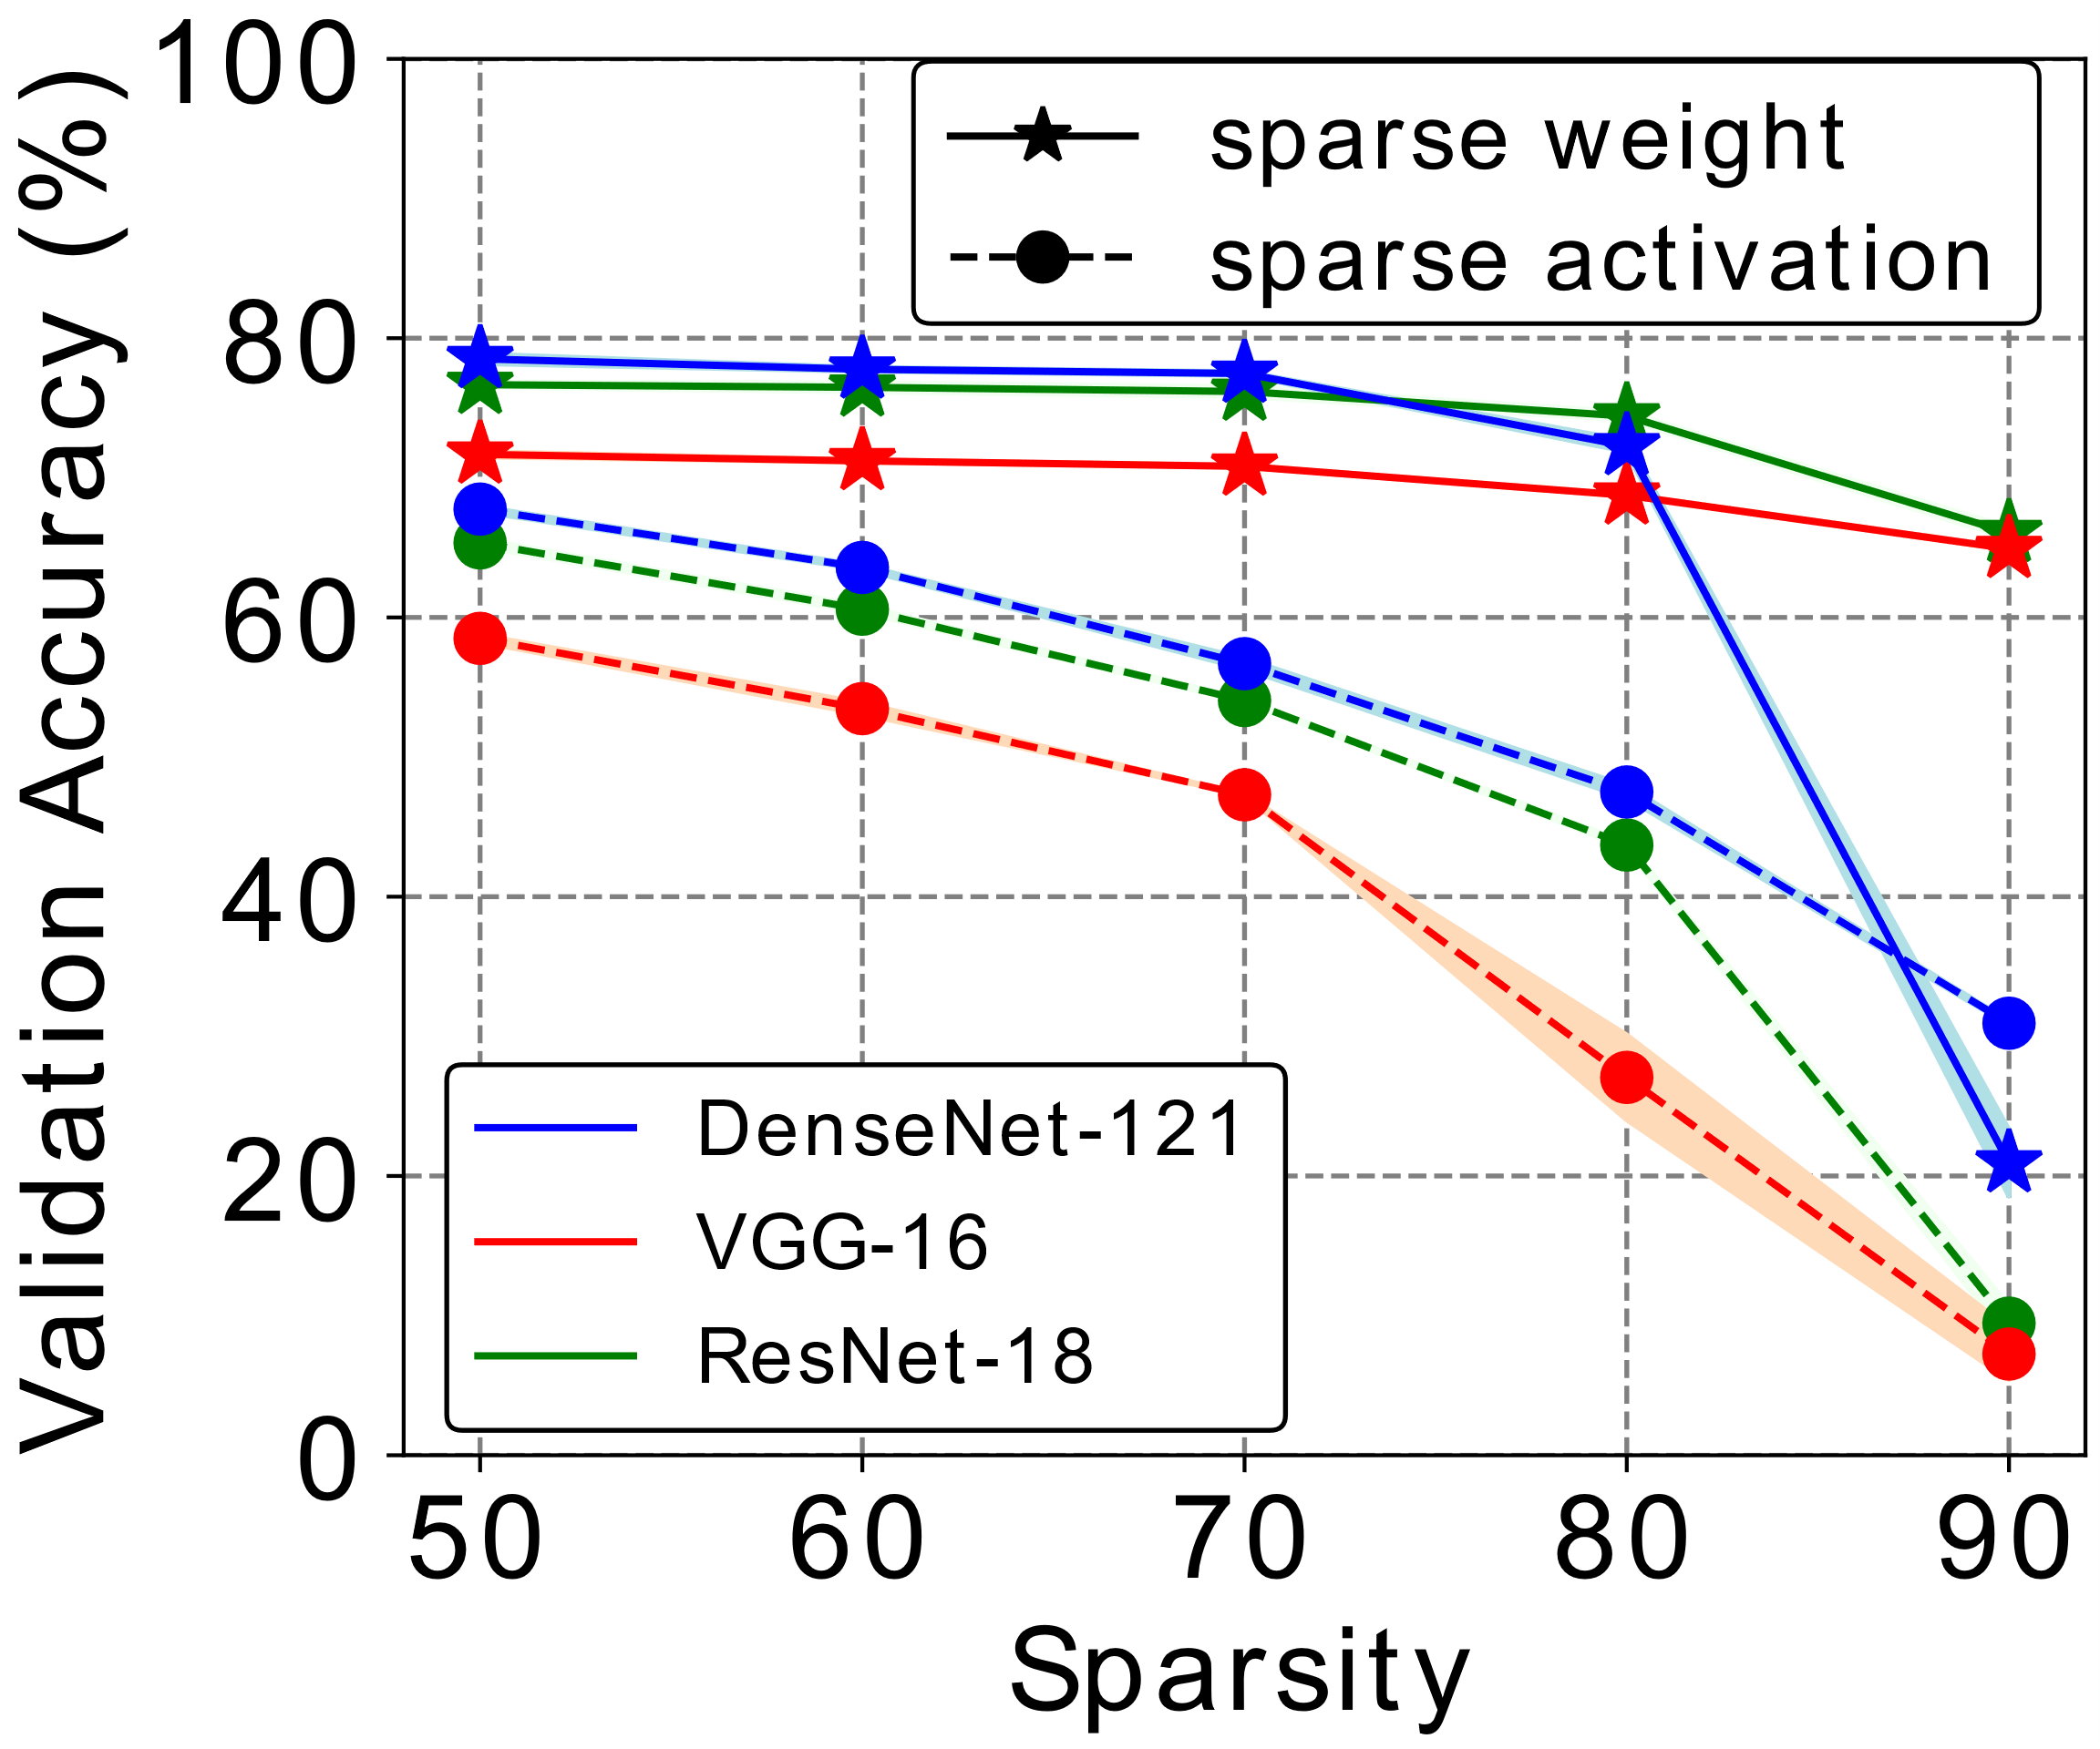
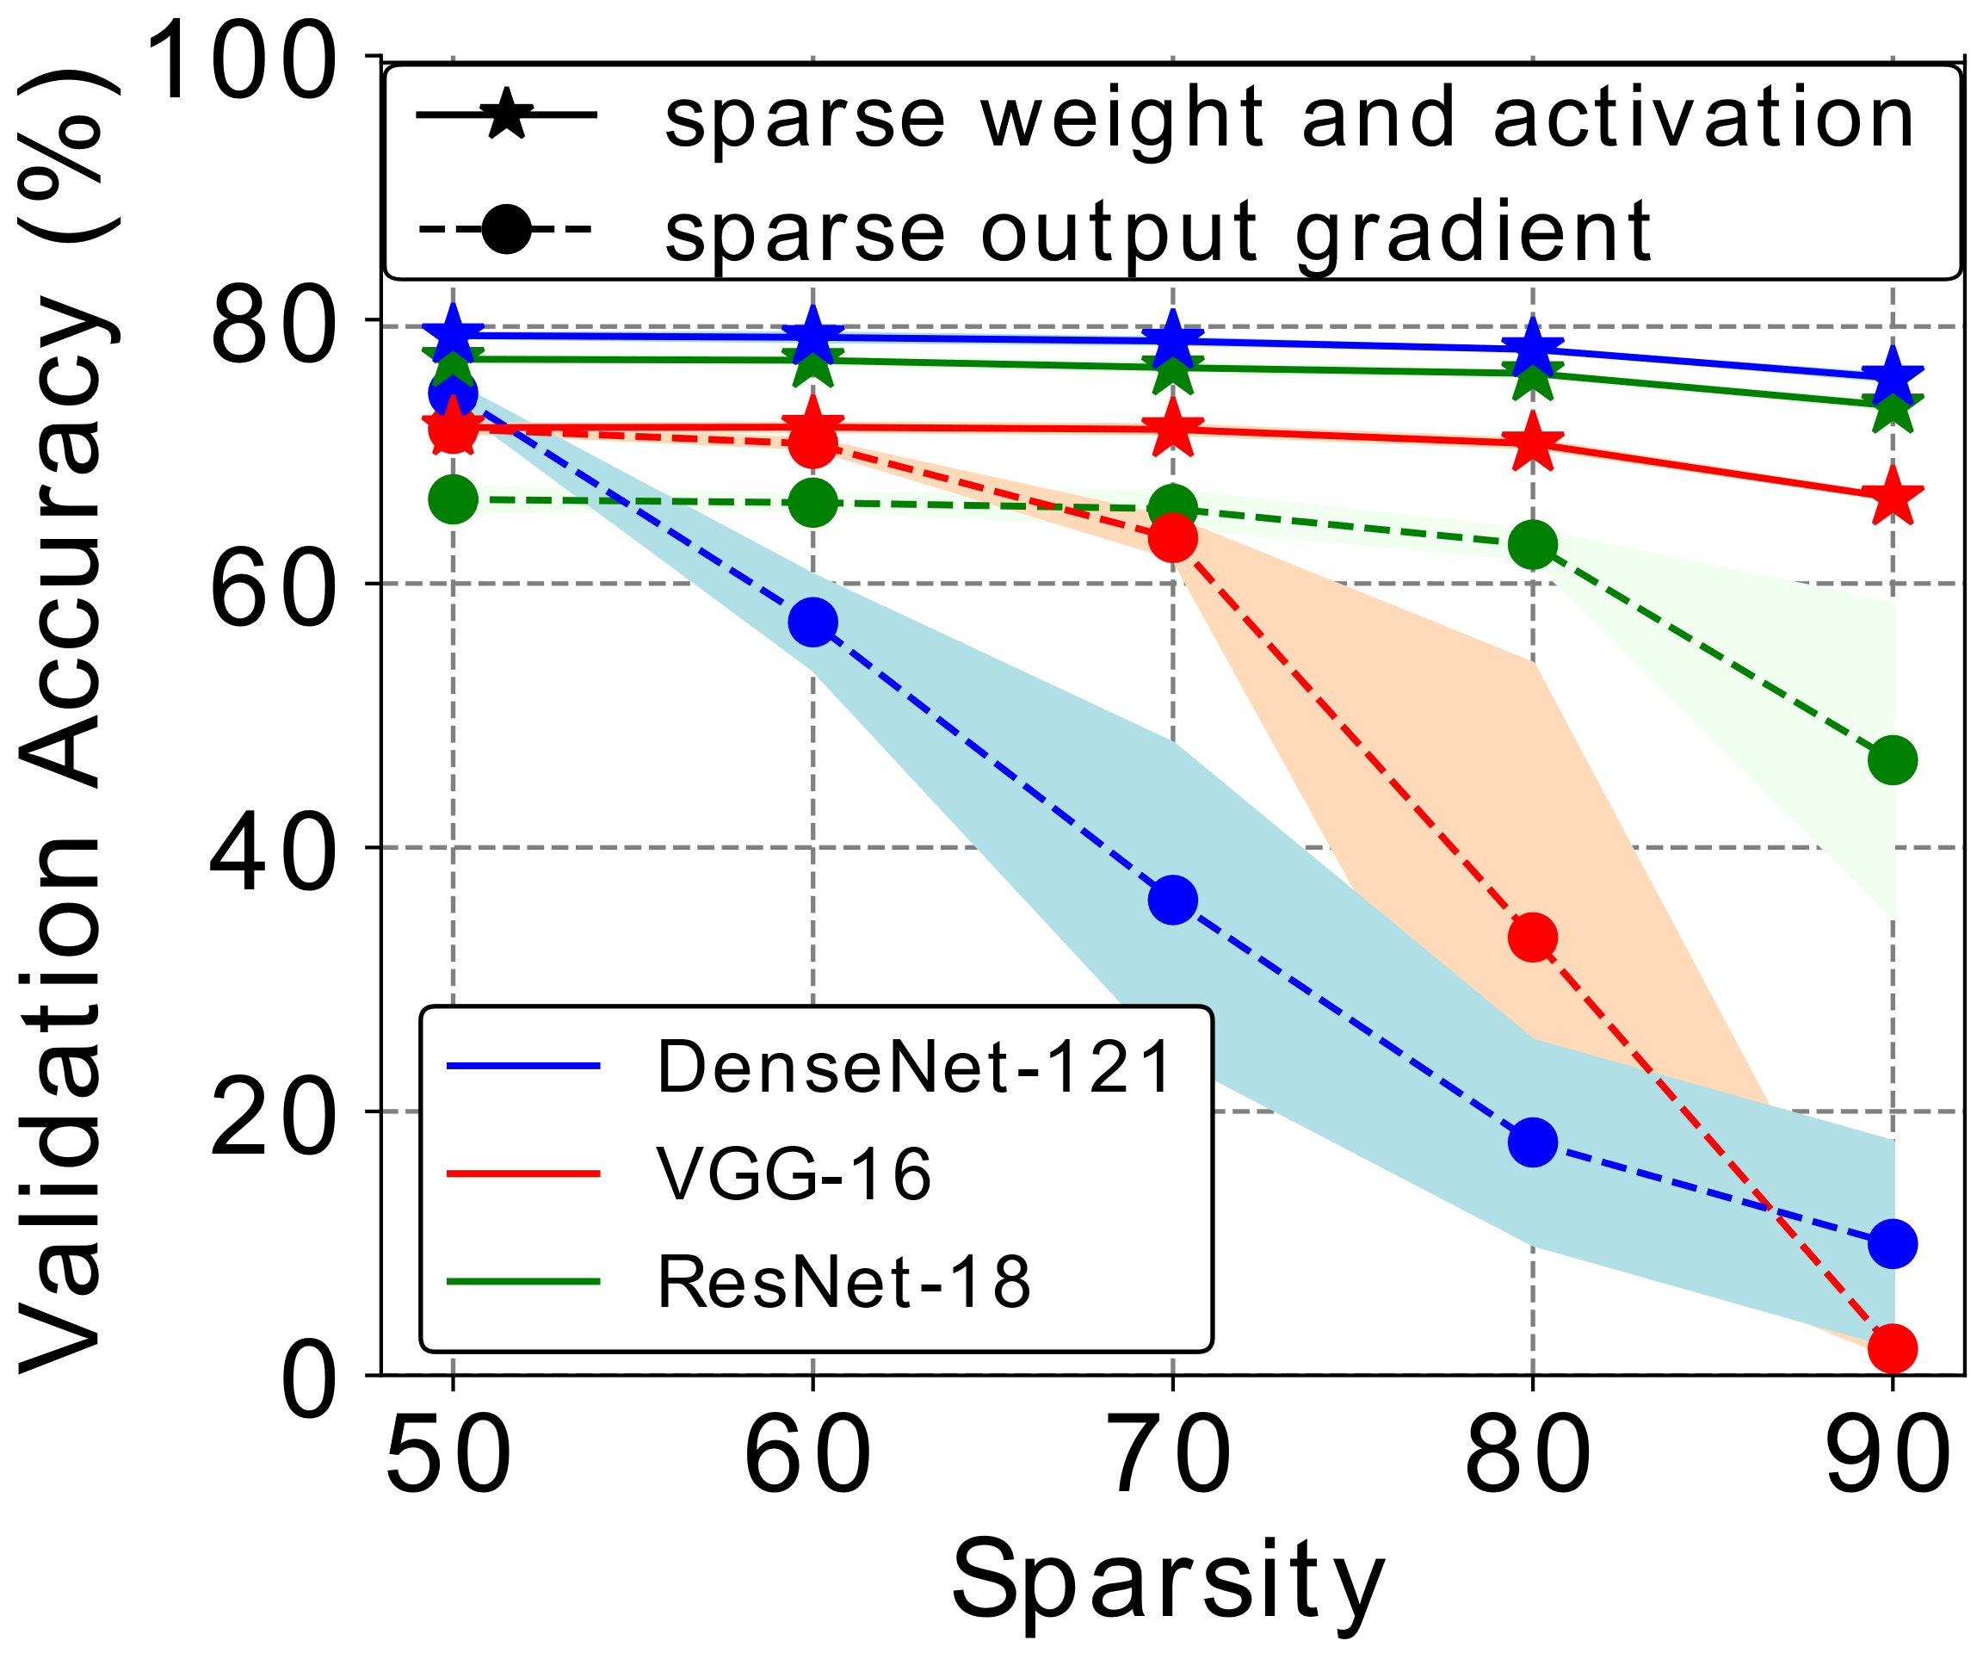
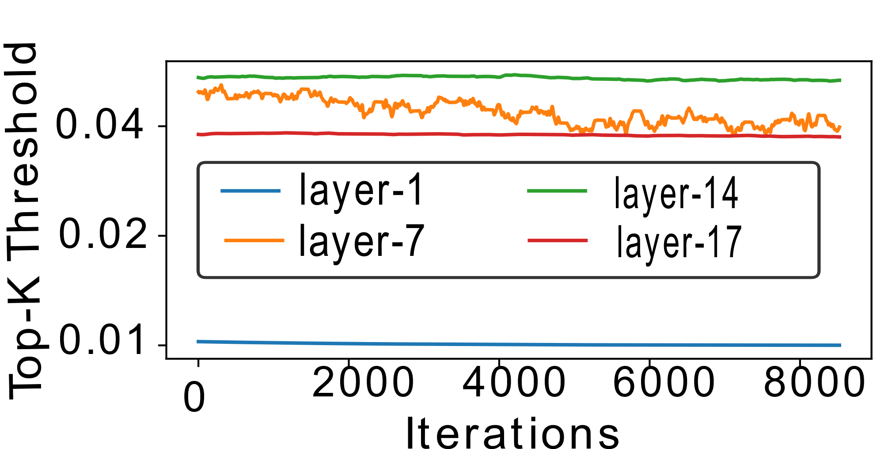
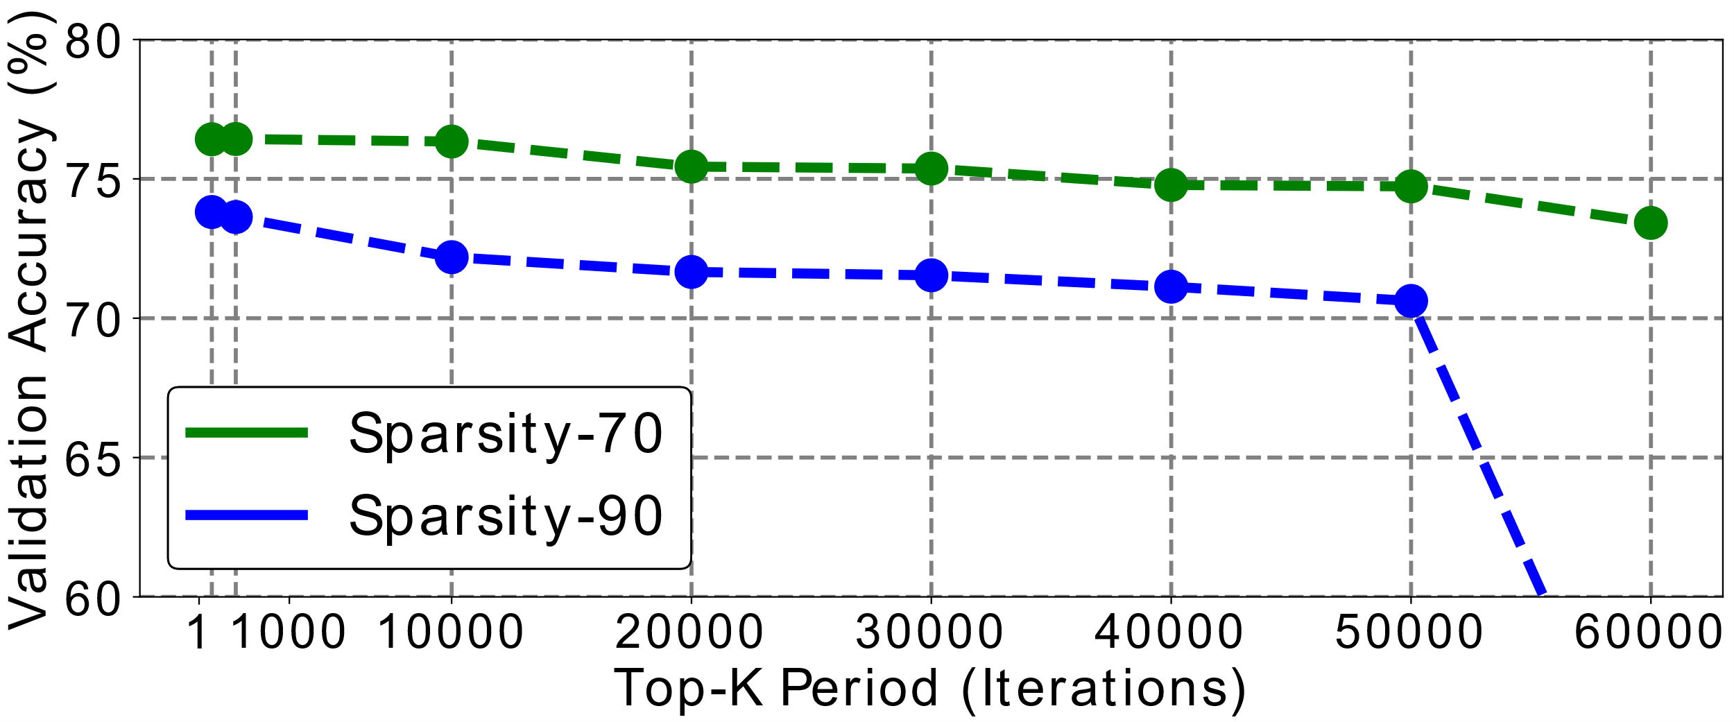



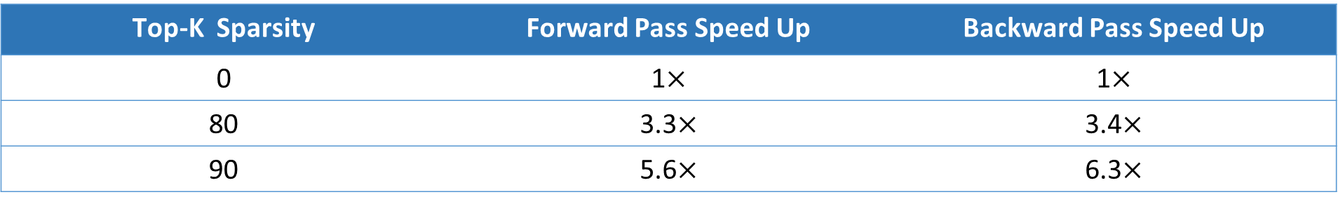


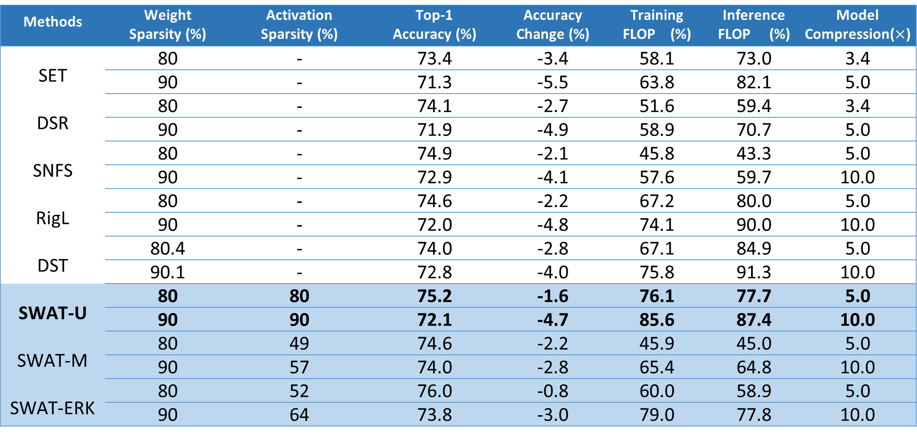




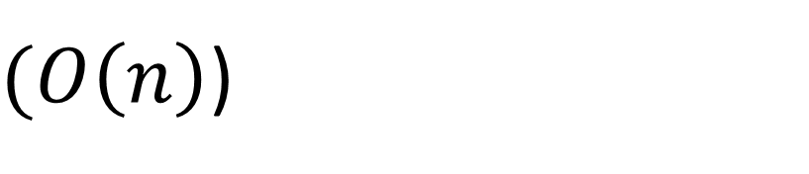



Sparse Weight Activation Training
Md Aamir Raihan, Tor M. Aamodt
Summary
Sparse Weight Activation Training
Results
We propose sparse weight activation training (SWAT), a training algorithm that introduces sparsity during both forward and backward passes.
SWAT is a sparse learning algorithm and can learn both structured and unstructured sparse network.
SWAT reduces total computation during training by 50% to 90% and reduces memory footprint during backward pass by 23% to 50% for activation and 50% to 90% for weights.
A sparse weight topology is induced during the forward pass using Top-K sparsification.
During the backward pass, sparse weights and activations are used for generating weight and input gradients
FORWARD PASS
Comparison with recent work
$$w_{l}$$
Layer
Parameters
Algorithms | Sparse Forward Pass | Sparse Input Gradient Computation | Sparse Weight Gradient Computation | Unstructured Sparse Network | Structured Sparse Network
meProp | No | Yes | Yes | No | No
SNFS/RigL/STR | Yes | Yes | No | Yes | -
SWAT | Yes | Yes | Yes | Yes | Yes
$$a_{l−1}$$
TOP K
SPARSE WEIGHT
$$a_{l}$$
TOP K
$$f_{l}\left(a_{l−1},w_{l}\right)$$
SAVE FOR BACKWARD PASS
$${∇w}_{l}$$
SPARSE WEIGHT
Unstructured Sparse Learning: ResNet-50 trained using SWAT on ImageNet
$$F_{l}\left(a_{l−1},{∇a}_{l}\right)$$
$${∇a}_{l}$$
Methods | Weight Sparsity (%) | Activation Sparsity (%) | Top-1 Accuracy (%) | Accuracy Change (%) | Training FLOP (%) | Inference FLOP (%) | Model Compression($×$)
SET | 80 | - | 73.4 | -3.4 | 58.1 | 73.0 | 3.4
 | 90 | - | 71.3 | -5.5 | 63.8 | 82.1 | 5.0
DSR | 80 | - | 74.1 | -2.7 | 51.6 | 59.4 | 3.4
 | 90 | - | 71.9 | -4.9 | 58.9 | 70.7 | 5.0
SNFS | 80 | - | 74.9 | -2.1 | 45.8 | 43.3 | 5.0
 | 90 | - | 72.9 | -4.1 | 57.6 | 59.7 | 10.0
RigL | 80 | - | 74.6 | -2.2 | 67.2 | 80.0 | 5.0
 | 90 | - | 72.0 | -4.8 | 74.1 | 90.0 | 10.0
DST | 80.4 | - | 74.0 | -2.8 | 67.1 | 84.9 | 5.0
 | 90.1 | - | 72.8 | -4.0 | 75.8 | 91.3 | 10.0
SWAT-U | 80 | 80 | 75.2 | -1.6 | 76.1 | 77.7 | 5.0
 | 90 | 90 | 72.1 | -4.7 | 85.6 | 87.4 | 10.0
SWAT-M | 80 | 49 | 74.6 | -2.2 | 45.9 | 45.0 | 5.0
 | 90 | 57 | 74.0 | -2.8 | 65.4 | 64.8 | 10.0
SWAT-ERK | 80 | 52 | 76.0 | -0.8 | 60.0 | 58.9 | 5.0
 | 90 | 64 | 73.8 | -3.0 | 79.0 | 77.8 | 10.0
$${∇a}_{l−1}$$
SPARSE ACTIVATION
$$G_{l}\left(w_{l},{∇a}_{l}\right)$$
BACKWARD PASS
Motivation
SWAT Variants
Increasing computation demand:
Bigger models: millions of parameters and billions of FLOPs during training.
Neural Architectural Search.
Emergence of machine learning accelerators [1]:
dedicated hardware unit for sparse computation [2].
SWAT can learn structured/unstructured sparse network.
Training at extreme sparsity constraint
Unstructured SWAT
Structured SWAT
Channels
Channels
12
1
13
-3
12
1
13
-3
-1
20
1
3
34
20
Filters
Filters
-1
20
1
3
-15
-2
9
-7
-15
-2
9
-7
-15
12
-4
-6
44
26
L1 norm
Structured Sparse Learning: ResNet-50 trained using SWAT on ImageNet
Sensitivity Analysis
PARAMETER
-15
12
-4
-6
Methods | Weight Sparsity (%) | Activation Sparsity (%) | Training Flop (%) | Channel Pruned (%) | Fine-Tune Epoch | Top-1 Accuracy (%) | Accuracy Change (%) | Inference FLOP (%)
DCP | Offline Pruning |  |  | - | 60 | 75.95 | -1.06 | 55.0
CCP | Offline Pruning |  |  | 35 | 100 | 75.50 | -0.65 | 48.8
AOFP | Offline Pruning |  |  | - | Yes (-) | 75.11 | -0.23 | 56.7
Soft-Pruning | - | - | - | 30 | No | 74.61 | -1.54 | 41.8
SWAT-U | 50.0 | 50.0 | 49.1 | 50 | No | 76.51 | -0.29 | 48.6
 | 60.0 | 60.0 | 58.9 | 60 | No | 76.35 | -0.45 | 58.3
 | 70.0 | 70.0 | 68.7 | 70 | No | 75.67 | -1.13 | 68.0
Selecting Top-K weights
PARAMETER
Network convergence is robust to elimination of
Forward pass: small magnitude weights
Backward pass: both small magnitude weights and activations
Selecting channels with highest L1 norm
Sparsity Distribution:
SWAT-U: same sparsity across all layers except first layer.
SWAT-ERK: layer dimension is taken into consideration for computing layer sparsity [3].
SWAT-M: less sparsity is allocated to layer with smaller average momentum [4].
Better Accuracy at more inference FLOP reduction
Forward Pass
Backward Pass
Efficient Top-K Implementation
We estimated the acceleration possible using SWAT on sparse training accelerator using DNNSim [5].
Dataset: CIFAR100
Dataset: CIFAR100
Threshold operation and using BFPRT or quickselect for finding the threshold .
Top-K Sparsity | Forward Pass Speed Up | Backward Pass Speed Up
0 | 1$×$ | 1$×$
80 | 3.3$×$ | 3.4$×$
90 | 5.6$×$ | 6.3$×$
$(O\left(n\right)$)
Compute threshold periodically after certain iteration.
Backward pass is kept dense, i.e., backward pass
uses dense weights and activation
Forward pass is kept dense, i.e., forward pass
uses dense weights and activation
References
Reuther, Albert, et al. "Survey of Machine Learning Accelerators." arXiv preprint arXiv:2009.00993 (2020).
NVIDIA A100 Tensor Core GPU Architecture whitepaper.
Evci, Utku, et al. "Rigging the lottery: Making all tickets winners." International Conference on Machine Learning. 2020.
Dettmers, Tim, and Luke Zettlemoyer. "Sparse networks from scratch: Faster training without losing performance."
DNNsim: Deep Learning Accelerators Toolkit. https://github.com/isakedo/DNNsim..
Code: https://github.com/AamirRaihan/SWAT
Variation in Top-K threshold during training
Effect of Top-K period on network convergence
PAPER
CODE

