Slide 1



Computer vision
University of Education, Lahore (Multan Campus)

Slide 2
Members:
Aamir Khan (1604208)
Nauman Saleem (1604217)
Tariq Qureshi (1604180)

Slide 3
Agenda
What is Computer Vision?
How It Works?
Tools
Few Computer Vision Applications
Practical Implementation

Slide 4
What is Computer Vision?
“Computer vision is an interdisciplinary scientific field that deals with how computers can be made to gain high-level understanding from digital images or videos. From the perspective of engineering, it seeks to automate tasks that the human visual system can do [1].”

Slide 5




How it works?
Acquiring
Processing
Analyzing

Slide 6


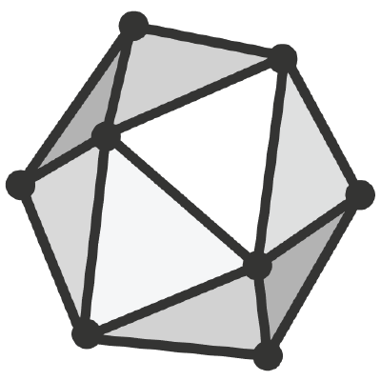


Tools / Libraries
Open CV
Yolo V3
ONNX
Torch
TensorFlow API

Slide 7
Open CV
Stands For Open Source Computer Vision
Officially launched in 1999 the OpenCV project was initially an Intel Research
The library is cross-platform and free

Slide 8
YOLO v3
YOLO stands for You Only Look Once[4]
Developed By Joseph Redmon, Ali Farhadi[5]
YOLO v2
Tiny YOlO (For Mobiles)

Slide 9


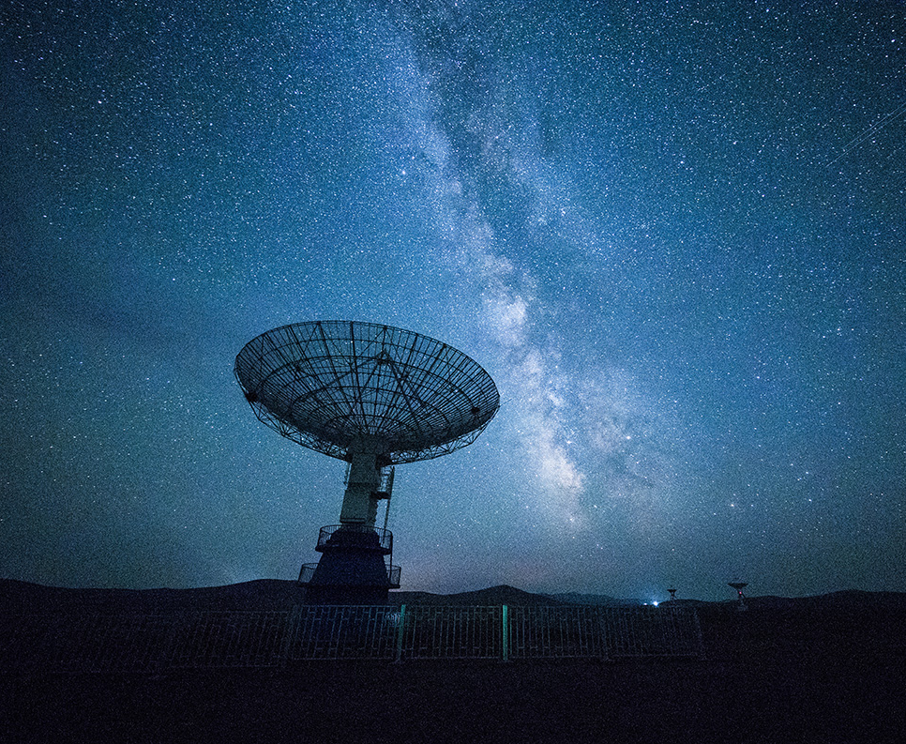
Few Applications of Computer Vision
Motion Detection
Custom Object Detection
Facial Object Detection
Object Identification

Slide 10

Motion Detection
Motion detection is the process of detecting a change in the position of an object relative to its surroundings or a change in the surroundings relative to an object. Motion detection can be achieved by either mechanical or electronic methods.[2]

Slide 11

Facial object detection
Face detection is a computer technology being used in a variety of applications that identifies human faces in digital images.[3]

Slide 12
Let’s DO some practical work

Slide 13
References:
Dana H. Ballard; Christopher M. Brown (1982). Computer Vision. Prentice Hall. ISBN 978-0-13-165316-0.
"motion detection". Retrieved 26 January 2015.
https://facedetection.com/
https://pjreddie.com/darknet/yolo/
https://arxiv.org/search/cs?searchtype=author&query=Redmon%2C+J

Slide 14
Download links
https://github.com/Aamirkhan10218/ObjectIdentification_YOLOv3
https://amin-ahmadi.com/cascade-trainer-gui/
https://www.kaggle.com/moltean/fruits
http://cocodataset.org/#home
https://github.com/Aamirkhan10218/YOLOv3_OpenCV_ObjectDetection_Identification

Slide 15
ANY QUESTION
?

Slide 16

Thank You!
amirkhan10218@gmail.com

