Slide 1
Important Points to note in R
Dr. Aammar Tufail
CEO/Founder at Codanics.com

Slide 2
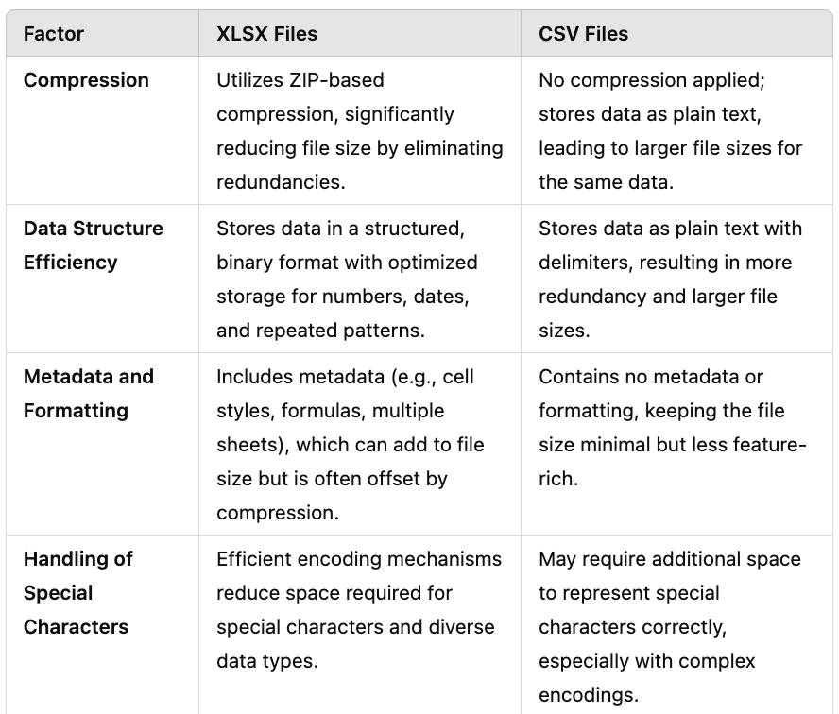
.xlsx vs. .csv files

Slide 3
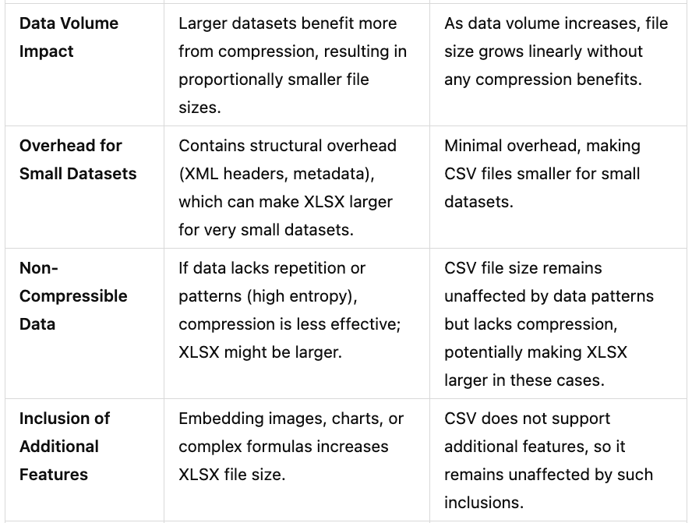
.xlsx vs. .csv files

Slide 4
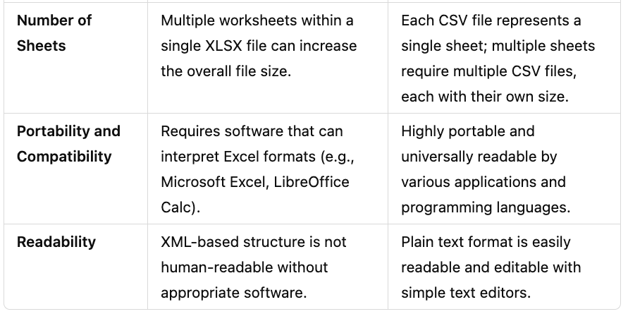
.xlsx vs. .csv files

