Slide 1
pandas
Dr. Aammar Tufail
CEO/Founder at Codanics.com

Slide 2
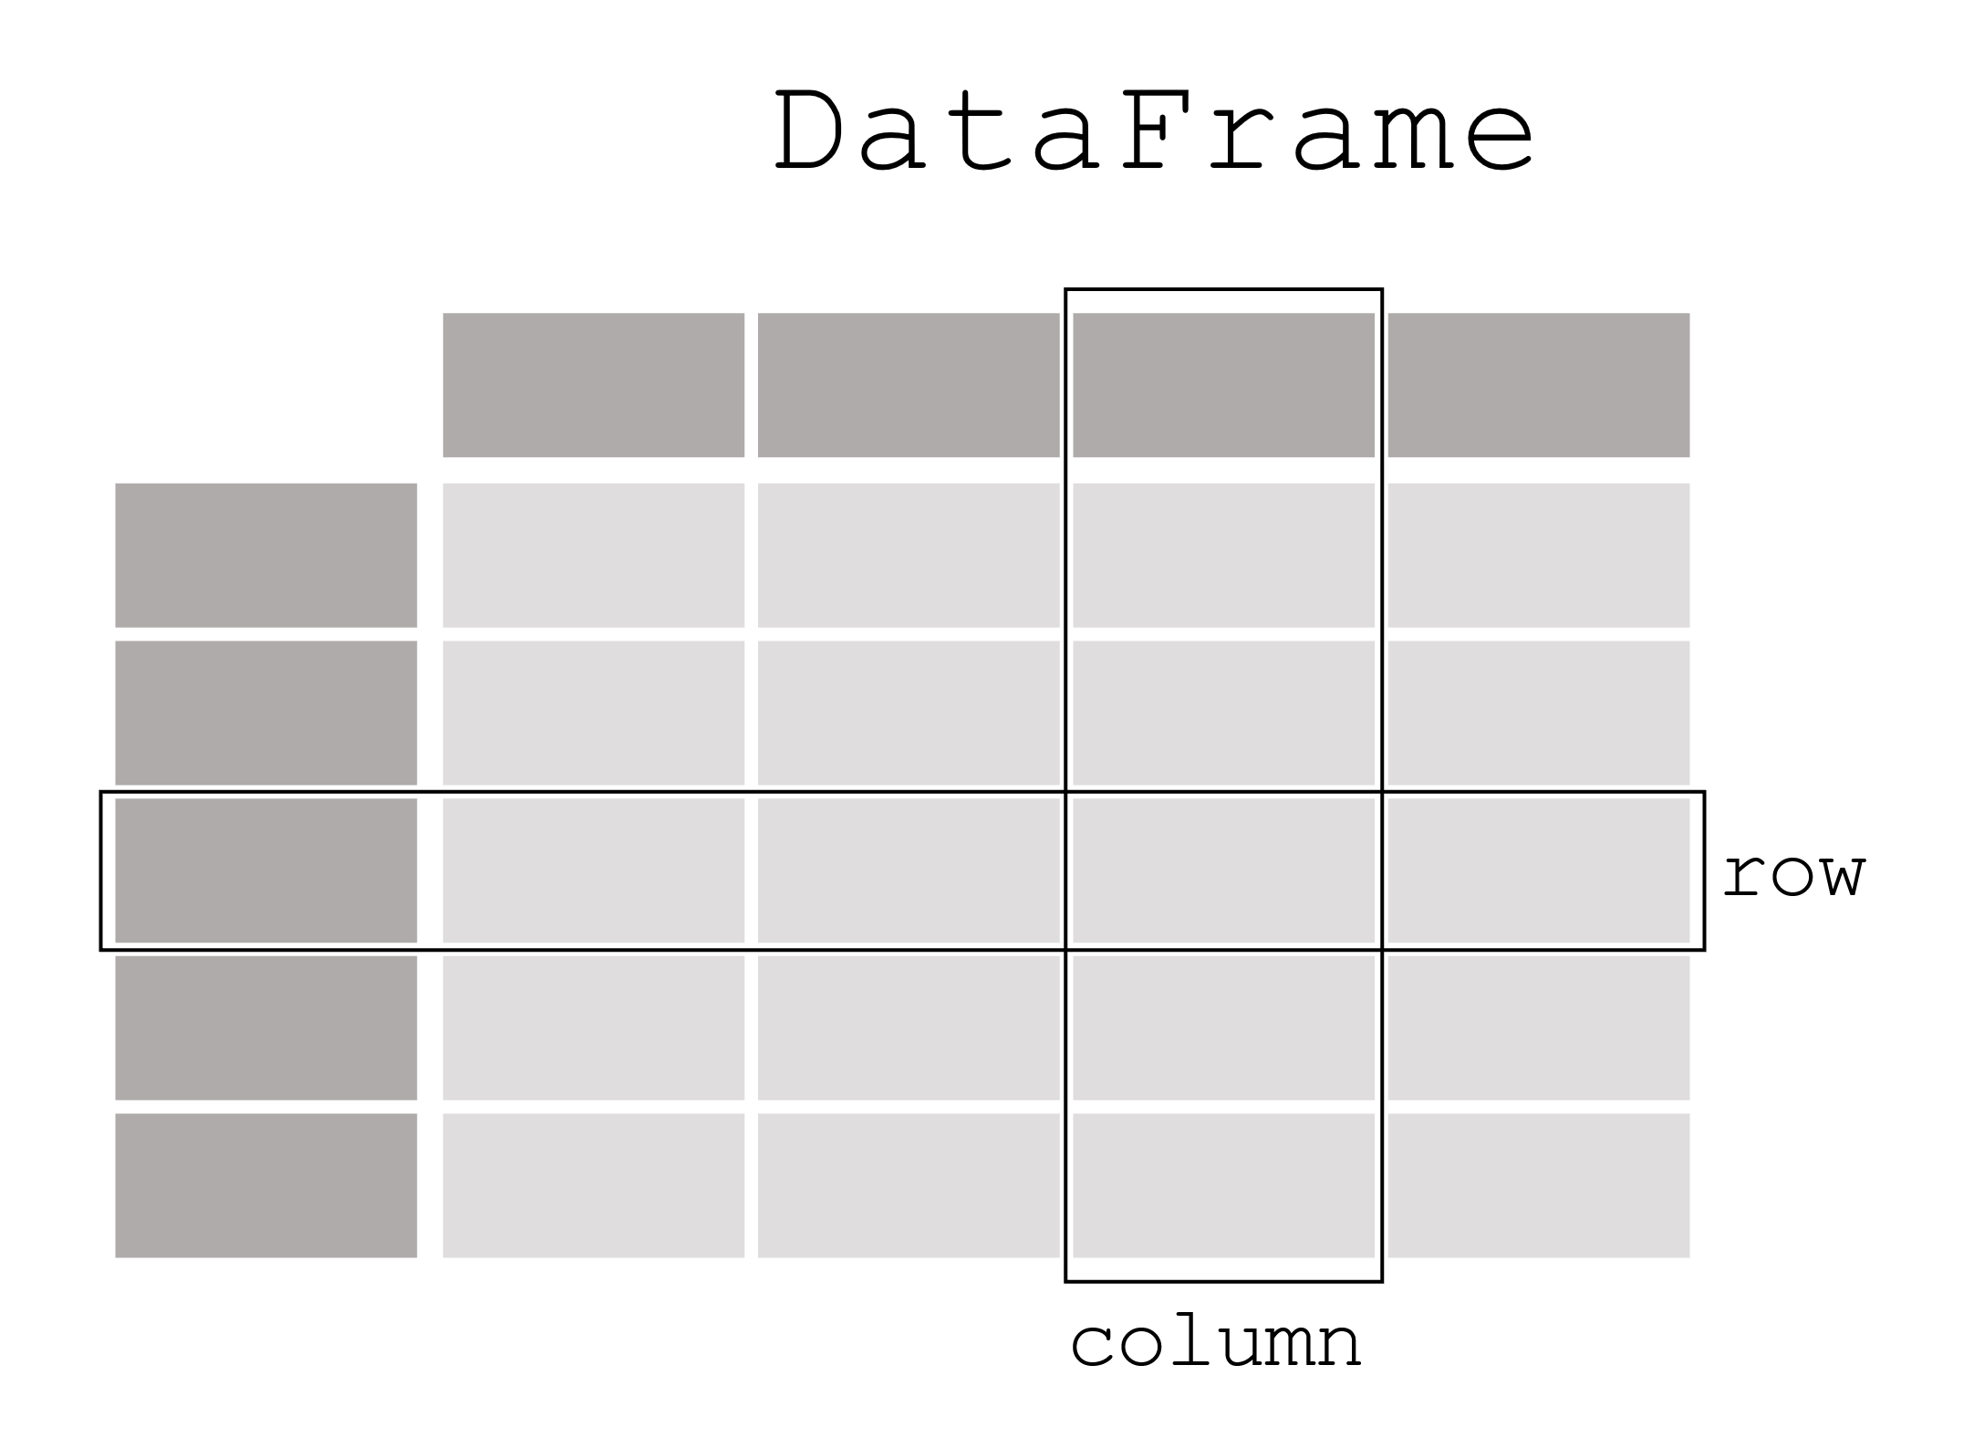
pandas data table representation

Slide 3

Each column in dataframe is a series/ pandas series
Each column in a DataFrame is a Series

Slide 4
Work with Series or dataframes

Slide 5
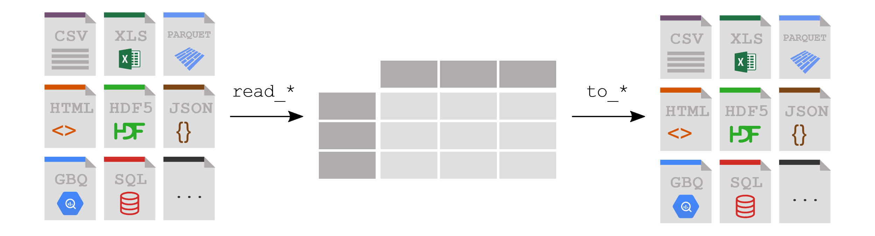
How do I read tabular Data?

Slide 6
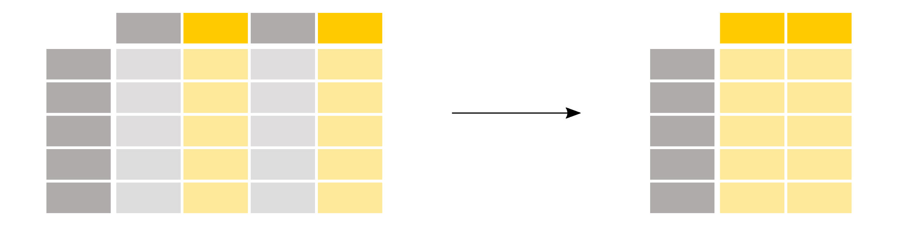
How do I select a subset of a Dataframe?

Slide 7
How do I select a specific row of a Dataframe?

